Slide 1


SunGuide 8.0 Hotfix 4
Design Review
SunGuide Software Users Group | 3/24/21

Slide 2
SG-4936 - Add Roadway Filter to Monthly Performance
Measures Report
Tucker Brown
SunGuide Software Users Group | 3/24/21

Slide 3
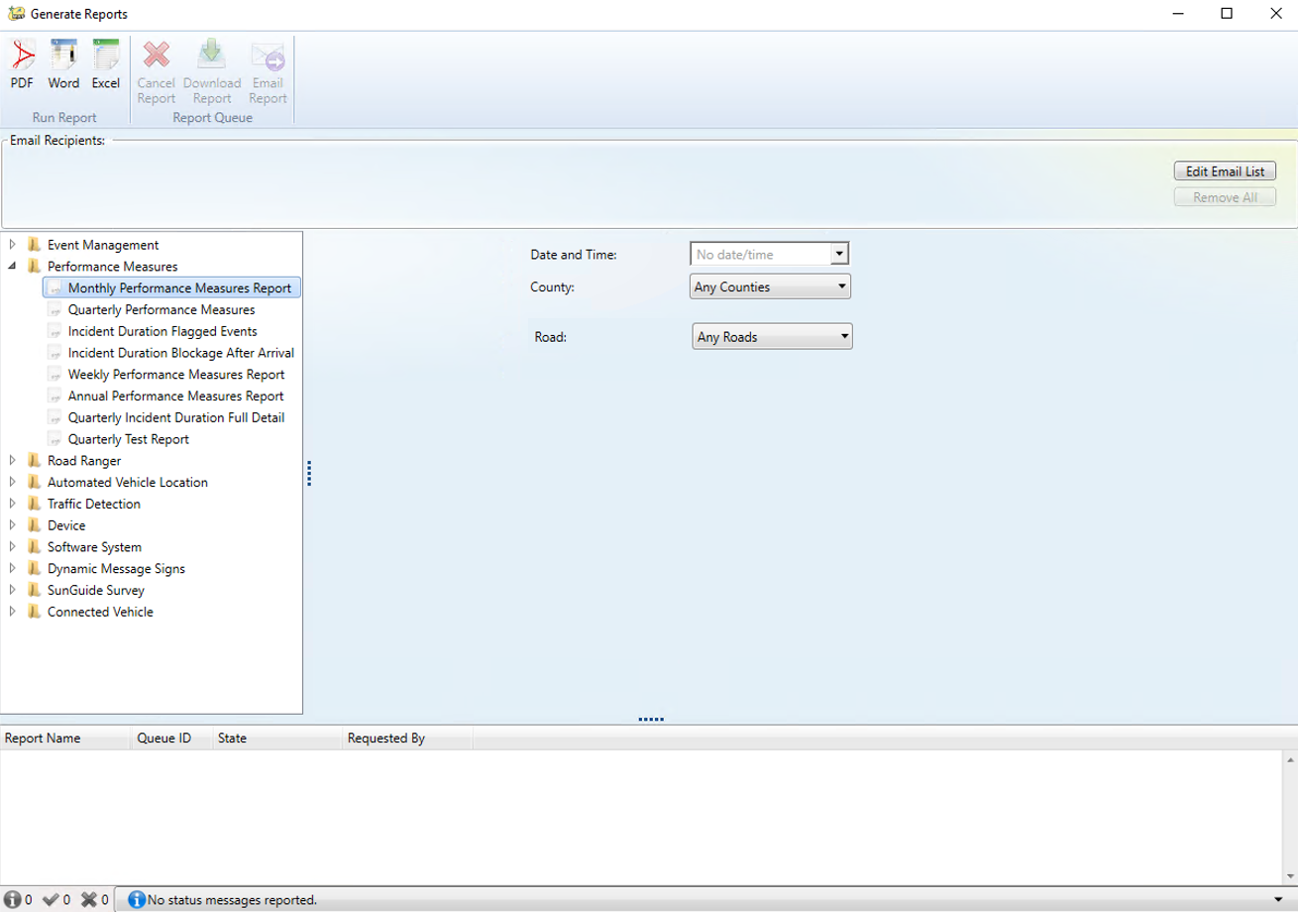
  Adding a new filter to the performance measures report.
SunGuide Software Users Group | 3/24/21

Slide 4
QUESTIONS?
SunGuide Software Users Group | 3/24/21

Slide 5
SG-2570 - Allow comments to be added to closed events without reopening
Tucker Brown
SunGuide Software Users Group | 3/24/21

Slide 6
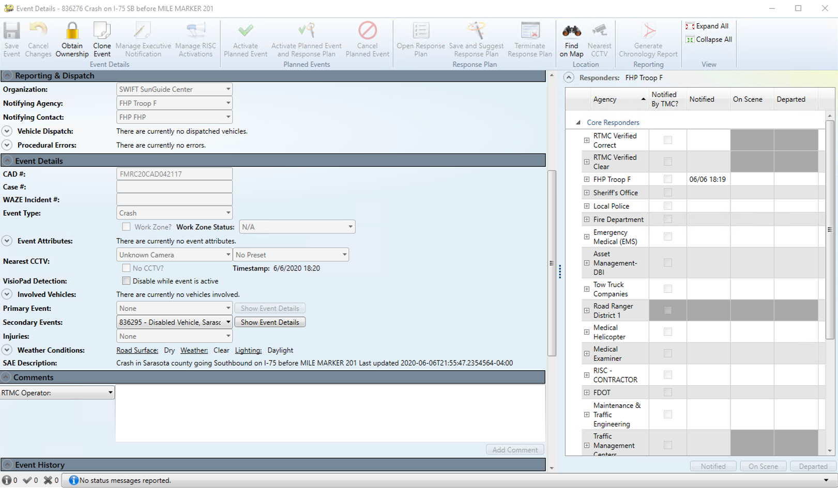
  Comments are allowed on closed Events. Does not require ownership.
SunGuide Software Users Group | 3/24/21

Slide 7
QUESTIONS?
SunGuide Software Users Group | 3/24/21

Slide 8
SG-5359 - Wrong Way
Driver Alert
Tucker Brown
SunGuide Software Users Group | 3/24/21

Slide 9
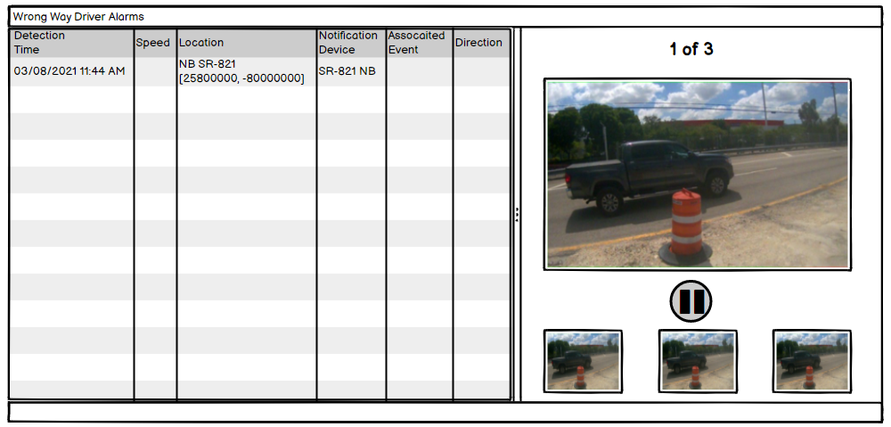
  Alert images will now take up the right half of the dialog as opposed to a single row.
  Slideshow will automatically begin when alert is shown.
SunGuide Software Users Group | 3/24/21

Slide 10

  When paused, the user can pick a specific image to show from the slideshow.
  No image limit.
SunGuide Software Users Group | 3/24/21

Slide 11
QUESTIONS?
SunGuide Software Users Group | 3/24/21

Slide 12
SG-3962 - Add Open CCTV from Event List &
Event Details Feature
Tucker Brown
SunGuide Software Users Group | 3/24/21

Slide 13
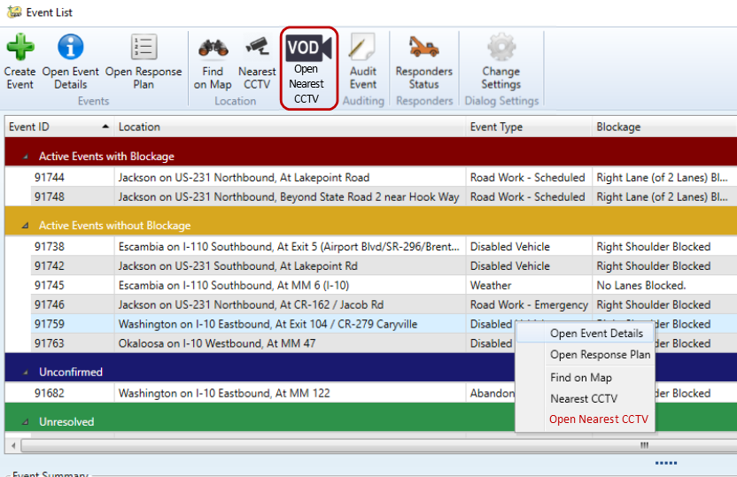
  Button will launch a new VOD dialog.
  If no camera is set, button will be greyed out.
SunGuide Software Users Group | 3/24/21

Slide 14
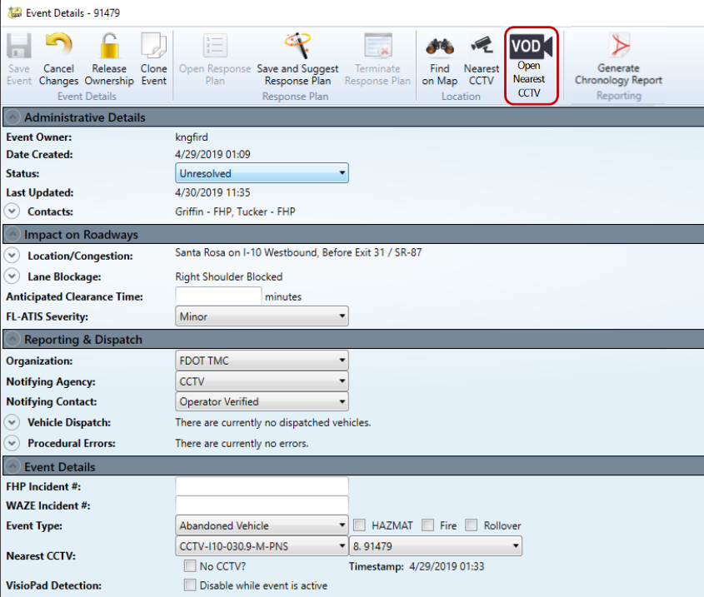
  Button will launch a new VOD dialog.
  If no camera is set, button will be greyed out.
SunGuide Software Users Group | 3/24/21

Slide 15
QUESTIONS?
SunGuide Software Users Group | 3/24/21

Slide 16
SG-3745 - Allow the organization to be selected within the "Add New Event“ dialog box
Tucker Brown
SunGuide Software Users Group | 3/24/21

Slide 17
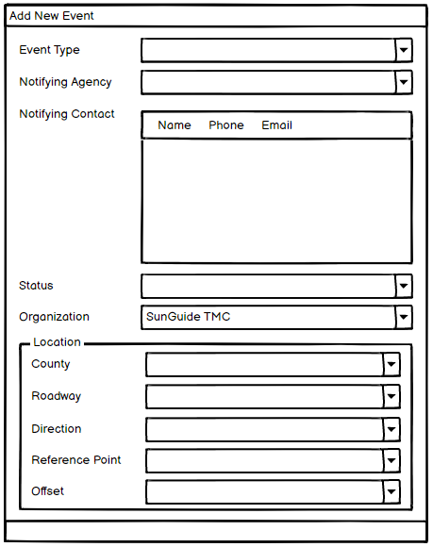
  Value will be set to the same default as SunGuide would use for event creation.
SunGuide Software Users Group | 3/24/21

Slide 18
QUESTIONS?
SunGuide Software Users Group | 3/24/21

Slide 19
SG-4965 - Add support for mileage tracking in SPARR interface
Tucker Brown
SunGuide Software Users Group | 3/24/21

Slide 20
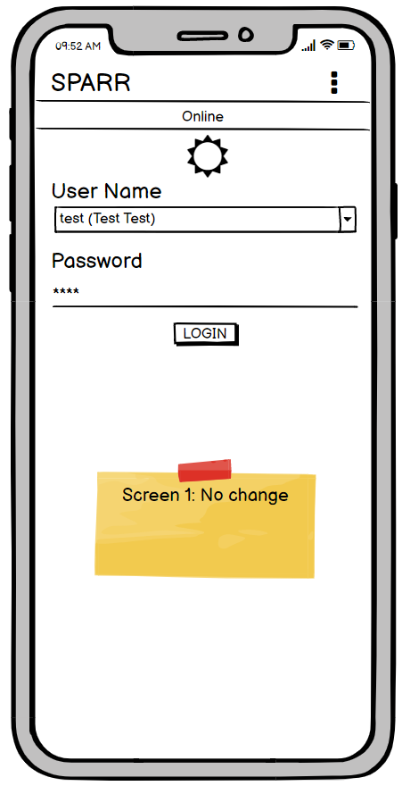
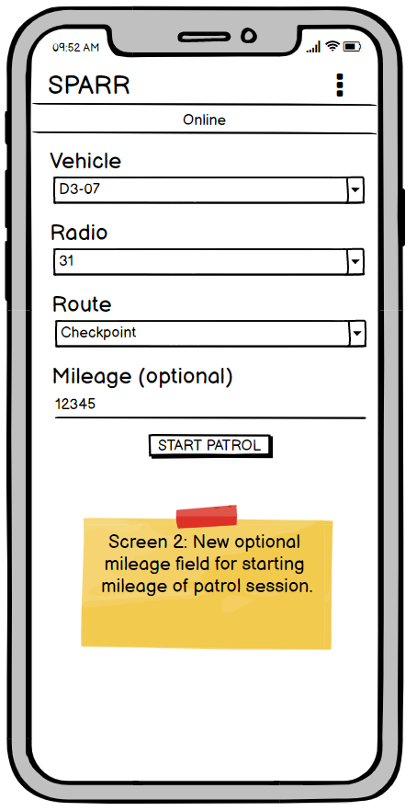
  Allows for an optional mileage to be set on login.
SunGuide Software Users Group | 3/24/21

Slide 21
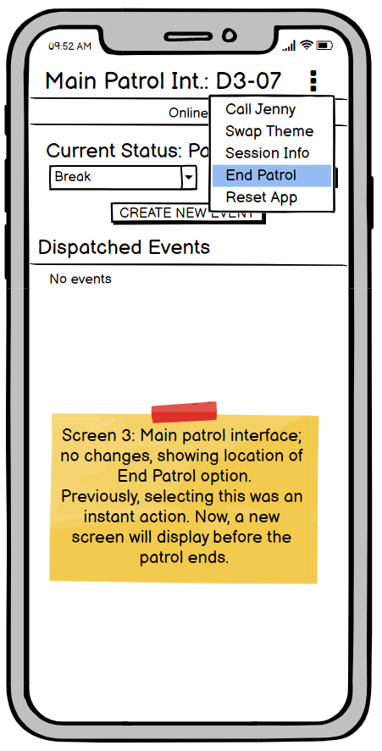
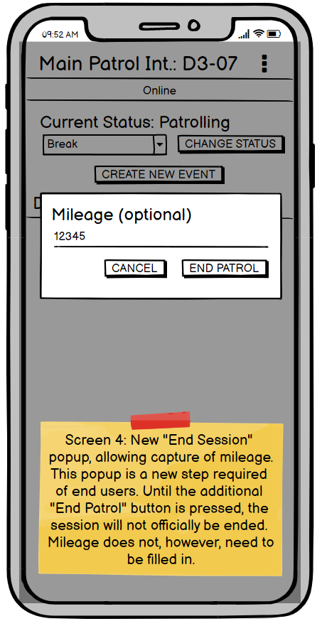
  Allows for an optional mileage to be set on logout.
SunGuide Software Users Group | 3/24/21

Slide 22
QUESTIONS?
SunGuide Software Users Group | 3/24/21

Slide 23
Other issues
Tucker Brown
SunGuide Software Users Group | 3/24/21

Slide 24
  SG-5251 - Wrong Way Device - Incorrect images displayed in SunGuides with Alert
    Alerts will be generated for all alerts reported to the driver, even if an alert is currently active.
    All images for all alerts will be saved with unique filenames to prevent overwrite
    When an alert is handled, the images will be deleted.
  SG-3499 - Reporting "Ramp Closed" for Different Lane Mappings
    Suggested wordings have been circulated for comments
  SG-5565 - Add support for Govcomm WWVDS
    Standard WWD functionality
  SG-5469 - ISS - Wrong Way Driver
    Standard WWD functionality
SunGuide Software Users Group | 3/24/21

Slide 25
QUESTIONS?
SunGuide Software Users Group | 3/24/21

Slide 26
Event “System” Attributes
Tucker Brown
SunGuide Software Users Group | 3/24/21

Slide 27
  System Attributes
  D6 installed version 8.0 last week.
  System attributes, at this time, are not configured to accept additional text.
  D6 would like all system attributes to accept additional text.
  This would not affect reporting and it is optional to put in text.
  Any objections to making this a statewide change?
SunGuide Software Users Group | 3/24/21

Slide 28
QUESTIONS?
SunGuide Software Users Group | 3/24/21

