Slide 1


SunGuide Software Users Group:
SunGuide 8.1
Design Review Meeting
April 29, 2021

Slide 2
WELCOME
ATTENDEE ROLL CALL
SunGuide Software Users Group | 4/29/21

Slide 3
SG-5410 - Question about new Executive Notification
Tucker Brown
SunGuide Software Users Group | 4/29/21

Slide 4
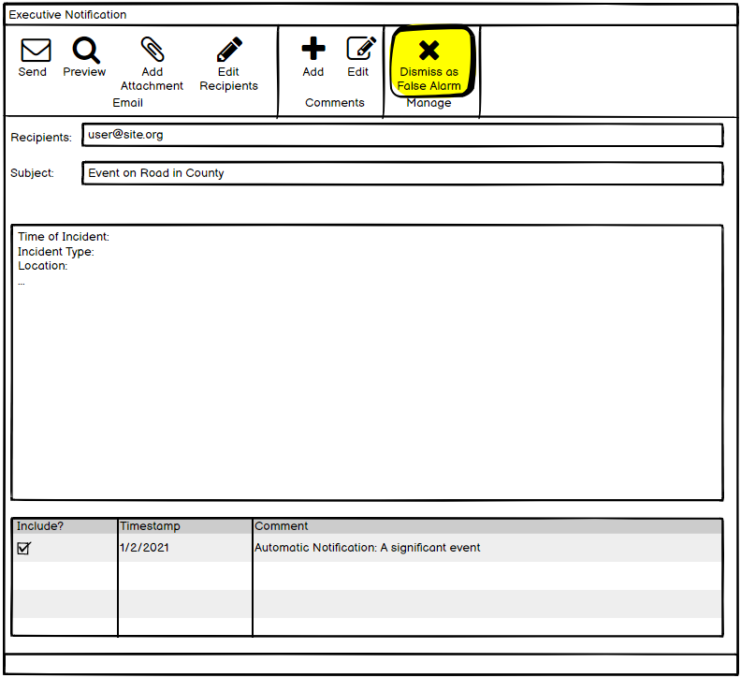
Send to ALL users capable of handling an Executive Notification
  Configurable option to send to the event owner
Dialog will disappear when closed, or when an Executive Notification is sent by any user.
Users can mark the notification as a False Alarm and the trigger criteria will reset as if none had be triggered.
  If the criteria remains, the notification will continue to generate when saved.
  If someone selects False Alarm, the dialog will disappear for all users.
SunGuide Software Users Group | 4/29/21

Slide 5
QUESTIONS?
SunGuide Software Users Group | 4/29/21

Slide 6
SG-3335 - Alert the operator when a travel time is double (or some other ratio) the free flow travel time
Tucker Brown
SunGuide Software Users Group | 4/29/21

Slide 7
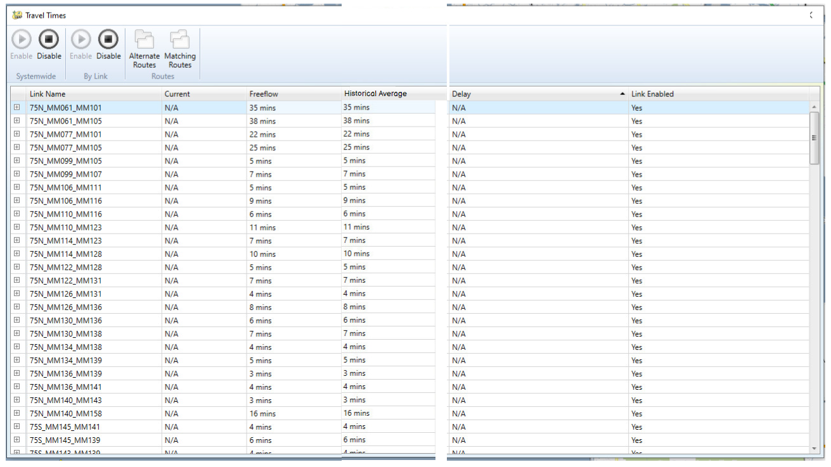
  Historical Average will be calculated based on the historical average of the TSS links of the travel time.
SunGuide Software Users Group | 4/29/21

Slide 8
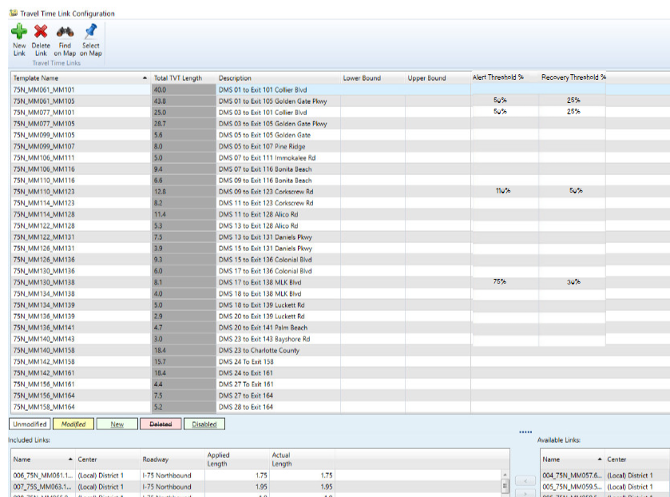
  Alert and recovery threshold can be configured as a percentage of the historical average.
SunGuide Software Users Group | 4/29/21

Slide 9
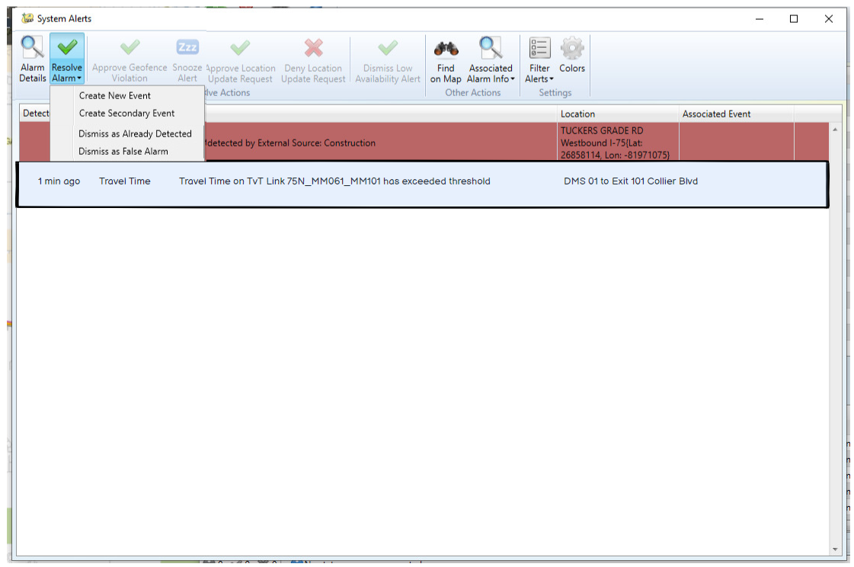
  Alerts are seen in the same way as IDS alerts and allow the user to take action.
SunGuide Software Users Group | 4/29/21

Slide 10
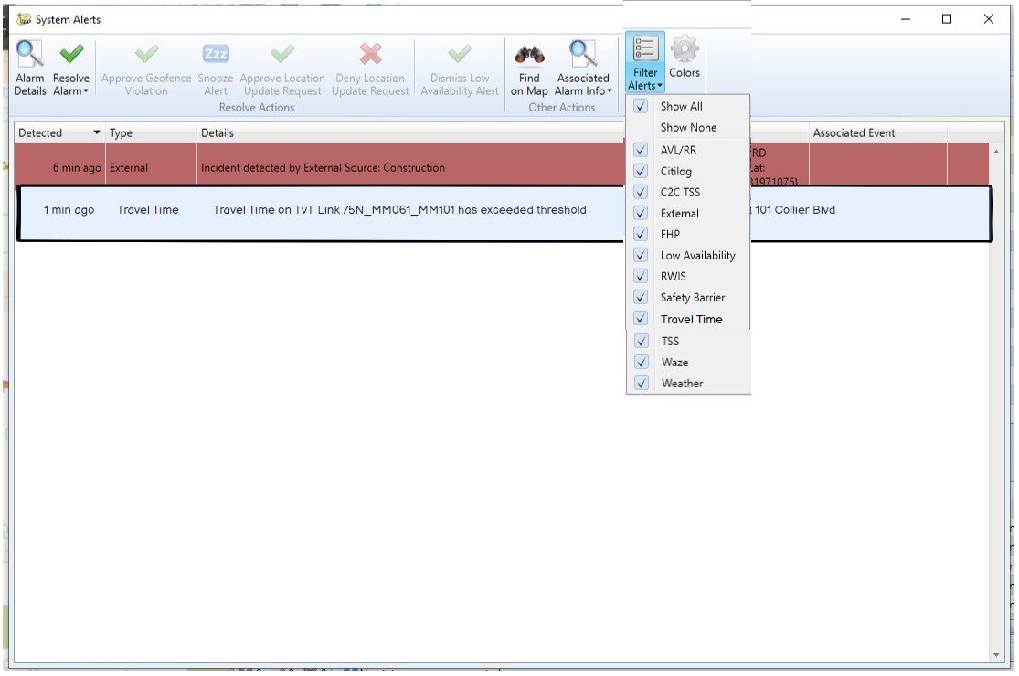
  Alerts can be filtered out of the list if users to do NOT wish to see them.
SunGuide Software Users Group | 4/29/21

Slide 11
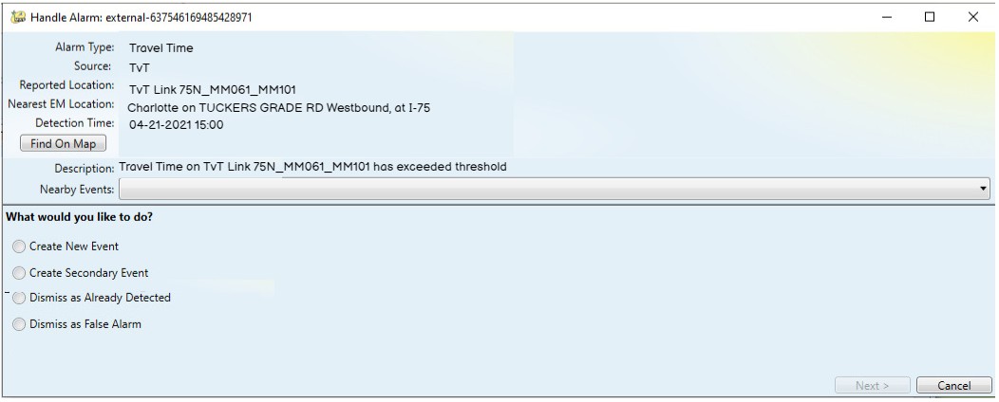
  The standard alert dialog will allow the user to take the specified actions.
SunGuide Software Users Group | 4/29/21

Slide 12
QUESTIONS?
SunGuide Software Users Group | 4/29/21

Slide 13
SG-2510 - Indicate removed items in Current Response Plan list prior to plan activation
Tucker Brown
SunGuide Software Users Group | 4/29/21

Slide 14
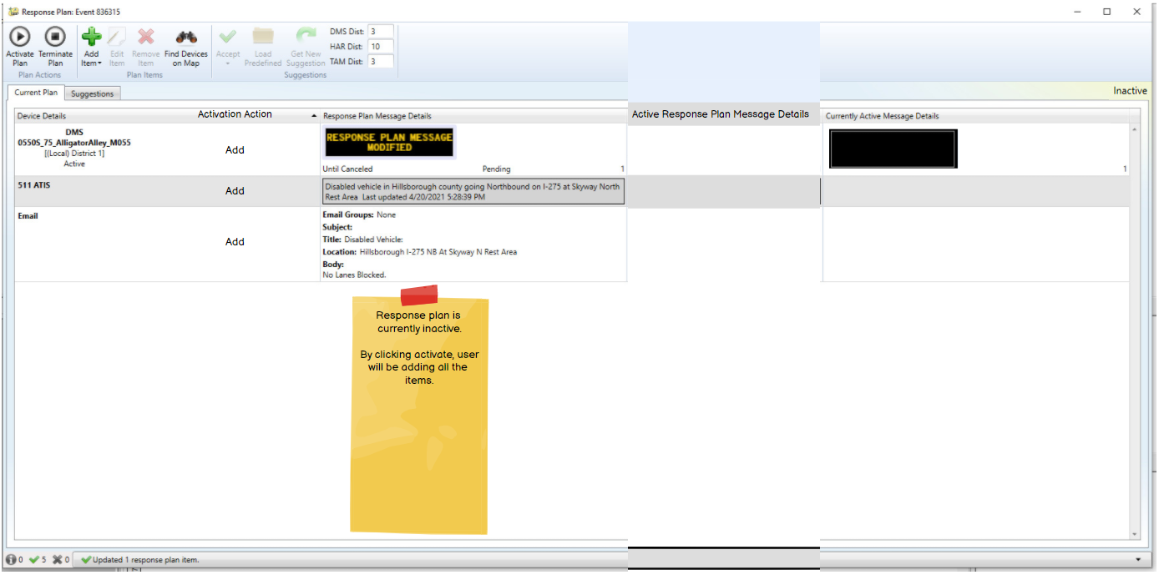
  New Response plan with no activated items.
SunGuide Software Users Group | 4/29/21

Slide 15
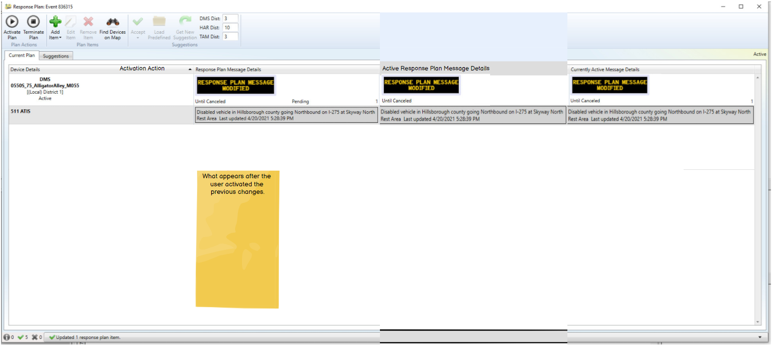
  New Response plan after activation.
SunGuide Software Users Group | 4/29/21

Slide 16
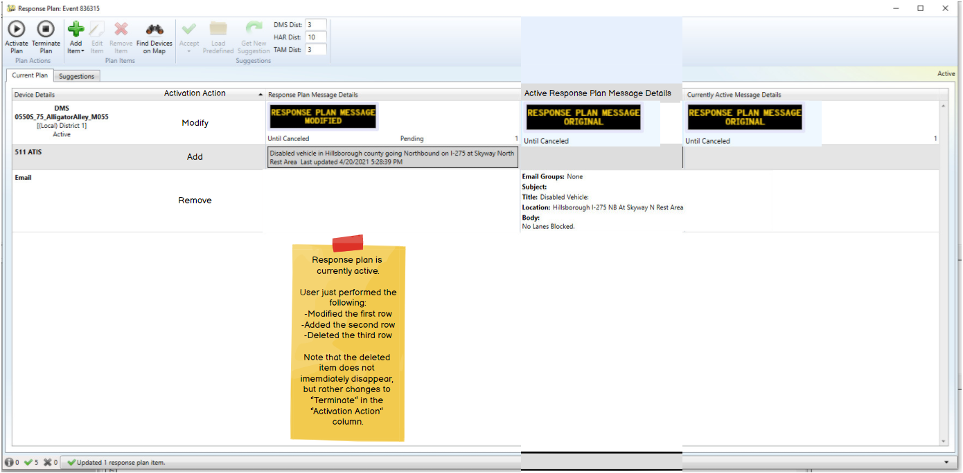
  User has made changes to the response plan.
SunGuide Software Users Group | 4/29/21

Slide 17
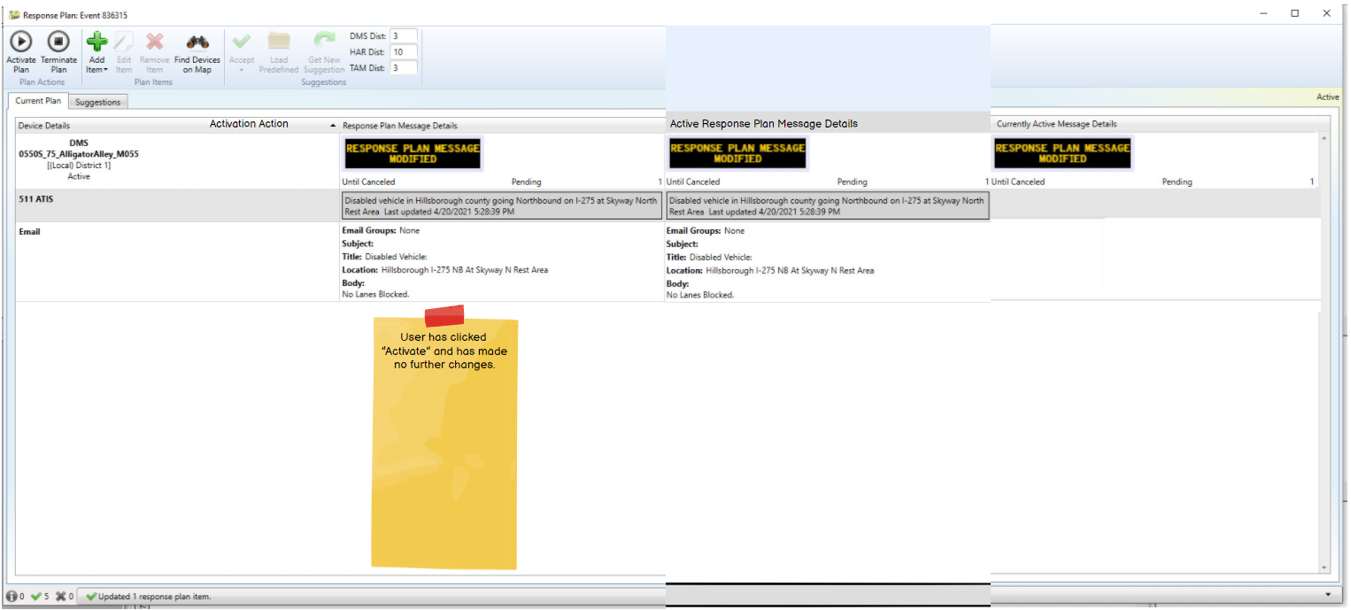
  User activated the new response plan.
SunGuide Software Users Group | 4/29/21

Slide 18
QUESTIONS?
SunGuide Software Users Group | 4/29/21

Slide 19
SG-4209 - Use polyline instead of a single point for road closures
Tucker Brown
SunGuide Software Users Group | 4/29/21

Slide 20
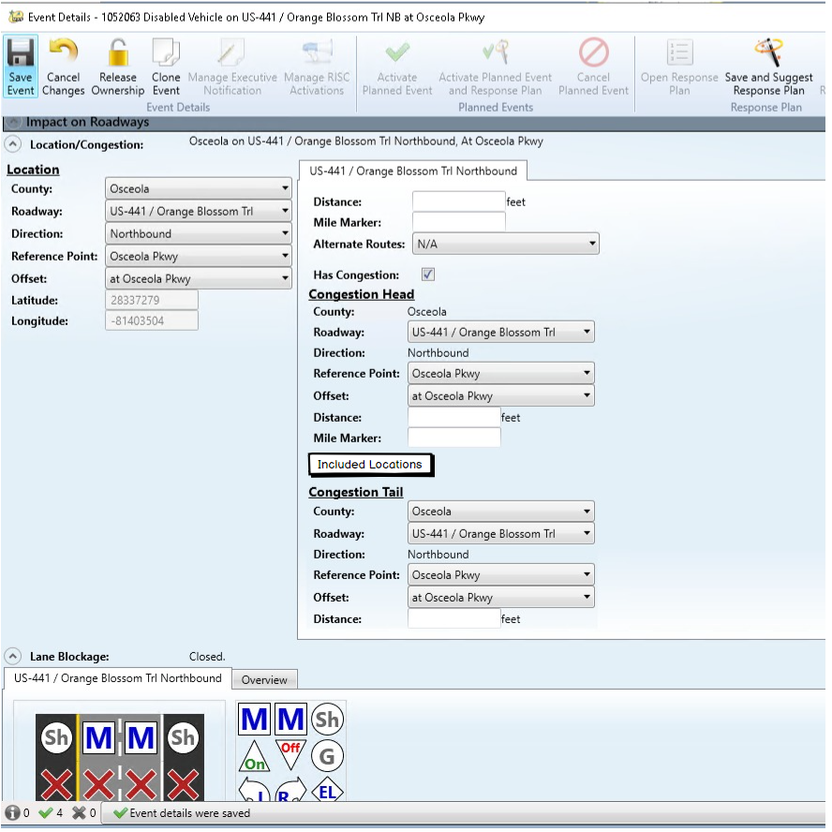
  Users have the ability to add additional location between the congestion head and tail.
SunGuide Software Users Group | 4/29/21

Slide 21
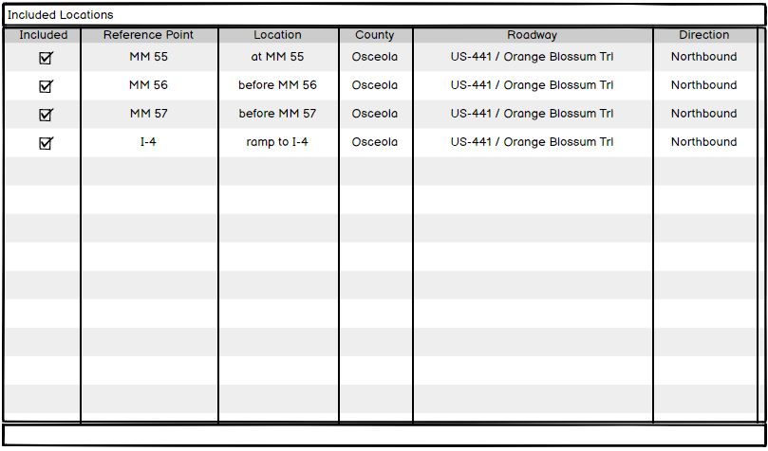
  User can choose the locations to include.
  Locations must be between the congestion head and tail (based on sort order).
SunGuide Software Users Group | 4/29/21

Slide 22
QUESTIONS?
SunGuide Software Users Group | 4/29/21

Slide 23
SG-4985 - Ability to configure response plan search radius by event type
Tucker Brown
SunGuide Software Users Group | 4/29/21

Slide 24
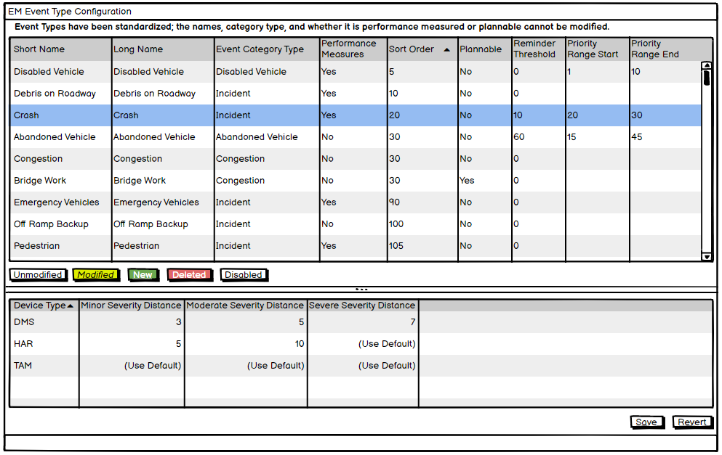
  Administrators may set event specific distances.
  Defaults will still be defined in the config file (same as current behavior).
SunGuide Software Users Group | 4/29/21

Slide 25
QUESTIONS?
SunGuide Software Users Group | 4/29/21

Slide 26
SG-3143 - Status
Logger Filters
Tucker Brown
SunGuide Software Users Group | 4/29/21

Slide 27
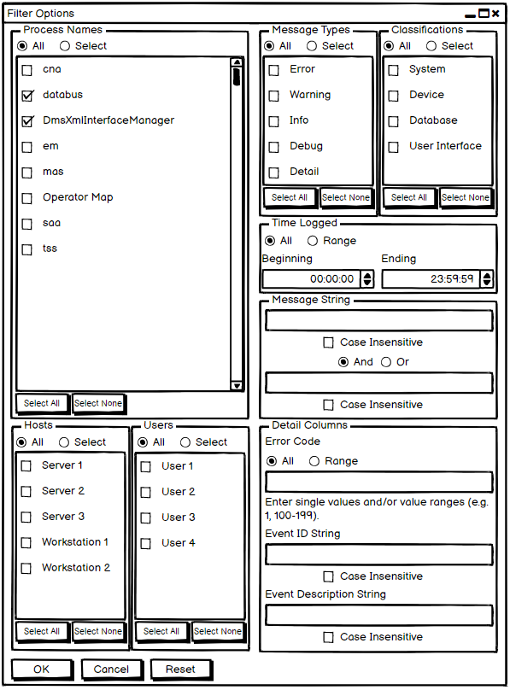
  Expanded Process Names
    Select All/Select None options
  Hosts and Users will be side by side at the bottom
  Message string will allow for and AND/OR criteria
SunGuide Software Users Group | 4/29/21

Slide 28
QUESTIONS?
SunGuide Software Users Group | 4/29/21

Slide 29
SG-2364 - Log username of user that changes device status
Tucker Brown
SunGuide Software Users Group | 4/29/21

Slide 30
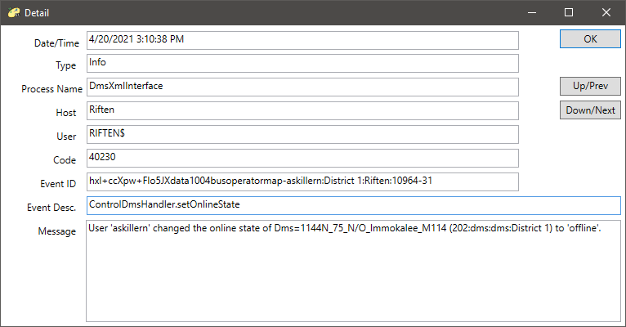
  Username will be seen in the message.
  Message will be at the Info level so it will always be logged.
SunGuide Software Users Group | 4/29/21

Slide 31
QUESTIONS?
SunGuide Software Users Group | 4/29/21

Slide 32
SG-564 - Remove List Options without Deleting
Phase 1 (SAA, TSS, CCTV, DMS)
Tucker Brown
SunGuide Software Users Group | 4/29/21

Slide 33
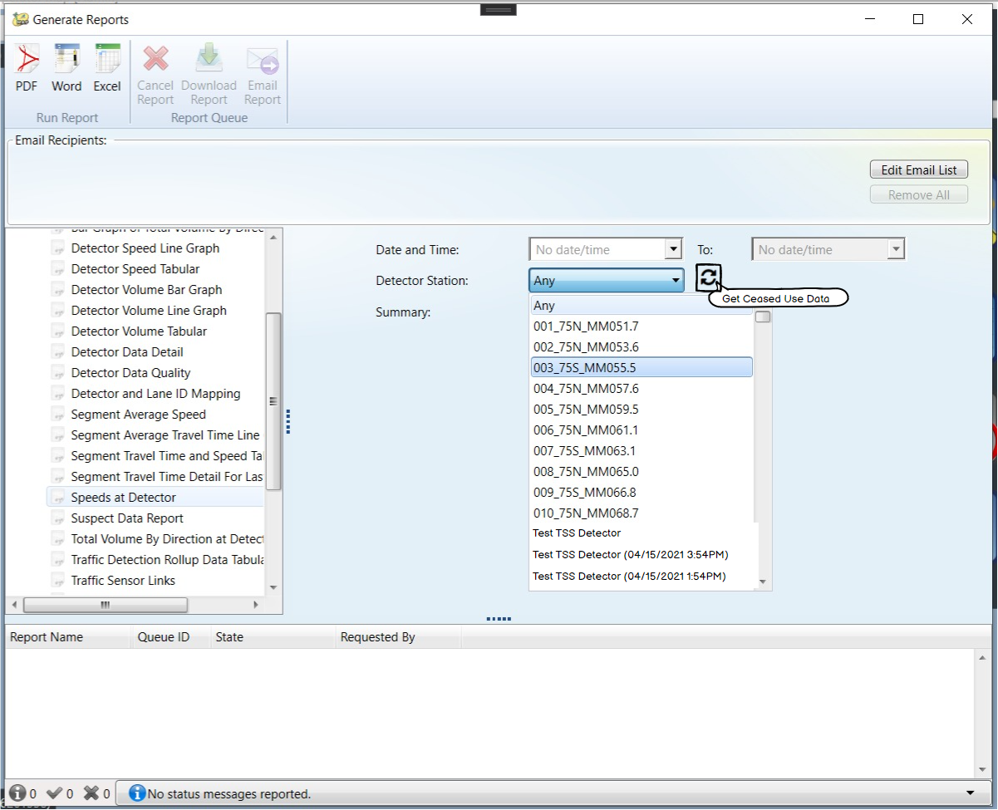
  Devices can be retrieved (if needed) and will include the ceased date for uniqueness.
  Default will only show current devices.
  Initial usage will be for DMS, Cameras, Users, and TSS Detectors only.
SunGuide Software Users Group | 4/29/21

Slide 34
QUESTIONS?
SunGuide Software Users Group | 4/29/21

Slide 35
SG-5065 - Add support for authentication via Active Directory
Tucker Brown
SunGuide Software Users Group | 4/29/21

Slide 36
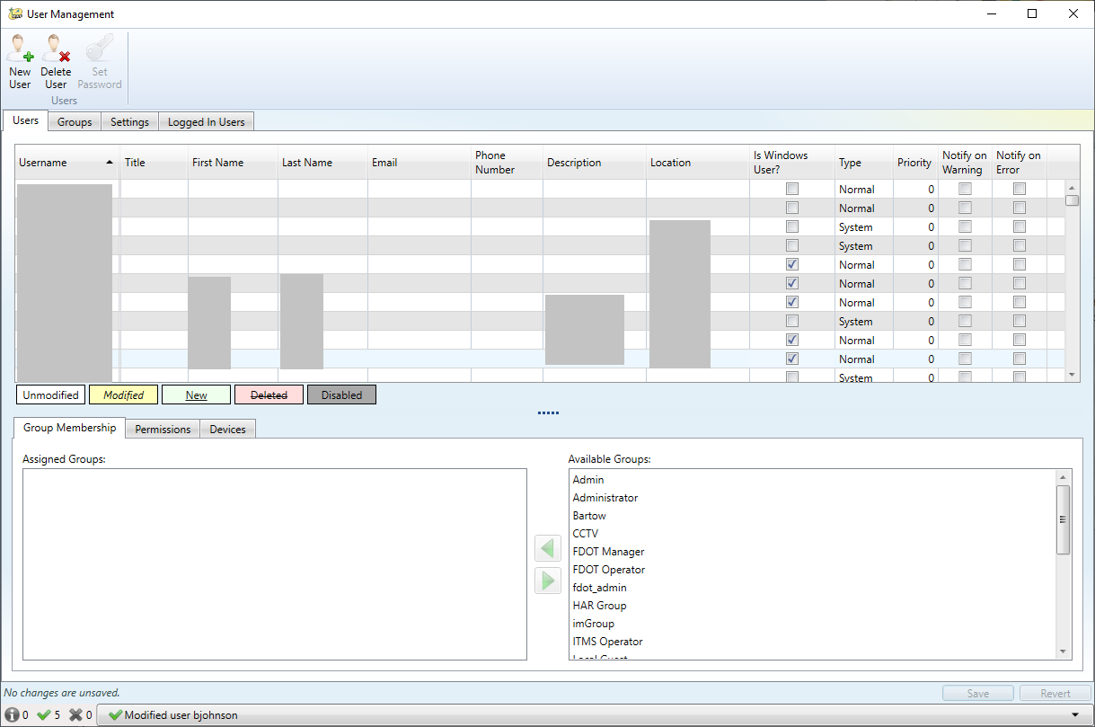
  System will allow users to authenticate with Active Directory as opposed to SunGuide.
  Permissions will still be tied to the user as defined in SunGuide.
SunGuide Software Users Group | 4/29/21

Slide 37
QUESTIONS?
SunGuide Software Users Group | 4/29/21

Slide 38
SG-3338 - Allow floodgates to be scheduled through SAS
Tucker Brown
SunGuide Software Users Group | 4/29/21

Slide 39
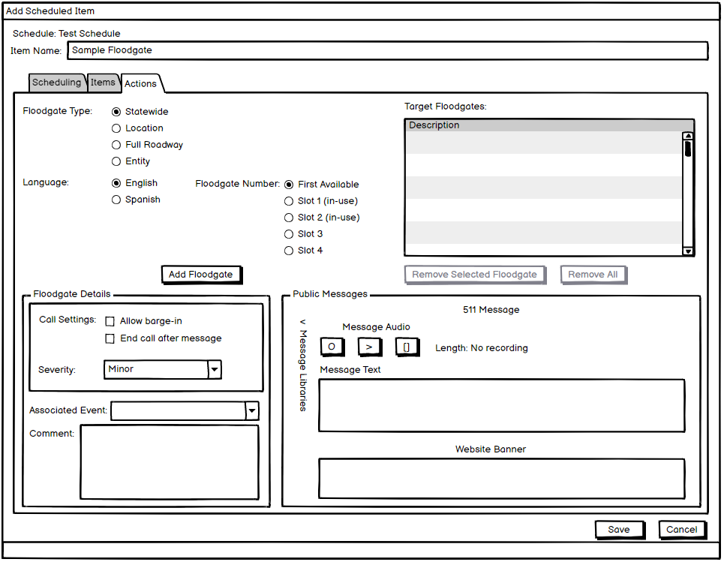
  Same Floodgate dialog, but accessible through SAS.
  What slot should be chosen? First Available?
SunGuide Software Users Group | 4/29/21

Slide 40
  Floodgate Retries
    It was requested at the SSUG to retry if the Floodgate request was rejected.
  Open questions:
    Is this still needed?
    Would this apply to Floodgates only? Or other SAS items as well?
    How many times should it retry? Immediate or should it wait?
SunGuide Software Users Group | 4/29/21

Slide 41
QUESTIONS?
SunGuide Software Users Group | 4/29/21

Slide 42
SG-2493 - Icon enhancement for Arterial DMS
Tucker Brown
SunGuide Software Users Group | 4/29/21

Slide 43
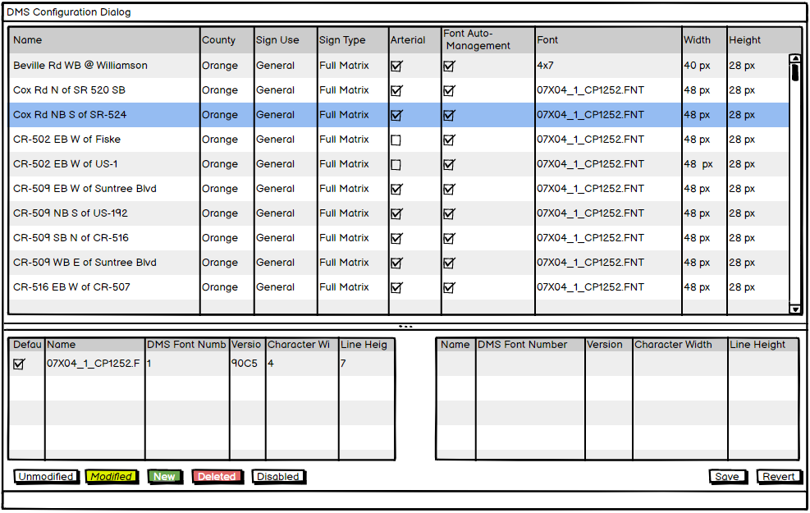
  Any DMS can be configured as an Arterial DMS.
SunGuide Software Users Group | 4/29/21

Slide 44
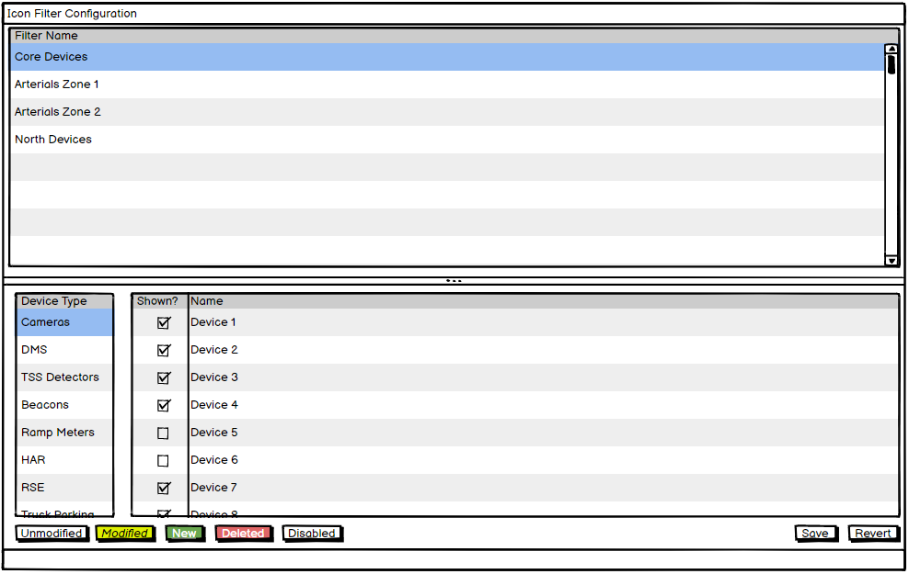
  Users set up “groups of icons” known as Icon Filters.
  No limit to number of devices or device types.
SunGuide Software Users Group | 4/29/21

Slide 45
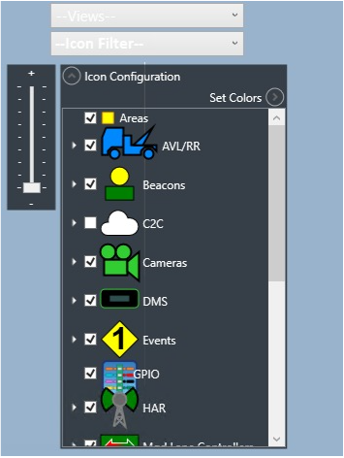
  In addition to the regular icon preferences, this would allow specific device within a group to be shown.
    Example: A group can be set up to only have cameras and DMS from I-4. DMS and CCTV would still be checked in the icons preferences but only DMS and CCTV on I-4 would be shown.
SunGuide Software Users Group | 4/29/21

Slide 46
QUESTIONS?
SunGuide Software Users Group | 4/29/21

Slide 47
SG-5278 - Blank Out Signs Integration
Tucker Brown
SunGuide Software Users Group | 4/29/21

Slide 48
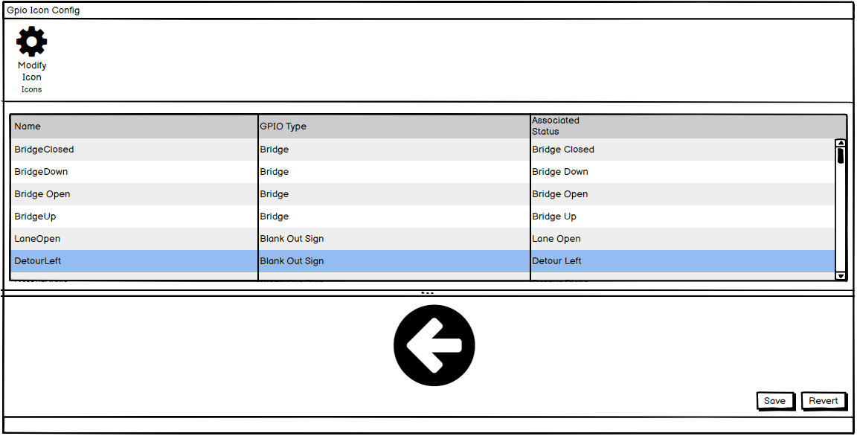
Blank Out Signs
  States/Icons of the Blank Out Signs can be configured.
SunGuide Software Users Group | 4/29/21

Slide 49
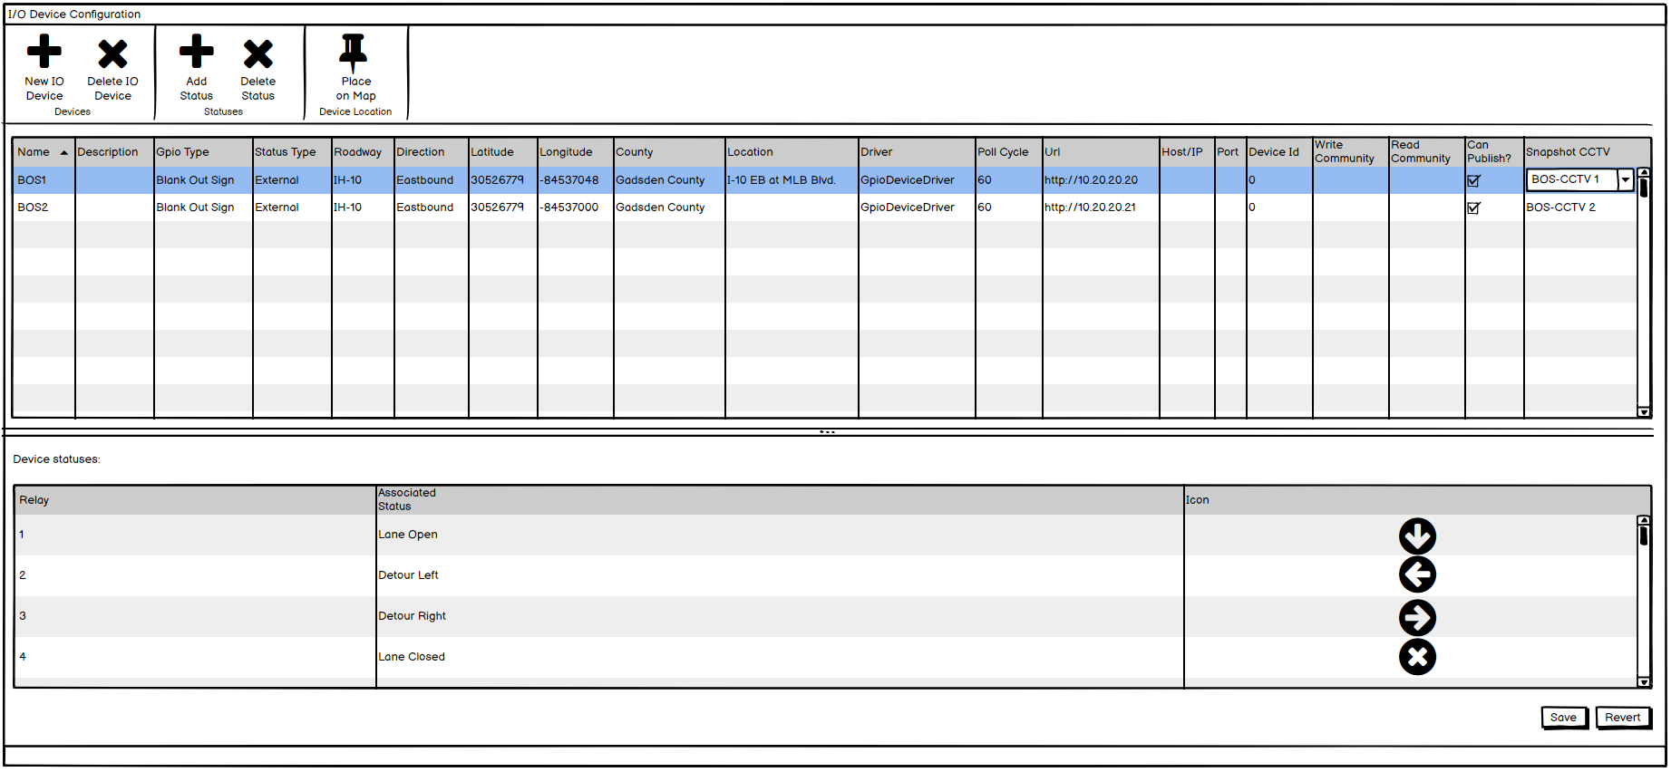
Blank Out Signs
  Blank Out Signs can be configured as part of General Purpose Input/Output (GPIO) subsystem and each relay can be assigned a specific state for the sign.
SunGuide Software Users Group | 4/29/21

Slide 50
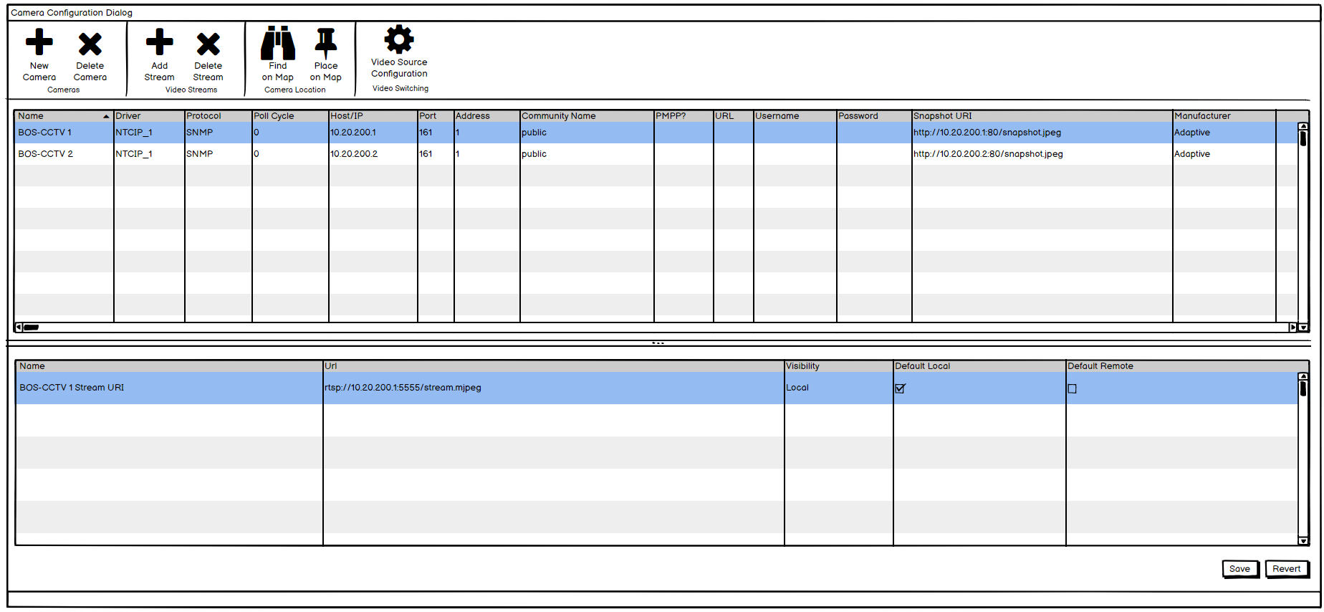
Blank Out Signs
  An optional “snapshot location” will be added to CCTV to allow BOS to pick up the latest snapshot as part of status.
SunGuide Software Users Group | 4/29/21

Slide 51
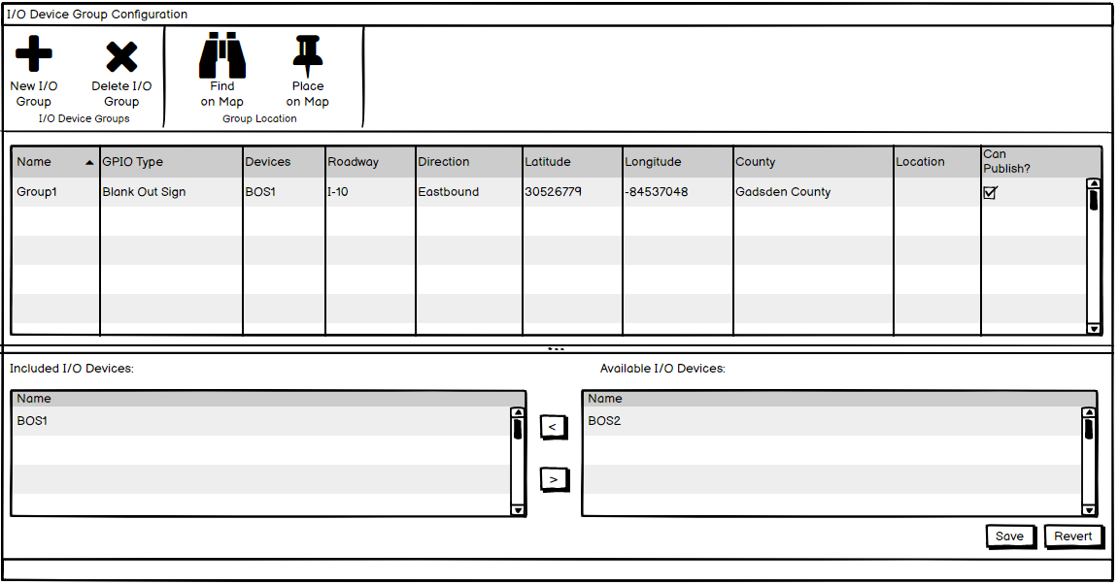
Blank Out Signs
  Blank Out Signs can be added to GPIO Device groups, but not required.
SunGuide Software Users Group | 4/29/21

Slide 52
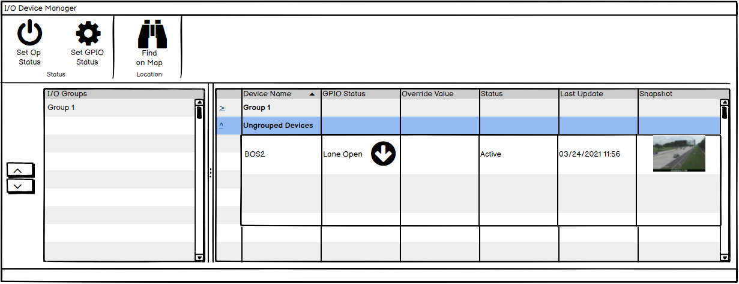
Blank Out Signs
  Blank Out Signs status will show the snapshot.
  Users can view status for each device in a group or as individual devices.
SunGuide Software Users Group | 4/29/21

Slide 53
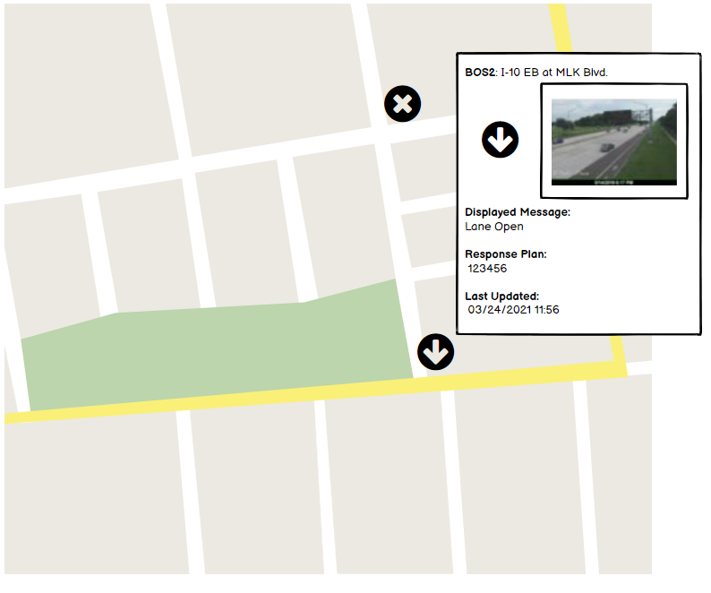
Blank Out Signs
  Icons on the Map will show status and a snapshot in the hovertext, if available.
SunGuide Software Users Group | 4/29/21

Slide 54
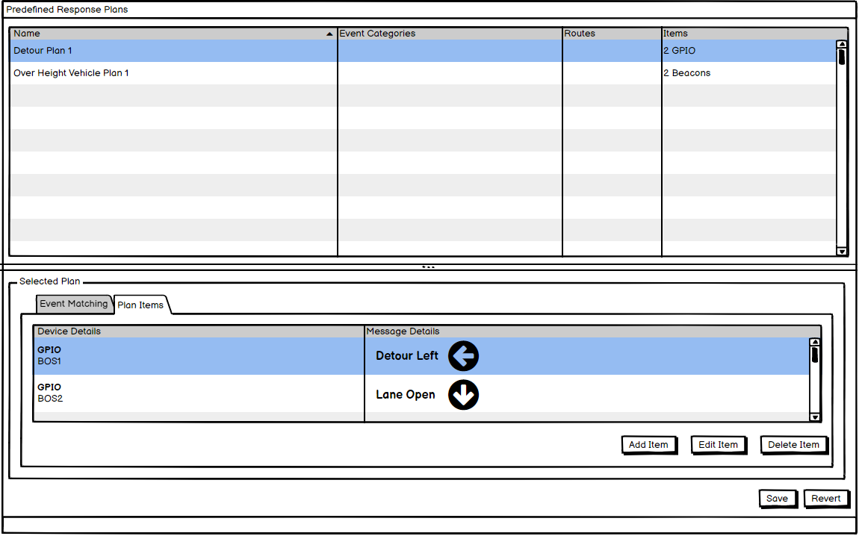
Blank Out Signs
  Blank Out Signs may be used in Pre-defined response plans.
SunGuide Software Users Group | 4/29/21

Slide 55
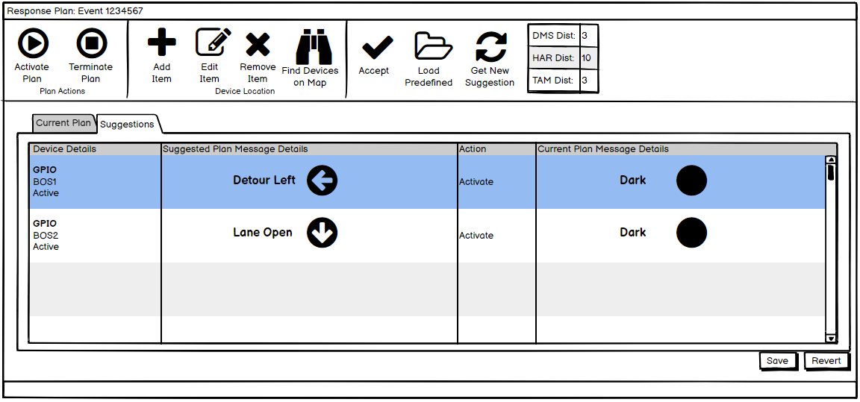
Blank Out Signs
  Pre-defined response plans with Blank Out Signs can be loaded into response plans.
SunGuide Software Users Group | 4/29/21

Slide 56
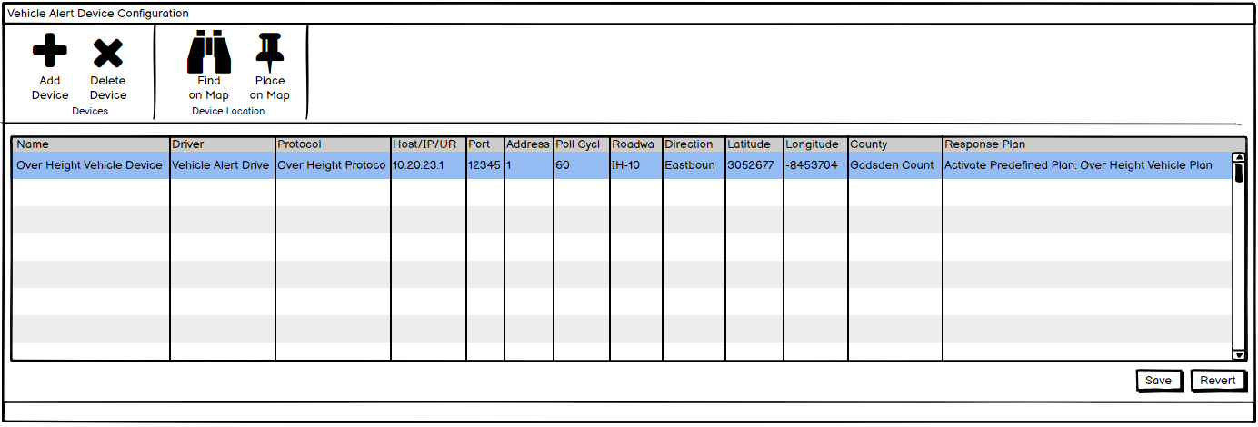
Over Height Detector
  Over Height Vehicle Detector can be configured.
SunGuide Software Users Group | 4/29/21

Slide 57
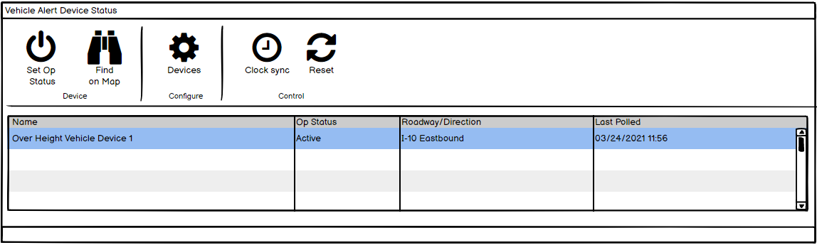
Over Height Detector
  Status dialog will show the current communication status.
SunGuide Software Users Group | 4/29/21

Slide 58
QUESTIONS?
SunGuide Software Users Group | 4/29/21

Slide 59
SG-5236 - We would like a TPAS enhancement that would alarm when a space has been occupied for an extended time.
Tucker Brown
SunGuide Software Users Group | 4/29/21

Slide 60
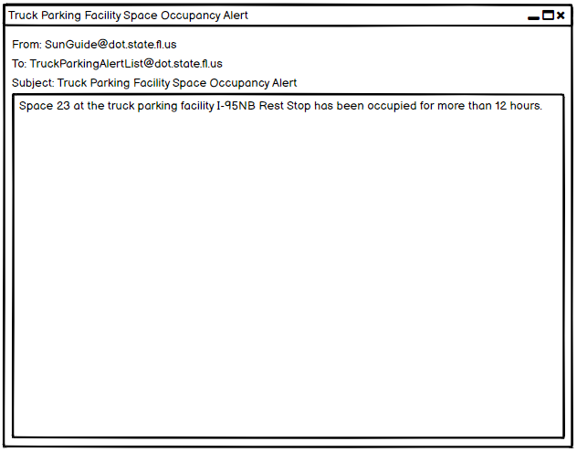
  Emails will be generated to alert an Administrator of this condition.
SunGuide Software Users Group | 4/29/21

Slide 61
QUESTIONS?
SunGuide Software Users Group | 4/29/21

Slide 62
Other Issues
Tucker Brown
SunGuide Software Users Group | 4/29/21

Slide 63
Non-GUI issues
  SG-4781 - Request update of integrated VLC libraries
    Library will be upgraded to the current VLC version
  SG-5470 - Carmanah - Wrong Way Driver
    Integration of the Carmanah WWD protocol
  SG-5327 - Integrate TrafficVision video analytic alerts into SunGuide
    Integration of the TrafficVision WWD protocol
  SG-5303 - MH Corbin WWD Integration
    Integration of the MH Corbin WWD protocol
  SG-3925 - Add assigned Beat to Road Ranger information in Event Reports
    Reports will be updated to include beat information.
    Reports will be updated to be filtered by vehicle.
SunGuide Software Users Group | 4/29/21

Slide 64
QUESTIONS?
SunGuide Software Users Group | 4/29/21

Slide 65
News
Release 8.0 Hotfix 4 is currently being tested at the TERL.
  If deploying 8.0, please bring the system all the way to this hotfix as part of the upgrade.
  Contains several enhancements as well as bugfixes.
The next SSUG Meeting will be on 5/13/21.

Slide 66
Reminder
Release 8.0 included a new C2C data type called telemetryData.
This data type will provide Central Office with visibility into which SunGuide components are deployed in each district, as well as current release information.
Please reach out if you run into any problems configuring your production SunGuide or C2C infrastructure to support this data.

Slide 67
QUESTIONS?
ADJOURN

