Slide 1


SSUG 1-7-21
SunGuide Software Users Group | 1/7/21

Slide 2
SG-5349 - FL-511 not publishing correct lane blockage if an event has both the turn lane and travel lane blocked
Tucker Brown

Slide 3
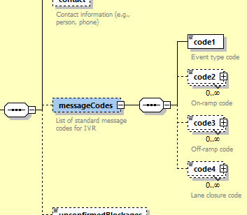
FLATIS Lane Blockage (current)
SunGuide uses Society of Automotive Engineers(SAE) codes to relay lane and blockage information to FLATIS.
Due to a lack of options to relay information, SunGuide can't send things like “Left travel lane and Turn lane blocked”
  Would show as “Left lane blocked”
We could expand the SAE codes but still may not get a full solution.

Slide 4
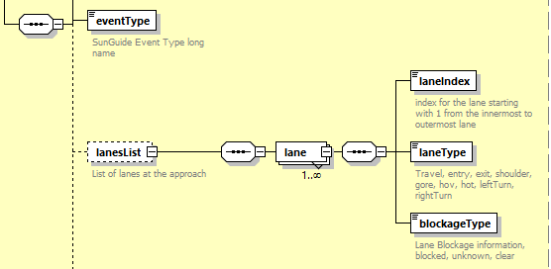
Proposed Changes
Change blockage to report actual lanes and blockage
FLATIS can then generate any blockage convention based on the actual data
FLATIS is currently the only user of the data so no need for 3rd party considerations

Slide 5
QUESTIONS?

Slide 6
Release 8.0 Database Scripts and SunGuide downtime
Tucker Brown

Slide 7
District upgrades
Almost all districts responded with an ability to be down for less than 4 hours to complete the 8.0 upgrade
Based on testing, the current 8.0 scripts will take longer than that.
Given that, we will need to make changes to how these are run.
  Split the timezone change (90+% of the script time) into its own script.
  This part will have to run after SG comes back online and while operations is running.
    This will affect reporting until complete. May take a day or 2 to finish.

Slide 8
Upgrade
For those upgrading
  Testing the DB script is highly encouraged
  Due to the large number of changes for timestamps, transactions logs are filling the drive as part of the upgrade
    For test DBs, change the recovery mode to Simple and transaction logs will not be written
    For Production, after we make the change to the scripts, you will likely need to take frequent backups to clear the transaction log.

Slide 9
Upgrade
For those requiring even less downtime, please get with SwRI and Central Office to come up with a custom plan on how best to meet your need.

Slide 10
QUESTIONS?

Slide 11
SG-4209 - Use polyline instead of a single point for road closures
Tucker Brown

Slide 12
Polylines
Polyline ConOps in development
Trying to achieve multiple goals as part of this effort
  Give operations the ability to put in events that contain multiple EM locations and track as part of one event
  Get events to show in the Waze feed.
    Waze requires a start and end point for all events
  Get events to show in the Waze closure feed
    Waze requires a start and end point for all events

Slide 13
Proposed Changes
Operator creates an event
  Have the option to turn the event into a polyline event if it is a full road closure
  Operator would set the start and end of the closure
  Software would pick up and automatically select all locations between the start and the end point
    Operator would be allowed to view the list of midpoints and deselect locations they might not need to publish
      Only select locations with on-ramps by default?
  Operator publishes message to 511 with full list of affected locations

Slide 14
Polylines for Waze
If an event is a single point (not a closure over the roadway), we have already asked the 511 team to create a second point within 50m in the direction of the event.
If an event is multiple EM locations, we will ask the 511 team to provide a list of points between the start point and end point.
This may move to SunGuide generating the points based on those discussions but this would all be automated with no operator input

Slide 15
QUESTIONS?

