Slide 1


SunGuide Software
Users Group Meeting
December 16, 2021

Slide 2
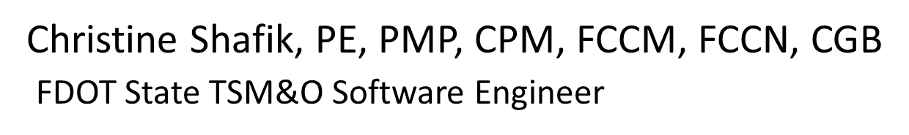
WELCOME
ATTENDEE ROLL CALL

Slide 3
SG-6120 – Allow Saving Configuration of Items without Errors, Despite Errors in Other Items of the Same Type
Mark Laird
District 6

Slide 4
Current Behavior
All items of one type are included in a configuration table.
When any item is changed and saving is attempted, the configuration of all items in the list is validated.
If any item has an issue, the changes made cannot be saved until all, including pre-existing, issues with all items of that type have been addressed.
A system change affecting many/all requires all to be fixed in one session.

Slide 5
Enhancement
Permit any configuration changes that are found to be valid to be saved.
  If there is a conflict with another (e.g., IP address, consider invalid)
  Prefer to get errors from modified rows before others
Report validation errors as it does today, so that we are aware that there are still issues with other items.

Slide 6
QUESTIONS?
COMMENTS?
SUPPORT?

Slide 7
SG-6044 – Exclude MOT Events from Performance Measures
Dee McTague
District 4

Slide 8
Issue
Need a means to exclude MOT events resulting from a primary event from performance measures.
MOT response to long-term closures (both on the express and general use lanes) negatively impacts district performance measures.
  Closure events in express lanes almost always require the closure of multiple ingresses, inaccurately inflating incident and roadway clearance performance measures.

Slide 9
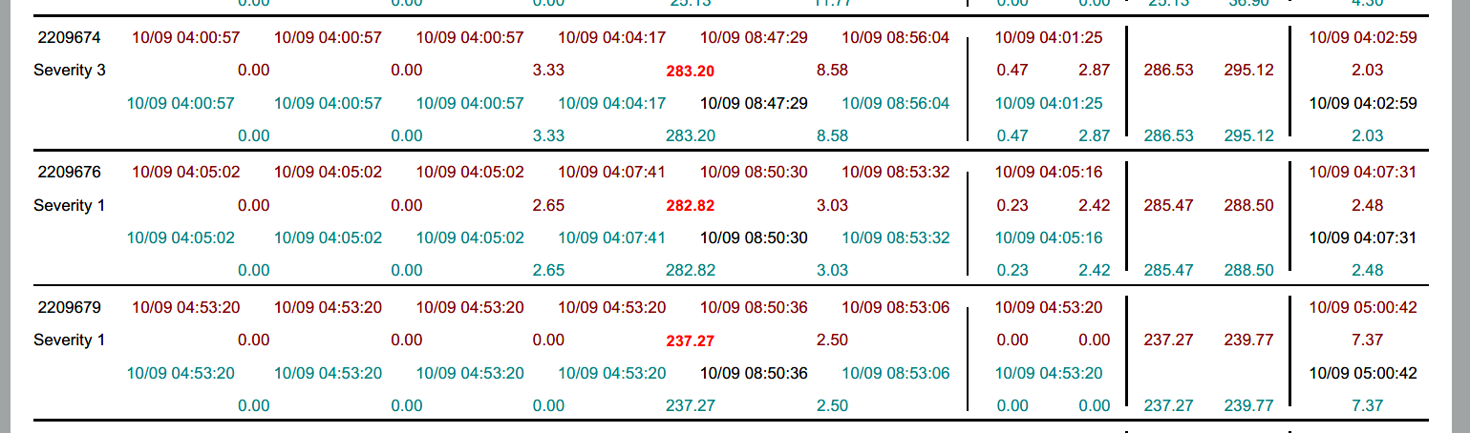
Example

Slide 10
Enhancement
Create a means to flag secondary MOT events to be excluded from performance measures.

Slide 11
QUESTIONS?
COMMENTS?
SUPPORT?

Slide 12
SG-5456 – “TMC Notified”
Jason Evans
District 2

Slide 13
Issue & Question
When the notified timestamp is entered for an event, the chronology lists it as “TMC Notified” and the responder.
If the “Notified by TMC” box is checked to the left of the timestamp, the chronology entry looks the same
  What is the intended use/function of the checkbox?

Slide 14
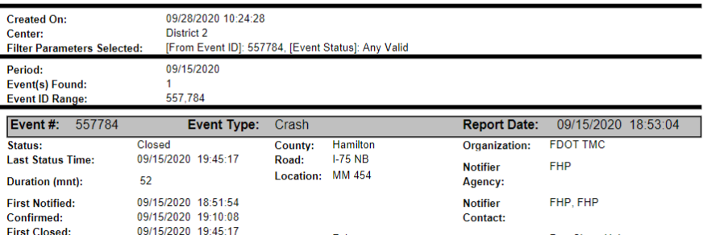
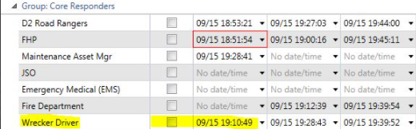
Example

Slide 15
Enhancement
Propose changing the chronology entry to read “TMC Notified” if the box is checked and just “Notified” if the timestamp is entered without the checkbox.
Open to other suggestions to denote in chronology that TMC was the notifier.

Slide 16
QUESTIONS?
COMMENTS?
SUPPORT?

Slide 17
SG-5215 – SAS Missing Merge with Travel Time Option
John Hope
CFX

Slide 18
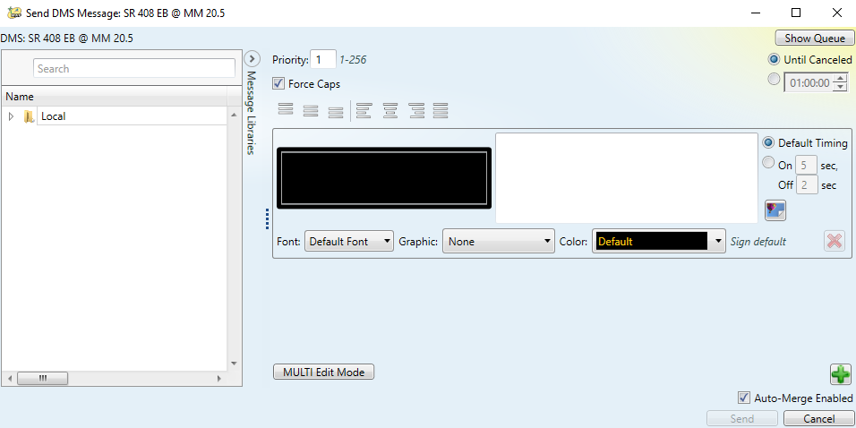
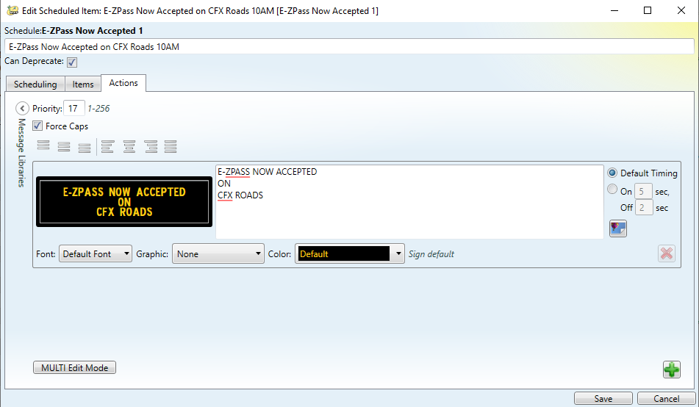
Issue
When scheduling DMS messages via SAS, there is no “Auto-Merge Enabled” checkbox.

Slide 19
Enhancement
Add “Auto-Merge Enabled” checkbox to SAS Action for DMS so that scheduled messages can be automatically merged with travel time messages.

Slide 20
QUESTIONS?
COMMENTS?
SUPPORT?

Slide 21
JIRA Issues
Christine Shafik, PE, PMP, CPM, FCCM, FCCN, CGB
FDOT State TSM&O Software Engineer

Slide 22
JIRA Issues
Central Office would like to ensure districts are getting maximum responsiveness on high priority Critical Failure and Failure issues.
Please ensure issues are categorized correctly when creating Jiras.
  Critical Failure: A failure of multiple SunGuide software subsystems or a single critical SunGuide subsystem that prevents operation of the SunGuide Software or inhibits the Department’s ability to manage the roadways.
    Ex) Databus or Map inability to run. DMS, EM won’t start
  Failure: A single SunGuide application, subsystem or driver failure that prevents operation of a part of the SunGuide Software and does not prevent the Department’s ability to manage the roadways.
    Ex) EM failed, but was restarted and is now working

Slide 23
JIRA Issues
Central Office has instructed SwRI to monitor Failure issues more closely and resolve as soon as possible.
  Would like districts to reply to all Failure issues within 3 days of being requested to provide any additional information.
    If issue has NOT reoccurred or there is no additional information, that is also helpful for determining frequency.
  SwRI will be pinging all Failure issues every 5 business days if no response is received.
    SwRI has been asked to provide regular updates to Central Office on the progress of resolving issues.

Slide 24
JIRA Issues
Central Office has also sent out emails on non-responsive issues for JIRA.
  Thanks to all who have already responded.
  Please keep updating issues in a timely manner to make sure we can focus on the important parts of the backlog.

Slide 25
OTHER ANNOUNCEMENTS?
QUESTIONS?
COMMENTS?
ADJOURN.

