Slide 1
SG-4649: Keep DMS device icons on map when using TVT configuration
Tucker Brown

Slide 2
Enhancement
Current Behavior
  When selecting TSS links from the Operator Map, the Map removes all icons except TSS links.
Proposed Change
  To more easily determine at which link to end the travel time, the DMS icons would also be left of the Operator Map when in this selection mode.

Slide 3
QUESTIONS?

Slide 4
SG-3632: Investigate discontinuous lane blockages in relation to open roads durations
Tucker Brown

Slide 5
Issue
Current Behavior
  The issue is actually already resolved but wanted to make users aware of the implications.
  At the time, there was an issue calculating blockage time for discontinuous blockage.
  This would have affected systems pre-6.2 (Q2 2016)
Potential Change
  A tool was suggested to be developed to back-fix any data however this never went forward
  At this time, would recommend closing the issue
  Are any users seeing requests for event data 5+ years back for blockage time that would justify the need for this?

Slide 6
QUESTIONS?

Slide 7
SG-4806: Response Plan "511 ATIS" preview section does not match what is posted to FLATIS
Tucker Brown

Slide 8
Enhancement
Current Behavior
  The preview of the 511 item in the response plan does not match the output at 511.
    Response Plan Generation "511 ATIS" Preview window, at the top of a suggested response plan.
      Location Long Name (As part of Location Config)
    The actual event location that a DMS will display, as populated by the Response Plan
      Reference Point (Name in Location Config) (Field populated from Reference Point Long name, in Reference Point config)
    The location that FLATIS displays on the actual site.
      Reference Point (Name in Location Config) (Field populated from Reference Point Long name, in Reference Point config)

Slide 9
Enhancement
Proposed Change
  Change the Preview window of the response plan to:
    Reference Point (Name in Location Config) (Field populated from Reference Point Long name, in Reference Point config)
  Would make them consistent across all views.

Slide 10
QUESTIONS?

Slide 11
SG-5629: Trauma Alert
Tucker Brown

Slide 12
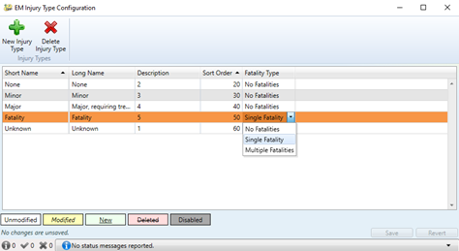
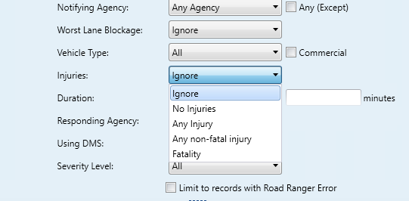
Issue
Current Behavior
  Injury types are added but must be categorized.
  In reports, filtering is based on the categorized label, not the name.

Slide 13
Issue
Request:
  Add a new Injury Type for “Trauma Alert”
Options:
  Add a new category for “Trauma Alert”
  Add “Trauma Alert” as a new 8.0 Attribute. This would require no software changes and would immediately allow reporting.

Slide 14
QUESTIONS?

Slide 15
SG-3570: Capture Additional BSM1 and BSM2 Data from
Connected Vehicles
Mark Dunthorn

Slide 16
Current Status
SunGuide sends TIM (Traveler Information Message) to RSUs
SunGuide receives BSM (Basic Safety Message) and PVD (Probe Vehicle Data)
  Link speed

Slide 17
Future Needs
Besides Location, Speed, and Direction, BSM’s can also include other data that might be useful in safety applications
  Brake status
Other messages
  Roadside Alert (RSA)

Slide 18
Other Considerations
Edge processing
Central storage

Slide 19
QUESTIONS?
Should Central Office/SunGuide team start collecting BSM’s?
  Produce a ConOps
Do any of the districts have a project (current and/or planned) that produces BSM’s or other relevant messages that can be shared with CO?

