Slide 1


SSUG 2-4-21
SunGuide Software Users Group | 2/4/21

Slide 2
SG-5561: Give permitted users ability to assign active event to a user
Jason Evans

Slide 3
Enhancement
Current Behavior
  When releasing an event, the event owner is blank (no ownership)
    This can lead to a failed reassigning of the event to an operator.
Proposed Change
  When releasing an event, the user would be able to see the list of active users in the system and select a user to assign ownership of the event.
    The selected user would be notified by a pop up with a link to the event.
  Operators without permission would get the release event functionality only.

Slide 4
QUESTIONS?

Slide 5
SG-5093: Change the Lane Mapping Icons
Tucker Brown

Slide 6
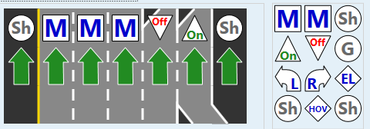
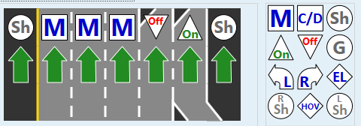
Enhancement
Current Behavior
  Lane Types, especially mainlines, use the same icon making it difficult to pick the right type of lane.
Proposed Change
  Change the lane types to have a unique icon or make the icons configurable.

Slide 7
QUESTIONS?

Slide 8
SG-5413: Executive Notification Email recipients populate on "CC" line rather than "To" line
Tucker Brown

Slide 9
Enhancement
Current Behavior
  All recipients are added to the CC list.
  Some users may have rules to move/trash these or ignore the email if on the CC list
Proposed Change
  Allow the users to select who appears on the To, CC, and BCC lines

Slide 10
QUESTIONS?

Slide 11
SG-5601: Addition of bike lanes to lane configuration options
Tucker Brown

Slide 12
Enhancement
Proposed Change
  Add bike lane to lane configuration options in order to provide a more accurate representation of arterial roadway lane mappings.
  As the arterial management coverage areas increase, districts are starting to see more of these types of lanes which might need to be configured.

Slide 13
QUESTIONS?

