Slide 1
SG-4524: Missing Roadway in Floodgate List
Mark Dunthorn

Slide 2
Floodgate File Updates
District opens Jira issue
Central Office coordinates request with FL-ATIS to get the database updated
Central Office coordinates with SwRI to get the Floodgate file updated and uploaded to the FTP site
When updates are complete, Central Office notifies districts

Slide 3
District Impact
No special coordination needed for additions
  File is read when operator logs into Operator Map
Modifications and deletions may require a synchronized rollout

Slide 4
QUESTIONS?

Slide 5
SG-4968: Wrong Way Detection Pop-Up Alerts
Tucker Brown

Slide 6
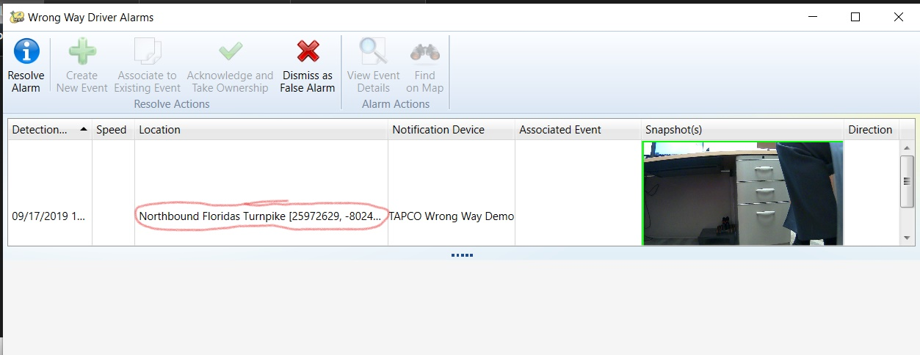
Current State
Location information shows Roadway, Direction and Lat/Lon

Slide 7
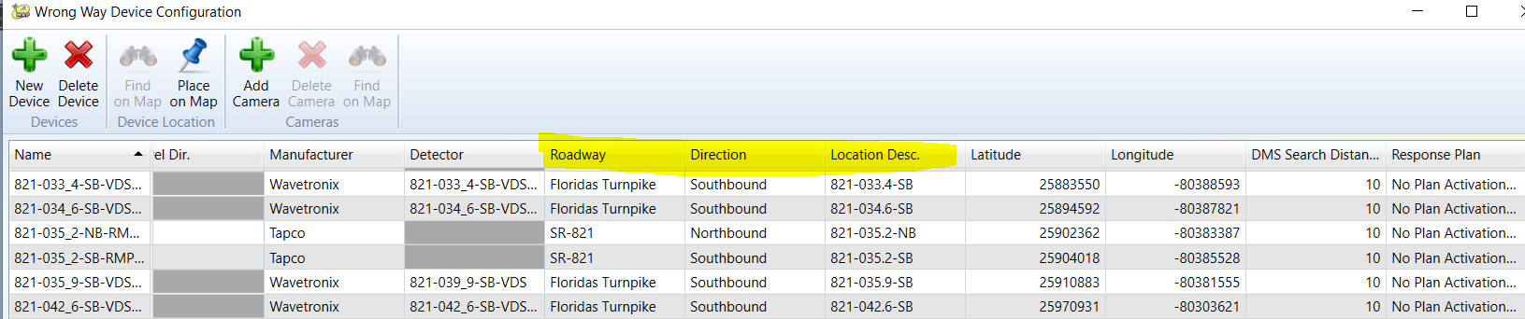
Enhancement
Remove Lat/Long and replace with Location Description.

Slide 8
QUESTIONS?
SUPPORT?

Slide 9
SG-4999: "Set Responder" option for alarms should be removed
Tucker Brown

Slide 10
Current State and Enhancement
Current State
  “Set Responder” is an option under FHP alerts, as well as other types
  Functionality is the same as “Associate to Event”
Enhancement
  Remove “Set Responder” as an option on all alerts.

Slide 11
QUESTIONS?
SUPPORT?

Slide 12
SG-5668: WWD Detection on Mainlines using MVDS
Tucker Brown

Slide 13
History
Mainline detection of WWD events using the directional bin has already been implemented as a test for D4.
  These are not currently hooked into the WWD module.
D4 has gathered the data and written a full ConOps for this effort.

Slide 14
Enhancement
Create an association between mainline MVDS that allows detection of consecutive detectors
Trigger WWD detection based on the directional bin of consecutive MVDS
  Configurable number of consecutive detectors
  Time constraints for consecutive detections
  Same alert functionality as ramp WWD detection
Allow association of mainline WWD detections to existing WWD events for tracking

Slide 15
Enhancement
Links on the map should flash when mainline detection is triggered.
  Consecutive detections should flash but suppress alerts.
Disable WWD detection on some mainline MVDS as needed (Construction, etc.).

Slide 16
QUESTIONS?
SUPPORT?

