Slide 1


SunGuide Software
Users Group Meeting
July 8, 2021

Slide 2
WELCOME
ATTENDEE ROLL CALL

Slide 3
Announcements
Christine Shafik
State TSM&O Software Engineer

Slide 4
Annual Database Request
Christine Shafik

Slide 5
Annual Database Request
Used for:
  Statewide reporting
  IV&V test systems
CO will send an email with the formal request:
  We need a full backup through the end of the day on 6/30/2021.
  Upload to TERL FTP server by COB 7/31/2021.

Slide 6
QUESTIONS?
COMMENTS?

Slide 7
Report Background Documentation
Christine Shafik

Slide 8
Report Background Info
  Central Office and SwRI are creating background documents for reports that do not currently have one.
  Current priority is based on district input and report frequency.
  All newly developed reports will come with background documents.

Slide 9
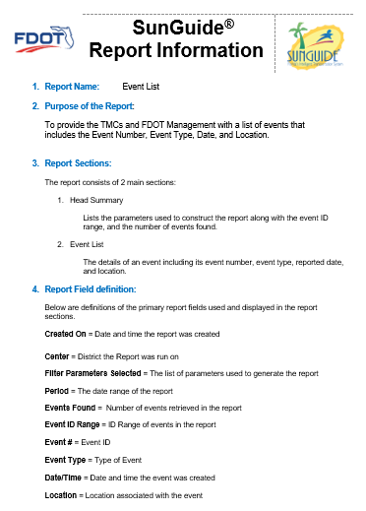
Current Priority
Event Chronology (Done)
Event List (Done)
Camera Usage Summary (Done)
Beat Coverage Summary (Done)
AVL Summary (In-progress)
Event Summary (In-progress)
Others pending district input
Notes:
Device Location Report & Detector List Report are scheduled For August.

Slide 10
QUESTIONS?
COMMENTS?

Slide 11
RTMC Operations Staff to Participate in
SunGuide 8.1 IV&V
Christine Shafik

Slide 12
Background
CO requests that a few Districts provide a representative to be on-site at the TERL for IV&V Testing for SG 8.1.
CO will coordinate with TSM&O Engineers and RTMC Managers on schedule and logistics for districts who would like to participate.
Notes:
In the past, RTMC Management Staff attended IV&V. Senior Operations Staff may have more flexible schedules, so districts are free to send whom they choose.

Slide 13
Purpose & Schedule
Purpose:
  Ensure that testing replicates as closely as possible real-world SunGuide usage.
  Provide information that will refine the development and application of test cases.
Schedule:
  SG 8.1 IV&V currently scheduled for the September/October timeframe.

Slide 14
QUESTIONS?
COMMENTS?

Slide 15
SG-5327: Integrate TrafficVision video analytic alerts into SunGuide
Mark Dunthorn

Slide 16
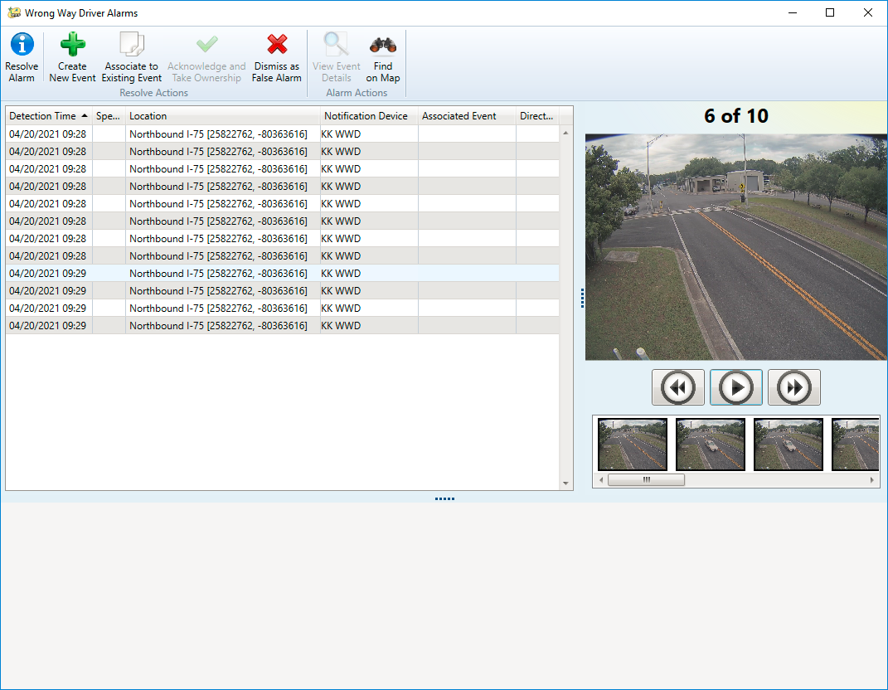
Current State
WWD detection devices on the APL send multiple images.
SunGuide displays this sequence of images in the WWD Alarms dialog.

Slide 17
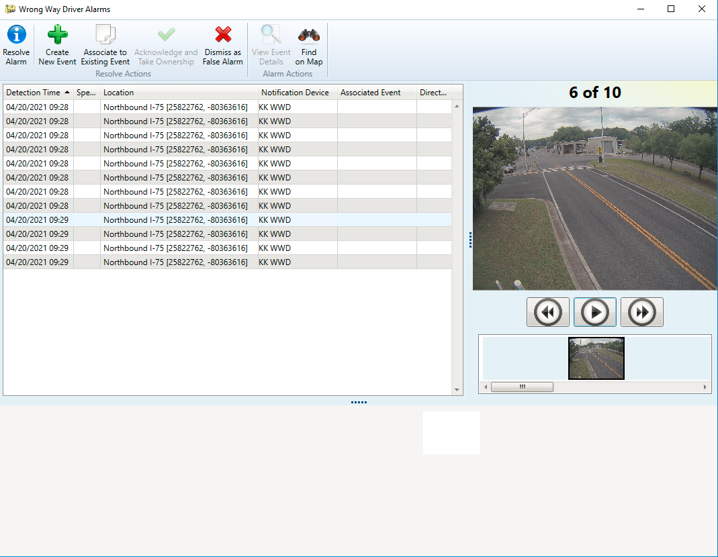
Enhancement
TrafficVision only provides a single image.
No changes to dialog are proposed.
Will a single image provide the detail needed to operationally handle the alert?
Targeted for release in SG 8.1.

Slide 18
Possible Future Enhancements
Other Alert Types:
  stopped_vehicle
  congestion
  slow_speeds
  pedestrian
  low_visibility

Slide 19
QUESTIONS?
COMMENTS?
SUPPORT?

Slide 20
SG-5895: Map tile updates
Mark Dunthorn

Slide 21
Current State and Enhancement
Current State
  ESRI delivers updates quarterly
  CO updates tiles on request (last update was SG 7.2)
Enhancement
  Would there be value in a new tile set being generated on a more regular basis?
  Would annual updates be acceptable?

Slide 22
QUESTIONS?
COMMENTS?
SUPPORT?

Slide 23
SG-5808: Event Attribute for approval
Mark Dunthorn

Slide 24
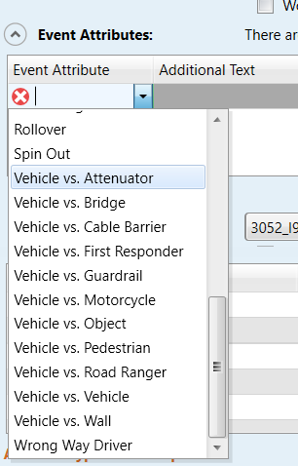
Current State and Enhancement
Proposed new attribute:
Vehicle vs. Toll Gantry
Usage:
Used when a vehicle strikes a toll gantry.

Slide 25
SOG Updates
Updates to the SOGs to clarify usage of each attribute are in-progress.
This effort will help ensure consistent usage across districts and facilitate statewide reporting.

Slide 26
QUESTIONS?
COMMENTS?
SUPPORT?

Slide 27
SG-4887: TIM Report
Mark Dunthorn

Slide 28
Status Update
At the December 2020 SSUG, the districts requested a way to automate delivery of this data.
A report template has been prepared and was designed to be configured to run automatically in SAS and deliver the report via email to an FDOT address.

Slide 29
Next Steps
We’ll need the districts to run the report manually one or more times in order to catch up.
First automatic run will be July 31, which will send the June data to the CO.
We’ll send an email after the meeting with details.

Slide 30
QUESTIONS?
COMMENTS?

Slide 31
QUESTIONS?
COMMENTS?
DISTRICT ANNOUNCEMENTS?
ADJOURN

