Slide 1


SunGuide Software
Users Group Meeting
August 5, 2021

Slide 2
WELCOME
ATTENDEE ROLL CALL

Slide 3
SG-4941: Emails for Device
Issues
Tucker Brown

Slide 4
Enhancement
  Allow the system to detect large system outages.
  Allow user to define device groups (of any device type) and assign that device group to a specific email group.
  Allow the user to define a percentage threshold for number of device entering a Error or Failed state.
      Add a potential for adding an alarm for this condition.
  Can turn this part on/off dynamically.

Slide 5
QUESTIONS?
SUPPORT?

Slide 6
SG-5810: Copy a SAS Plan
Tucker Brown

Slide 7
Enhancement
  Allow a user to make a copy of a SAS Plan Item.
      Name would change for uniqueness, but the devices or type would remain the same with the same configuration.
  Allow a user to make a copy of a SAS schedule
      Schedule name and names of the scheduled items would change for uniqueness.

Slide 8
QUESTIONS?
SUPPORT?

Slide 9
SG-5592: Data Archive is Not Correctly Rolling Up Bin Data
Tucker Brown

Slide 10
Current State and Enhancement
  Current State
  Data Archive takes an average of the bin data over the rollup period and stores the data in the database
  Enhancement
  For this data type, calculating a total number of vehicles for the bin during the rollup period would make more sense and presumably be more useful.
  Need to confirm no one is using this data currently and that this change would not impact other users.

Slide 11
QUESTIONS?
SUPPORT?

Slide 12
D3 8.0 DMS Issue
Tucker Brown

Slide 13
D3’s Ledstar DMS Issues
  During the switchover from 7.2 to 8.0, almost all of the Ledstar DMS went into a bad state where the system could no longer send messages to the device
  Device could be polled
  Device would respond to an auto-configure request
  Failed to transition to a modifying state as part of posting a message
    Message was never sent as the state transition is the 1st thing done
  Confirmed both in SunGuide and an external tool

Slide 14
D3’s Ledstar DMS Issues
  Signs were physically reset in the field and D3 was then able to post messages.
  Did anyone else experience anything like this?

Slide 15
QUESTIONS?
SUPPORT?

Slide 16
Failure Reporting of Issues
Tucker Brown

Slide 17
SunGuide Failure Reporting Process
  Some districts are making phone calls directly to SwRI staff when a failure occurs.
  CO requests that RTMC personnel call the support line first at 210-522-6883.
  This triggers emails and text to multiple staff members which may be able to help
  Calling a single SwRI staff member does not guarantee a response and may delay troubleshooting efforts.
  Applies to Critical Failure, Failure, and External Failure issues

Slide 18
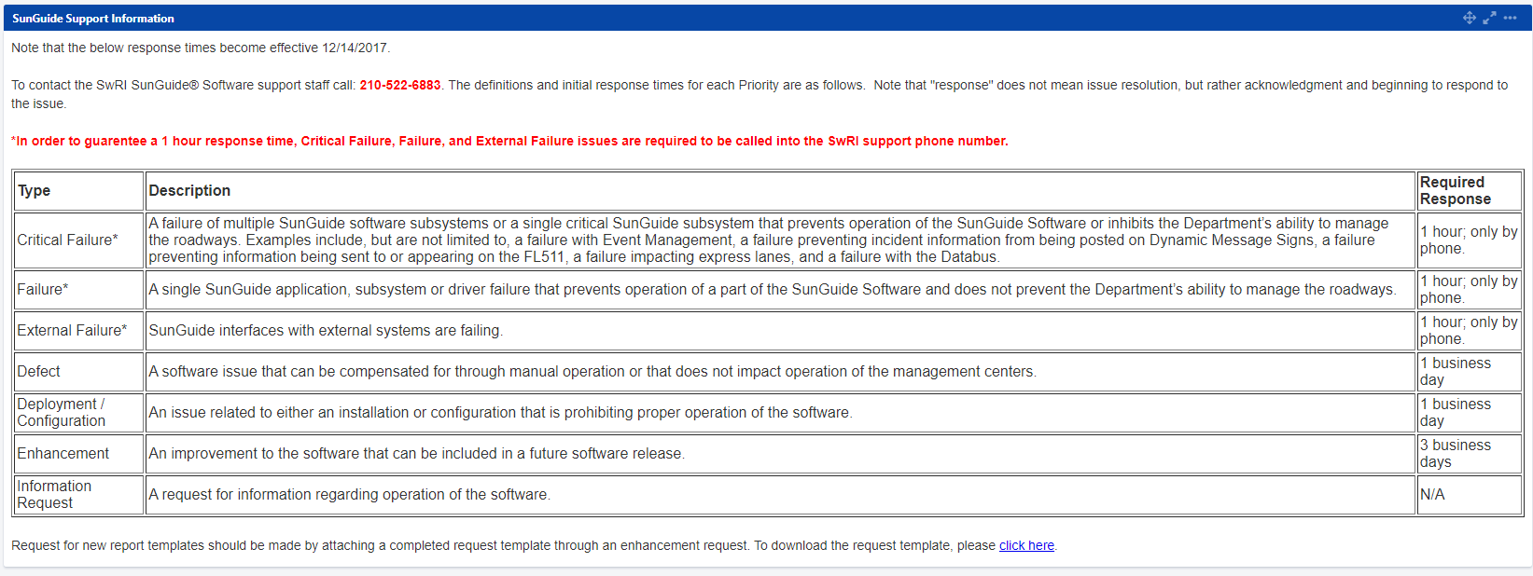
SunGuide Failure Reporting Process

Slide 19
QUESTIONS?
COMMENTS?
ADJOURN.

