Slide 1


SunGuide Software
Users Group Meeting
September 16, 2021

Slide 2
a.k.a. “The Big F.A.T. SSUG” Questions from SunGuide 8.1
Factory Acceptance Testing
September 16, 2021

Slide 3
WELCOME
ATTENDEE ROLL CALL

Slide 4
Overview of
SunGuide 8.1
Factory Acceptance Testing
Carla Holmes, P.E., PTOE

Slide 5
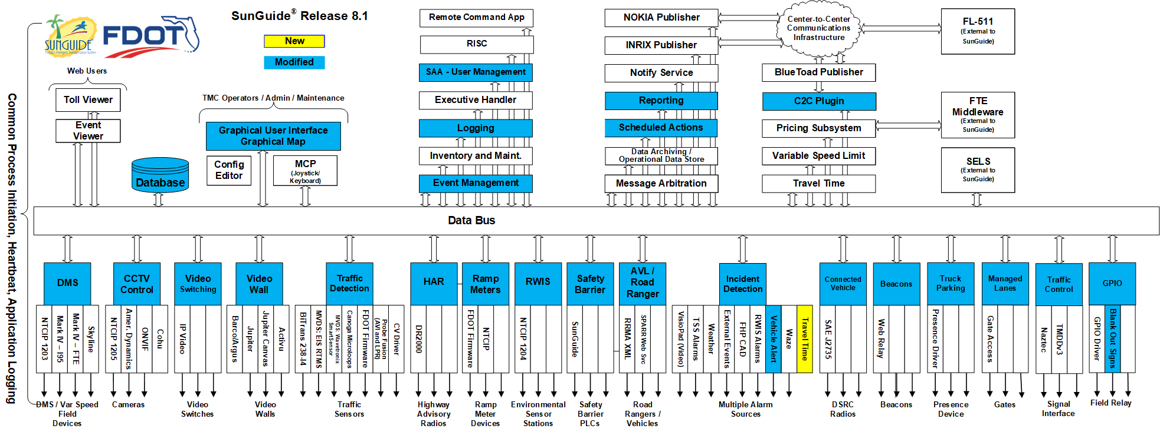
SunGuide Release 8.1

Slide 6
SunGuide Release 8.1 FAT
  FAT was conducted 8/30/21 – 9/2/21.
  FDOT CO’s SunGuide Support Team participated onsite at SwRI’s facilities in San Antonio, TX, and remotely.
  Operational questions were raised during FAT on a few enhancements, and we’d like to get input from SSUG Members.

Slide 7
SunGuide Release 8.1 FAT
SG-3335 - Alert the operator when a travel time is double (or some other ratio) the free flow travel time
SG-2510 - Indicate removed items in Current Response Plan list prior to plan activation
SG-4209 - Use polyline instead of a single point for road closures
SG-4985 - Ability to configure response plan search radius by event type
SG-3143 - Status Logger Filters
SG-2364 - Log username of user that changes device status
SG-564 - Remove List Options without Deleting
SG-5065 - Add support for authentication via Active Directory
SG-4781 - Request update of integrated VLC libraries
SG-3338 - Allow floodgates to be scheduled through SAS
SG-3925 - Add assigned Beat to Road Ranger information in Event Reports

Slide 8
SunGuide Release 8.1 FAT
SG-2493 - Icon enhancement for Arterial DMS
SG-5278 - Blank Out Signs Integration
SG-5236 - We would like a TPAS enhancement that would alarm when a space has been occupied For an extended time.
SG-5327 - Integrate TrafficVision video analytic alerts into SunGuide
SG-5303 - MH Corbin WWD Integration
In addition to SunGuide 8.1 enhancements, the following SunGuide 8.0 Hotfix issues were retested:
SG-3488 - DMS priority in Response Plan changes all DMS sign messages
SG-3800 - Reporting of more accurate locations
SG-4936 - Add Roadway Filter to Monthly Performance Measures Report.

Slide 9
SunGuide Release 8.1 IV&V
  FAT was completed successfully, and we are preparing for Independent Verification & Validation (IV&V) Testing.
  We are setting up systems and conducting dry-runs in preparation for IV&V.
  We are coordinating with districts who will be sending representatives to observe IV&V.

Slide 10
QUESTIONS?
COMMENTS?

Slide 11
SG-3335: Alert the operator when a travel time is double (or some other ratio) the free flow travel time
Carla Holmes / Tucker Brown

Slide 12
Enhancement
  SunGuide will generate an alert when travel times rise above a configurable threshold based on historical data.
  Historical data is based on average travel times for that hour from a configurable number of days of data for that TVT link.

Slide 13
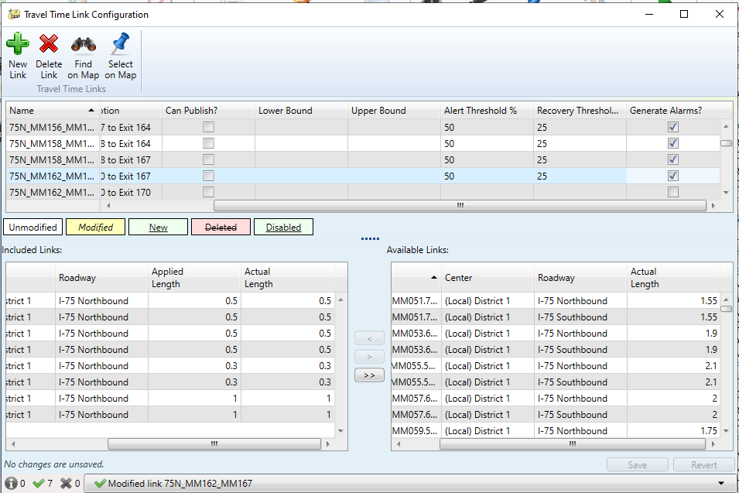
Enhancement

Slide 14
Questions for SSUG
  Should the alert and recovery thresholds be configurable for different days of the week?
  Specific days?
  Weekends versus weekdays?
  Enhancement was developed using median speeds. The median of each lane is found, then the lanes are averaged together to generate travel times. Are there any reports or other systems this methodology may conflict with?
  Are there any operational considerations when using this methodology?

Slide 15
QUESTIONS?
COMMENTS?

Slide 16
SG-5278: Blank Out Signs Integration
Carla Holmes / Tucker Brown

Slide 17
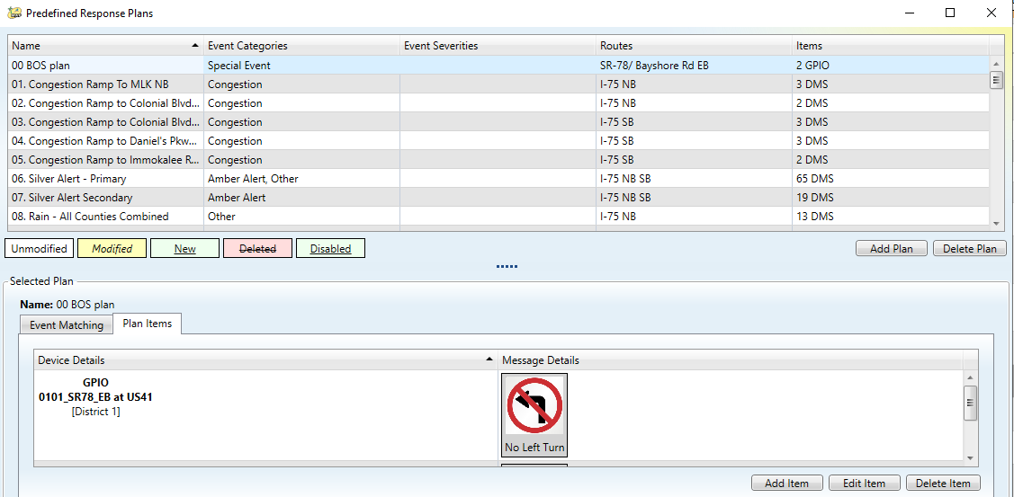
Enhancement
  This enhancement will add BOS Response Plans to SunGuide.

Slide 18
Questions for SSUG
  We are coordinating with the FLATIS Support Team, but also wanted to get SSUG input and operational perspective on the following questions:
  Should Blank Out Sign messages be reported on FL-511?
  If so, how do you recommend they be displayed?
  What operational scenarios do you foresee where FL-511 reporting would be beneficial?
  The “featureStatus” property (Dark, Right-turn only, etc.) is configurable as free text. Is this something we want to standardize?

Slide 19
QUESTIONS?
COMMENTS?

Slide 20
SG-4209: Use polyline instead of a single point for road closures
Carla Holmes / Tucker Brown

Slide 21
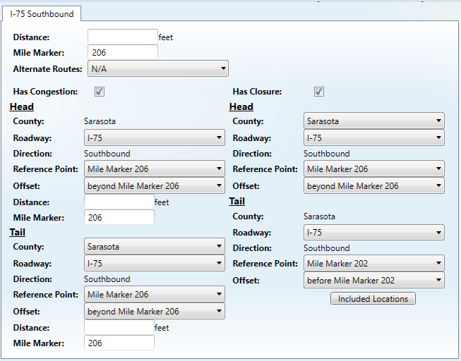
Enhancement
  SunGuide will allow tracking and reporting of closures with multiple locations included.

Slide 22
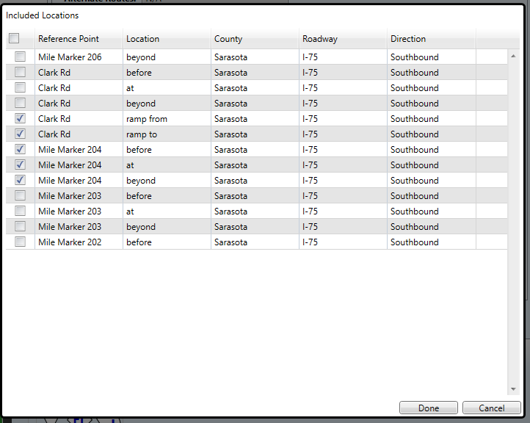
Enhancement

Slide 23
Questions for SSUG

Slide 24
Questions for SSUG
  Could there be issues with having the Distance and Mile Marker fields in the Event Location and Has Congestion dialogs, but not in the Has Closure dialog?
  Is the Distance field in the Has Congestion dialog ever used by Operators? For what scenarios is it, or could it be, used?
  If not, could it be removed from the Has Congestion dialog?
  Should this field also be included in the Has Closure dialog?

Slide 25
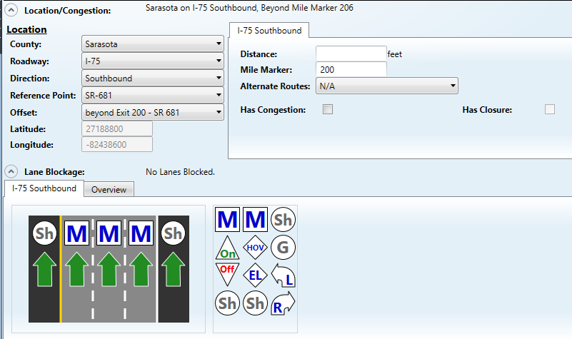
Questions for SSUG

Slide 26
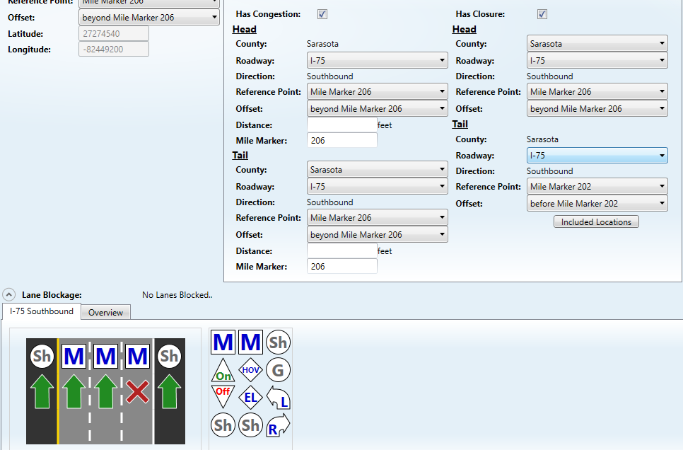
Questions for SSUG

Slide 27
Questions for SSUG
  The Has Closure checkbox will only be clickable to open the Has Closure dialog if there is a lane blockage entered.
  Lane blockage does not have to show all travel lanes blocked, but unless at least one travel lane is shown as being blocked, the Has Closure checkbox will be grayed out.
  If a specific lane is not blocked, one will have to be checked “artificially” to allow the Has Closure dialog to be opened.

Slide 28
Questions for SSUG
  Since a closure is indicated, should all lanes be shown as blocked?
  Should the lane blockage requirement be eliminated?
  Are there operational reasons for an event to have a closure without any specific lanes being blocked, such as:
  Planned Special Event?
  Presidential Motorcade?
  Police Activity?
  Others?

Slide 29
QUESTIONS?
COMMENTS?

Slide 30
SG-3800: Reporting of more accurate locations
Carla Holmes / Tucker Brown

Slide 31
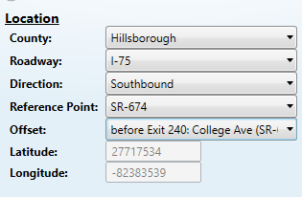
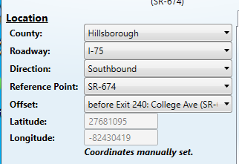
Enhancement
  This enhancement will allow a more accurate event location to be set manually by an Operator or Road Ranger.

Slide 32
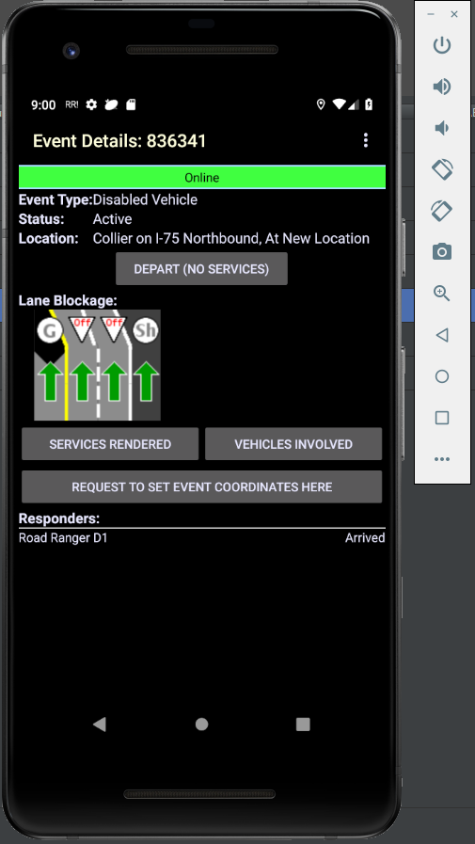
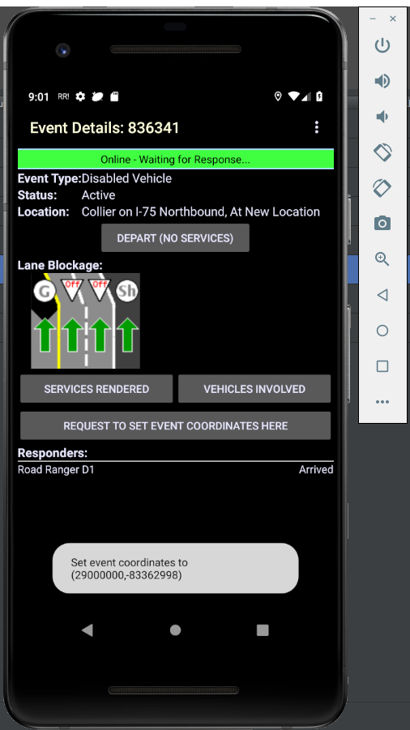
Enhancement
  This enhancement will allow a more accurate event location to be set from the SPARR app.

Slide 33
Questions for SSUG
  Is there an operational need for an indication on the SPARR app if the request to set event coordinates by a Road Ranger is approved or denied by the TMC?
  Is there an operational need for an indication if a manual location was set by the TMC or by a Road Ranger?
  Is there an operational need to add the time an event location was manually set to the event chronology?

Slide 34
QUESTIONS?
COMMENTS?

Slide 35
Announcements

Slide 36
Announcements
  Karthik Devarakonda is no longer with the SunGuide Support Team. Please contact Mark Dunthorn for assistance.
  SunGuide 8.0 Hotfix 5 was released on August 20th.
  Several districts have already deployed.
  For those who have not, please email Christine Shafik to advise her of your deployment plans.
  As always, please let us know how we can support you before, during, or after deployment of this Hotfix.

Slide 37
QUESTIONS?
COMMENTS?
ADJOURN.

