Slide 1


SunGuide Software
Users Group Meeting
February 10, 2022

Slide 2
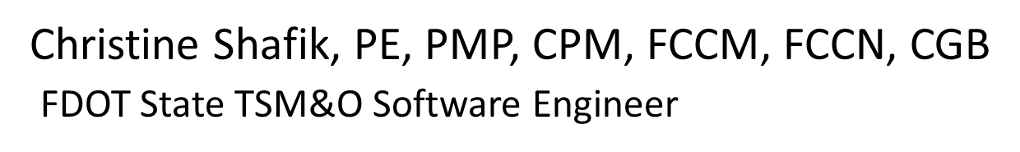
WELCOME
ATTENDEE ROLL CALL

Slide 3
SunGuide 8.1 Hotfix 2
Design Review
Tucker Brown

Slide 4
SG-5585 - CV Connected Vehicle App SunGuide Support
Request (I-4 FRAME)
Tucker Brown

Slide 5
Enhancement
Add a Message Library to the TAM dialog.
  Similar to the DMS Message Library.
Add a field to describe the associated CV application (Classification) of the message to store in the database.
  Available options will be stored and read at the database level.
  No configuration dialog for these classifications, but could be added at the database level, if needed.

Slide 6
Enhancement
TAM classifications for CV Applications may include:
    “Traffic Incident Management"
    “Dynamic Roadway Warning”
    “Speed Warning and Enforcement”.
    Wrong Way Vehicle Detection and Alert”
    “Dynamic Route Guidance”
    “Weather Motorist Alert and Warning”
    “Back-of-Queue Warning”
    “Reduced Speed Warning/Lane Closure”
    “Work Zone Management”.
    “Incident Scene Safety Monitoring”
    “Advanced Railroad Crossing”.
    “Speed Harmonization”
    “Static In-Vehicle Signage”
    “End of Ramp Warning”

Slide 7
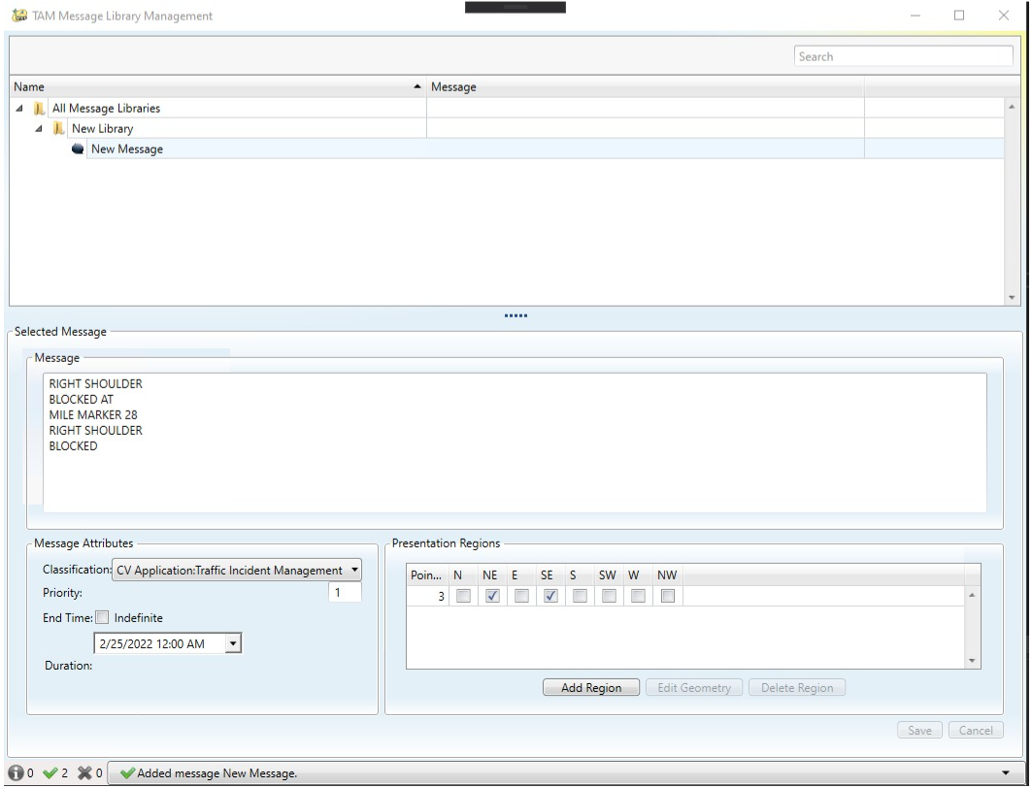
Enhancement – Message Library – Add/Modify/Delete

Slide 8
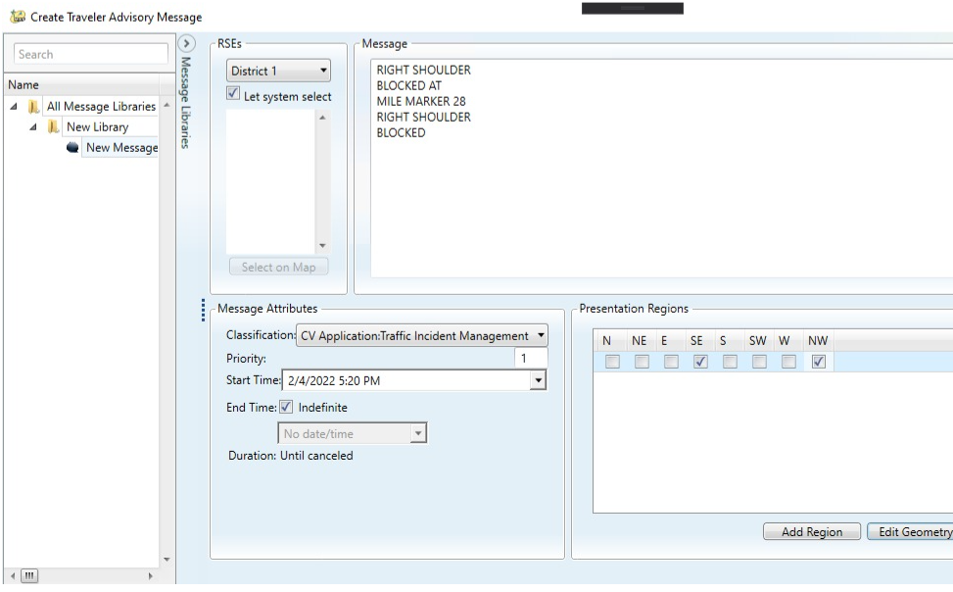
Enhancement – TAM Dialog

Slide 9
QUESTIONS?
COMMENTS?
SUPPORT?

Slide 10
SG-5994 - Update J2735Driver from "polygon(oldRegion)" to circle or lane.
Tucker Brown

Slide 11
Enhancement
Change the Presentation Region of a TAM to be either a circle with a defined radius, or a line segment with a defined width.

Slide 12
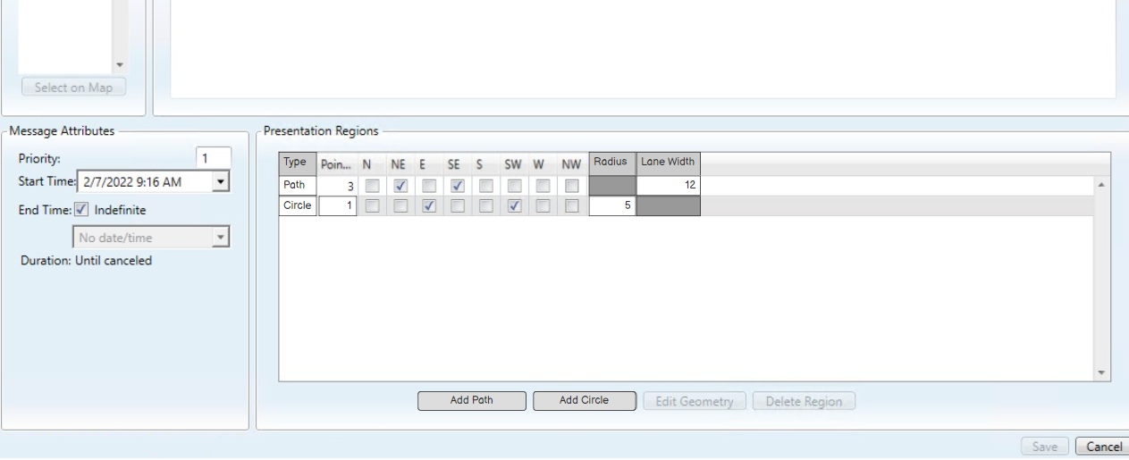
Enhancement – Regions

Slide 13
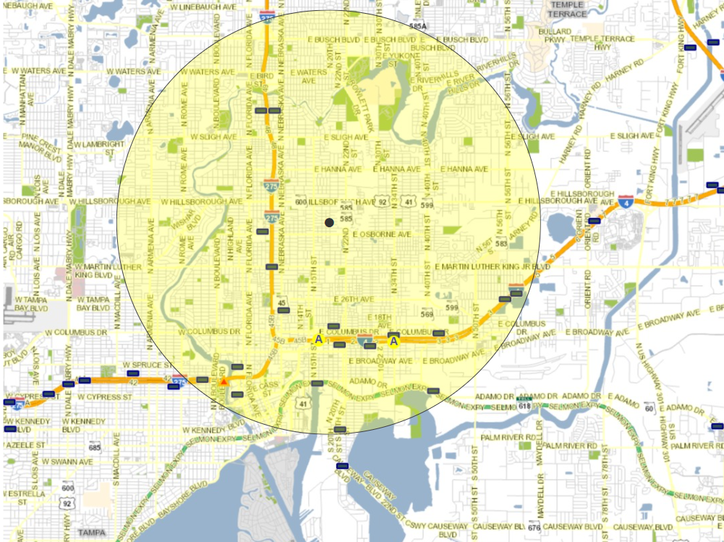
Enhancement – Circle Region

Slide 14
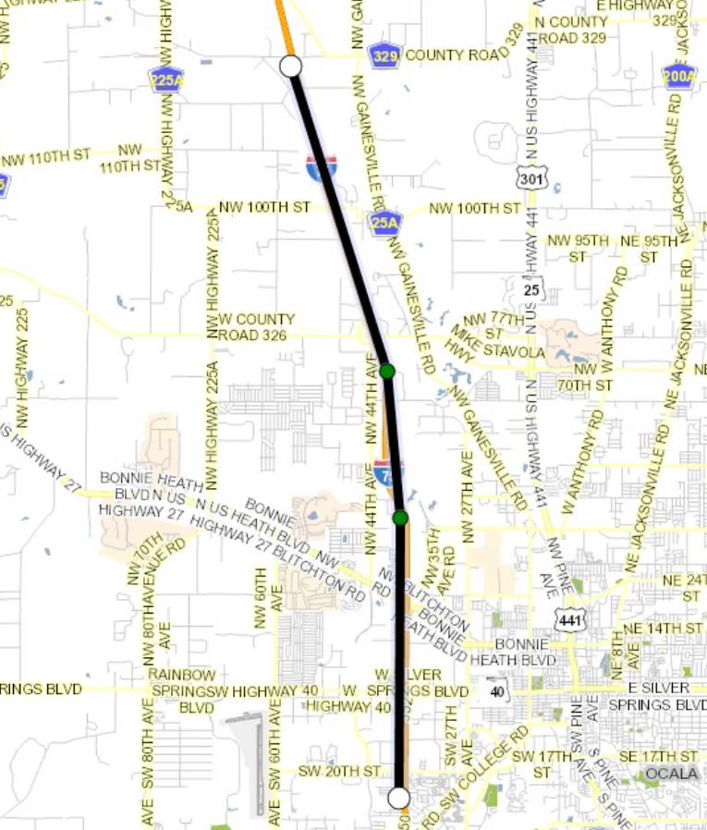
Enhancement – Path Region

Slide 15
QUESTIONS?
COMMENTS?
SUPPORT?

Slide 16
SG-6078 – Add Last Login Timestamp to User
Management Window
Tucker Brown

Slide 17
Current Behavior and Enhancement
Current Behavior
  Users can be added but specific login information is not noted.
Enhancement
  Track and display a “Last Login Time” per user in the User Configuration dialog, to assist in determining which users might need to be removed.
  Alternate Option:
    Use Crystal Reports to be able to run and show the Last Login Time.

Slide 18
QUESTIONS?
COMMENTS?
SUPPORT?

Slide 19
SG-5981 – Add “# of Items” column to SAS Schedule Table
Tucker Brown

Slide 20
Current Behavior and Enhancement
Current Behavior
  SAS was updated to deprecate and remove old schedule items, but SAS schedules remain even after the items have been archived.
Enhancement
  Add a column to the list of schedules that indicates the number of schedule items within the schedule.
  Will assist in knowing when certain schedules are no longer needed.

Slide 21
Announcements

Slide 22
Announcements
  New Map Tiles
  Updated map tiles, based on the 4th quarter 2021 shape files, are available on the Statewide Share.
  There’s a README file with installation instructions included.
Call for SunGuide Databases
  Please upload a copy of your SunGuide database and configuration files to either the TERL FTP or the SwRI FTP.
  Include information up to February 1, 2022.
  Please provide the files by COB Monday, February 28th.

Slide 23
QUESTIONS?
COMMENTS?
SUPPORT?

Slide 24
OTHER ANNOUNCEMENTS?
QUESTIONS?
COMMENTS?
ADJOURN.

