Slide 1


SunGuide Software
Users Group Meeting
February 24, 2022

Slide 2
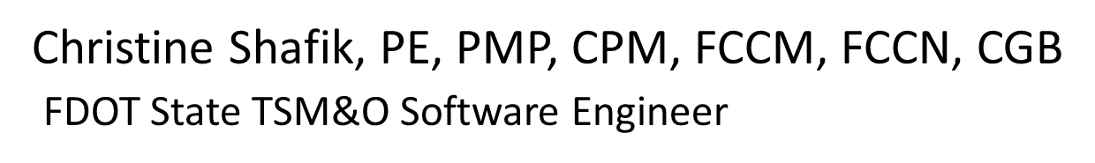
WELCOME
ATTENDEE ROLL CALL

Slide 3
SG-6189 – TPS - Send
Corrected Availability
Tucker Brown

Slide 4
Current Behavior and Enhancement
Current Behavior
  TPS area “Corrected Availability” is available on all areas.
  User who modified the count is not logged.
Enhancement
  Allow the administrator to select a flag on each area to allow sending Corrected Availability.
  Archive the username of the user who changes Corrected Availability.

Slide 5
QUESTIONS?
COMMENTS?
SUPPORT?

Slide 6
SG-5682 – Wrong Way Driver response plan's location
Tucker Brown

Slide 7
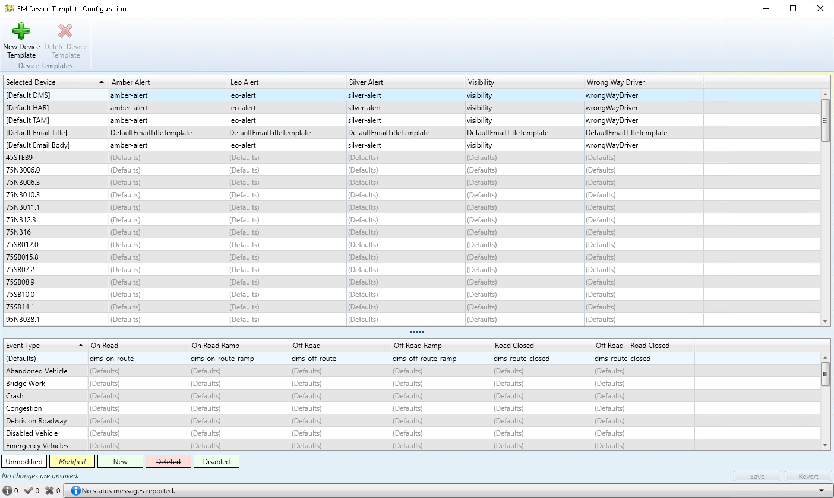
Current Behavior
WWD events are treated as an area event for emails in response plans, with no specific location.

Slide 8
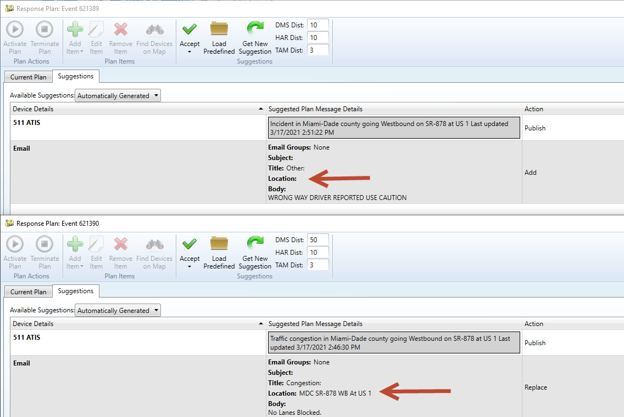
Enhancement
  Move WWD to the location-specific event types.
  Location will be added to the response plan email.

Slide 9
QUESTIONS?
COMMENTS?
SUPPORT?

Slide 10
SG-6193 – Enhance the Contact section in SunGuide
Tucker Brown

Slide 11
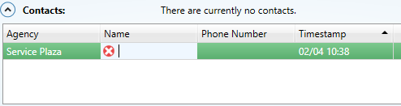
Current Behavior and Enhancement
Current Behavior
  Contacts in the Event Details dialog allow selection of an agency, but not a specific contact.
Enhancement
  Allow selection of a stored contact.
  Continue to allow manually typed contacts.
  Would be the same as the Responders grid.

Slide 12
QUESTIONS?
COMMENTS?
SUPPORT?

Slide 13
SG-6201 – Add EM audit events to DAR XML feed
Tucker Brown

Slide 14
Current Behavior and Enhancement
Current Behavior
  Event updates are sent through the DAR interface to RITIS and other 3rd parties.
  Once the event is closed and no longer in cache, changes (audits) are not sent through the DAR interface.
Enhancement
  Add a subscription to the system to receive updates based on event audits.
  Would NOT go out to everyone, only users that need it.
    Map would not get these, as it would not be needed.

Slide 15
QUESTIONS?
COMMENTS?
SUPPORT?

Slide 16
ANNOUNCEMENTS?
QUESTIONS?
COMMENTS?
ADJOURN.

