Slide 1


SunGuide 8.1 Hotfix 3
Design Review
SunGuide Software Users Group | 3/24/22

Slide 2
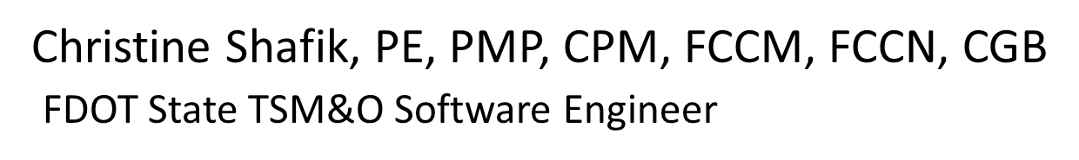
WELCOME
ATTENDEE ROLL CALL

Slide 3
SG-5865 - Improve EM DMS suggestions if message does not fit
Tucker Brown
SunGuide Software Users Group | 3/24/22

Slide 4
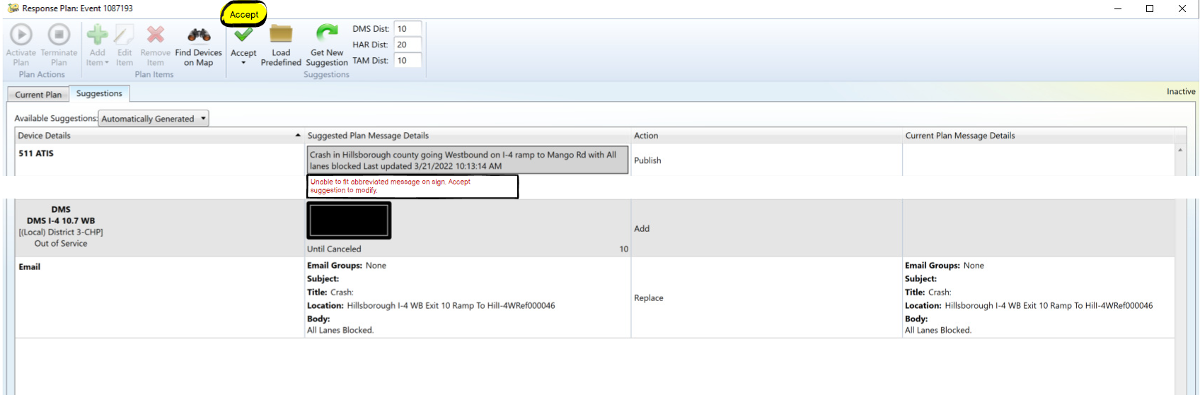
Message Does Not Fit
  User will be notified the sign doesn’t fit in the Suggestion tab.
SunGuide Software Users Group | 3/24/22

Slide 5
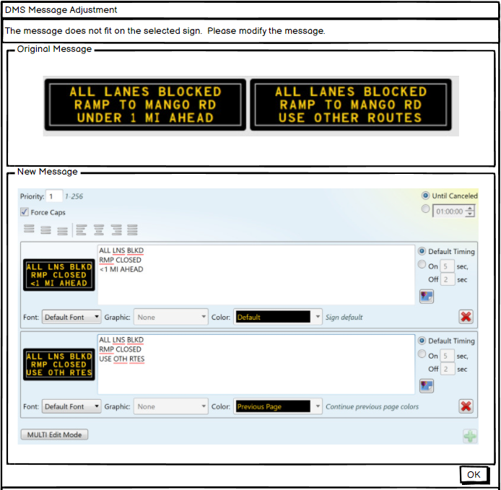
Change Message
  User will correct the message before moving to the Current tab.
  Adding a sign to the Current Plan will generate the same dialog if the message doesn’t fit.
  Should this be the Abbreviated message? Or the full message without abbreviations?
SunGuide Software Users Group | 3/24/22

Slide 6
COMMENTS?
QUESTIONS?
SunGuide Software Users Group | 3/24/22

Slide 7
SG-6039 - Temporary "Allowed Word" option for authorized users
Tucker Brown
SunGuide Software Users Group | 3/24/22

Slide 8
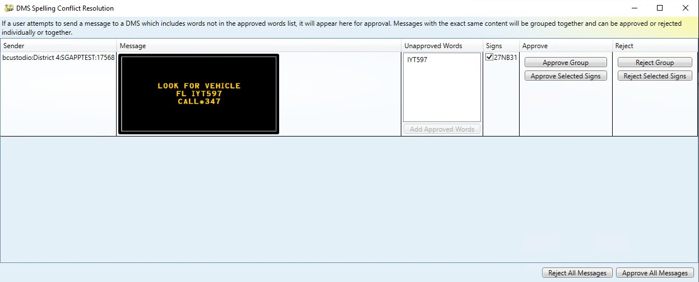
Approve Message
  Option 1: Replace the existing option that approves it for the one instance.
    Dialog would look no different than existing dialog.
SunGuide Software Users Group | 3/24/22

Slide 9
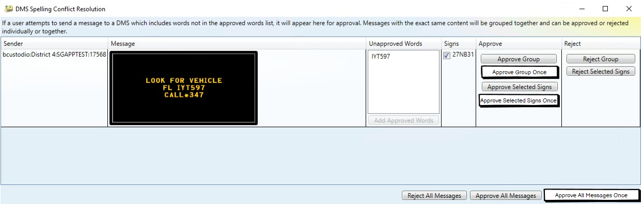
Approve Message
  Option 2: There would be options to approve it one time, or for the lifetime of the message.
    New buttons would be added for approving the word one time.
SunGuide Software Users Group | 3/24/22

Slide 10
COMMENTS?
QUESTIONS?
SunGuide Software Users Group | 3/24/22

Slide 11
SG-4968 - Wrong Way Detection Pop-Up Alerts
Tucker Brown
SunGuide Software Users Group | 3/24/22

Slide 12
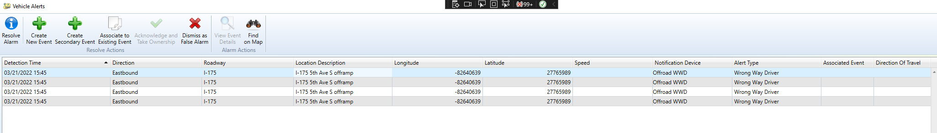
Vehicle Alert Dialog
  Break apart Roadway, Direction, Latitude, Longitude; and add a Location Description column.
  “Direction” was renamed to “Direction of Travel”.
SunGuide Software Users Group | 3/24/22

Slide 13
COMMENTS?
QUESTIONS?
SunGuide Software Users Group | 3/24/22

Slide 14
SG-5811 - Search Historical Reports by FHP CAD & Case#
Tucker Brown
SunGuide Software Users Group | 3/24/22

Slide 15
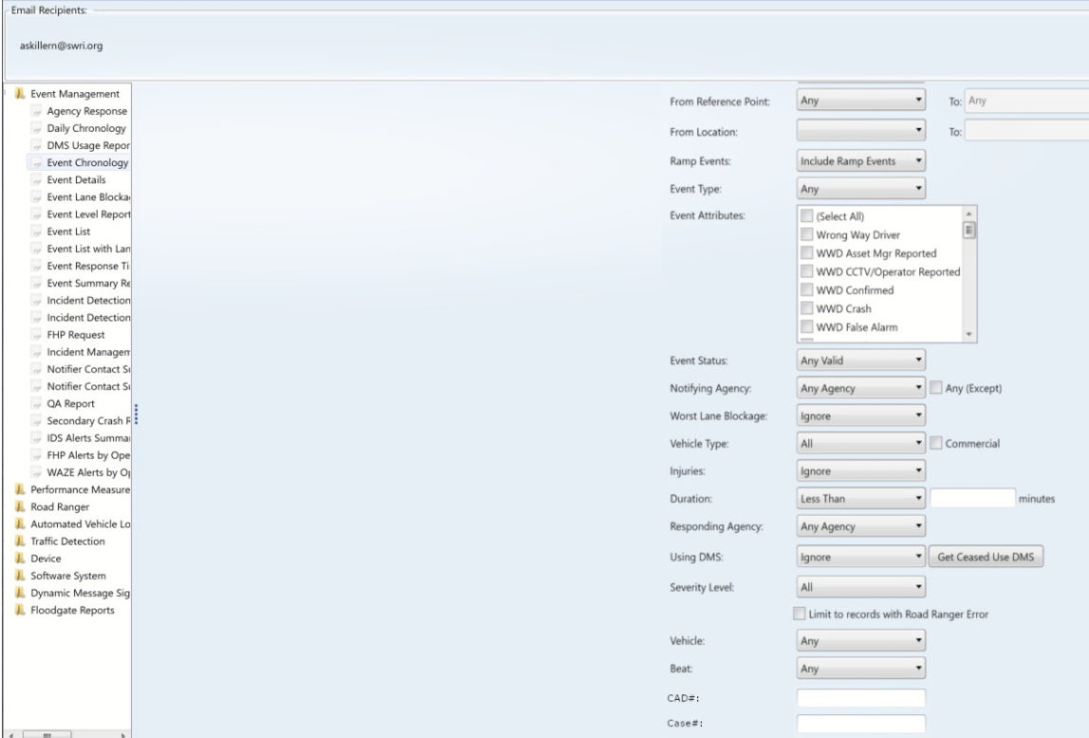
Report Filtering
  New report filters added.
SunGuide Software Users Group | 3/24/22

Slide 16
COMMENTS?
QUESTIONS?
SunGuide Software Users Group | 3/24/22

Slide 17
SG-5782 - RISC Module Enhancements
Tucker Brown
SunGuide Software Users Group | 3/24/22

Slide 18
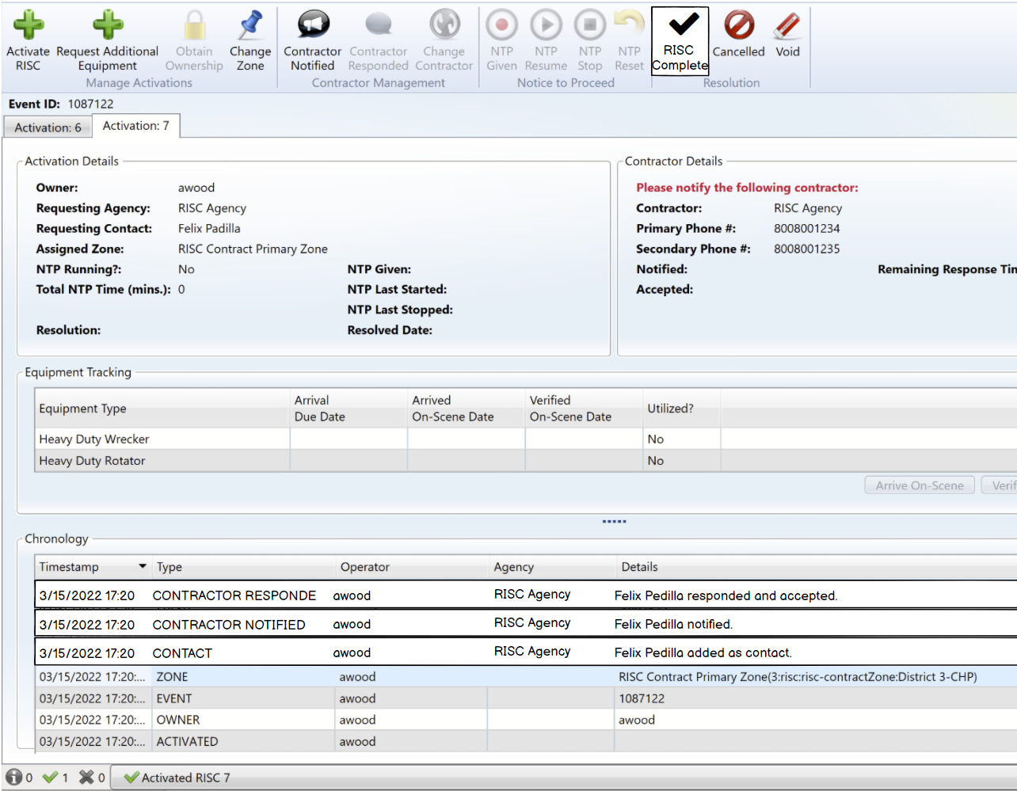
  Contractor and comments in the Chronology.
  Button renamed to “RISC Complete”.
SunGuide Software Users Group | 3/24/22

Slide 19
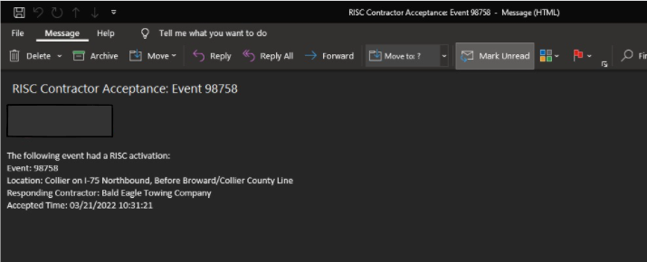
RISC Email
  Email will be sent on RISC “Activation”.
  When should the email be sent?
    Current requirements will send when the contractor accepts the RISC.
  Should any other information be included?
SunGuide Software Users Group | 3/24/22

Slide 20
COMMENTS?
QUESTIONS?
SunGuide Software Users Group | 3/24/22

Slide 21
SG-5561 - Give permitted users the ability to assign an active event to a user
Tucker Brown
SunGuide Software Users Group | 3/24/22

Slide 22
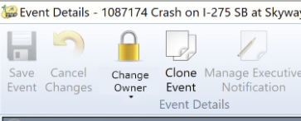
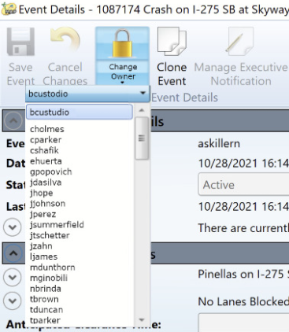
Event Details Dialog
  Button will be renamed to Change Owner.
  Top half of the button will still be a lock icon (user does not have ownership) and an unlock icon (user has ownership).
  If the user has permission to assign a user, the drop down will be available and they can select the user to assign.
  User must be a currently logged in user to the system.
SunGuide Software Users Group | 3/24/22

Slide 23
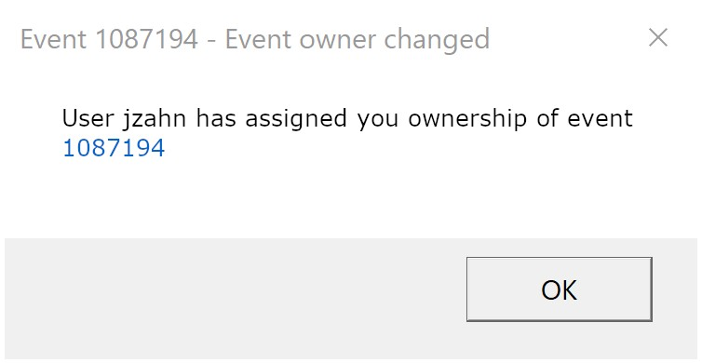
Event Details Dialog
  User assigned to the event would receive a popup to alert of the change in event ownership.
SunGuide Software Users Group | 3/24/22

Slide 24
COMMENTS?
QUESTIONS?
SunGuide Software Users Group | 3/24/22

Slide 25
SG-5215 - SAS Missing Merge with Travel Time Option
Tucker Brown
SunGuide Software Users Group | 3/24/22

Slide 26
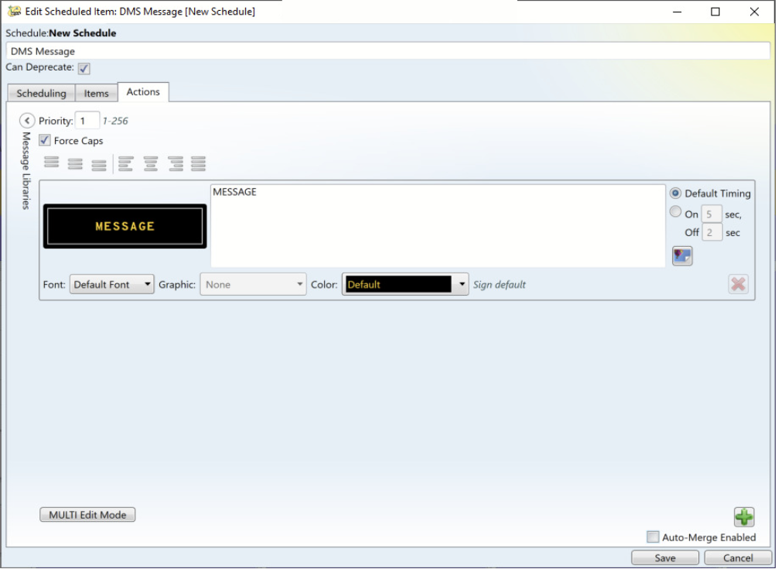
SAS DMS Dialog
  Auto-Merge now available in SAS plans.
SunGuide Software Users Group | 3/24/22

Slide 27
COMMENTS?
QUESTIONS?
SunGuide Software Users Group | 3/24/22

Slide 28
Other Enhancements
Tucker Brown
SunGuide Software Users Group | 3/24/22

Slide 29
Other Enhancements
  SG-6072 - Vehicle Alert dialog does not pop up when minimized
    Vehicle Alert dialog will always take focus when a new alert is generated, even if the dialog is minimized or open behind other dialogs.
  SG-5282 - Change "Terminate Schedule" in SAS to also remove DMS from device queue.
    When a schedule or scheduled item is disabled, the final action for the active scheduled items will be performed.
      For DMS, remove the message.
  SG-6037 - Make SunGuide usernames case insensitive
    All usernames will be made case insensitive.
  SG-4760 - Not Auto-Merging Scheduled Messages
    Auto Merge will find the next message on the queue that is allowed to be merged (as opposed to only checking the next message).
SunGuide Software Users Group | 3/24/22

Slide 30
COMMENTS?
QUESTIONS?
SunGuide Software Users Group | 3/24/22

Slide 31
ANNOUNCEMENTS?
QUESTIONS?
COMMENTS?
ADJOURN.

