Slide 1


SunGuide Software
Users Group Meeting
(a.k.a. The Big FAT
& IV&V SSUG)
January 25, 2024

Slide 2
WELCOME
ATTENDEE ROLL CALL
Christine Shafik, PE, PMP®, CPM, FCCM, FCCN, CGB
State Connected Mobility & Technologies Engineer

Slide 3
Please Note
Changes in the enhancements as developed may incur a cost and impact the proposed SunGuide 9.0 release schedule.
Please carefully consider the needs and priorities of your district when providing feedback and indicating support.
Major changes and/or lower priority, ”nice-to-have” enhancements may need to be pushed to future releases.

Slide 4
FAT Question:
SG-5668 WWD Detection on Mainlines using MVDS
Tucker Brown

Slide 5
FAT Behavior
The software uses the TSS roadway geometry to identify consecutive WWD TSS detectors reporting wrong way vehicles on the same roadway and geometry.
If a WWD TSS detector is in maintenance mode, the device is not counted in the consecutive detectors needed to create a vehicle alert.

Slide 6
FAT Question
Should SunGuide handle ‘Out of Service’ detectors in the same way as detectors in maintenance mode?
Should SunGuide handle ‘Error’ detectors in the same way as detectors in maintenance mode?
Should SunGuide handle ‘Failed’ detectors in the same way as detectors in maintenance mode?

Slide 7
QUESTIONS?
COMMENTS?
SUPPORT?

Slide 8
FAT Question:
SG-1053 Add filter in reports for "Comment Type" and SG-4784 Keyword search for Reports
Tucker Brown

Slide 9
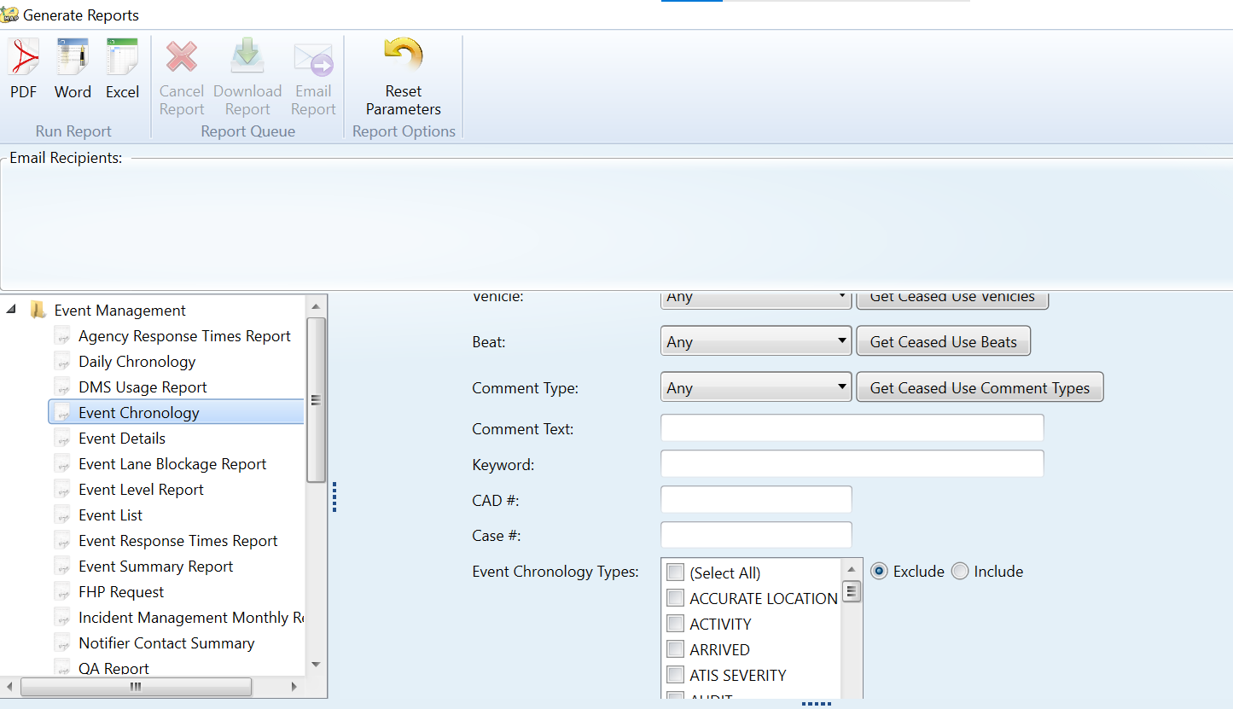
Comment Type / Text and Keyword Filters

Slide 10
FAT Question
Are there other fields in the Event Chronology Report that should be searchable?
Some of the fields discussed during testing include:
  Nearest CCTV Camera ID
  Weather Conditions (Already been addressed with SG-4678 - Weather Conditions Filter for Reporting. Should this enhancement be prioritized?)
Should all fields in the Event Chronology Report be searchable?

Slide 11
QUESTIONS?
COMMENTS?
SUPPORT?

Slide 12
FAT Question:
SG-6556 - Generic
Alert Interface
Tucker Brown

Slide 13
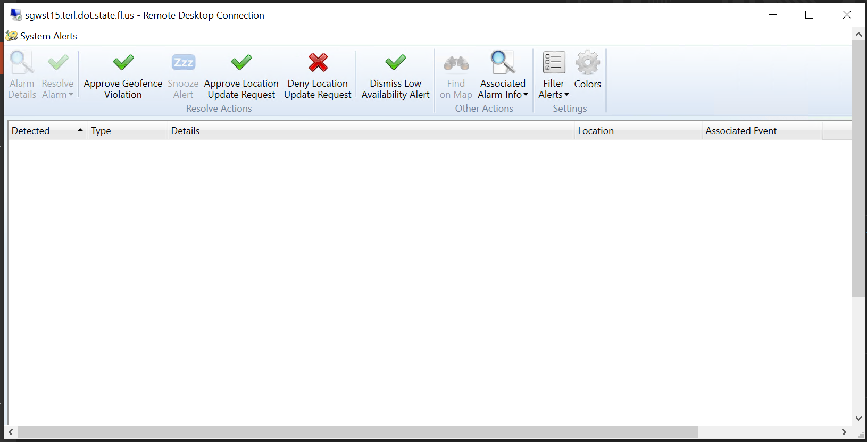
FAT Question
The API allows a videoReplayUrl to be sent.
Where should this video stream be displayed if a device were to send this information?
May involve some form of video storage, so the video retention policy currently being formulated may come into play.

Slide 14
QUESTIONS?
COMMENTS?
SUPPORT?

Slide 15
IV&V Question:
SG-6463 Status Log Level Monitor
Tucker Brown

Slide 16
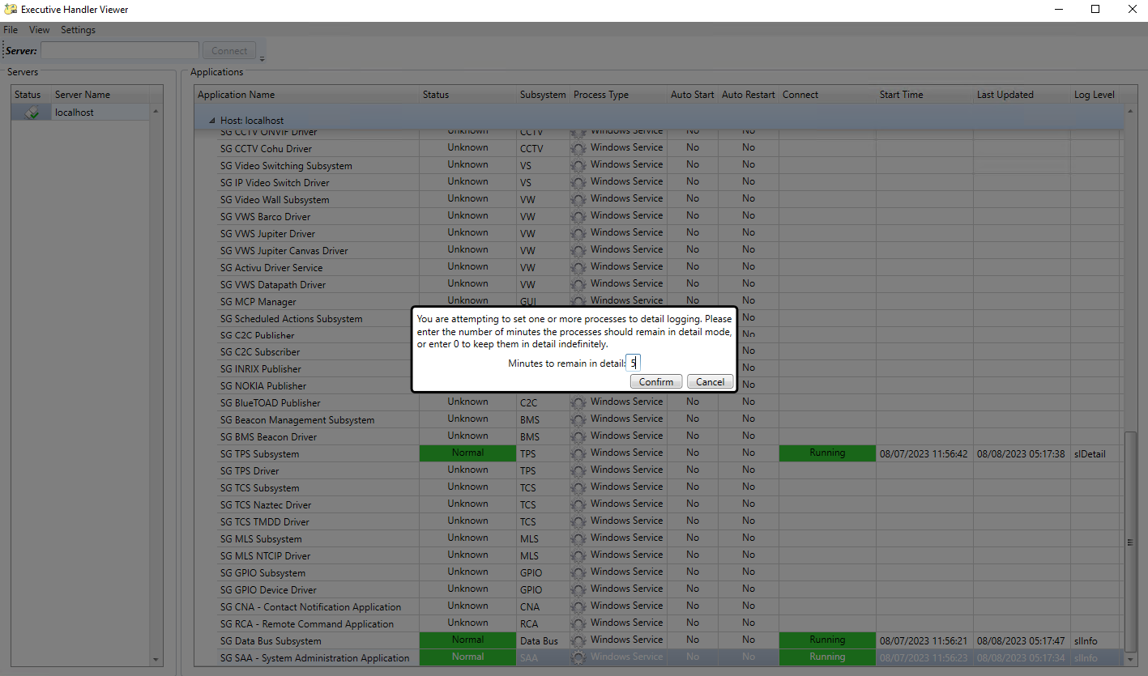
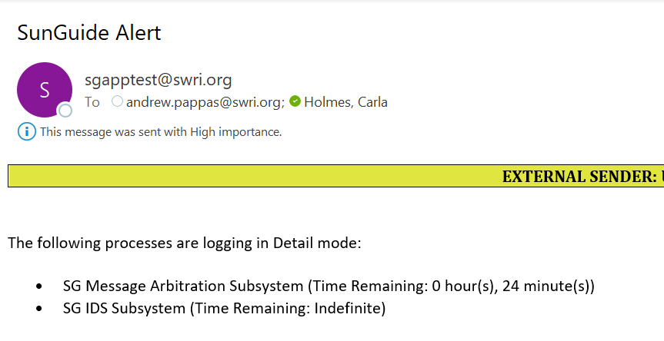
IV&V Behavior
Status Logger Alert
Can select number of minutes, or continue with indefinite duration.
Currently only includes Executive Handler processes.

Slide 17
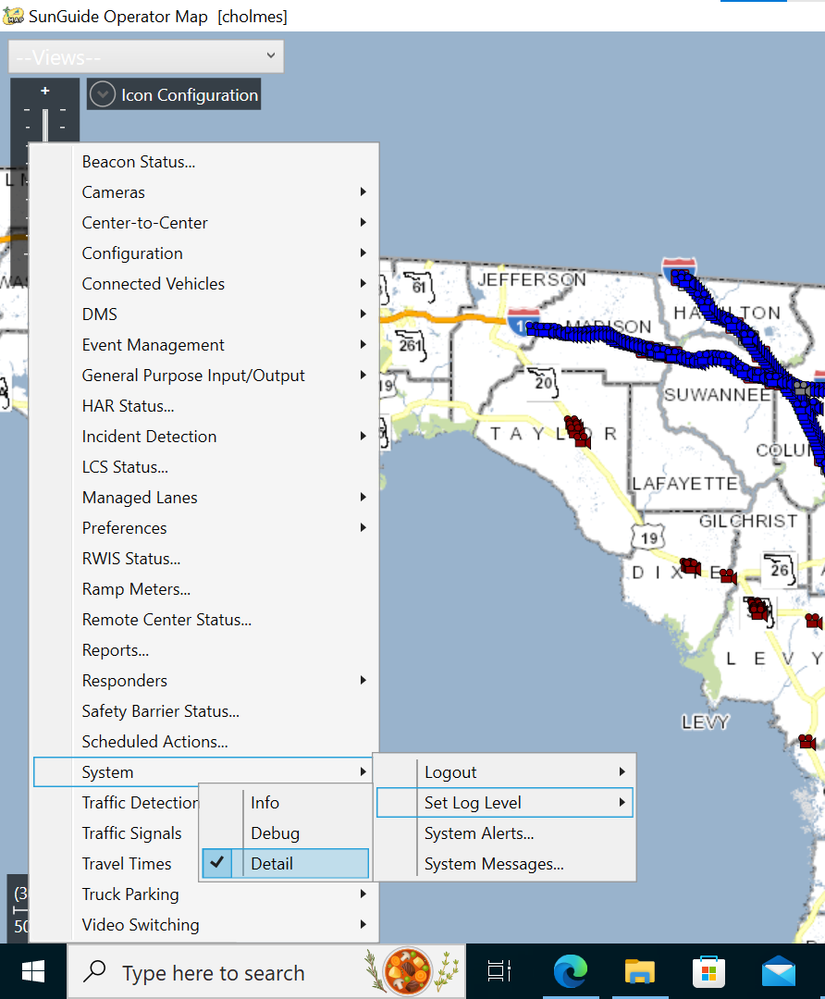
IV&V Question
The Operator Map was not included in this enhancement.
Should the Operator Map also have this Detail Mode functionality:
  Allow to set timing of changing back to Info mode?
  Send email reminder?

Slide 18
QUESTIONS?
COMMENTS?
SUPPORT?

Slide 19
IV&V Question:
SG-3232 Associating FHP and TSS Alerts to Already Created Events
Tucker Brown

Slide 20
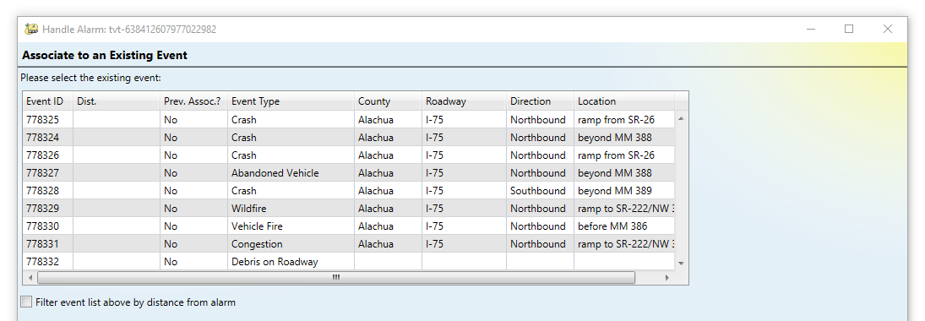
IV&V Behavior
The distance from TVT alerts to events is not populating.
Distances do populate for TSS alerts, so this was thought to be a bug during testing.
In discussions with SwRI, this was identified as expected behavior since there is no single point identified from which to measure.

Slide 21
IV&V Question
Is this information needed?
Would there be any operational impacts if this information was not provided?
The only geo information we have is the link information from the underlying links.
May be able to use the distance from the closest link to the event, if this information is needed.

Slide 22
QUESTIONS?
COMMENTS?
SUPPORT?

Slide 23
ANNOUNCEMENTS?
QUESTIONS?
COMMENTS?
ADJOURN.

