Slide 1


SunGuide Software
Users Group Meeting
January 26, 2023

Slide 2
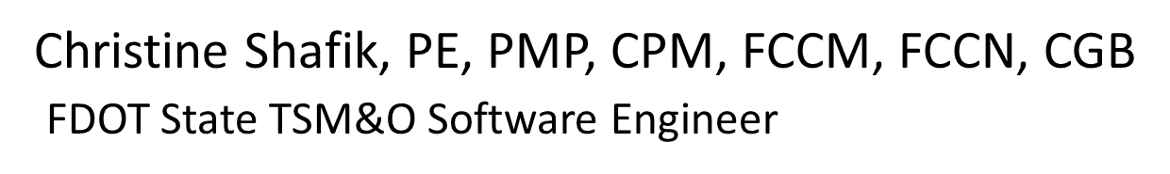
WELCOME
ATTENDEE ROLL CALL

Slide 3
SG-6254 - RISC Management in SG
Tucker Brown

Slide 4
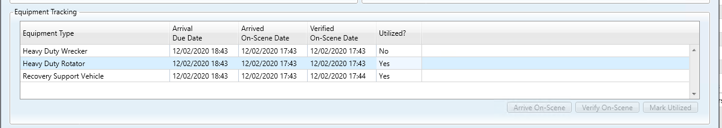
Current Behavior
  Default Equipment is added to a RISC event.
  Additional Equipment can be requested, but not removed.

Slide 5
Enhancement 1
  Change section from “Request Additional Equipment“ to “Manage Equipment”.
  Add columns showing “Added” and “Removed” timestamps showing when the equipment was managed.

Slide 6
Enhancement 2
  Override Rotation Option
    Allow users to select a vendor without documenting action against the current vendor.
      Should it be from the vendors relevant to the contract? Or the full list of vendors?
    No reorder of the list would occur.
      Confirm the ordering would remain the same?
    Would require the operator to specify the authorizer for the override.

Slide 7
QUESTIONS?
COMMENTS?
SUPPORT?

Slide 8
SG-6255 - Safe Tow Rotation in RISC Subsystem
Tucker Brown

Slide 9
Enhancement
Add the option for a Safe Tow rotation.
Different button in the ribbon (Or same button with an additional selection?), but similar behavior.
  Separate rotation list
  No equipment tracking
  Same ability as SG-6254 to override rotation order

Slide 10
QUESTIONS?
COMMENTS?
SUPPORT?

Slide 11
SG-6555 - Select Predefined Plan for FDLE Alert Types
Tucker Brown

Slide 12
Current Behavior and Enhancement
Current Behavior
  New FDLE alert can’t be associated to the correct predefined plans.
Enhancement
  Allow attributes to be associated to predefined response plans.
  Suggest pre-defined response plan when the attributes match the event attributes.
  If no attributes associated, behavior would be the same as current.

Slide 13
QUESTIONS?
COMMENTS?
SUPPORT?

Slide 14
SG-6545 - TSS Raw Speed Data Availability on Mouse-Over
Tucker Brown

Slide 15
Current Behavior and Enhancement
Current Behavior
  Hover text on TSS links show the average speed.
Enhancement
  Show the raw speed instead of the average speed.
  Configurable?
    Raw or Average?
    System or User?
  Show both in the same hover?

Slide 16
QUESTIONS?
COMMENTS?
SUPPORT?

Slide 17
SG-6452 - Device Templates can exclude DMS from response plans based on blockage scenarios
Tucker Brown

Slide 18
Current Behavior and Enhancement
Current Behavior
  Signs found as part of the device linking search are always suggested in the response plan.
Enhancement
  Allow the device to be excluded from the response plan based on blockage situation.
    Only add to the response plan when roadway is closed.
    Any other scenarios?

Slide 19
QUESTIONS?
COMMENTS?
SUPPORT?

Slide 20
Review of Draft SunGuide Generic Incident Alert Protocol
Mark Dunthorn

Slide 21
Generic Incident Alert Protocol
Generic protocol is being developed to send various types of alerts and images to IDS.
Similar to the generic protocol for Wrong Way Vehicle Detection System.
Will allow vendors who implement the protocol to integrate with SunGuide without requiring changes to the software.
Which districts work with incident alert device vendors?
Will provide the draft document for review and comment.

Slide 22
ANNOUNCEMENTS?
QUESTIONS?
COMMENTS?
ADJOURN.

