Slide 1


SunGuide Software
Users Group Meeting
February 22, 2024

Slide 2
WELCOME
ATTENDEE ROLL CALL
Christine Shafik, PE, PMP®, CPM, FCCM, FCCN, CGB
State Connected Mobility & Technologies Engineer

Slide 3
SG-6942 – Enhance the status monitoring of RSUs
Tucker Brown

Slide 4
Current Behavior & Enhancement
Current Behavior
  RSUs are monitored via SNMP to ensure the device is still responsive.
  Enhancement
  Use NTCIP 1218 to capture status elements on the RSU for storage and sending through C2C.
  Should continue to use the current status mechanism if NTCIP is not supported by the device.
  Update the CVS Status dialog to current standard and add the status fields.

Slide 5
Enhancement
  Status Elements
    rsuHostIPAddr, rsuHostNetMask, rsuHostGateway, rsuHostDNS, rsuID,
    rsuClockSourceStatus, rsuHostDHCPEnable, rsuManufacturer, rsuLastLoginUser,
    rsuLastLoginTime, rsuLastLoginSource, rsuGnssStatus, rsuGnss, rsuSystemStatus,
    rsuStatus, rsuModeStatus, rsuFirmwareVersion, rsuTimeSincePowerOn, rsuSecCredReq,
    rsuSecEnrollCertStatus, rsuSecEnrollVertValidRegion, rsuSecEnrollCertUrl,
    rsuSecEnrollCertId, rsuSecEnrollCertExpiration, rsuSecuritySource

Slide 6
QUESTIONS?
COMMENTS?
SUPPORT?

Slide 7
SG-6092 – Add ITIS Codes into
TIM Messages
Tucker Brown

Slide 8
Current Behavior and Enhancement
Current Behavior
  TIMs allow for sending a free text message out to OBUs.
  Vendors prefer to use a fixed list of ITIS codes to better prepare and display a canned message to a user.
Enhancement
  Allow administrators to configure a list of words (or phrases) associated to ITIS codes.

Slide 9
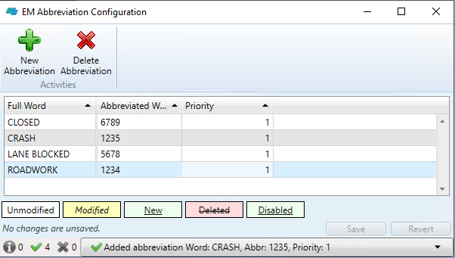
Sample ITIS Configuration

Slide 10
Enhancement
  When replacing text as part of a TIM, if the text in the message matches the configured words or phrases, the associated ITIS code should be added to the message.
  One or more codes could be added to the TIM.
  The operator will see the ITIS codes and what they represent as part of the TIM. Operators will have the option to add or remove ITIS codes associated with the message.
  As part of the TAM message library, allow administrators to configure the ITIS codes as part of the saved message.

Slide 11
Enhancement
  One or more codes could be added to the TIM.
  The operator will see the ITIS codes and what they represent as part of the TIM. Operators will have the option to add or remove ITIS codes associated with the message.
  As part of the TAM message library, allow administrators to configure the ITIS codes as part of the saved message.

Slide 12
QUESTIONS?
COMMENTS?
SUPPORT?

Slide 13
SG-6871 – Wrong Way Driver
DMS Search
Tucker Brown

Slide 14
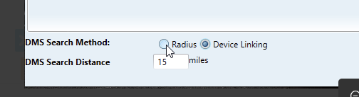
Current Behavior & Enhancement
Current Behavior
  WWD alerts are handled using the device linking file to find relevant DMS to post a WWD message.
  Enhancement
  When creating a WWD event, allow a configuration setting to select Radius as the default.

Slide 15
Enhancement
When creating a WWD event, instead of auto-activating DMS in a response plan, allow a configuration item to force Operations to post the sign as part of the regular response plan behavior.
When creating an event from an IDS alert, a configuration item would determine the default selection algorithm for DMS.
Add a configuration item to the DMS config to determine if the DMS should be used in WWD events.
  Are we just trying to exclude arterial signs? Or other signs?

Slide 16
Enhancement
Add WWD device into the device linking to allow for specific upstream DMS selection.
  Options
    Associate specific DMS to a vehicle alert device. (Might not cover manually-created events.)
    Create a specific linking for WWD devices separate from the device linking.
    Others?

Slide 17
QUESTIONS?
COMMENTS?
SUPPORT?

Slide 18
SG-6419 – FHP CAD Alert Event Types
Tucker Brown

Slide 19
Current Behavior
  FHP alerts base the event type for the event on a configuration file matching the EventType in the alert to the Event Types of SunGuide.
  The issue is that there isn't a broad range of event types seen from the EventType field in the alert.

Slide 20
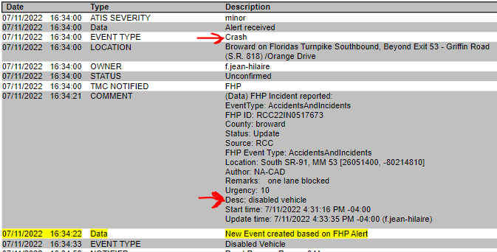
Enhancement
  Recent information provided indicates that the “Desc” field in the alert is NOT a free text field and has a specific list of possible entries.
  Instead of using the “EventType” field, change to use the “Desc” in the mapping for event types.

Slide 21
QUESTIONS?
COMMENTS?
SUPPORT?

Slide 22
9.0 Reminders
Tucker Brown

Slide 23
Features
Compression, Encryption, and changes to the password format are included as features in the 9.0 Release.
Passwords for everyone MUST be updated with the 9.0 release.
Compression and Encryption should NOT be enabled by default on your systems as you upgrade.
  Engage your 3rd party data consumers and verify they can handle this messaging prior to activating any of these changes.

Slide 24
QUESTIONS?
COMMENTS?

Slide 25
ANNOUNCEMENTS?
QUESTIONS?
COMMENTS?
ADJOURN.

