Slide 1


SunGuide Software
Users Group Meeting
February 23, 2023

Slide 2
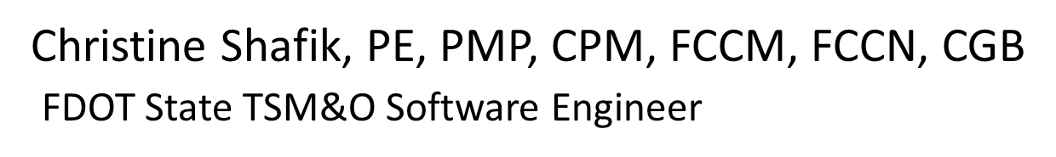
WELCOME
ATTENDEE ROLL CALL

Slide 3
SG-5430 - Add Dispatch Info to RR Popup and Modify RR Map Icon
Tucker Brown

Slide 4
Enhancement
Add all event numbers for events where the Road Ranger is currently dispatched to the Road Ranger hover text.
Add an indicator to the Road Ranger icon that would visually indicate the Road Ranger is dispatched.
  This would still allow coloring based on current state, while also showing the RR is dispatched to other events.

Slide 5
QUESTIONS?
COMMENTS?
SUPPORT?

Slide 6
SG-6603 - Road Ranger
Safety Focus
Tucker Brown

Slide 7
Enhancement
All RR-created or RR-involved events would be considered a blocking event since RR presence blocks either a lane or a shoulder. This then allows Operations' blocking event protocols to be used for all RR events.
RR AVL location would be used to suggest nearest mainline CCTVs for verification of RR being on-scene.
  Use a radius around the RR?
  The CCTVs found should automatically pop-up in a Desktop Video Dialog window for the operator after hitting "Save/Suggest Response Plan”.

Slide 8
Enhancement
For mainline-only events involving RR
  If only a single-phase response plan message is used, suggest a 2nd phase that would be a "RR Move-Over” PSA message.

Slide 9
QUESTIONS?
COMMENTS?
SUPPORT?

Slide 10
SG-5759 - Add Agency When creating a responder
Tucker Brown

Slide 11
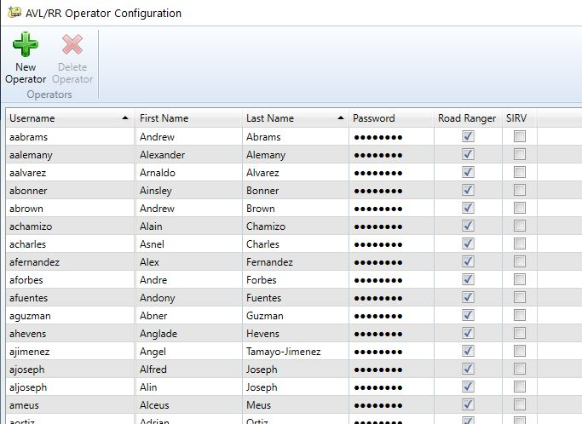
Enhancement
When configuring RR Operators, add an “Agency” for the Operator to the dialog.
Should the software limit logging in as vehicles that are not the same agency as the driver?

Slide 12
QUESTIONS?
COMMENTS?
SUPPORT?

Slide 13
SG-5510 - Velocity 3.0 devices are not matching tags in SunGuide.
Tucker Brown

Slide 14
Enhancement
There was an update to the Velocity protocol which now has updated fields that are not parsed correctly by the current code.
Request is to add the newer version of the protocol.
D5 has these. Does anyone else use these?

Slide 15
QUESTIONS?
COMMENTS?
SUPPORT?

Slide 16
CCTV Wipers
Tucker Brown

Slide 17
Enhancement
Wiper functionality was removed from the Map in 8.2 due to changes in the NTCIP driver.
D2 requested this be fixed.
Any other districts using wiper functionality in SG?

Slide 18
QUESTIONS?
COMMENTS?
SUPPORT?

Slide 19
REVISITING:
SG-5984 - Beacon activation history and Allow beacon activation based on traffic conditions
Tucker Brown

Slide 20
Enhancement
Discussed at the last SSUG Meeting specifically related to beacon activations based on traffic conditions.
John Hope mentioned a Queue Warning System (QWS) that already exists and noted that this functionality may already be covered.
User Manual and Overview Presentation for QWS was sent to the districts for review.

Slide 21

Software Data Flows
HERE
BlueTOAD
Center-2-Center Infrastructure
Queue Warning Software
Other Districts
External Agencies
System Administrator
SunGuide Software
Existing
MVDS
DMS
Next Release
Beacons
Planned
Loops
Connected Vehicle
Probe Detection

Slide 22
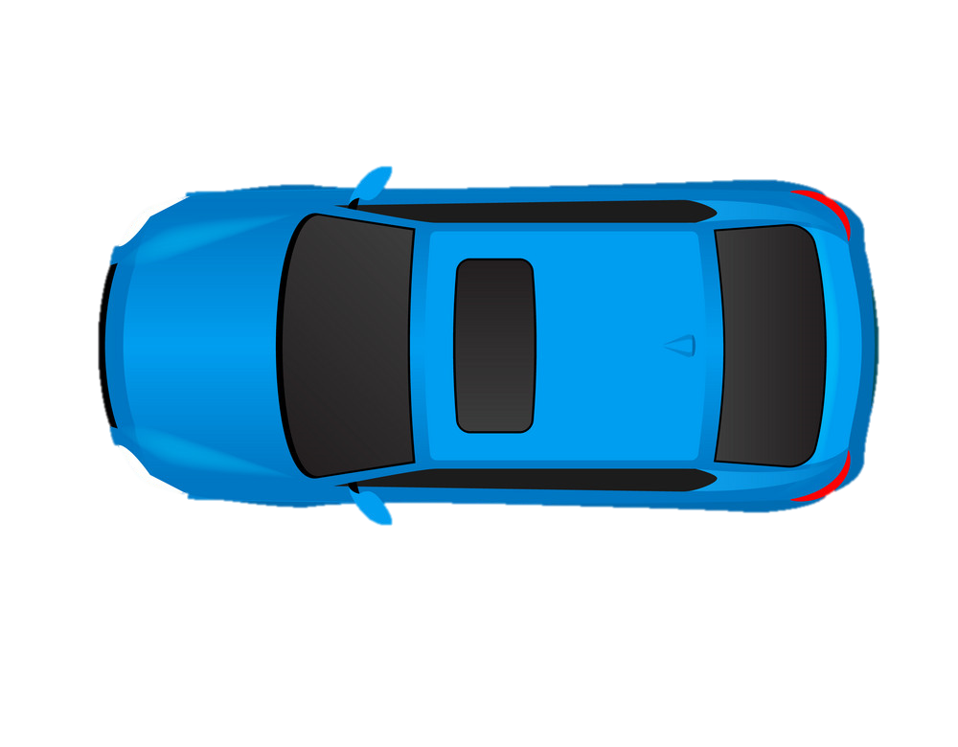

Sample Condition 1
DMS
Ramp Queued
Freeflow Mainline

Slide 23

Sample Condition 2
DMS
Ramp Queued
Right Lane Blocked
Freeflow Left Lane

Slide 24

Sample Condition 3
DMS
Freeflow at DMS
Congestion X Miles Ahead
Mileage will update automatically every minute

Slide 25

Sample Condition 4
DMS
Congestion at DMS
Freeflow X Miles Ahead
Mileage will update automatically every minute

Slide 26
Enhancement
This covers the functionality for this issue, as well as adds more to the system.
Interest in adding this directly to the SunGuide base functionality?
Questions about the functionality?

Slide 27
QUESTIONS?
COMMENTS?
SUPPORT?

Slide 28
ANNOUNCEMENTS?
QUESTIONS?
COMMENTS?
ADJOURN.

