Slide 1


SunGuide Software
Users Group Meeting
March 7, 2024

Slide 2
WELCOME
ATTENDEE ROLL CALL
Christine Shafik, PE, PMP®, CPM, FCCM, FCCN, CGB
State Connected Mobility & Technologies Engineer

Slide 3
SG-6951 – Databus REST API for real time TSS and TVT data.
Tucker Brown

Slide 4
Current Behavior
Options for connecting to receive SunGuide data include
  C2C
    Limited data set
  Direct Databus connection
    Exposed backend servers to 3rd parties
  Database
    Potential impact to operations.
    Not always real time.

Slide 5
Enhancement
  Other states have created HTTP-based APIs for 3rd party communications
  Independent module can be setup in a DMZ
  Allows client requests for data without affecting operations
  Similar communication format as connecting directly to Databus
  Intent is a pass-through for Databus communication
  Provides options for push updates
  May be able to use what other states have done, with necessary edits for SunGuide

Slide 6
QUESTIONS?
COMMENTS?
SUPPORT?

Slide 7
SG-5564 – Unknown DMS Merge Checkbox State
Tucker Brown

Slide 8
Current Behavior
  A DMS merge checkbox has 3 possible states
  Checked – Explicitly telling the system to merge messages
  Unchecked – Explicitly telling the system to NOT merge messages
  Blue square in the checkbox – Use the system default for merging
  Operations might be confused by the blue square option

Slide 9
Enhancement
  Only have a 2-state checkbox (check or unchecked)
  The blue state checkbox should be an explicitly check or uncheck based on the default state

Slide 10
QUESTIONS?
COMMENTS?
SUPPORT?

Slide 11
SG-6068 – Status Logger using configuration stored on local installation directory
Tucker Brown

Slide 12
Current Behavior and Enhancement
  Current Behavior
  Executive Handler and Status Logger do not require startup parameters and rely on a process specific configuration file
  This can cause confusion in a clustered environment where startup is performed in the cluster
  Enhancement
  Allow an optional startup parameter on both to allow a cluster to specify startup configuration parameters

Slide 13
QUESTIONS?
COMMENTS?
SUPPORT?

Slide 14
SG-6957 – Add Law Enforcement Pursuit as an attribute in SunGuide.
Tucker Brown

Slide 15
Current Behavior and Enhancement
  Current Behavior
  The system allows configuration of custom attributes, but statewide attributes need to be added at the database level
  Enhancement
  Add “Law Enforcement Pursuit” as a statewide attribute

Slide 16
QUESTIONS?
COMMENTS?
SUPPORT?

Slide 17
Tileset Updates
Tucker Brown

Slide 18
Enhancement
  A new tileset will be created
  2024 Q1 data was released and will be used
  MDX logo is going to change to GMX
  Any other changes needed?
  Navteq data will also be updated and will be released at a later time

Slide 19
QUESTIONS?
COMMENTS?

Slide 20
SunGuide Style Guide
Training & Certification
Computer Based Training (CBT)
Mark Dunthorn

Slide 21

SunGuide Style Guide CBT Overview
Has been live in the Learning Curve production environment since November 2020
Intended for all SunGuide users and as part of new hire orientation
Use as a reference when configuring and conducting operations
Standardizes naming conventions and data entry protocols
1.0 PDH credit upon completion

Slide 22
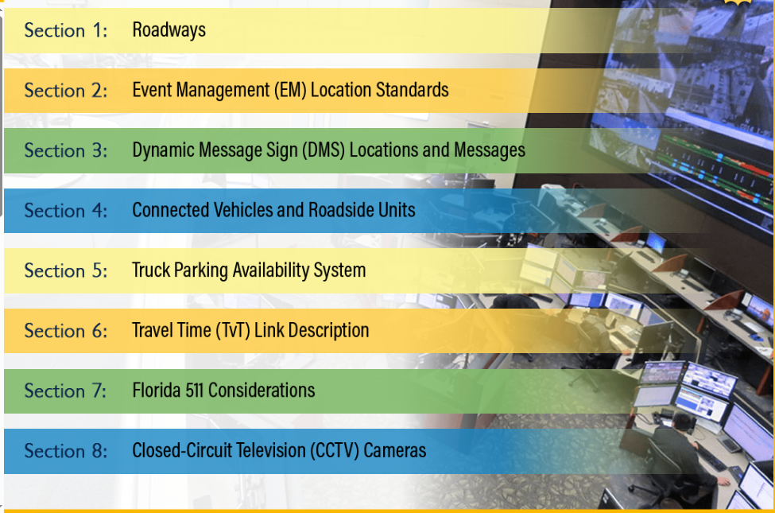
SunGuide Style Guide CBT Outline

Slide 23
Accessing Learning Curve
For FDOT users use Learning Curve Dashboard at https://floridadot.myabsorb.com/#/search?term=sunguide.
  Free for FDOT users
For Non-FDOT users use this external link https://learningcurve.myabsorb.com/#/public-dashboard
  $6 fee for Non-FDOT users to set up a Learning Curve account

Slide 24
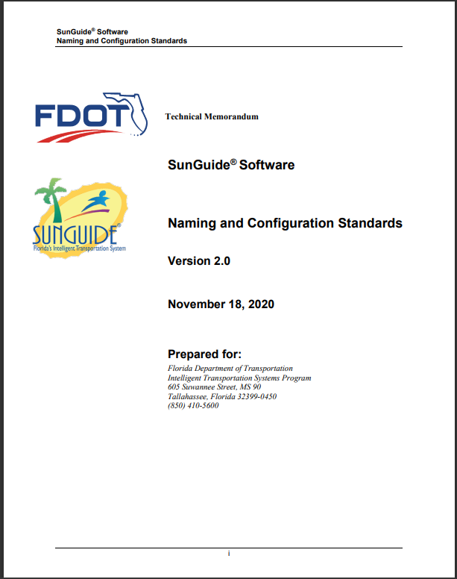
Naming & Configuration Standards
Training is based on SunGuide Software Naming and Configurations Standards
Document can be found online at SunGuide® Software - Training (sunguidesoftware.com)

Slide 25
QUESTIONS?
COMMENTS?

Slide 26
ANNOUNCEMENTS?
QUESTIONS?
COMMENTS?
ADJOURN.

