Slide 1


SunGuide 8.2 Hotfix 3
Design Review
SunGuide Software Users Group | 3/9/23

Slide 2
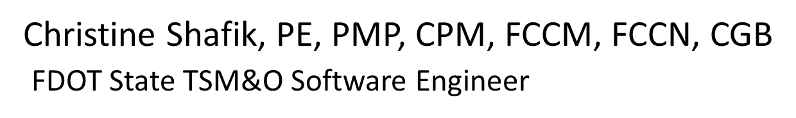
WELCOME
ATTENDEE ROLL CALL

Slide 3
SG-6036 EM selects predefined group of event attributes based on event type
Tucker Brown
SunGuide Software Users Group | 3/9/23

Slide 4
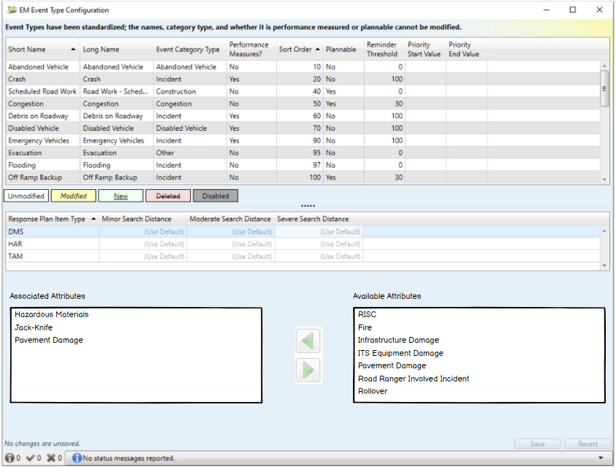
Configuration: Option 1
  Add to the configuration dialog underneath the Proximity Configuration.
SunGuide Software Users Group | 3/9/23

Slide 5
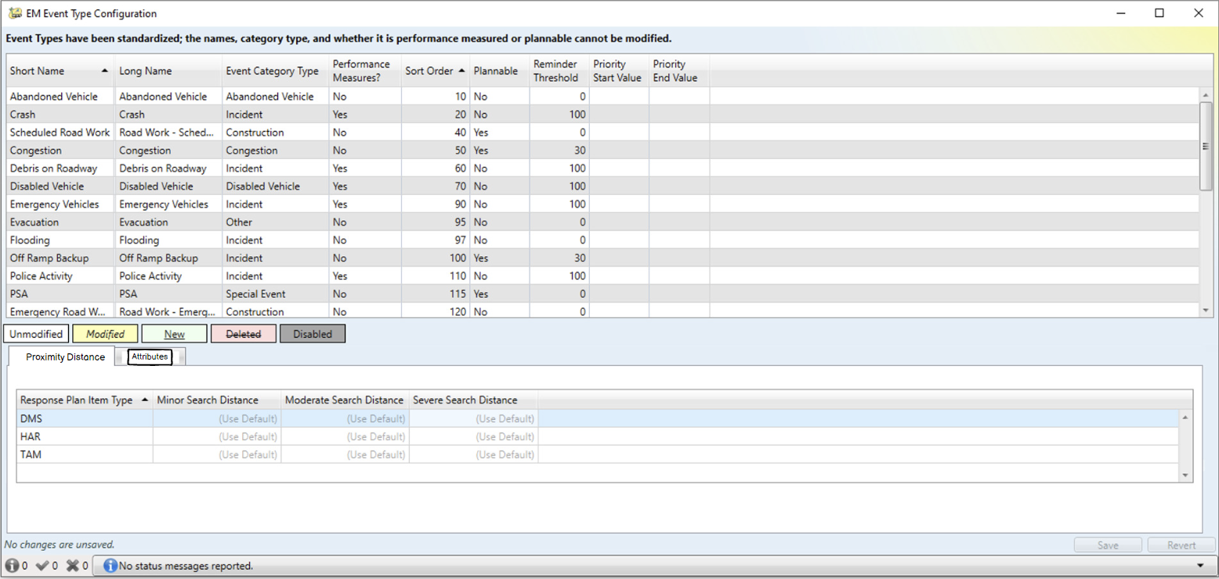
Configuration: Option 2
  Add to the configuration dialog in tabs, along with the Proximity configuration.
SunGuide Software Users Group | 3/9/23

Slide 6
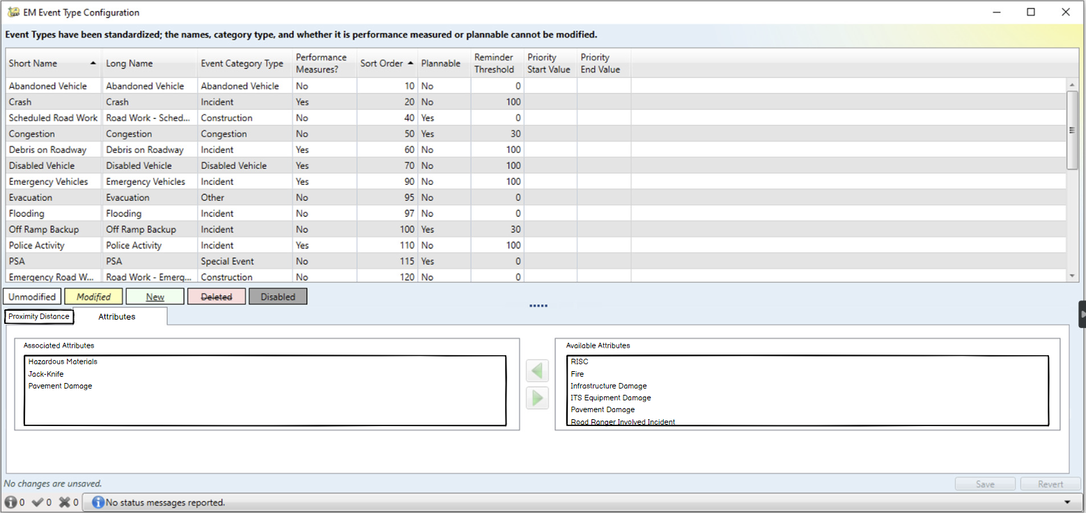
Configuration: Option 2
  Add to the configuration dialog in tabs, along with the Proximity configuration.
SunGuide Software Users Group | 3/9/23

Slide 7
COMMENTS?
QUESTIONS?
SunGuide Software Users Group | 3/9/23

Slide 8
SG-4649 Keep DMS device icons on map when using TVT configuration
Tucker Brown
SunGuide Software Users Group | 3/9/23

Slide 9
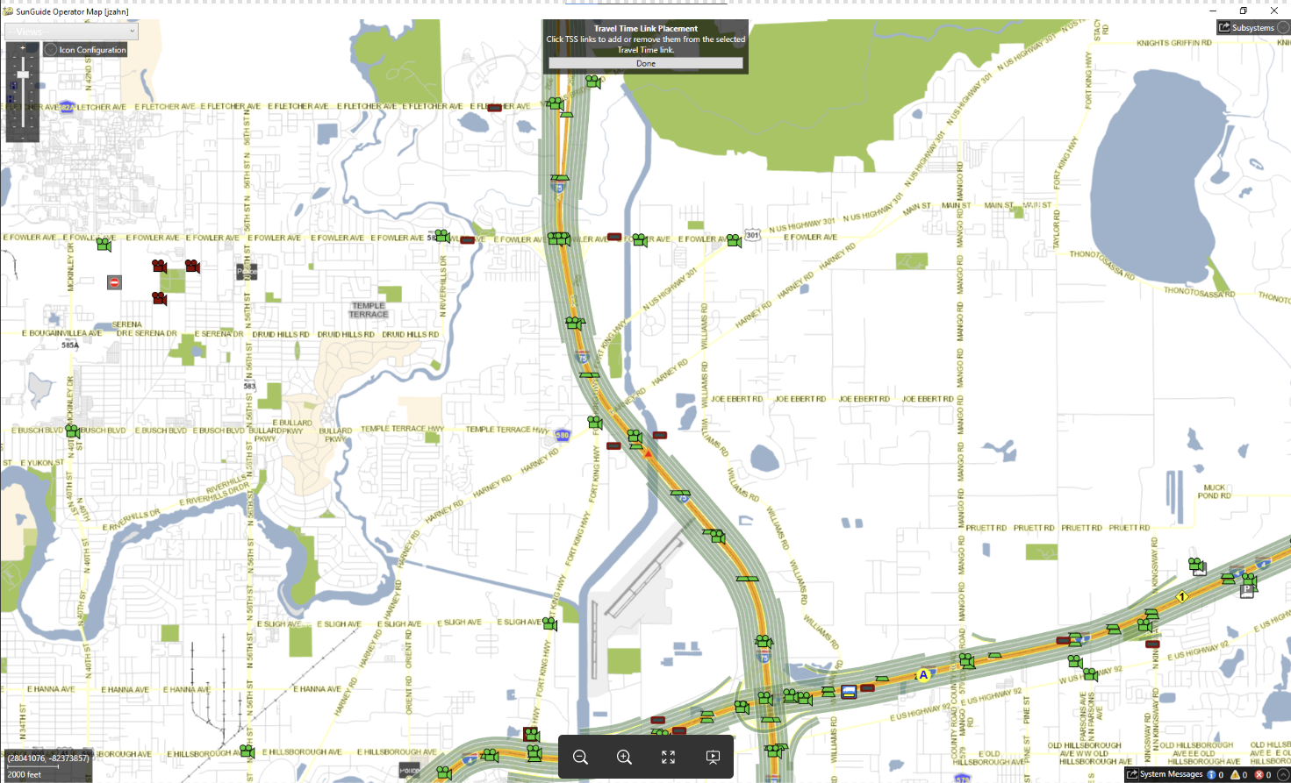
Map Display Modes
  Travel Time configuration shown with all device icons shown on the map.
  This will apply to all Operator Map display modes.
  A system setting will determine if all devices should be shown or to keep the current behavior.
SunGuide Software Users Group | 3/9/23

Slide 10
COMMENTS?
QUESTIONS?
SunGuide Software Users Group | 3/9/23

Slide 11
SG-4794 Hide the password in "TSS Detector Configuration" Dialog box
Tucker Brown
SunGuide Software Users Group | 3/9/23

Slide 12
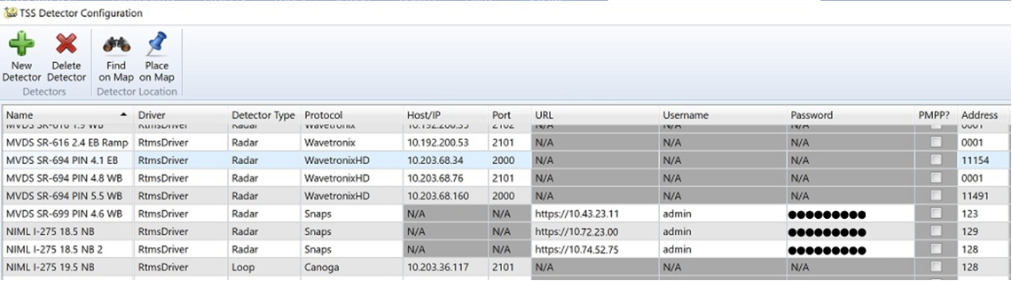
Password Display
  Passwords in the password columns will always be hidden in configuration dialogs
SunGuide Software Users Group | 3/9/23

Slide 13
COMMENTS?
QUESTIONS?
SunGuide Software Users Group | 3/9/23

Slide 14
SG-5349 FL-511 not publishing correct lane blockage if an event has both the turn lane and travel lane blocked.
Tucker Brown
SunGuide Software Users Group | 3/9/23

Slide 15
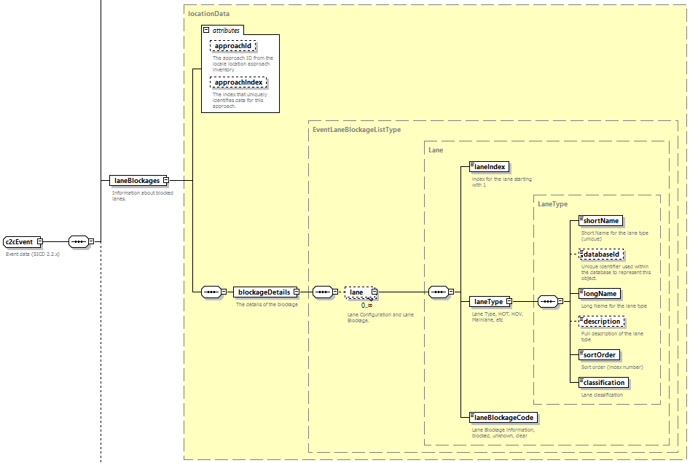
C2C Schema Changes
  Schema will contain the full lane configuration and blockage.
  SAE codes will be maintained in the short term for backward compatibility.
  Added to both the event published to 511 and the c2cEvent in the status.
SunGuide Software Users Group | 3/9/23

Slide 16
COMMENTS?
QUESTIONS?
SunGuide Software Users Group | 3/9/23

Slide 17
Other Enhancements
Tucker Brown
SunGuide Software Users Group | 3/9/23

Slide 18
Other Enhancements
  SG-4791 Incident Clock should Start when the Operator Clicks on "new event"
    A new column will be stored for an event that will hold the time the initial “Create New Event” dialog is opened.
    At this time, this will be for comparison purposes to the time the operator clicks the Create Event button.
  SG-4725 Requesting an additional field in the "EventChrono RPT View“
    A new column containing the “First Vehicle Departure” time will be added to the performance measures table and related views.
SunGuide Software Users Group | 3/9/23

Slide 19
Other Enhancements
  SG-4876 TSS Alarms - Agency Contact Config
    If a contact needs to be created as part of creating a new event from an alert, the system will create the new contact (as opposed to the operator).
    Will allow operators without permission to continue to create the event without direct CNA or EM configuration permissions.
  SG-6513 FDOT Standard TPS Protocol
    Open, published protocol will allow any vendor to write to the specification and integrate with SunGuide, without changes to the software.
SunGuide Software Users Group | 3/9/23

Slide 20
COMMENTS?
QUESTIONS?
SunGuide Software Users Group | 3/9/23

Slide 21
ANNOUNCEMENTS?
QUESTIONS?
COMMENTS?
ADJOURN.

