Slide 1


SunGuide Software
Users Group Meeting
April 7, 2022

Slide 2
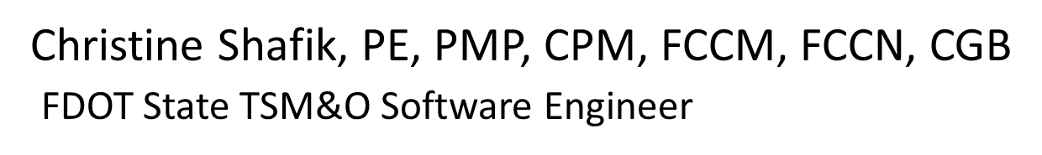
WELCOME
ATTENDEE ROLL CALL

Slide 3
UPDATE:
SG-5782 - RISC Module Enhancements
Carla Holmes / Shawn Kinney

Slide 4
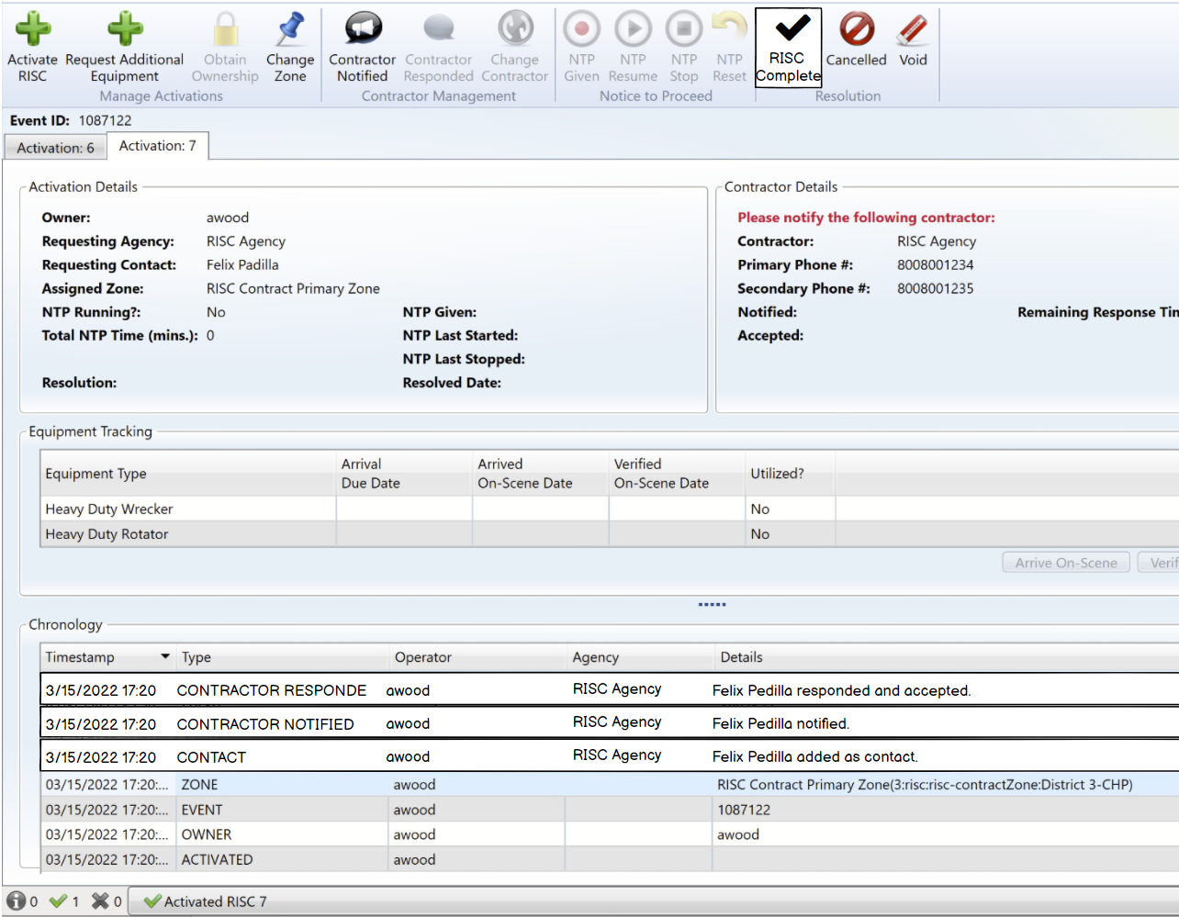
Updates on RISC Enhancements
RISC Milestones in SunGuide
  Activate RISC
  NTP
    Given
    Resume
    Stop
    Reset
  RISC Complete
  All Lanes Cleared
  Departure of Equipment

Slide 5
Updates on RISC Enhancements
RISC Email
  Based on Design Review Meeting consensus, an email will be sent when the contractor accepts the RISC.
  What emails are currently being sent, and to whom?
  RISC Chronology Report
  Will need to design report:
    Intended audience?
    Purpose / objective?
    Content?
    Included as part of Event Chronology Report?
  Will be delivered after release of R8.1 Hotfix 3.
  If you have any input, please email Christine Shafik.

Slide 6
COMMENTS?
QUESTIONS?

Slide 7
SG-6235 – Video on Desktop using significantly more resources after installing 8.1
A.J. Skillern

Slide 8
Current Behavior and Discussion
Current Behavior
  As of 8.1, Video on Desktop is using VLC version 3.0.16.
  D2 found that the CPU usage in the newer version is higher.
  Saved walls that previously worked now max out the CPU.
  Downgrading the VLC version (2.2.6) appeared to fix the issue.
Discussion
  Should we revert to the older version of VLC, with the option to manually upgrade your operators if you want?

Slide 9
QUESTIONS?
COMMENTS?
SUPPORT?

Slide 10
SG-6241 – TrafficVision Alert Integration
A.J. Skillern

Slide 11
Current Behavior and Enhancement
Current Behavior
  As of 8.1, WWD alerts are supported for TrafficVision.
Enhancement
  TrafficVision also can alert on stopped vehicle/debris in the road, congestion, low visibility, pedestrians, and slow speeds.
  Are all of these types wanted/needed?
  Would need to discuss how each of these would present to the user for each alert type.
    Vehicle Alert dialog vs Alert List

Slide 12
QUESTIONS?
COMMENTS?
SUPPORT?

Slide 13
SG-6249 – Polyline Closure Reporting and Email
Enhancement
A.J. Skillern

Slide 14
Enhancement
When the new polyline Has Closure checkbox is checked:
  Add closure location(s) to email (match wording used in FL511 message)
  Add closure location(s) to Executive Notification Email
  Add closure location(s) to Event Chronology
  Add closure location(s) to Event Chronology Report (top half)

Slide 15
QUESTIONS?
COMMENTS?
SUPPORT?

Slide 16
SG-5477 – Associate CCTV from C2C in Event Details
A.J. Skillern

Slide 17
Current Behavior and Enhancement
Current Behavior
  With C2C or RCA, remote cameras are now more readily available to operators for viewing or using to verify events.
  A remote camera cannot be set as the nearest camera (local cameras only).
Enhancement
  Allow C2C and RCA cameras to be set as the nearest camera in an event.

Slide 18
QUESTIONS?
COMMENTS?
SUPPORT?

Slide 19
ANNOUNCEMENTS?
QUESTIONS?
COMMENTS?
ADJOURN.

