Slide 1


SunGuide Software
Users Group Meeting
April 20, 2023

Slide 2
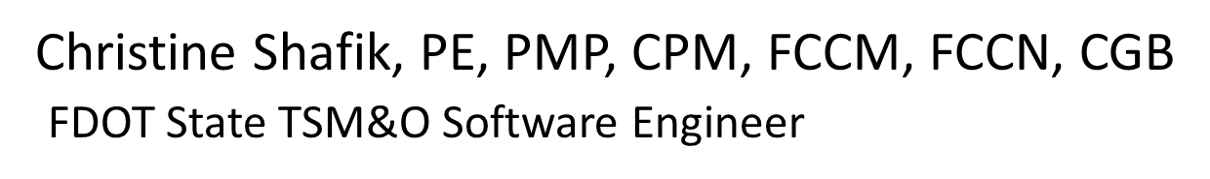
WELCOME
ATTENDEE ROLL CALL

Slide 3
SG-6640 - Add Road Ranger dispatch and activity data to C2C
Tucker Brown

Slide 4
Enhancement
New data is being requested to be sent through C2C and posted on FL511:
  When a Road Ranger is on the scene of an event
  What activities the Road Ranger is performing
Would most likely be added to the eventData element in C2C, as well as to published events.
Any issues with this data going to the DIVAS team?

Slide 5
QUESTIONS?
COMMENTS?
SUPPORT?

Slide 6
REVISITING:
SG-6087 - Collect additional data related to RR-involving incidents
Tucker Brown

Slide 7
Enhancement
Enhancement released in R8.2 HF2.
  There is a need to collect additional information if an event involves a RR being injured, or a RR vehicle being involved in an incident.
  The data will be collected by the operations staff, and can also be audited after the event is closed.
  No new report template was requested or developed as part of the enhancement.

Slide 8
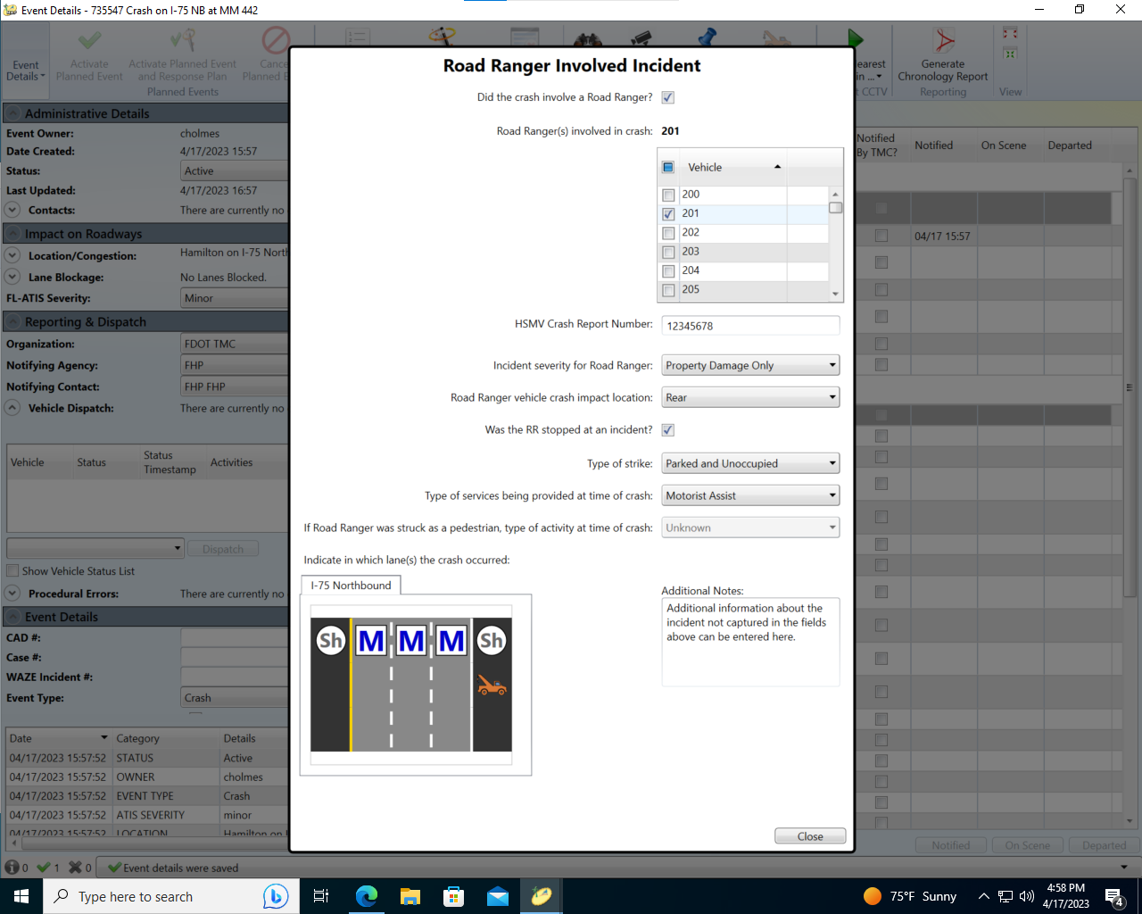
Enhancement
SG-6087
Collect additional data related to RR-involving incidents

Slide 9
Reporting Needs
How will the districts use this information?
What reporting mechanism should be used?
  Add to existing report(s)?
    Which one(s)?
  Create a new report?
    Should any other information be included on the new report?
    Modeled after an existing report?
  Both create a new report and add information to existing report(s)?

Slide 10
QUESTIONS?
COMMENTS?
SUPPORT?

Slide 11
SG-6284 - Have SunGuide response plan suggestion react to tail of closure while using polyline feature
Tucker Brown

Slide 12
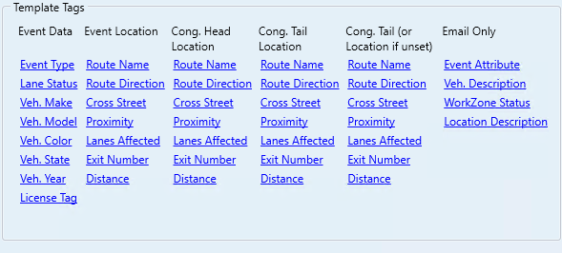
Current Behavior
In a polyline event, the event location is used to create a response plan.
Tags exist to change the response plan location for congestion events.

Slide 13
Enhancement
Create new tags for a “Closure Head” and “Closure Tail” of an event.
Create new tags for “Closure Head (or location if unset)”.
Distance Tag would include the distance calculation based on the polyline head or tail.
Tags configuration would get even larger, might switch to a tab-based selection.

Slide 14
QUESTIONS?
COMMENTS?
SUPPORT?

Slide 15
SunGuide
Software User Manual
(SUM)
Tucker Brown

Slide 16
Current Situation
The SUM is produced for every major release, and has become an extremely large document.
It can sometimes be difficult to find necessary information.
Large PDF is not as useful for operations staff.
Should this be converted to some other format, more useful to the districts?
Considering changing the format for the 9.0 release.

Slide 17
Options
Site-based options
      SunGuide dialogs linked to HTML-based site
      SharePoint Wiki-style Help Pages
          Web based options could have dynamic images linked to the code base (with fake data) that automatically update the documentation images for every release.
  Video walk-throughs of the dialogs and features
  Other ideas?

Slide 18
QUESTIONS?
COMMENTS?
SUPPORT?

Slide 19
ANNOUNCEMENTS?
QUESTIONS?
COMMENTS?
ADJOURN.

