Slide 1


SunGuide Software
Users Group Meeting
April 6, 2023

Slide 2
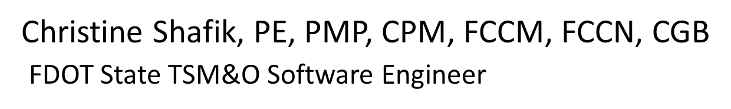
WELCOME
ATTENDEE ROLL CALL

Slide 3
SG-5483 - Add Location Description column option to Truck Parking Facility Status dialog
AJ Skillern

Slide 4
Enhancement
Include the Location Description field as a column option in the Truck Parking Facility Status dialog.
Location Description is used on the FL511 site, so having it on the status dialog would make it easier to match if the Location Description and Facility Name are different.

Slide 5
QUESTIONS?
COMMENTS?
SUPPORT?

Slide 6
SG-6310 - Change Default Grouping in Executive Handler
AJ Skillern

Slide 7
Enhancement
Change the default grouping in Executive Handler to group by Subsystem instead of by Server.
Especially in clustered systems, this gives an easier view of all subsystems, regardless of node.
Alternate Solution
  Save user settings and apply on startup. Would maintain the last state of filters/settings.

Slide 8
QUESTIONS?
COMMENTS?
SUPPORT?

Slide 9
SG-6618 - Show details on who delete a device in slInfo mode and
SG-6014 - Enhanced Tracking of Changes in SunGuide
AJ Skillern

Slide 10
Enhancement
Capture changes associated with modifications to SunGuide.
Offers assistance with the following:
  Identification of permissions attributed incorrectly to a user or user group.
  Identification of inadvertent/accidental changes. Who performed them and when.
  Useful details that can be included in troubleshooting.

Slide 11
Enhancement
Types of fields to capture
  Type and Id
  Type of change (add, change, ceased)
  Old Configuration (from, if ‘new’ item will show as null)
  New Configuration (to, if ‘ceased’ item will show as null)
  Date and Time
  UserID

Slide 12
QUESTIONS?
COMMENTS?
SUPPORT?

Slide 13
REVISITING:
SG-5423 Night Mode
Carla Holmes

Slide 14
Current Behavior and Enhancement
Presented at 3/21/2023 CMB. Decided to get district input and revisit at SSUG Meeting.
Current Behavior
  SunGuide doesn’t have a “theme”, only a set color scheme which is a light blue background with white grids/elements.
Enhancement
  Create a “Night Mode” theme which will change the colors of dialogs to a darker color.
  Would make user selectable on/off and dark time/light time.
  Would need a “Dark” tile set.

Slide 15
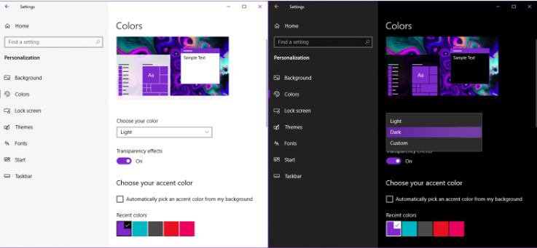
Enhancement
Between 250-300 dialogs
    Implementation, setup, and testing for each dialog
Estimated LOE: $118k

Slide 16
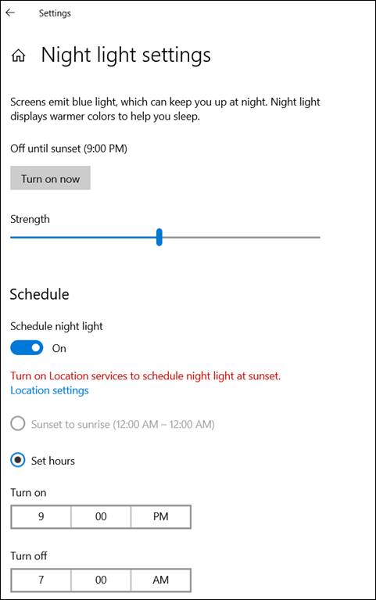
Input from Districts
All but one RTMCs’ lights are completely off, partially off, or are dimmed.
6 of 9 districts have gotten operator complaints about computers being too bright in the RTMC’s low-light environment.
Currently addressed by:
  Using Windows Night Light Settings.
  Adjusting monitor brightness.
  Setting a schedule for smart walls to remove the blue light during evening hours.

Slide 17
Input from Districts
Suggestions for alternative solutions:
  Use Windows Night Light Settings.
  Adjust monitor brightness.
  Use a screen overlay (like a privacy screen / glare screen) to lessen the brightness.
  Use special glasses that are made to address eye strain.
  Use night mode in conjunction with a dark tile map layer.
  Investigate computer manufacturer and third-party software.
  Seek recommendations from an Optometrist or a specialist in Ergonomics.

Slide 18
Input from Districts
Priority dialogs for Night Mode enhancement:
  Cameras
    Camera Control
    Camera Blocking
    Desktop Video Dialog
  DMS
    Device Messaging
  Reports -> Generate Report
  C2C Floodgate Status
  Desktop Video Walls
  WWD List
  TPAS List
  Scheduled Actions
  Traffic Detection -> Status
  Event Management
    Event List
    Event Audit
    Predefined Response Plan
    Remove/Republish Events to FLATIS
  DMS Device List
  MVDS List
  Camera List

Slide 19
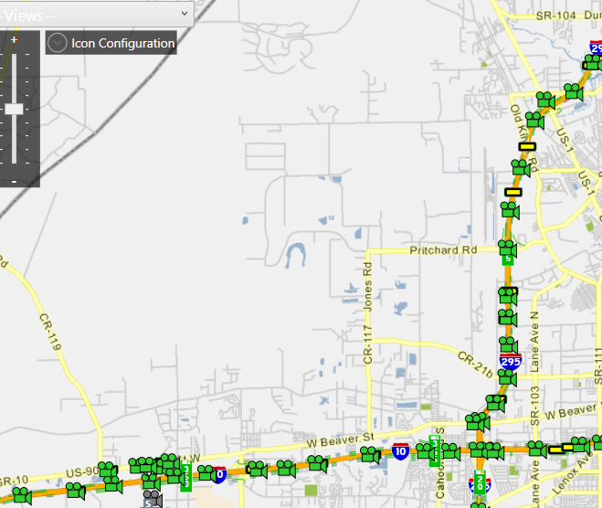
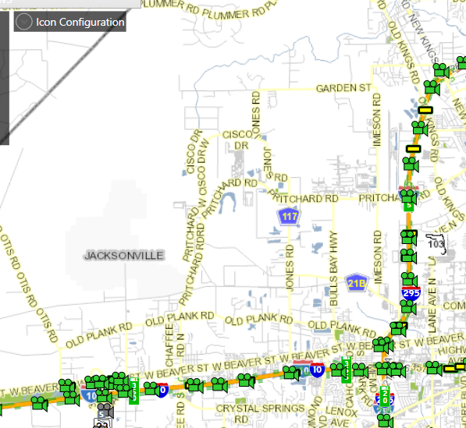
Input from Districts
Interest in only “Dark” tile set; no dialog enhancements:
  6 of 9 districts are okay with just a “Dark” tile set.
  Old grayish hue (2010) vs. newer bright white hue.

Slide 20
Next Steps?
  SunGuide enhancement options:
    Do nothing
    Priority dialogs
    Dark tile set
    Priority dialogs and Dark tile set
  Alternative solutions
  Other

Slide 21
QUESTIONS?
COMMENTS?

Slide 22
FYI:
New Roadway Shields in SunGuide
Christine Shafik

Slide 23


New Roadway Shields in SunGuide
The CO will be creating roadway shield graphics for:
  New roadways
  Missing graphics for existing roadways
Existing shields are located on the installation media under the DMS Graphics Folder.
  There are images for 54 and 96 pixel high signs.

Slide 24
New Roadway Shields in SunGuide
Do you have any issues with roadway shields in SunGuide?
    Are there any roads missing shields?
    Are there any new roads in your district for which shields need to be created?
    Are there any issues with the shields currently in the SunGuide DMS graphics library (sizing, resolution, etc.)?
REMINDER: Any new, non-MUTCD DMS graphics need to be submitted for approval to Dana Knox, Highway Signing Program Manager.

Slide 25
QUESTIONS?
COMMENTS?

Slide 26
ANNOUNCEMENTS?
QUESTIONS?
COMMENTS?
ADJOURN.

