Slide 1


SunGuide Release 8.2
Design Review
SunGuide Software Users Group | 5/5/22

Slide 2
SG-3926 Assign CCTV to DMS and provide shortcut in DMS dialog
Tucker Brown
SunGuide Software Users Group | 5/5/22

Slide 3
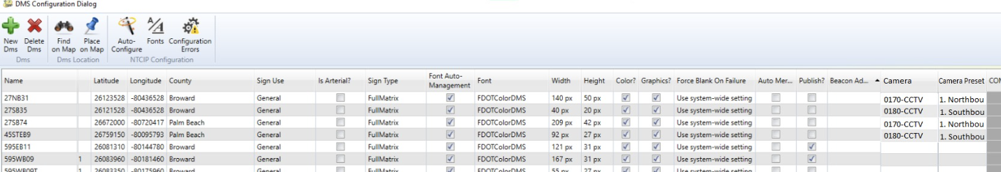
DMS Configuration
  Optional camera and optional preset can be configured for each DMS
SunGuide Software Users Group | 5/5/22

Slide 4
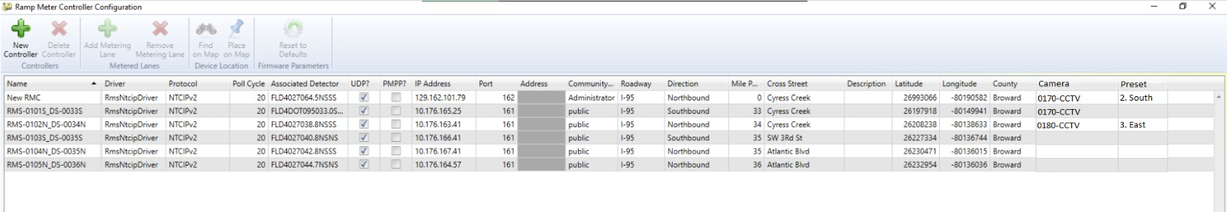
RMC Configuration
  Optional camera and optional preset can be configured for each Ramp Meter
SunGuide Software Users Group | 5/5/22

Slide 5
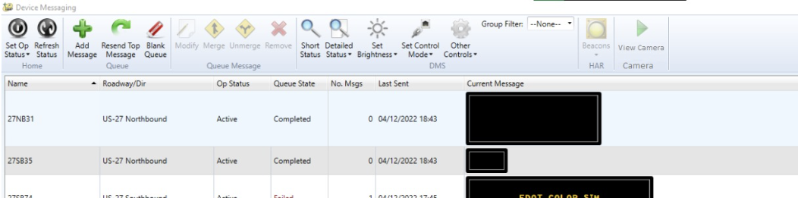
DMS Status
  If configured, the camera can be launched into Video on Desktop.
  If a preset is configured, the command to send the camera to the preset will be sent.
SunGuide Software Users Group | 5/5/22

Slide 6
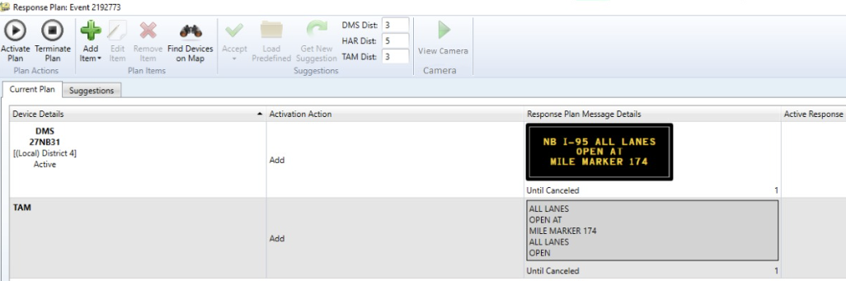
Response Plan
  If configured and a DMS is selected, the camera can be launched into Video on Desktop.
  If a preset is configured, the command to send the camera to the preset will be sent.
SunGuide Software Users Group | 5/5/22

Slide 7
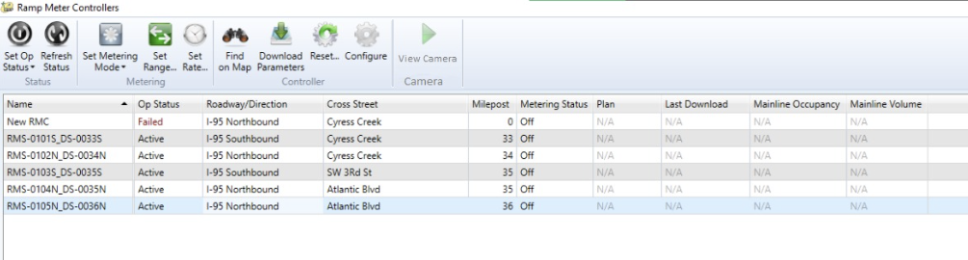
RMC Status
  If configured, the camera can be launched into Video on Desktop.
  If a preset is configured, the command to send the camera to the preset will be sent.
SunGuide Software Users Group | 5/5/22

Slide 8
COMMENTS?
QUESTIONS?
SunGuide Software Users Group | 5/5/22

Slide 9
SG-5143 Make Chronology report be able to be generated entirely or only in sections of interest.
Tucker Brown
SunGuide Software Users Group | 5/5/22

Slide 10
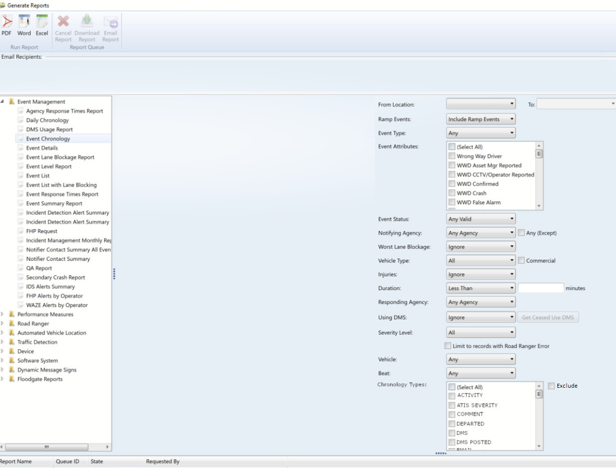
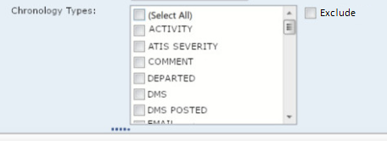
Reports
  New filter for Chronology Types – Whitelist and Blacklist
SunGuide Software Users Group | 5/5/22

Slide 11
COMMENTS?
QUESTIONS?
SunGuide Software Users Group | 5/5/22

Slide 12
SG-5456 "TMC Notified" for all notified times regardless of whether notified box is checked
Tucker Brown
SunGuide Software Users Group | 5/5/22

Slide 13



Event Chronology Messages
  “Notified by TMC?” check box determines the syntax of chronology message.
SunGuide Software Users Group | 5/5/22

Slide 14
COMMENTS?
QUESTIONS?
SunGuide Software Users Group | 5/5/22

Slide 15
SG-5557 Ability to Set WWD Sites to Maintenance
Mode via SG
Tucker Brown
SunGuide Software Users Group | 5/5/22

Slide 16
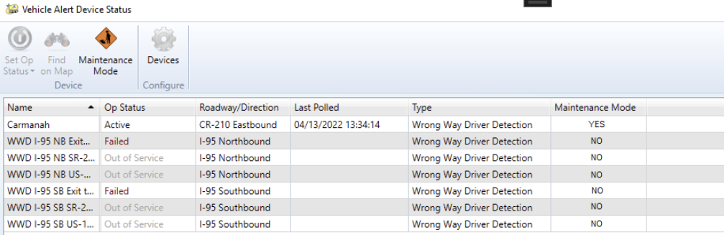
Maintenance Mode
  Selecting a device (or devices) and pressing the ribbon button will set the device to a maintenance mode.
  Devices in maintenance mode with not generate alerts.
  Current status of the maintenance mode is shown in the status dialog.
SunGuide Software Users Group | 5/5/22

Slide 17
COMMENTS?
QUESTIONS?
SunGuide Software Users Group | 5/5/22

Slide 18
SG-5706 Add timestamp in SunGuide incident when Executive Notification
Emails are sent
Tucker Brown
SunGuide Software Users Group | 5/5/22

Slide 19
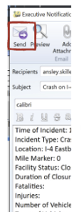
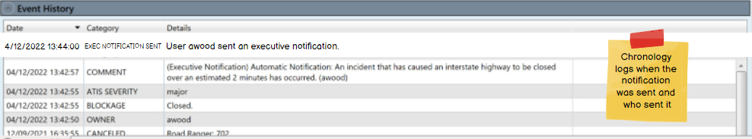
Log Executive Notification
  Log message will be put into the chronology based on the user that is SENDING the Executive Notification.
SunGuide Software Users Group | 5/5/22

Slide 20
COMMENTS?
QUESTIONS?
SunGuide Software Users Group | 5/5/22

Slide 21
SG-5806 Adding multiple activities to a responder at one time instead of only one at a time
Tucker Brown
SunGuide Software Users Group | 5/5/22

Slide 22
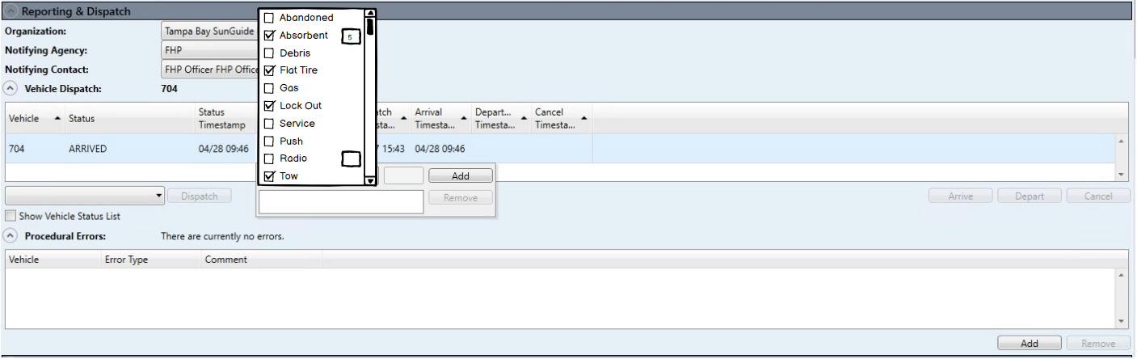
Multiple Activities
  Users can enter multiple activities from the event including quantity if needed.
SunGuide Software Users Group | 5/5/22

Slide 23
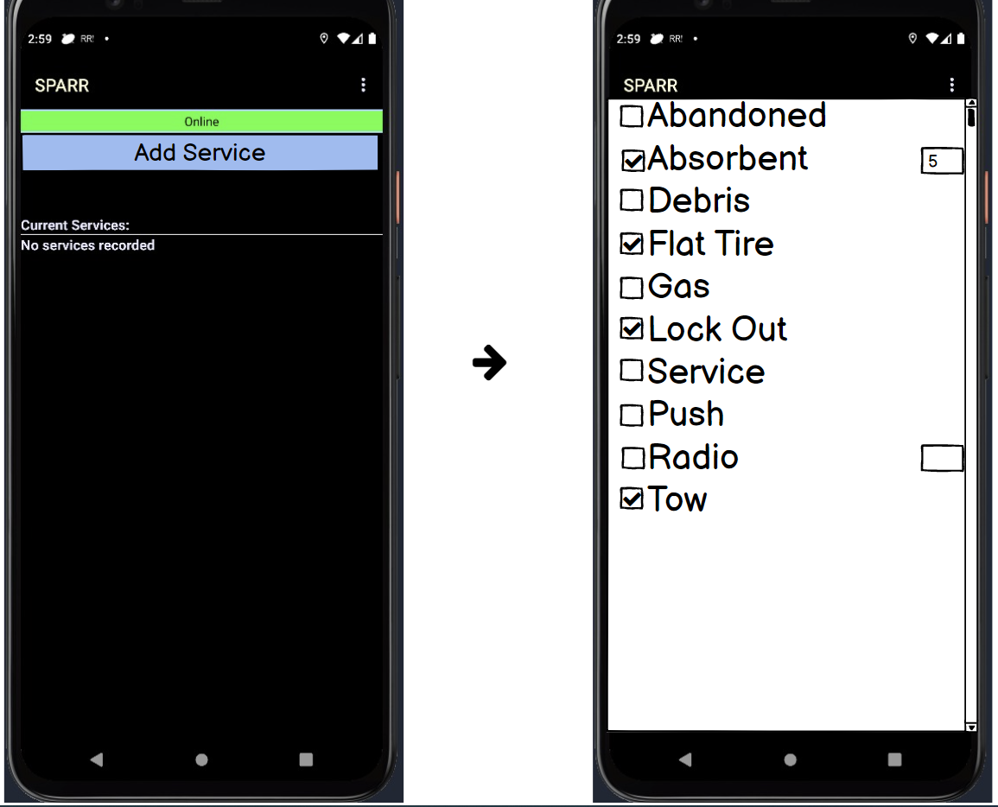
Multiple Activities
  Users can enter multiple activities from the SPARR application including quantity if needed.
SunGuide Software Users Group | 5/5/22

Slide 24
COMMENTS?
QUESTIONS?
SunGuide Software Users Group | 5/5/22

Slide 25
SG-5810 Copy a SAS Plan
Tucker Brown
SunGuide Software Users Group | 5/5/22

Slide 26
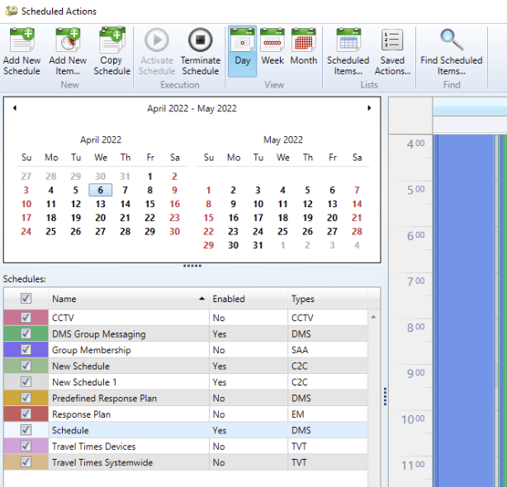
Copy SAS Schedule
  Adding the ability to copy a schedule by highlighting the schedule and selecting the ribbon button.
SunGuide Software Users Group | 5/5/22

Slide 27
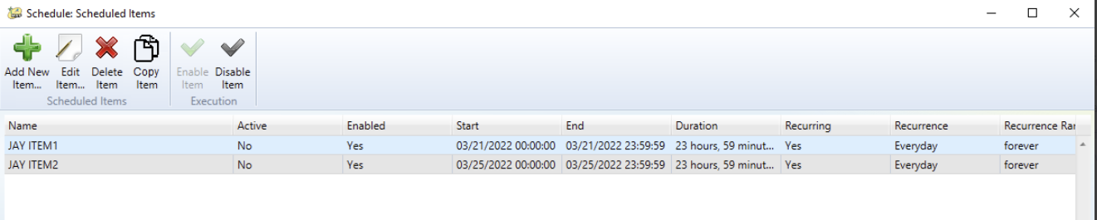
Copy SAS Schedule Item
  Adding the ability to copy a schedule item by highlighting the schedule item from the list of items in a schedule and selecting the ribbon button.
SunGuide Software Users Group | 5/5/22

Slide 28
COMMENTS?
QUESTIONS?
SunGuide Software Users Group | 5/5/22

Slide 29
SG-6015 TPAS prompt for verifying available spaces for CO reporting
Tucker Brown
SunGuide Software Users Group | 5/5/22

Slide 30
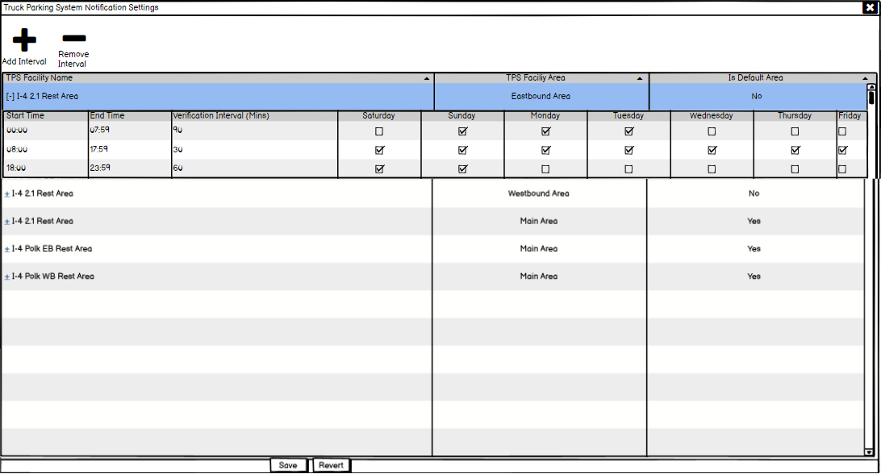
Verification Configuration
  Users can set the verifications for each area by day and time of day.
  No schedule implies that no verification is needed
SunGuide Software Users Group | 5/5/22

Slide 31
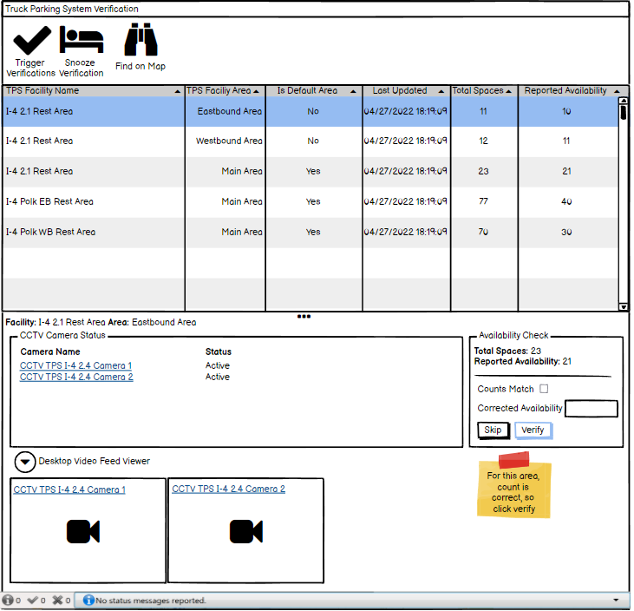
Verification Dialog
  Verification dialog pops up for all users with permission to resolve the verifications.
  System allows users to manually trigger the verification to appear
  System allows the user to snooze a specific area’s verification.
  User would confirm the area count, make sure it matches 511 (for default area only), or set the corrected availability.
  System allow the user to skip a verification.
SunGuide Software Users Group | 5/5/22

Slide 32
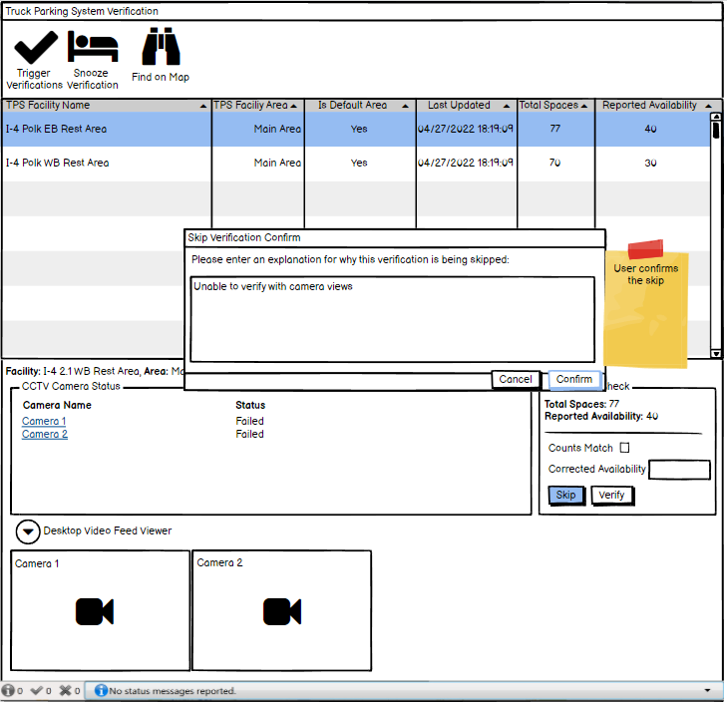
Verification Dialog
  User can skip the verification, but it would be noted in the database with comment.
SunGuide Software Users Group | 5/5/22

Slide 33
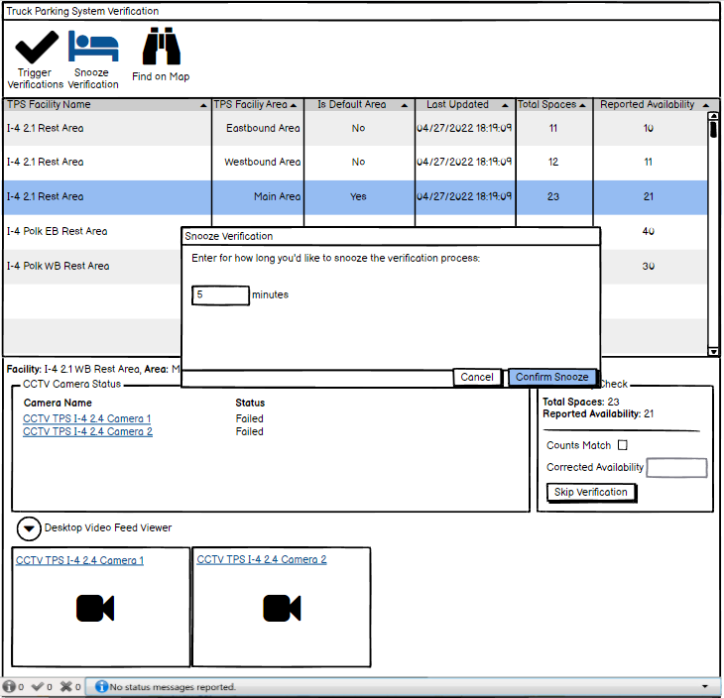
Verification Dialog
  System allows the user to snooze a specific area’s verification.
    If snoozing longer than the next verification, the verification would be resolved and the next one would be shown to the user.
SunGuide Software Users Group | 5/5/22

Slide 34
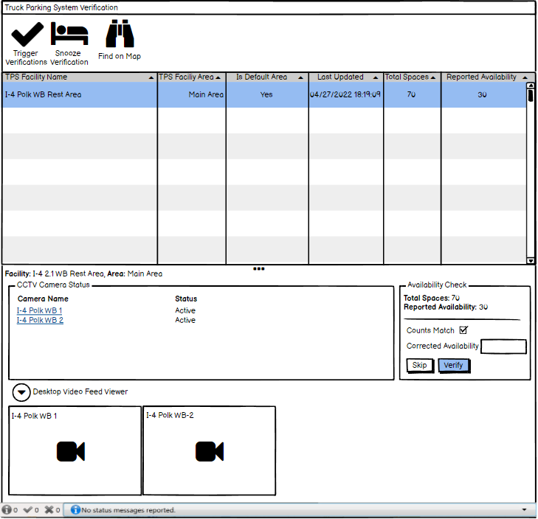
Verification Dialog
  Items are removed from the dialog as the users respond to the verifications.
  “Counts” Match is available to users if the area is a Default Area of a facility.
SunGuide Software Users Group | 5/5/22

Slide 35
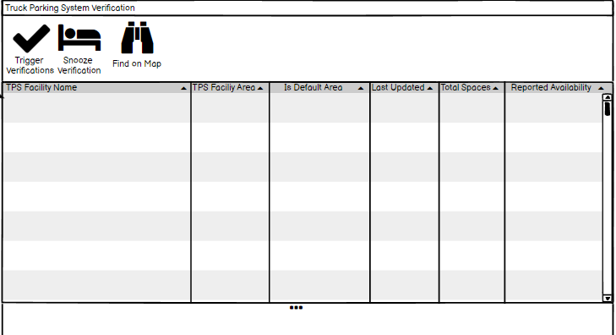
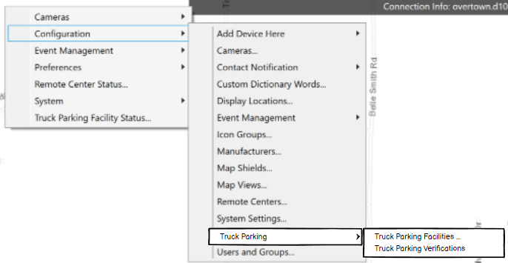
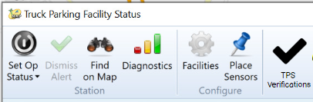
Verification Dialog
  The dialog is available at any time with or without pending verifications.
  Allows the manually triggered verifications even when there are no current verification to be completed.
SunGuide Software Users Group | 5/5/22

Slide 36
COMMENTS?
QUESTIONS?
SunGuide Software Users Group | 5/5/22

Slide 37
SG-6120 Allow saving configuration of items without errors despite errors in other items of the same type
Tucker Brown
SunGuide Software Users Group | 5/5/22

Slide 38
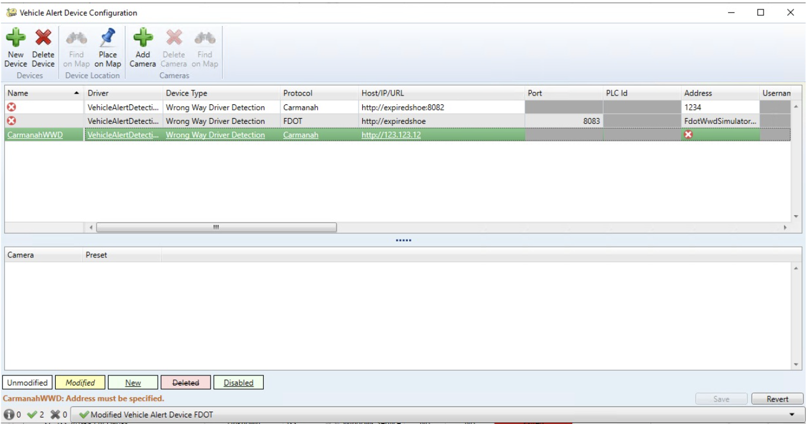
Issue with the modified item
  Problems with the added/modified line will show in the error message and prevent saving
SunGuide Software Users Group | 5/5/22

Slide 39
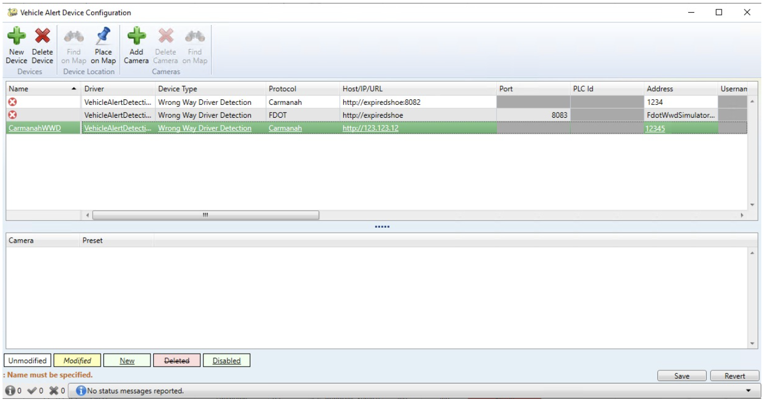
Issue NOT with the modified item
  Problems with other parts of the dialog will show in the error message but saving is allowed
SunGuide Software Users Group | 5/5/22

Slide 40
COMMENTS?
QUESTIONS?
SunGuide Software Users Group | 5/5/22

Slide 41
SG-6142 Add a "Submit Crash Report" option for
Operator Map Failures
Tucker Brown
SunGuide Software Users Group | 5/5/22

Slide 42
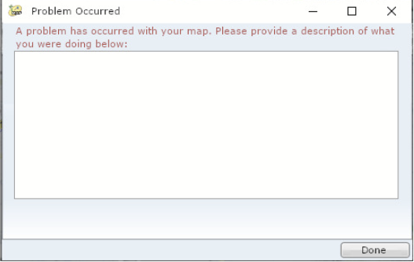
User Information for Crash
  If the map crashes, IF POSSIBLE, a dialog will prompt the user to enter any information about what was being done to potentially add to the issue report.
  Once information is collected, it will automatically open an issue in JIRA for SwRI to review and address.
SunGuide Software Users Group | 5/5/22

Slide 43
COMMENTS?
QUESTIONS?
SunGuide Software Users Group | 5/5/22

Slide 44
SG-5875 Issue 564 – Phase 2 – EM and AVL
Tucker Brown
SunGuide Software Users Group | 5/5/22

Slide 45
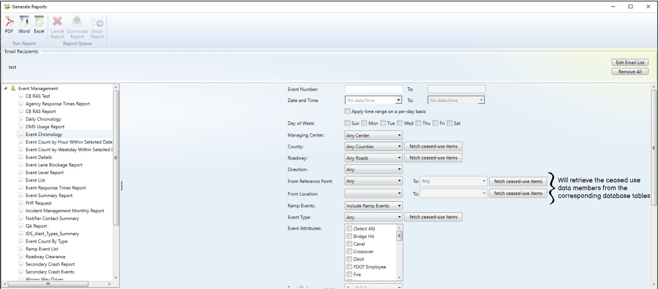
Reports
  Report dialog will allow the user to retrieve ceased use items
SunGuide Software Users Group | 5/5/22

Slide 46
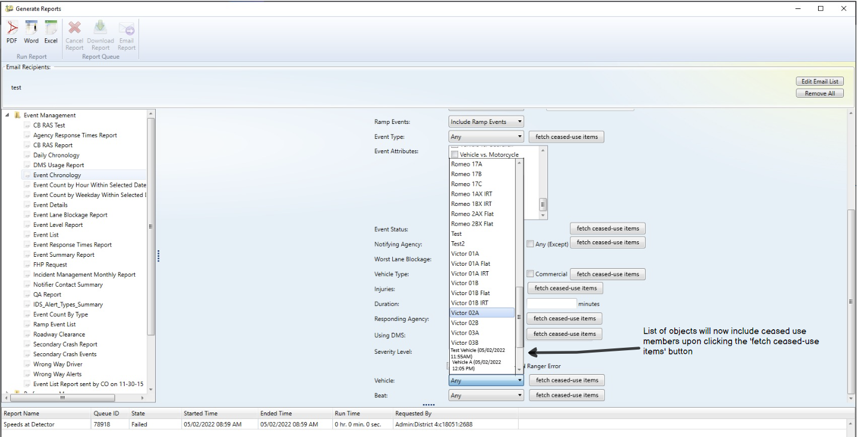
Reports
  Report dialog will have ceased use items in the menu
SunGuide Software Users Group | 5/5/22

Slide 47
COMMENTS?
QUESTIONS?
SunGuide Software Users Group | 5/5/22

Slide 48
Other Enhancements
Tucker Brown
SunGuide Software Users Group | 5/5/22

Slide 49
Other Enhancements
  SG-4891 Rewrite the CCTV NTCIP driver in C#
    Previously in Java, this will be written in C# and resolve threading issues seen in driver polling.
SunGuide Software Users Group | 5/5/22

Slide 50
COMMENTS?
QUESTIONS?
SunGuide Software Users Group | 5/5/22

