Slide 1


SunGuide Software
Users Group Meeting
May 18, 2023

Slide 2
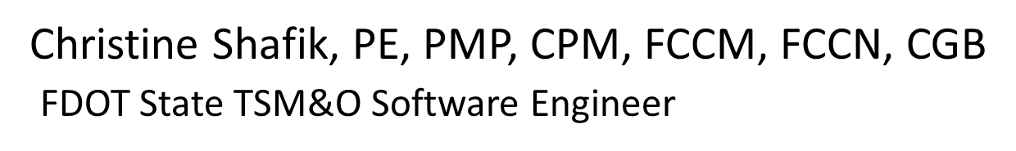
WELCOME
ATTENDEE ROLL CALL

Slide 3
SG-6679 - Block Camera
From Being Used
As Nearest CCTV In EM
Tucker Brown

Slide 4
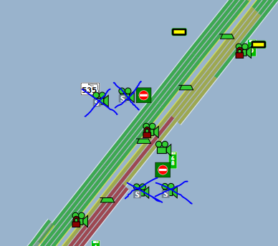
Current Behavior
WWD Cameras have been incorporated into the system and, due to their proximity, are being chosen as the nearest camera to events.
These static cameras are focused on the ramps, so they aren’t as useful when attempting to view events.

Slide 5
Enhancement Behavior
Do not select specific cameras automatically as a “Nearest Camera”.
Configuration flag will indicate if a camera should be chosen as the nearest camera by default.
All cameras would still be selectable in the nearest camera dialog.

Slide 6
QUESTIONS?
COMMENTS?
SUPPORT?

Slide 7
SG-6666 - Joystick
Tucker Brown

Slide 8
Enhancement
The American Dynamics 3000 Joystick is no longer made and is not available for purchase.
Who is using Joysticks with MCP?
Has anyone looked at alternatives?
Would more people use it if a newer Joystick became available for use in SunGuide?

Slide 9
QUESTIONS?
COMMENTS?
SUPPORT?

Slide 10
SG-5878 - Travel Time calculation when Speed 0 is reported
Tucker Brown

Slide 11
Current Behavior
Speed = 0 with Volume > 0 is treated as an error.
Speed = 0 with Volume = 0 is treated as valid, as you may have Occupancy and stopped traffic.
Speed = 0 with Volume = 0 and Occupancy = 0 is also valid, especially at night with no cars passing.
  0 is not a speed that can be used in travel times.

Slide 12
Enhancement Behavior
When seeing the criteria:
  Volume = 0
  Occupancy = 0
  Use speed limit as the speed for travel times
Allows travel times to be produced, even if the sensor reports Speed = 0 in these circumstances.

Slide 13
QUESTIONS?
COMMENTS?
SUPPORT?

Slide 14
SG-6627 - WWD CAV
Enhancement
Tucker Brown

Slide 15
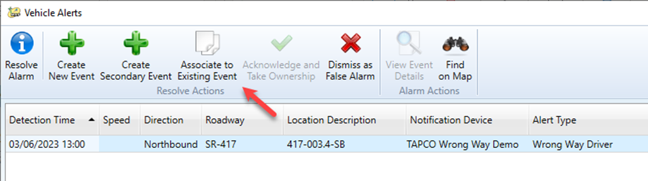
Current Behavior
When a WWD alert comes in, the user has the following options:
Associating the alert to an existing event lists the alert in the chronology.

Slide 16
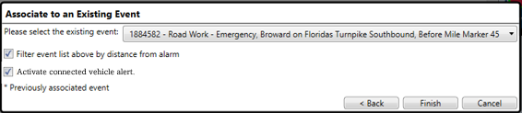
Enhancement Behavior
Add an option to the “Associate” behavior.
Should be checked by default but allow the operator to uncheck.
Why?
  Turnpike has a custom CV application that listens to resolution for WWD alerts, and may deploy WWD TIM messaging.

Slide 17
QUESTIONS?
COMMENTS?
SUPPORT?

Slide 18
SG-6674 - Alphabetize
Video Layout List
Tucker Brown

Slide 19
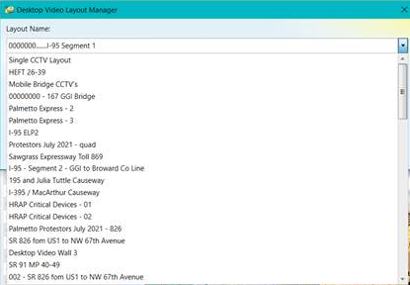
Current Behavior & Enhancement
There is a new enhancement to share VOD layouts, but the list is not alphabetized.
Request is to alphabetize the list.

Slide 20
QUESTIONS?
COMMENTS?
SUPPORT?

Slide 21
TERL DAR Updates
Mark Dunthorn

Slide 22
Status
  8 of 11 production SunGuide instances are now pushing data to the TERL.
  New version of the ESU dashboard is in-progress.
  Planned outage this Saturday morning – no impact to districts expected.

Slide 23
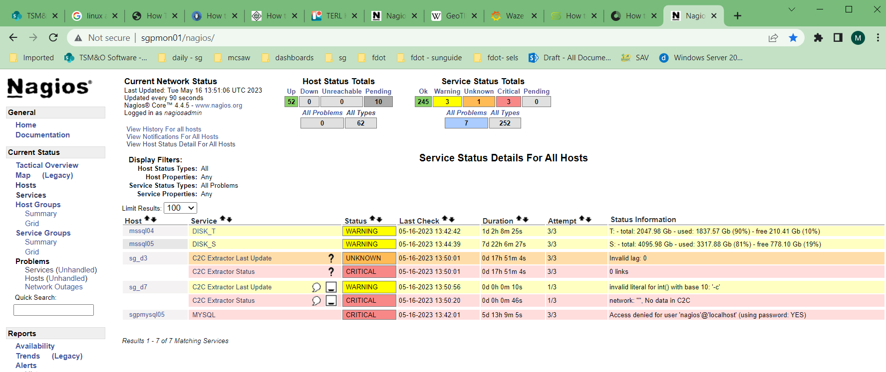
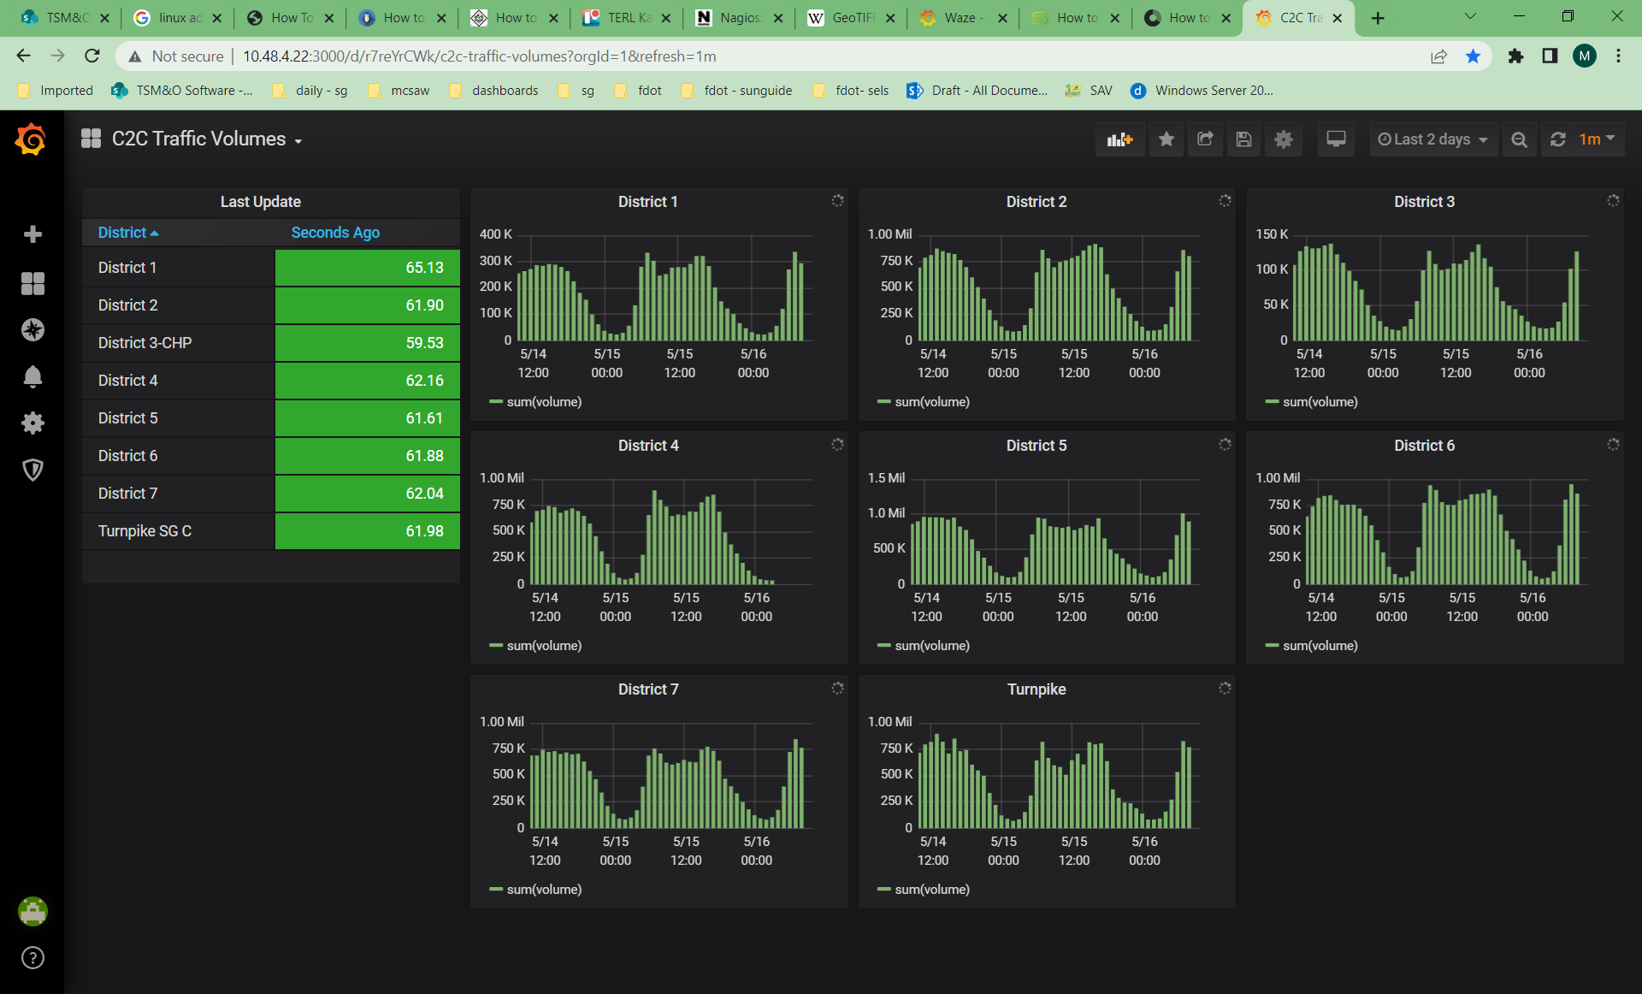
Monitoring
  Software team at the TERL monitors status of all production systems, including C2C and now DAR.
  If we detect an outage, we’ll reach out to the districts after one hour.
  Christine will reach out to the districts for contact info.

Slide 24
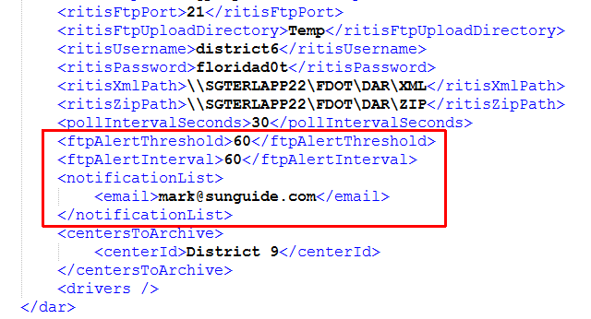
Notification Config
  SunGuide can be configured to send notifications when DAR is unable to transfer data.

Slide 25
QUESTIONS?
COMMENTS?

Slide 26
ANNOUNCEMENTS?
QUESTIONS?
COMMENTS?
ADJOURN.

