Slide 1


SunGuide Software
Users Group Meeting
June 1, 2023

Slide 2
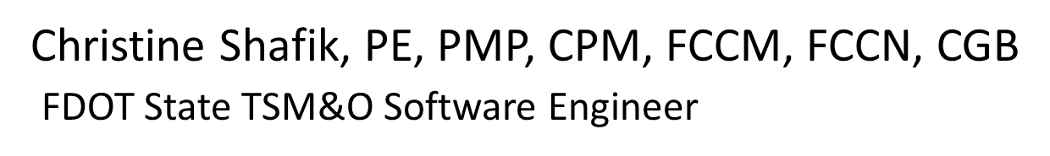
WELCOME
ATTENDEE ROLL CALL

Slide 3
SG-6009 - Request for help getting correct sign dimensions and fonts in the Color DMS Simulator SCAST
AJ Skillern

Slide 4
Current Behavior
  When simulating a DMS, the simulator modifies the sign configuration to a fixed font used by the simulator.
  After simulating a DMS, the user needs to modify the sign configuration on the test system and re-verify the sign to make it work.
  Unable to accurately simulate DMS from field.

Slide 5
Enhancement
  Modify the DMS Simulator to use the sign configuration stored in SunGuide.
      This would include the fonts associated to the sign.
  After simulating a DMS in SunGuide, no verification of sign is needed.

Slide 6
QUESTIONS?
COMMENTS?
SUPPORT?

Slide 7
SG-6475 - Toll Signs Allowed in DMS Actions for GPIO
AJ Skillern

Slide 8
Current Behavior and Enhancement
Current Behavior
  In GPIO, Toll and Lane Status signs can be selected for automatic posting of messages based on GPIO device input.
Enhancement
  Modify SunGuide to only allow “General” DMS to be configured for output as part of GPIO.
  Are there other spots in the system that need filtering?

Slide 9
QUESTIONS?
COMMENTS?
SUPPORT?

Slide 10
SG-6492 - Allow simultaneous remote/local devices from IDS vehicle alert device drivers
AJ Skillern

Slide 11
Current Behavior
When configuring a WWD type for where the client sends alerts, it is necessary to “register” with the client and tell the client where to send alerts.
This is configurable at the driver level for each protocol, but not for each device.
Some device types have devices that run OUTSIDE the network, requiring one IP for an external endpoint, while having other devices INSIDE the network requiring a different IP.

Slide 12
Enhancement
Allow the endpoint for alerts to be configurable at the device level for flexibility in how the districts choose to deploy WWD devices.

Slide 13
QUESTIONS?
COMMENTS?
SUPPORT?

Slide 14
SG-6689 - Congestion Tail passes
DMSs initially included in Response Plan
AJ Skillern

Slide 15
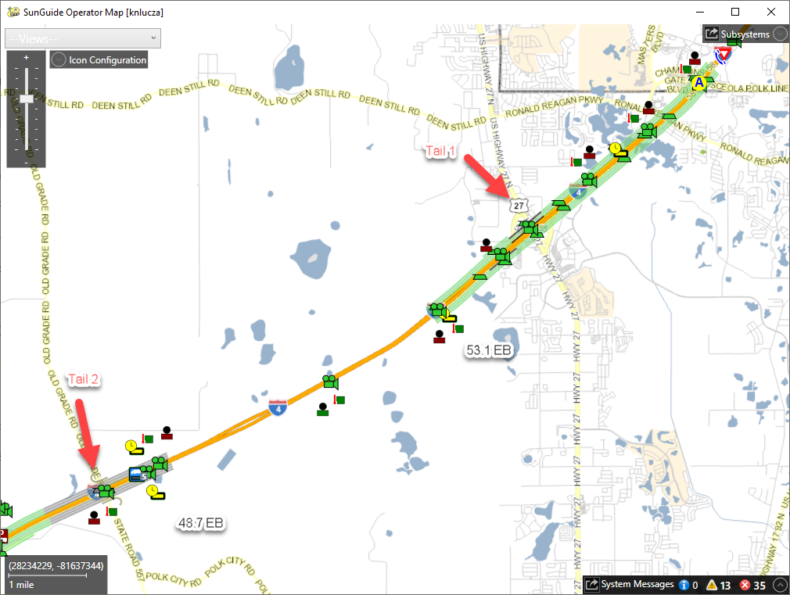
Current Behavior
When creating a response plan, DMSs are selected from the event location, and may include devices that are between the congestion head and tail.
In other states, these signs are excluded from the response plan, as messaging on them may not make sense.

Slide 16
Enhancement
What do we do with a selected sign within the congestion head and tail region?
  Remove the sign from the response plan?
  Add a new template category for this situation and let the district decide?
  Other?

Slide 17
QUESTIONS?
COMMENTS?
SUPPORT?

Slide 18
ANNOUNCEMENTS?
QUESTIONS?
COMMENTS?
ADJOURN.

