Slide 1


SunGuide Release 9.0
Design Review
Pt. 1
SunGuide Software Users Group | 6/15/23

Slide 2
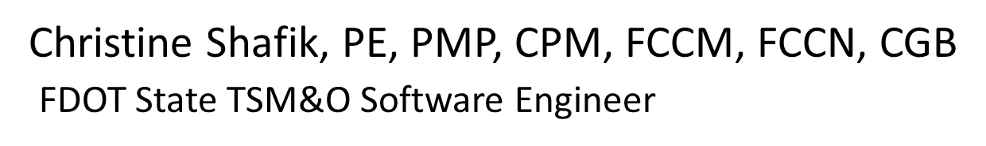
WELCOME
ATTENDEE ROLL CALL

Slide 3
SG-1053 Add filter in reports for "Comment Type" and SG-4784 Keyword search for Reports
Tucker Brown
SunGuide Software Users Group | 6/15/23

Slide 4
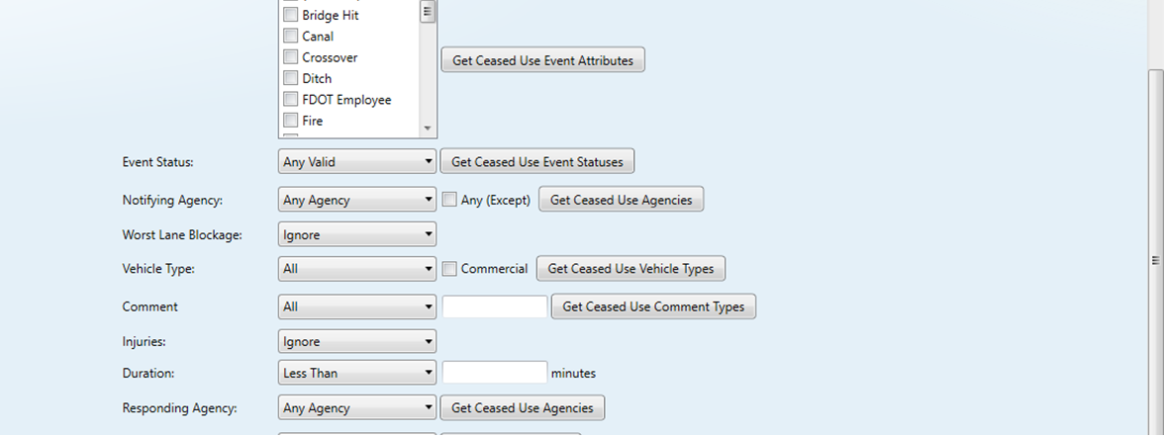
Comment Type / Text and Keyword Filters
  Comment Type and Text within that Comment Type can be filtered.
  Search based on Keyword.
SunGuide Software Users Group | 6/15/23

Slide 5
COMMENTS?
QUESTIONS?
SunGuide Software Users Group | 6/15/23

Slide 6
SG-6417 Configure RPG Distance for DMS Messages when
Travel Lanes are Cleared
Tucker Brown
SunGuide Software Users Group | 6/15/23

Slide 7
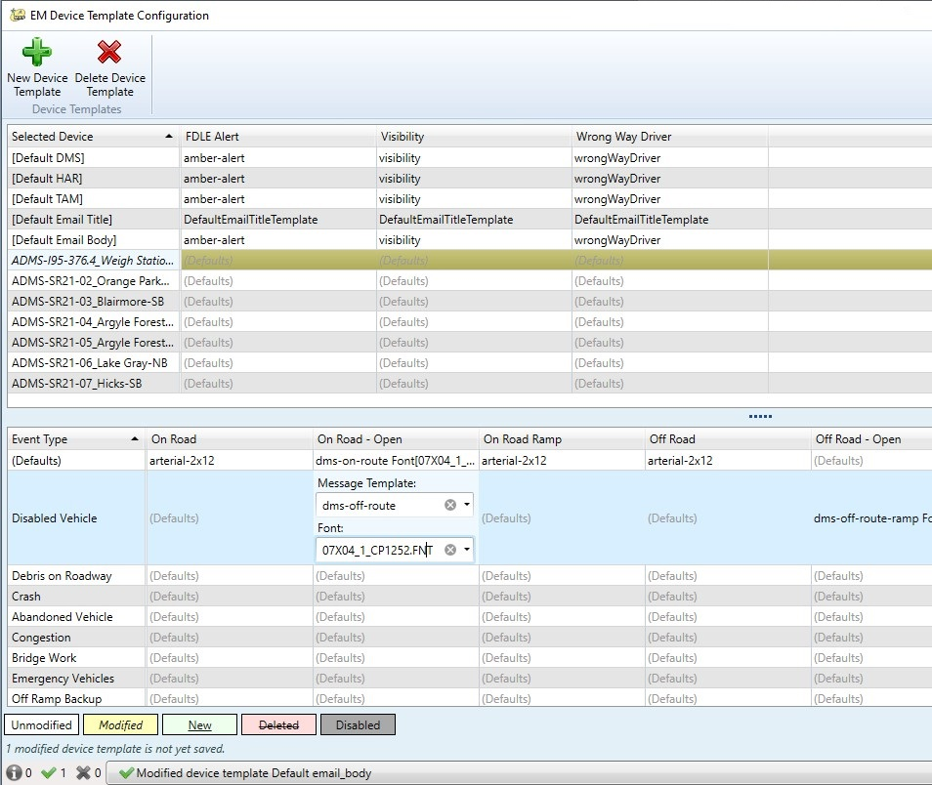
No Blockage Response Plan – On Road
New Template Category for a device that is on the same roadway as an event, but there is no blockage.
SunGuide Software Users Group | 6/15/23

Slide 8
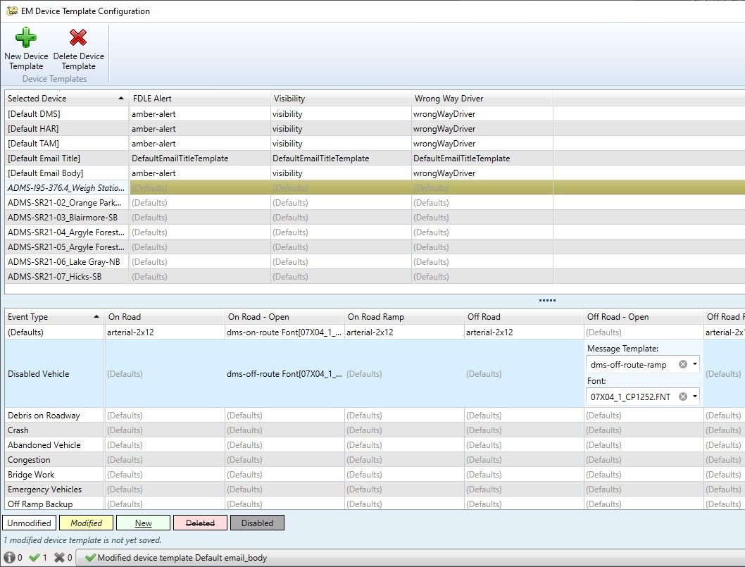
No Blockage Response Plan – Off Road
New Template Category for a device that is on a different roadway as an event, but there is no blockage.
SunGuide Software Users Group | 6/15/23

Slide 9
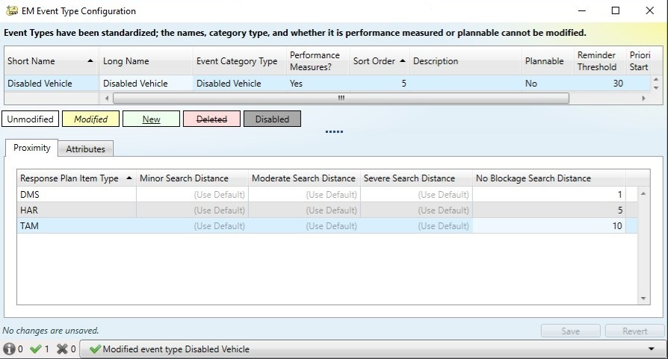
No Blockage Search Distance
New search distance setting defaults for the case when there is no blockage.
SunGuide Software Users Group | 6/15/23

Slide 10
COMMENTS?
QUESTIONS?
SunGuide Software Users Group | 6/15/23

Slide 11
SG-6193 Enhance the Contact section in SunGuide
Tucker Brown
SunGuide Software Users Group | 6/15/23

Slide 12
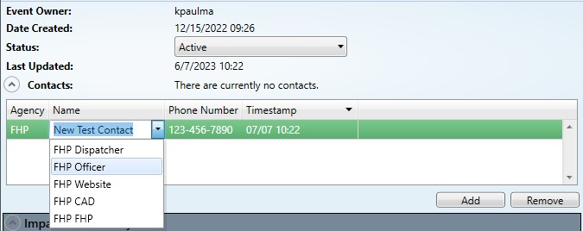
Selecting Contact
  Operator can type a contact or select an existing one.
SunGuide Software Users Group | 6/15/23

Slide 13
COMMENTS?
QUESTIONS?
SunGuide Software Users Group | 6/15/23

Slide 14
SG-5364 Request to enhance for Vehicle dispatch documentation
Tucker Brown
SunGuide Software Users Group | 6/15/23

Slide 15
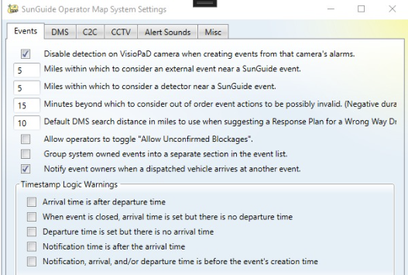
Notify AVL Event Owners Setting
SunGuide Software Users Group | 6/15/23

Slide 16
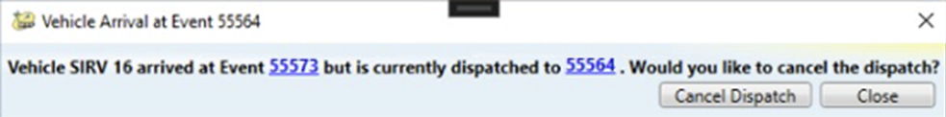
Notify AVL Event Owners Pop Up
  AVL Dispatched can be directly cancelled.
SunGuide Software Users Group | 6/15/23

Slide 17
COMMENTS?
QUESTIONS?
SunGuide Software Users Group | 6/15/23

Slide 18
SG-5682 Wrong Way Driver response plan's location
Tucker Brown
SunGuide Software Users Group | 6/15/23

Slide 19
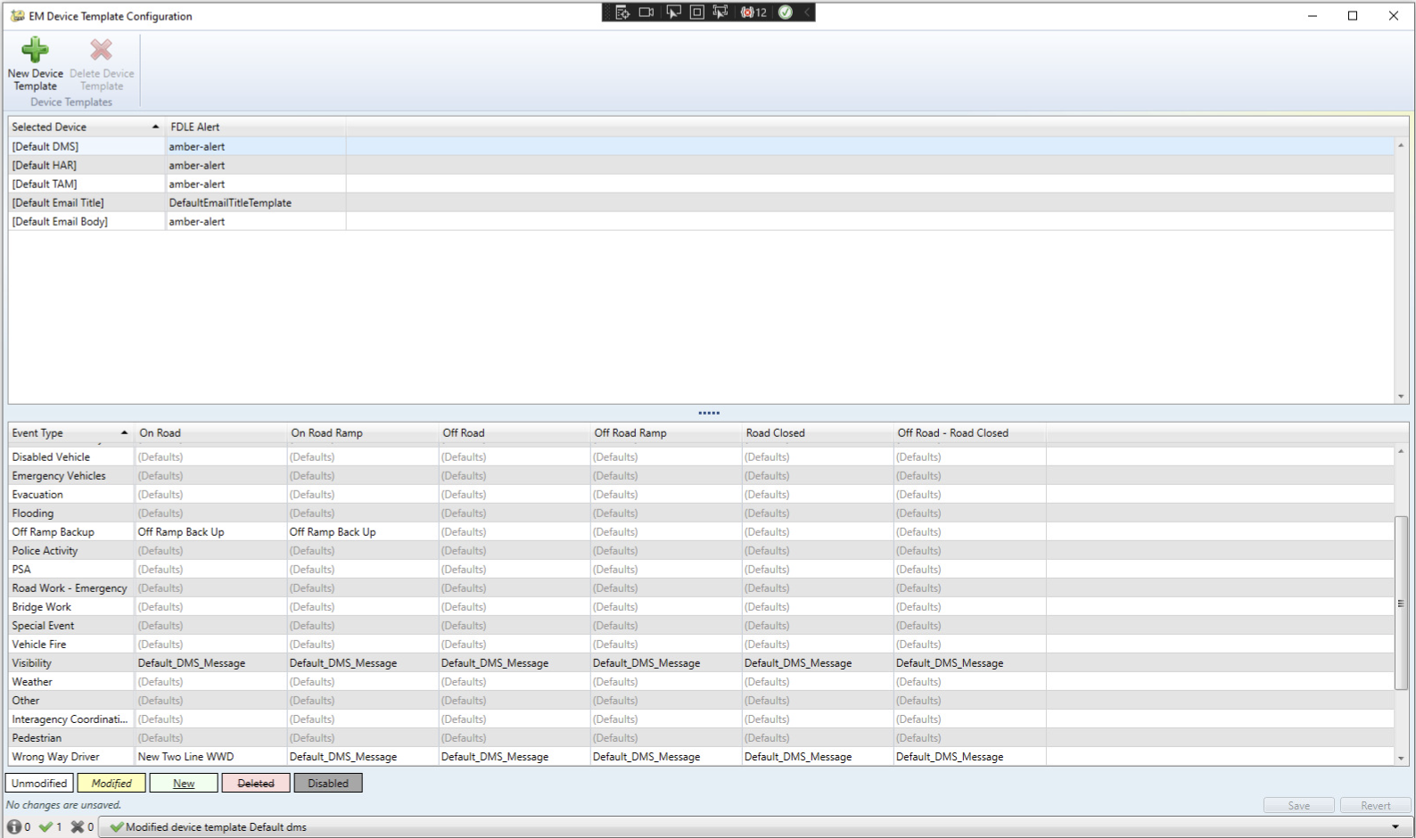
Location of Response Plan Template
Visibility and Wrong Way Driver event types are now moved to event location specific events, and can use different templates based on the location and blockage information.
SunGuide Software Users Group | 6/15/23

Slide 20
COMMENTS?
QUESTIONS?
SunGuide Software Users Group | 6/15/23

Slide 21
SG-3232 Associating FHP and TSS Alerts to Already Created Events
Tucker Brown
SunGuide Software Users Group | 6/15/23

Slide 22
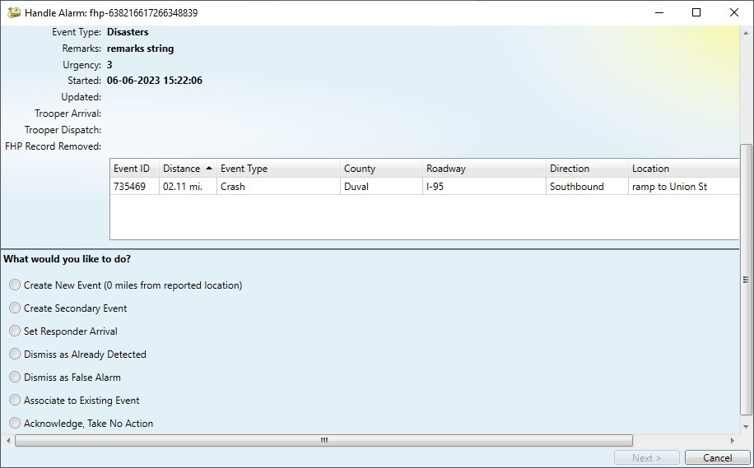
Alarm Dialog
SunGuide Software Users Group | 6/15/23

Slide 23
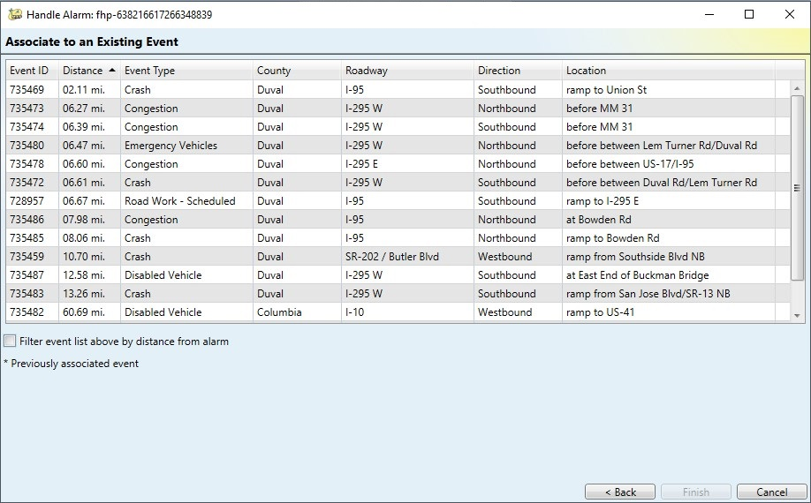
Grid for Associating Events
Grid will be added for additional filter capability.
SunGuide Software Users Group | 6/15/23

Slide 24
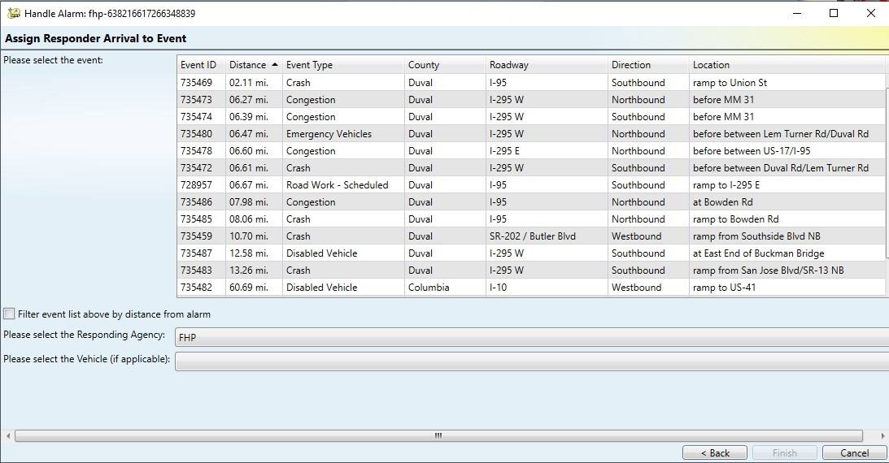
Grid for Responder Arrival
SunGuide Software Users Group | 6/15/23

Slide 25
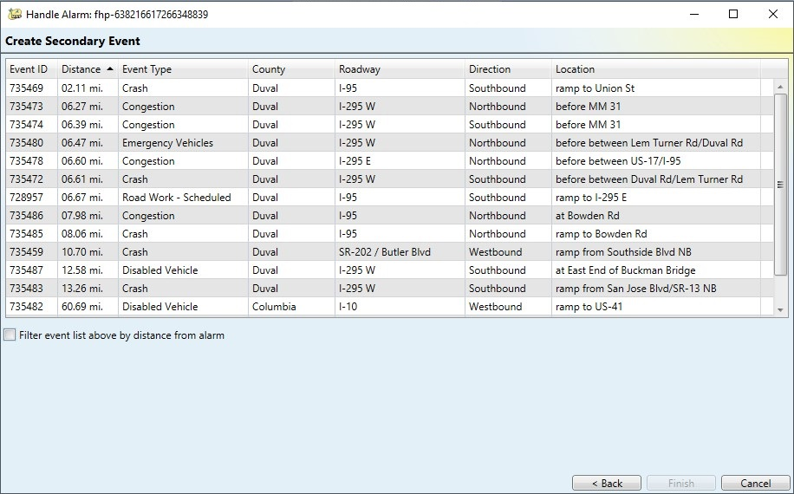
Grid for Secondary Events
SunGuide Software Users Group | 6/15/23

Slide 26
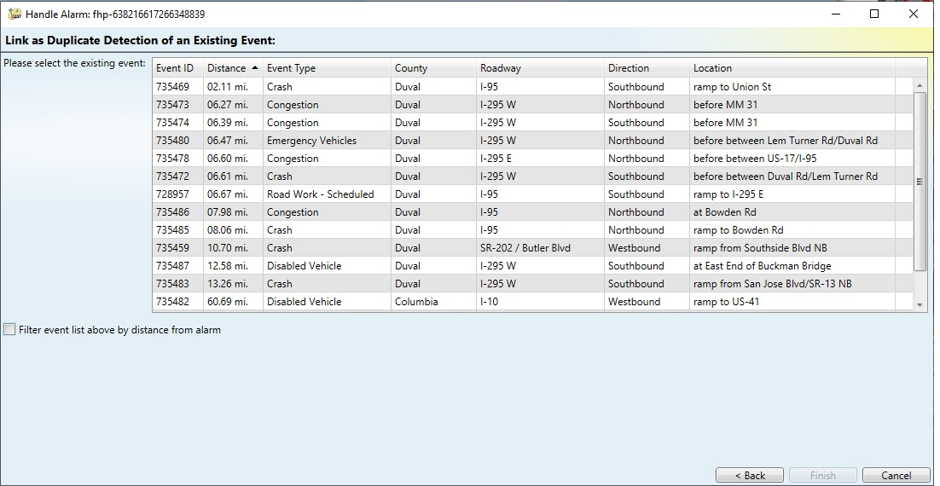
Grid for Duplicate Events
SunGuide Software Users Group | 6/15/23

Slide 27
COMMENTS?
QUESTIONS?
SunGuide Software Users Group | 6/15/23

Slide 28
SG-4758 RWIS Alerts need the alert type and value added
Tucker Brown
SunGuide Software Users Group | 6/15/23

Slide 29
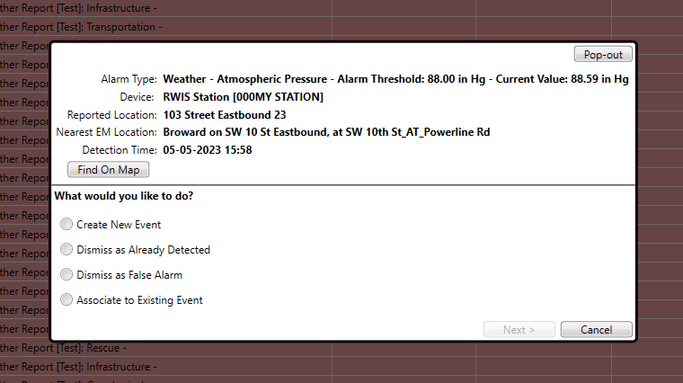
Additional Information for RWIS Alerts
SunGuide Software Users Group | 6/15/23

Slide 30
COMMENTS?
QUESTIONS?
SunGuide Software Users Group | 6/15/23

Slide 31
SG-6397 RISC Module Chronology Report
Tucker Brown
SunGuide Software Users Group | 6/15/23

Slide 32
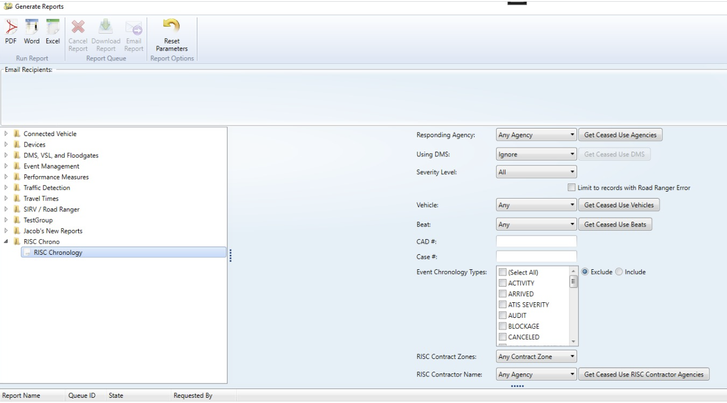
RISC Chronology Report
New report and filters.
SunGuide Software Users Group | 6/15/23

Slide 33
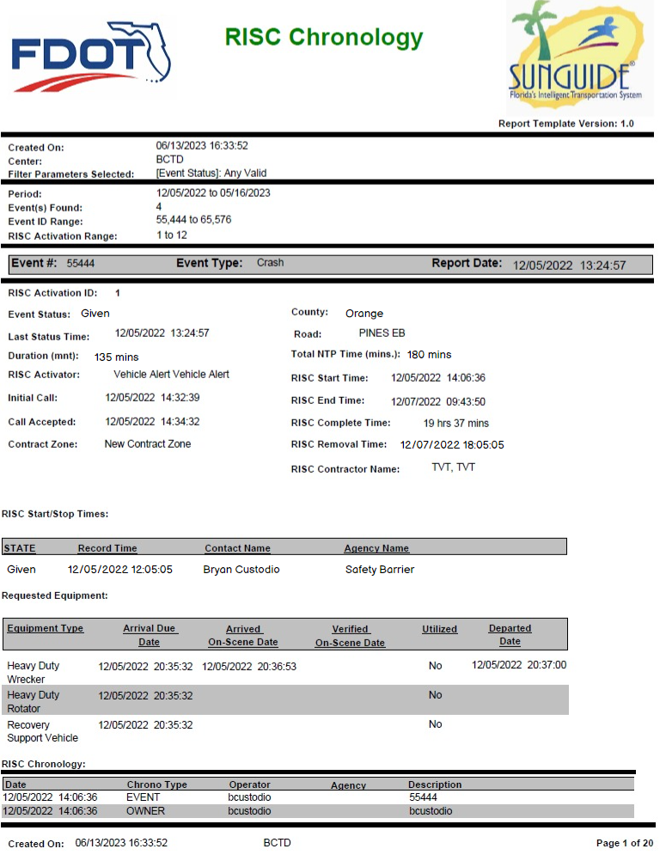
RISC Chronology Report
SunGuide Software Users Group | 6/15/23

Slide 34
COMMENTS?
QUESTIONS?
SunGuide Software Users Group | 6/15/23

Slide 35
SG-2964 Multiple Logical
Devices Mapped to
Same Physical Device
Tucker Brown
SunGuide Software Users Group | 6/15/23

Slide 36
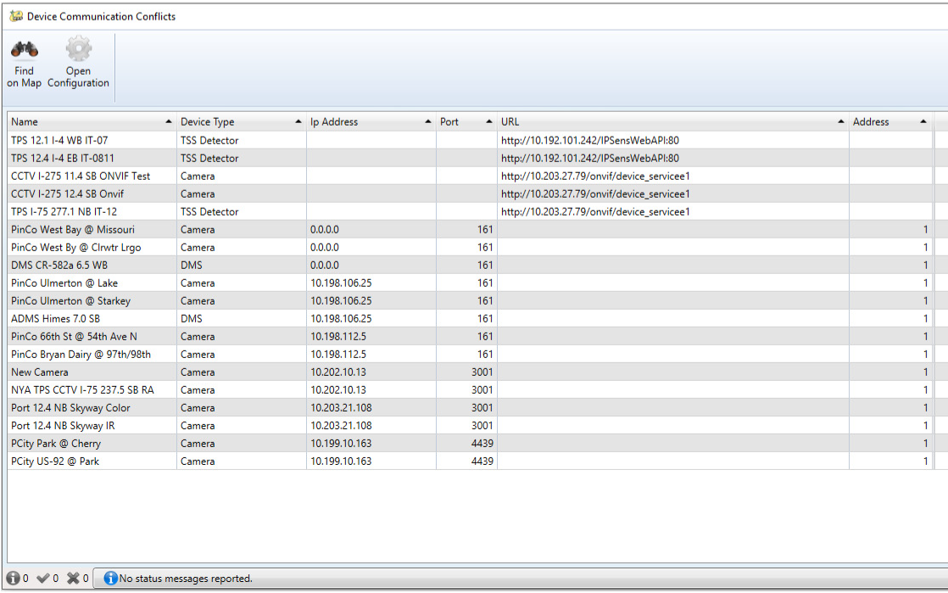
Conflict Checking
Link to configuration page for conflicting items
IP/Port or URL duplicates are flagged for evaluation
Cross device type communication parameters are evaluated
Accessed from the context menu. Configuration >> Device Uniqueness
SunGuide Software Users Group | 6/15/23

Slide 37
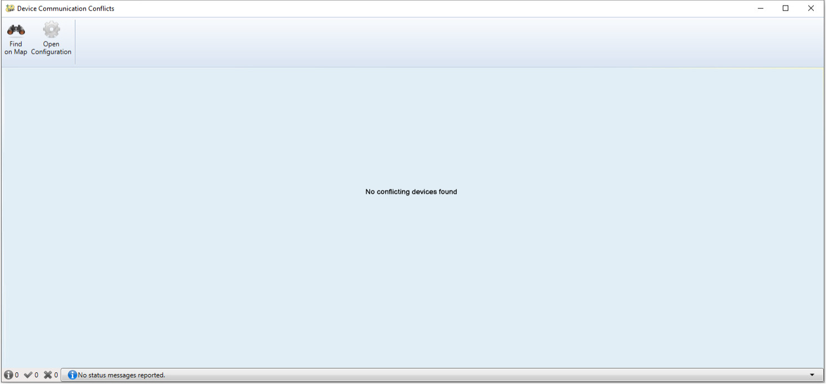
Conflict Checking
SunGuide Software Users Group | 6/15/23

Slide 38
COMMENTS?
QUESTIONS?
SunGuide Software Users Group | 6/15/23

Slide 39
Other Enhancements
Tucker Brown
SunGuide Software Users Group | 6/15/23

Slide 40
Other Enhancements
SG-6131 Involved Vehicle Make and Model Automatically Approved
  When checking a DMS message for spelling conflicts, the software will automatically approve words that are configured as vehicle make long name, vehicle model long name, vehicle color long name, or state abbreviations short name.
SG-4562 Nearest camera for SPARR created events
  When an event is created with a location through the AVL interface, the software will automatically set the nearest, in-service camera as the associated camera of the event.
SG-6201 Add EM audit events to DAR XML feed
  The software will send updates through the DAR interface when audits are made to events.
SunGuide Software Users Group | 6/15/23

Slide 41
COMMENTS?
QUESTIONS?
SunGuide Software Users Group | 6/15/23

Slide 42
ANNOUNCEMENTS?
QUESTIONS?
COMMENTS?
ADJOURN.

