Slide 1


SunGuide Software
Users Group Meeting
June 30, 2022

Slide 2
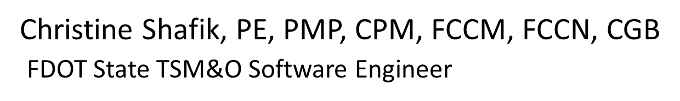
WELCOME
ATTENDEE ROLL CALL

Slide 3
SG-6355 – Security improvements
Tucker Brown

Slide 4
Enhancement
Secure interprocess communications (TLSv3)
  Encryption support by software. Might need changes to Java processes
Replace MD5 hashes for password with something more secure
  Add more to the hashing to make it unique even for the same username/password

Slide 5
Enhancement
Multi-Factor Authentication
Password complexity requirements
  Characters, length, password history, expirations
  Change on next login
Encrypt SQL Server data at rest
  Setting in SQL Server

Slide 6
Enhancement
Log people off after periods of inactivity
  Hard for processes that just read data
  Re-prompt for authentication
All stored passwords (maybe usernames) should be encrypted/obfuscated
  AVL? Comms Parameters?

Slide 7
QUESTIONS?
COMMENTS?
SUPPORT?

Slide 8
SG-6309 – Make Operator Map Connection with Databus More Network Tolerant
Tucker Brown

Slide 9
Enhancement
When Databus disconnects, Operator Maps are logged out. Can cause issues when entering time sensitive information.
Make Databus more tolerant to packet loss, small network disconnects.
TxDOT has done some work in this that can be integrated into SunGuide.

Slide 10
QUESTIONS?
COMMENTS?
SUPPORT?

Slide 11
SG-6366 – RISC Module popups should be configurable
Tucker Brown

Slide 12
Current Behavior and Enhancement
Current Behavior
  RISC popups are sent to all users with permissions to handle RISC.
  Recent enhancements to Executive Notifications send the notifications to specified users (not all that have permission).
Enhancement
  Request is to make the RISC popups behave in a similar manner to the Executive Notification changes.

Slide 13
QUESTIONS?
COMMENTS?
SUPPORT?

Slide 14
Atlassian Confluence Zero-Day Vulnerability Update
Tucker Brown

Slide 15
Update
All districts have modified/removed users with exposed passwords.
VPN users have been disabled/changed.
New VPN users have been granted access to District systems.

Slide 16
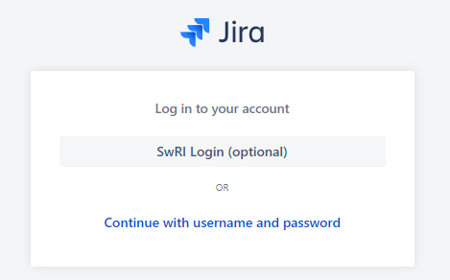
Update
JIRA is back up and running. Please make all updates here:
  https://jira-public.d10.us.swri.org
Same username/password as before
  If you forgot your password, please use the password reset option
Use the “Continue with username and password” option:

Slide 17
QUESTIONS?
COMMENTS?

Slide 18
ANNOUNCEMENTS?
QUESTIONS?
COMMENTS?
ADJOURN.

