Slide 1


SunGuide Software
Users Group Meeting
July 27, 2023

Slide 2
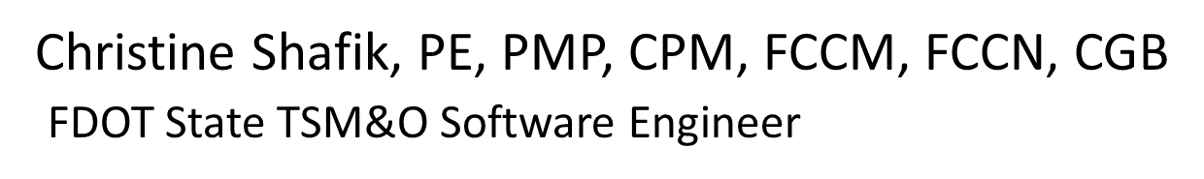
WELCOME
ATTENDEE ROLL CALL

Slide 3
SG-6704 - New Report:
Changes in Device Modes and Reason for Changes
AJ Skillern

Slide 4
Current Behavior
A report exists for changes in device Op Status, but it is missing the user (or subsystem) who made the request for a change.
Maintenance Mode for WWD devices is not part of any existing report.

Slide 5
Enhancement
Prompt the user for the reason they are changing Op Status.
  Add the username and reason to the archive if the user set the device to Active or Out of Service.
  Add the username to the existing report.
Create a report to show changes in Maintenance Mode for Vehicle Alert Devices.

Slide 6
QUESTIONS?
COMMENTS?
SUPPORT?

Slide 7
SG-6657 - Login Logout Issues in Subsystems Dialog
AJ Skillern

Slide 8
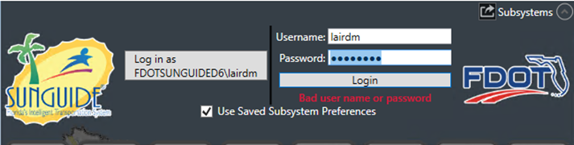
Current Behavior
The login dialog contains separate buttons for a Domain login vs. a SunGuide Login.
  Needed if the user logs out via the Map and needs to log back in.

Slide 9
Enhancement
Add text above the SSO to indicate what the button would be used for.
  Errors related to SSO would be displayed below the button.
Change the right side to a radio button selection between Domain login and SunGuide login.
  SunGuide login would remain the same.
SSO would still bypass all of this upon initial login.

Slide 10
QUESTIONS?
COMMENTS?
SUPPORT?

Slide 11
SG-6762 - Position a camera at a selected point in the image
AJ Skillern

Slide 12
Current Behavior
On the Video On Desktop dialog, the user can control the camera from the sun control element.
The user has the options for PTZ and nudge.

Slide 13
Enhancement
Allow the user to click on the image and move the camera to that point in the image.
  Potentially would require the use of absolute movement (not currently in SunGuide).
TDOT has implemented a similar feature using continuous movement, but FDOT has modified VOD to upgrade VLC versions.
  Will need integration, but would not have to build from scratch.

Slide 14
QUESTIONS?
COMMENTS?
SUPPORT?

Slide 15
SG-6761 - Finer Granularity
Pan and Tilt
AJ Skillern

Slide 16
Current Behavior
Joysticks that use MCP are no longer being sold.
  Not many (if any) replacement options.
Granularity and control through MCP is preferred to VOD control.
Both the Map and MCP use CCTV to send control command to the cameras.

Slide 17
Enhancement
The code indicates there are 8 levels of speed for both MCP and the Map.
Need to investigate the physical range for sending each of these speeds.
  VOD uses 8 equal sections.
  MCP may be logarithmic.
Modify the Map to match the granularity and control of MCP.

Slide 18
QUESTIONS?
COMMENTS?
SUPPORT?

Slide 19
ANNOUNCEMENTS?
QUESTIONS?
COMMENTS?
ADJOURN.

