Slide 1


SunGuide Software
Users Group Meeting
July 28, 2022

Slide 2
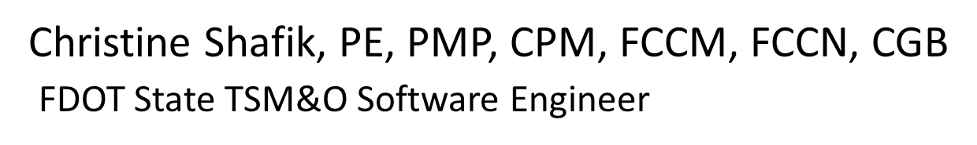
WELCOME
ATTENDEE ROLL CALL

Slide 3
SG-6397 – RISC Module Chronology Report
AJ Skillern

Slide 4
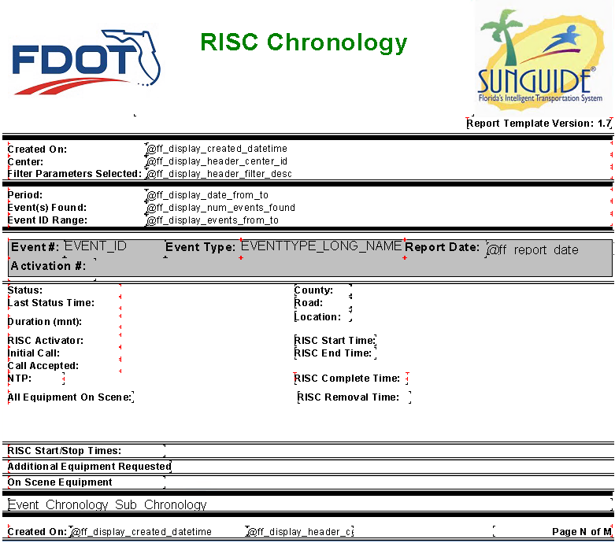
Enhancement
A request has been submitted for a RISC Chronology Report with the following fields:

Slide 5
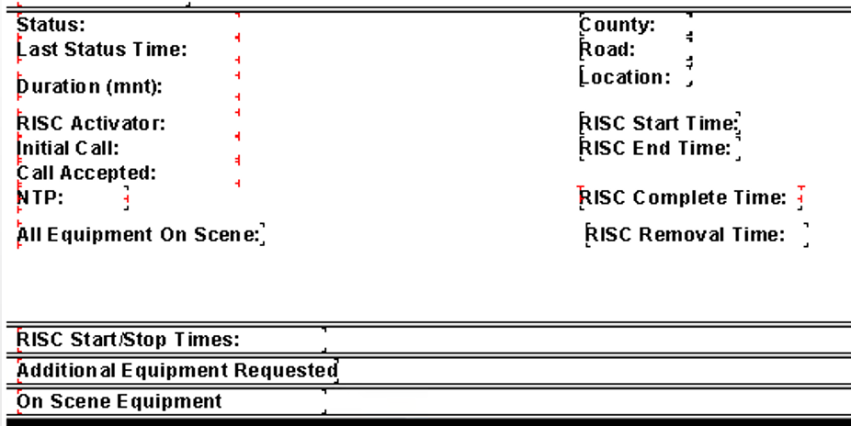
Enhancement
RISC Removal would be calculated as:
(RISC Complete Time – Initial NTP – SUM(NTP Stoppage)
Are there any other fields needed?

Slide 6
QUESTIONS?
COMMENTS?
SUPPORT?

Slide 7
SG-5488 – Ability to Associate and De-associate Multiple FHP # to Same Event
AJ Skillern

Slide 8
Current Behavior and Enhancement
Current Behavior
  A single FHP # is available when working an event.
  Reporting on FHP # is based on a single field.
Enhancement
  Allow a list of FHP #’s to be submitted as part of the event.
  Allow users to add and remove FHP #’s from the event while it is still open (without audit).
  Report on event where ANY of the FHP #’s match the search criteria.

Slide 9
QUESTIONS?
COMMENTS?
SUPPORT?

Slide 10
SG-5832 – Response Plan
Email
AJ Skillern

Slide 11
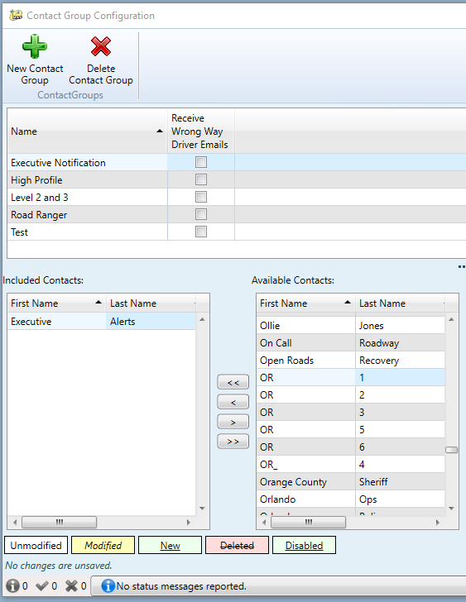
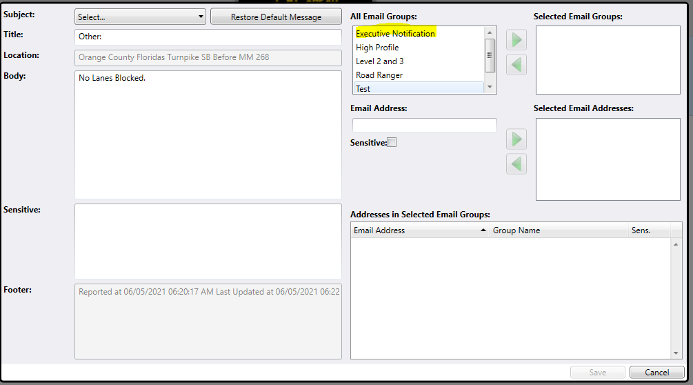
Current Behavior
Contact Groups do not have a sort order.
There is no way to reorder how Email Groups are sorted in the response plan.

Slide 12
Enhancement
Add sort order to Contact Groups, and sort them in any dialog that displays Contact Groups.

Slide 13
QUESTIONS?
COMMENTS?
SUPPORT?

Slide 14
SG-5432 – Email via RPG question
AJ Skillern

Slide 15
Current Behavior and Enhancement
Current Behavior
  Emails are sent with ONLY a Bcc: list, meaning the email doesn’t show the other recipients.
Enhancement
  Allow configuration to specify a To:, Cc:, and Bcc: list.
  Current functionality would remain the same.
  Additional options would allow the other lists to populate as well.

Slide 16
QUESTIONS?
COMMENTS?
SUPPORT?

Slide 17
ANNOUNCEMENTS?
QUESTIONS?
COMMENTS?
ADJOURN.

