Slide 1


SunGuide Release 9.0
Design Review
Pt. 2
SunGuide Software Users Group | 8/10/23

Slide 2
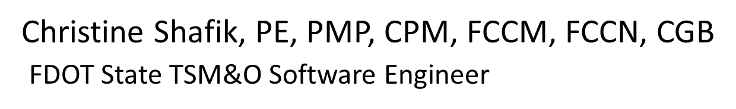
WELCOME
ATTENDEE ROLL CALL

Slide 3
SG-5668 WWD Detection on Mainlines using MVDS
Tucker Brown
SunGuide Software Users Group | 8/10/23

Slide 4
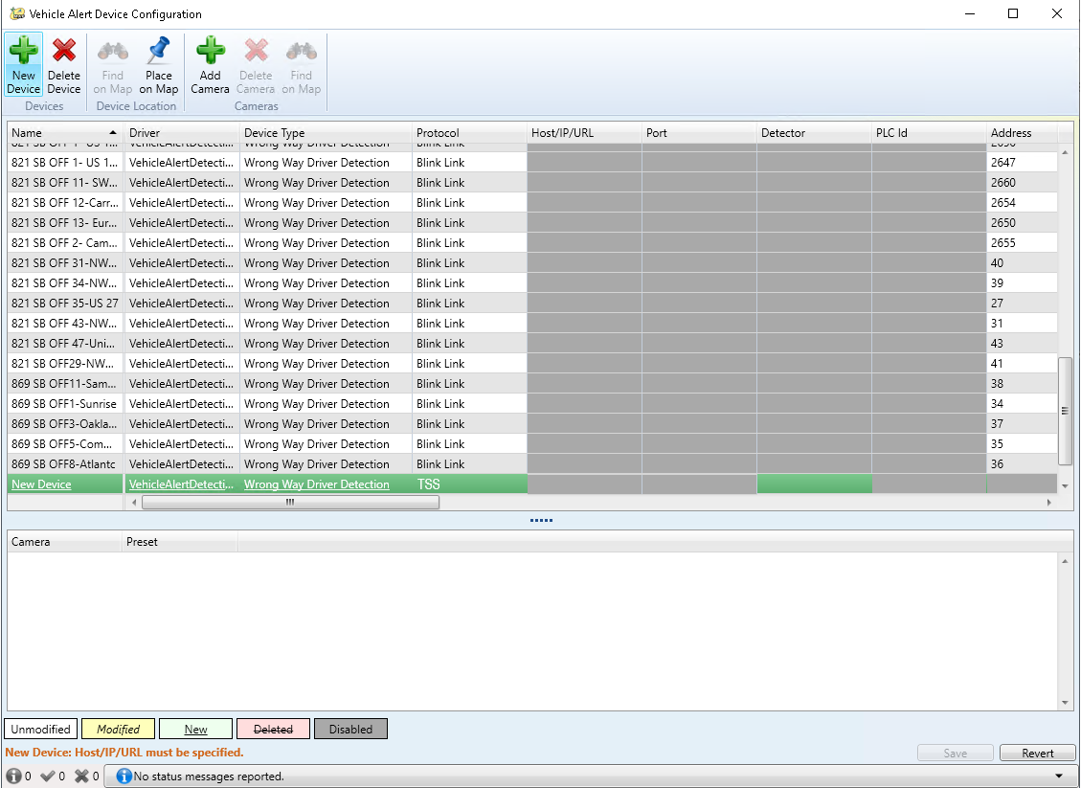
Configuration
Configure a matching TSS detector to a WWD device
System will use the mapped links to identify detector mapping (similar to TSS alerts)
Global configuration for consecutive detections needed
Maintenance Mode can be used to temporarily disable detection, if needed
Standard WWD alert
SunGuide Software Users Group | 8/10/23

Slide 5
COMMENTS?
QUESTIONS?
SunGuide Software Users Group | 8/10/23

Slide 6
SG-4941 Emails for Device Issues
Tucker Brown
SunGuide Software Users Group | 8/10/23

Slide 7
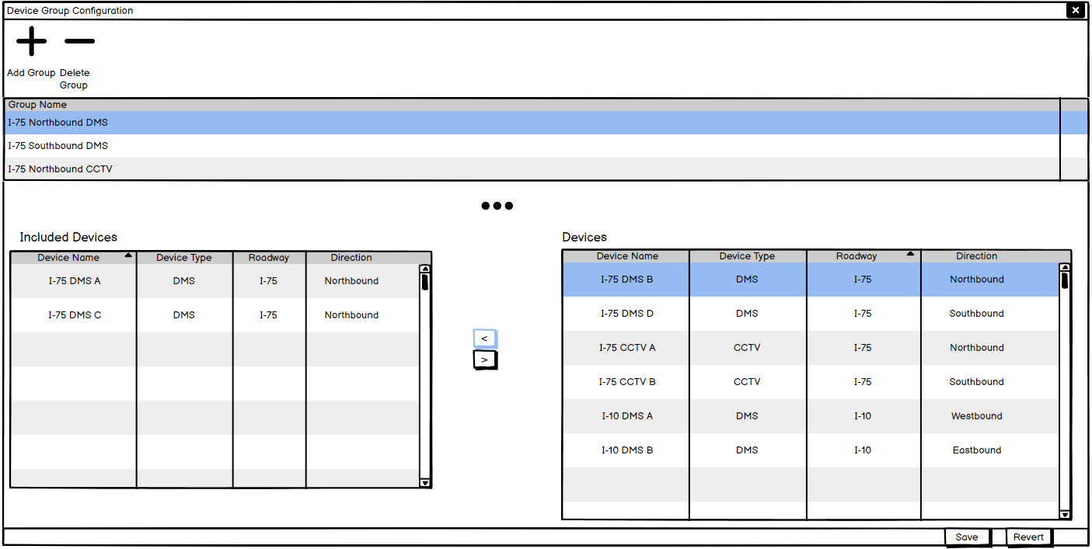
Device Group Configuration
  Independently create device groups of any type
SunGuide Software Users Group | 8/10/23

Slide 8
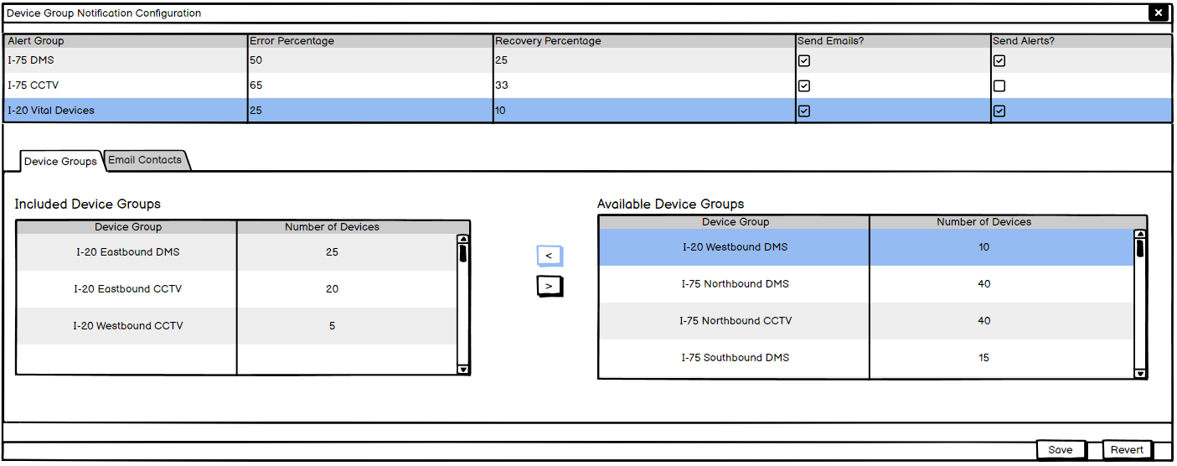
Alert Configuration
  One or more device groups and alert threshold settings
  Alerts or emails can be shut off by unchecking the box
SunGuide Software Users Group | 8/10/23

Slide 9
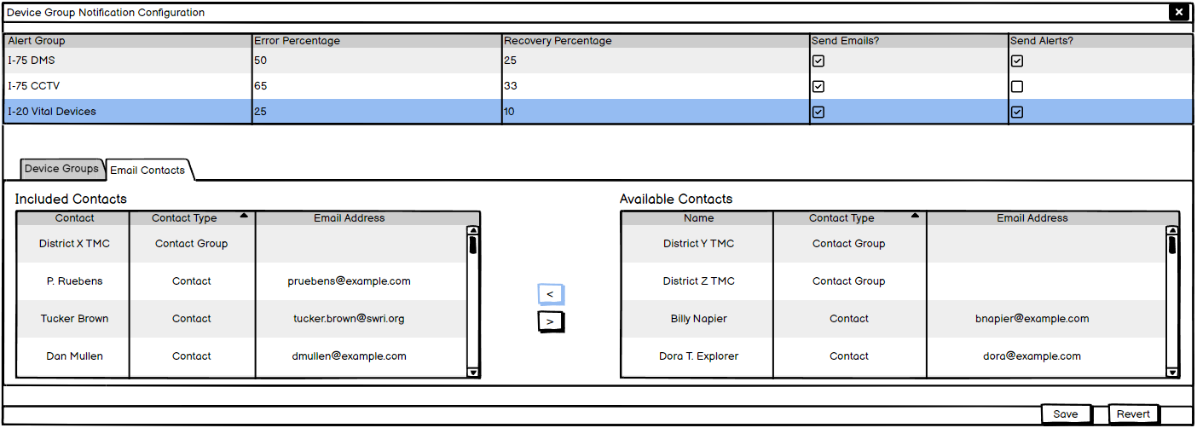
Alert Configuration
  Contacts for email and alert threshold settings
  Alerts or emails can be shut off by unchecking the box
SunGuide Software Users Group | 8/10/23

Slide 10
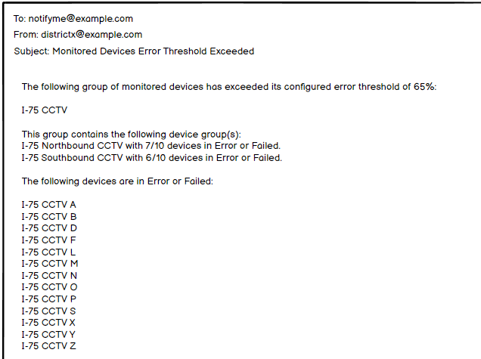
Sample Email
  Shows the alert name, groups with counts, and the devices in Error or Failed
SunGuide Software Users Group | 8/10/23

Slide 11
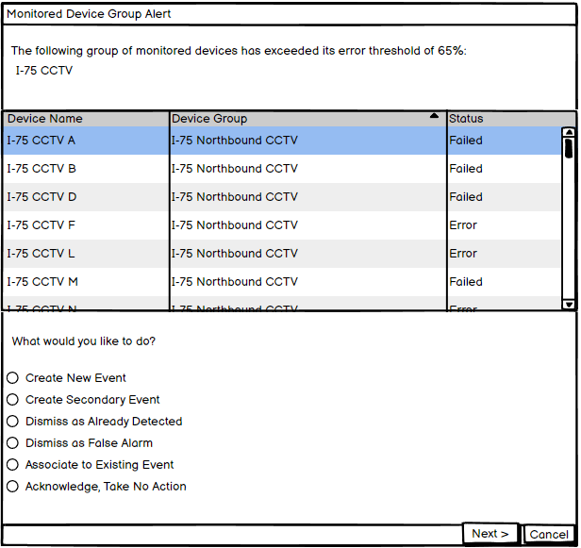
Sample Alert
  Standard alert dialog with standard alert options
SunGuide Software Users Group | 8/10/23

Slide 12
COMMENTS?
QUESTIONS?
SunGuide Software Users Group | 8/10/23

Slide 13
SG-6355 Security Improvements
Tucker Brown
SunGuide Software Users Group | 8/10/23

Slide 14
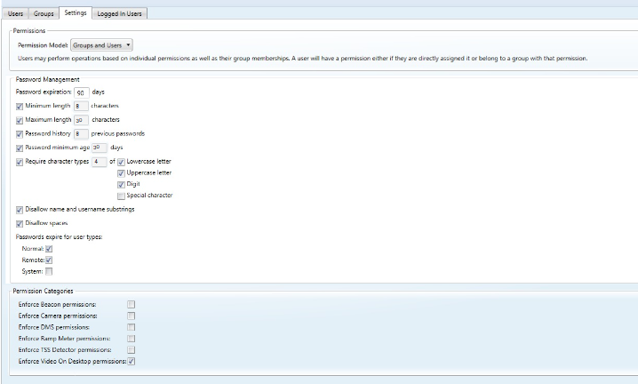
Configuration (Password Management)
Configuration is stored in the database
Configurations will be VIEWABLE but would be read-only in the UI
Default settings will be the FDOT standard for password management
SunGuide Software Users Group | 8/10/23

Slide 15
Other Security Changes
Message Encryption between processes (TLSv3)
Increase password hashing complexity
    No un-hashed password, even at rest
SunGuide Software Users Group | 8/10/23

Slide 16
COMMENTS?
QUESTIONS?
SunGuide Software Users Group | 8/10/23

Slide 17
SG-5876 564 Phase 3 (Ceased Use)
Tucker Brown
SunGuide Software Users Group | 8/10/23

Slide 18
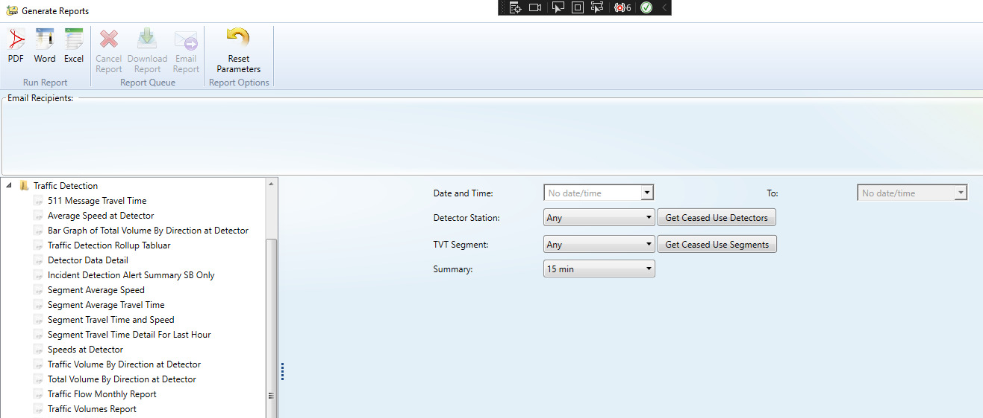
Get Ceased Use Items
SunGuide Software Users Group | 8/10/23

Slide 19
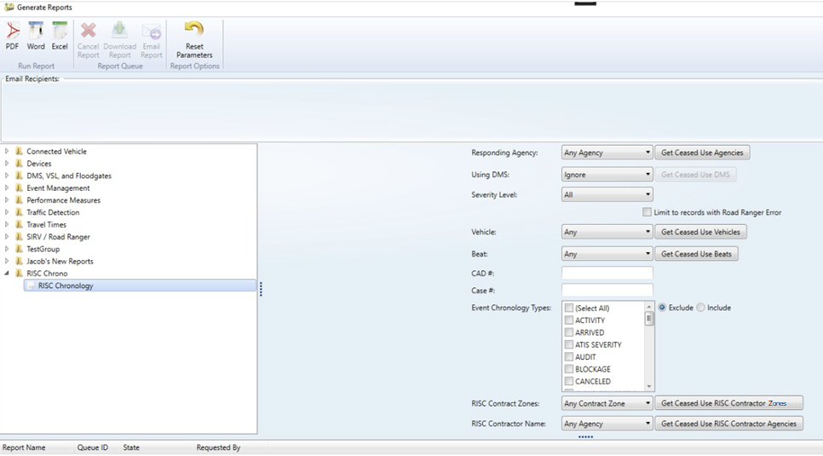
Get Ceased Use Items
SunGuide Software Users Group | 8/10/23

Slide 20
Other Ceased Use Items
Beacons
RSE
CNA Areas
CNA Contact Groups
CNA Contacts
DMS Message Actions
GPIO Device Groups
GPIO Devices
GPIO States
HAR
Icon Groups
Citilog Cameras
Vehicle Alert Devices
MLS Action List Template
MLS Action List
MLS Action Template
MLS Controllers
MLS Gates
MLS Segments
RWIS Stations
RWIS Thresholds
RCA Remote Centers
Ramp Meter Controllers
RISC Contracts
RISC Contract Zones
RS Report
RS Report Groups
SAS Schedules
SAS Scheduled Items
SAS Action Lists
Safety Barrier
Traffic Signal Routes
Travel Time Destinations
Travel Time Message Templates
Travel Time Links
Travel Time Thresholds
Truck Parking Facilities
Truck Parking Areas
Truck Parking Zones
Truck parking Verification Schedule
Video Destination
Video Source
Video Tour
Virtual Video Wall
VS Workstations
SunGuide Software Users Group | 8/10/23

Slide 21
COMMENTS?
QUESTIONS?
SunGuide Software Users Group | 8/10/23

Slide 22
SG-6367 LCS module for SunGuide
Tucker Brown
SunGuide Software Users Group | 8/10/23

Slide 23
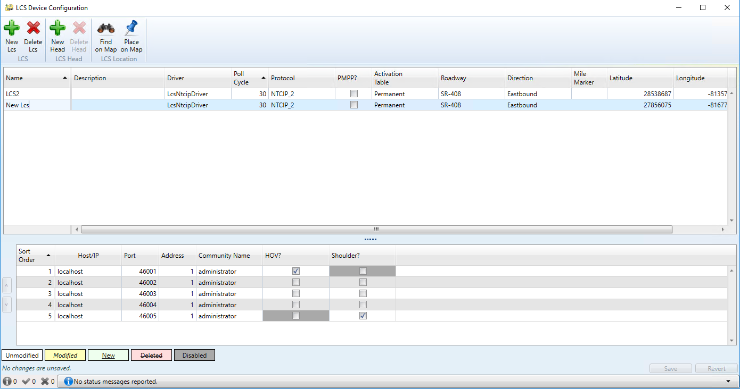
Configuration
SunGuide Software Users Group | 8/10/23

Slide 24
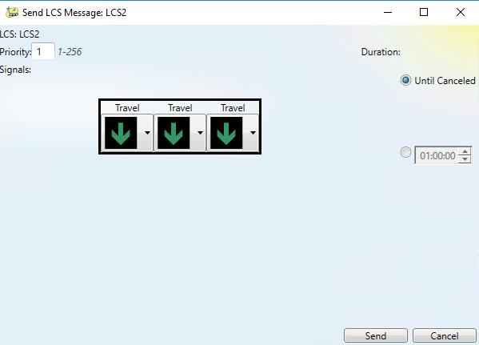
Send Message
User configured graphics
Select from the list of available images
SunGuide Software Users Group | 8/10/23

Slide 25
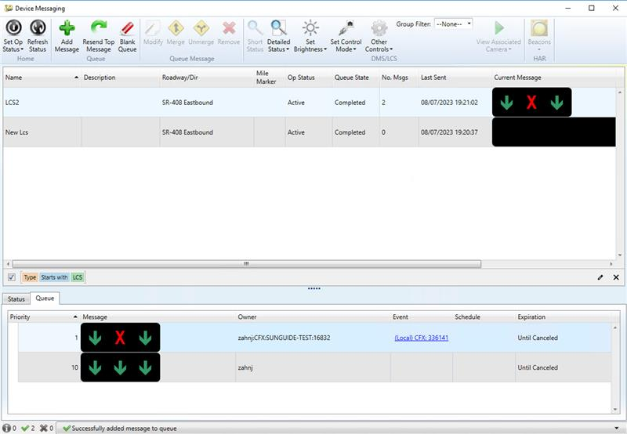
LCS Status
SunGuide Software Users Group | 8/10/23

Slide 26
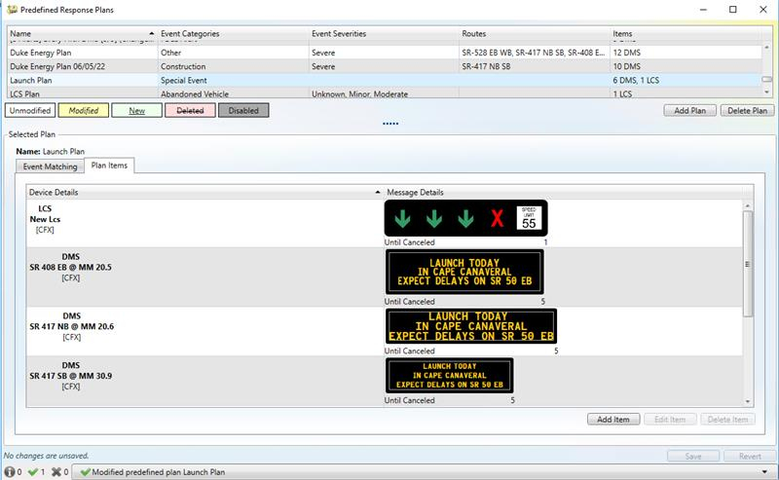
Predefined Response Plans
SunGuide Software Users Group | 8/10/23

Slide 27
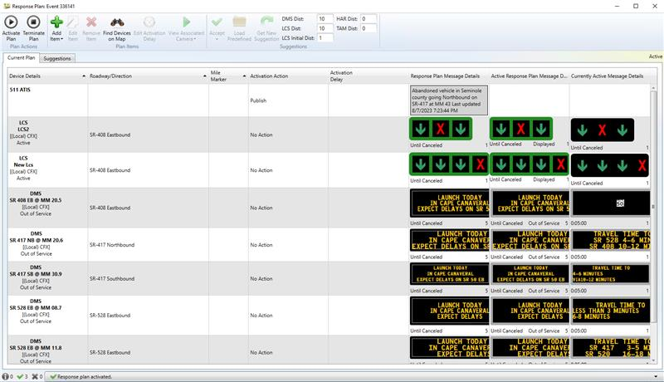
Response Plans
SunGuide Software Users Group | 8/10/23

Slide 28
Next Steps
Integrating an LCS module from TDOT into SunGuide.
Beta version of LCS module installed at CFX for observation and refinement of FDOT needs and use cases.
Will also deploy at D2.
Requirements will be finalized and sent out for district review and comment.
SunGuide Software Users Group | 8/10/23

Slide 29
COMMENTS?
QUESTIONS?
SunGuide Software Users Group | 8/10/23

Slide 30
SG-6135 SunGuide EM Ribbon Update
Tucker Brown
SunGuide Software Users Group | 8/10/23

Slide 31
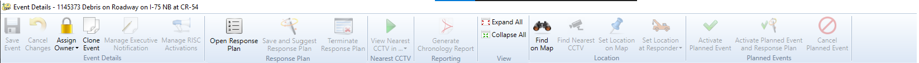
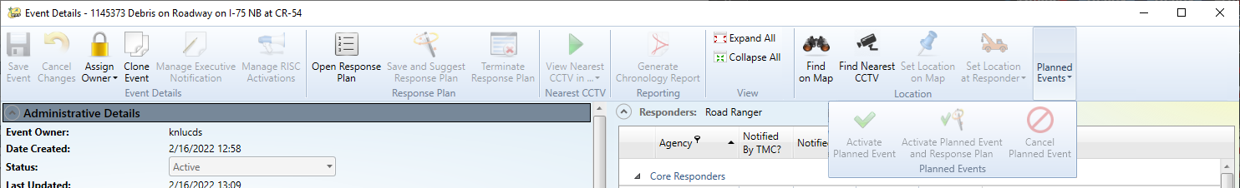
Ribbon Update
Current
New
Collapse from the right
SunGuide Software Users Group | 8/10/23

Slide 32
COMMENTS?
QUESTIONS?
SunGuide Software Users Group | 8/10/23

Slide 33
SG-3047 Multi-select cameras into new video wall window from map
Tucker Brown
SunGuide Software Users Group | 8/10/23

Slide 34
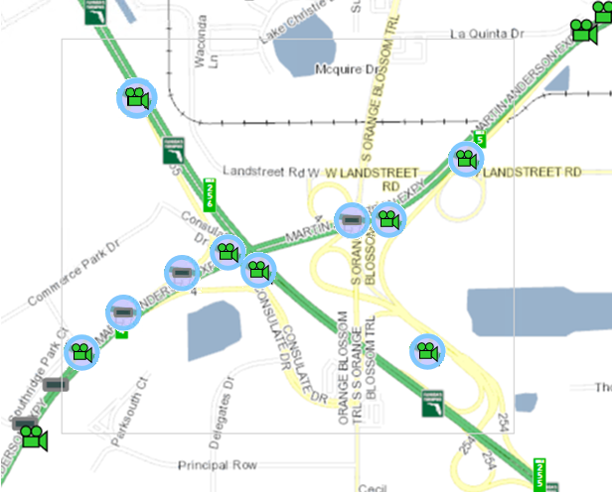
Multi-Select
Shift+Drag will allow Box Selection or Ctrl+Click selection for individual icons
Right click an icon to open the specific context menu
Selected cameras can be sent to VOD
A Send Message dialog can be opened that would send a message to the selected DMS
  Same as selecting multiple signs in the DMS status dialog and sending a message.
  Lowest common functionality on the signs must be used.
SunGuide Software Users Group | 8/10/23

Slide 35
COMMENTS?
QUESTIONS?
SunGuide Software Users Group | 8/10/23

Slide 36
SG-4385 Apply On a per day basis filter to device report
Tucker Brown
SunGuide Software Users Group | 8/10/23

Slide 37
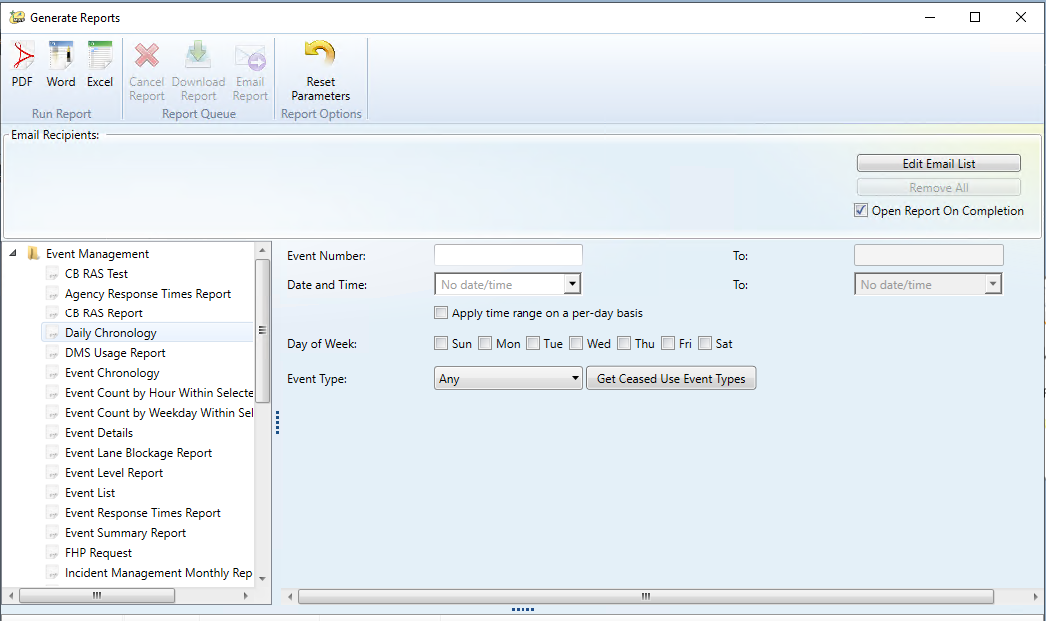
Per Day Filter
SunGuide Software Users Group | 8/10/23

Slide 38
COMMENTS?
QUESTIONS?
SunGuide Software Users Group | 8/10/23

Slide 39
SG-6312 Add Device and Link Geographic Filtering into C2C Subscriber
Tucker Brown
SunGuide Software Users Group | 8/10/23

Slide 40
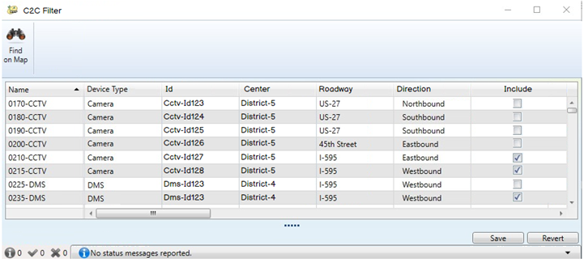
C2C Filter
Set by administrator
Global Configuration for all users
SunGuide Software Users Group | 8/10/23

Slide 41
COMMENTS?
QUESTIONS?
SunGuide Software Users Group | 8/10/23

Slide 42
SG-6463 Status Log Level Monitor
Tucker Brown
SunGuide Software Users Group | 8/10/23

Slide 43
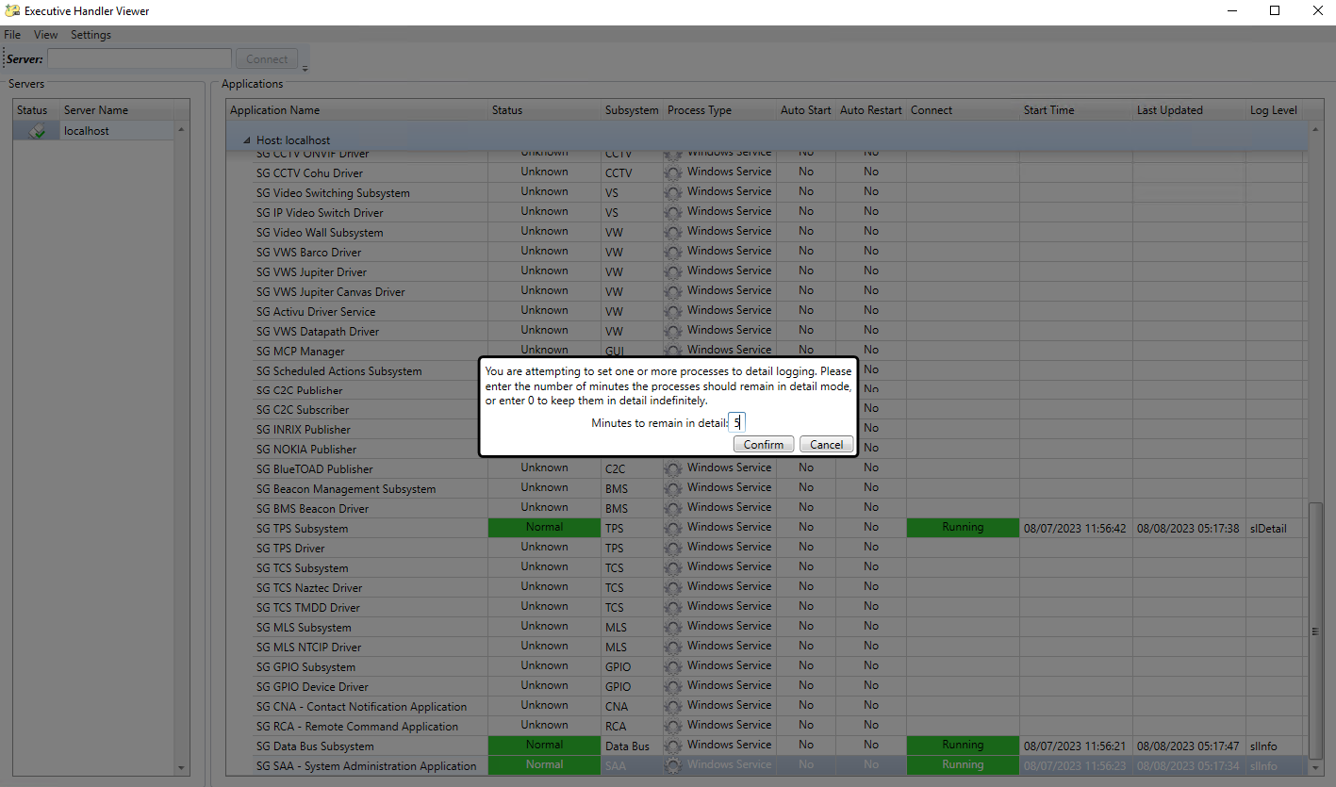
Executive Handler
User can select number of minutes or continue with indefinite duration.
SunGuide Software Users Group | 8/10/23

Slide 44
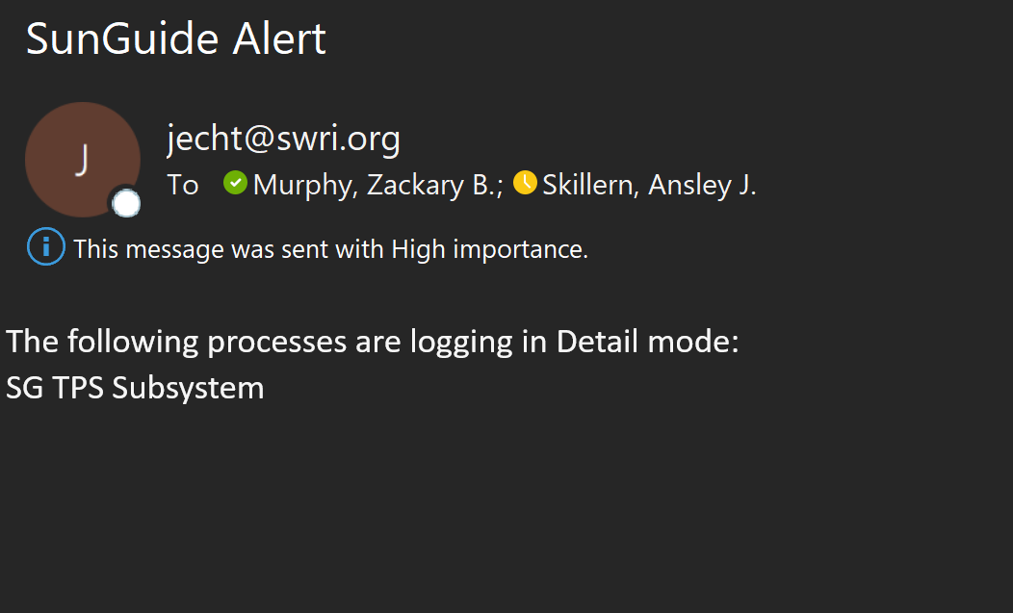
Sample Email
SunGuide Software Users Group | 8/10/23

Slide 45
COMMENTS?
QUESTIONS?
SunGuide Software Users Group | 8/10/23

Slide 46
ANNOUNCEMENTS?
QUESTIONS?
COMMENTS?
ADJOURN.

