Slide 1


SunGuide Software
Users Group Meeting
August 25, 2022

Slide 2
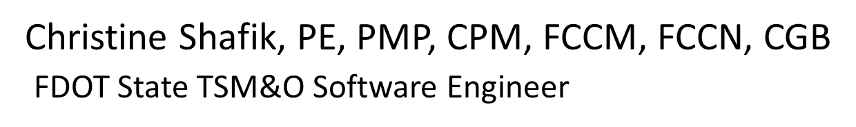
WELCOME
ATTENDEE ROLL CALL

Slide 3
SG-6413 – Ingest workzone data from one.network
Tucker Brown

Slide 4
Enhancement
A request has been made to ingest one.network data.
This would be a new IDS driver source
  Work zone and closure data
  Line based alert would be sent to the map
  Alert would contain the information available from one.network
  Standard alert handling options would be available
  This would be in Phase 1.

Slide 5
Enhancement
Real-time lane status information will also be available from one.network.
This could be a Phase 2 enhancement.
Would need further discussion on how this information could be ingested by SunGuide, and how it would be used by RTMC Operations.
What are your initial thoughts on the use of real-time lane status information?

Slide 6
QUESTIONS?
COMMENTS?
SUPPORT?

Slide 7
Revisiting:
SG-6087 - Collect additional data related to RR-involving incidents
Tucker Brown

Slide 8
Enhancement
  Presented and approved at the 12/2/2021 SSUG Meeting.
  Presented at the 12/13/2021 ITS Working Group Meeting.
  There is a need to collect additional information if the event involves a RR being injured or the RR vehicle being involved in the incident.
  The data would be collected by the operations staff, and could also be audited after the event is closed.

Slide 9
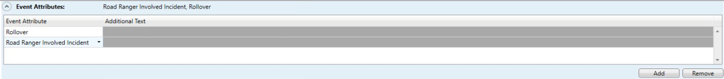
Enhancement
  Potential trigger: New System Attribute

Slide 10
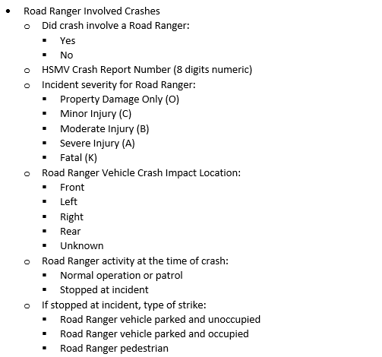
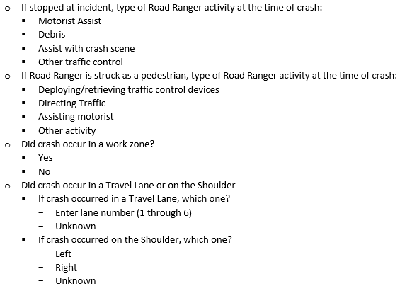
Enhancement
Potential form questions
(Updated since presented at SSUG.)

Slide 11
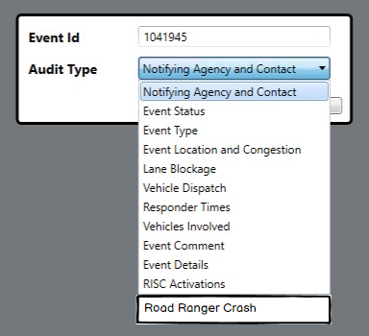
Enhancement
Auditable for entry after the event is closed

Slide 12
QUESTIONS?
COMMENTS?

Slide 13
Proposed Process for Reporting Events Using SunGuide and ERS
Carla Holmes

Slide 14
Event Reporting System
  RTMC Operations uses both SunGuide and ERS to enter events.
  A proposed process has been developed on how and when to use ERS so that:
    There is no unnecessary duplication of effort
    Information is reported appropriately on both platforms
    Events are reported consistently across all districts
  We need your input on the proposed procedure.

Slide 15
Event Location not in SunGuide
  If an event needs to be posted to FL511, but is in a location that has not been configured as a SunGuide Event Management (EM) location:
    Enter the event in ERS.
    Contact the local SunGuide Administrator as soon as possible to have them add that location to SunGuide as an EM location.
    When that location has been configured in SunGuide EM, enter the event in SunGuide.
    Remove the event from ERS.
    Continue to update the SunGuide event until it can be closed.

Slide 16
Event Requiring a Complex Detour
  If an event needs to be posted to FL511 that requires a detour that cannot be represented in SunGuide:
    Provide detour information to the GIS Team to develop the detour.
    Enter the event with detour information in ERS.
    Enter the event in SunGuide. (If the event involves a road closure, this information should also be entered in SunGuide.)
    Continue to update the ERS event until the detour is removed and the event can be closed.
    Continue to update the SunGuide event until it can be closed.

Slide 17
ERS & SunGuide
  For what other purposes does Operations use ERS?
  Are there any changes needed to the proposed procedure?

Slide 18
QUESTIONS?
COMMENTS?

Slide 19
Follow-Up:
Use of Graphics for DMS Messaging
Carla Holmes

Slide 20

Approved Graphics for DMS Messages
These are the only custom graphics allowed and must be used as shown on the ‘Approved Safety Messages for Changeable Message Sign website’ with the approved message.
These graphics will be shared in SharePoint: CMS Custom Graphics

Slide 21
Approved Graphics for DMS Messages
A spreadsheet will be created and shared in SharePoint that will list all previously submitted custom messages along with the outcome.
All other custom graphics must be approved by Central Office Traffic Ops before use.
Standard MUTCD graphics and messages are acceptable.

Slide 22
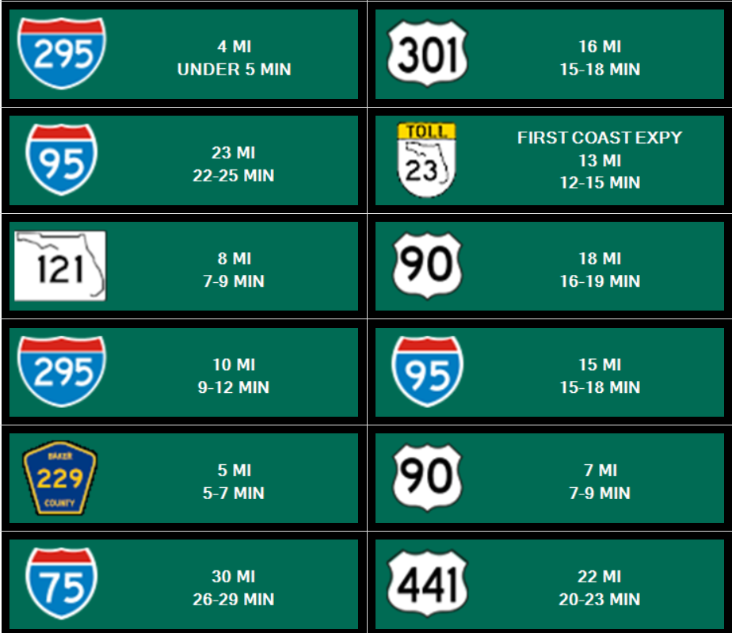
Examples of Standard DMS Messages

Slide 23
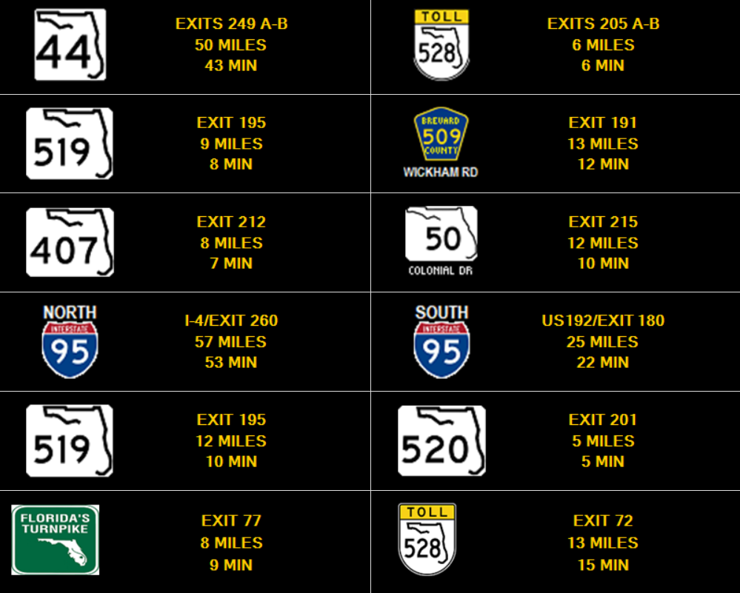
Examples of Standard DMS Messages

Slide 24
Non-Standard DMS Messaging
The RTMC states:
  “The use of graphics, symbols, and colors on DMSs are permitted only if the DMS can replicate the appropriate color combinations, lettering style, sign/symbol size consistent with the Manual on Uniform Traffic Control Devices (MUTCD).”
DMS messages using graphics to replicate MUTCD signs must also be approved by Central Office.
Lane Control Sign symbols do not have to be approved.

Slide 25
MUTCD / FHWA Guidance
Official Ruling No. 2(09)-174 (I) — Uses of and Nonstandard Syntax on Changeable Message Signs
Basic Message Development
Many of the current generation of electronic-display CMS have significant technological advancements when compared with their predecessors. Their high-resolution, full-color display capabilities have improved representation of sign lettering and allow the accurate depiction of route shields, symbols, and other features commonly used on static signs. While these capabilities are quite enabling, their overuse can result in overly complex or superfluous messages. Accordingly, it is essential that detailed messages developed for CMS adhere to the same principles used for static, non-changeable sign legends to the extent practicable. For example, displaying an image of a Speed Limit sign with a redundant word legend placed next to it within the CMS display confronts the observer with what appears to be multiple messages when, in fact, they convey the same message. Similarly, displaying the Slippery When Wet symbol sign adjacent to a word message that advises motorists of slippery roadway conditions also imposes an unnecessary informational load on observers. This effect of a duplicative sign and message within the same sign display is merely a product of the advanced capabilities of the CMS rather than actual need or improved effectiveness. The advanced functionality of newer CMS should be used only to improve legibility and comprehension of the sign message to convey a clear, simple meaning.

Slide 26
QUESTIONS?
COMMENTS?

Slide 27
ANNOUNCEMENTS?
QUESTIONS?
COMMENTS?
ADJOURN.

