Slide 1


SunGuide Software
Users Group Meeting
September 21, 2023

Slide 2
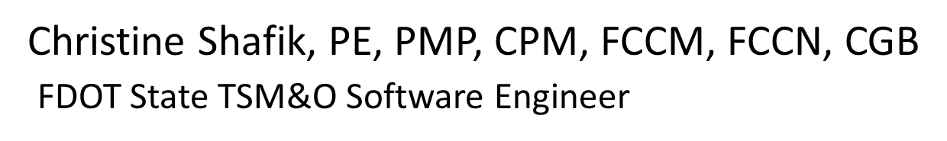
WELCOME
ATTENDEE ROLL CALL

Slide 3
SG-6805 - Driver for Deepblue Bluetooth Device?
Tucker Brown

Slide 4
Current Behavior and Enhancement
Current Behavior
  DeepBlue is a tag reader device that is currently on the APL.
  The protocol is not currently included in SunGuide, but was developed for Puerto Rico.
Enhancement
  Integrate the DeepBlue protocol from Puerto Rico for use in SunGuide

Slide 5
QUESTIONS?
COMMENTS?
SUPPORT?

Slide 6
SG-5420 - Consolidate "Unknown
MAC Address" Logs
Messages for BlueMAC
Tucker Brown

Slide 7
Current Behavior and Enhancement
Current Behavior
  SunGuide logs a message when a tag is received from a device that is not configured in the system.
    The intent was to alert operations of a device producing data, but still needs to be configured.
    Logs are in Warning, so they get full, even at Info logging.
Enhancement
  Consolidate the logs to once a min (maybe 5 mins?), and create a single message with all device IDs that sent tags.

Slide 8
QUESTIONS?
COMMENTS?
SUPPORT?

Slide 9
SG-6759 - Some Cameras Actively Refuse Request after HF#3
Tucker Brown

Slide 10
Current Behavior
CCTV NTCIP driver was re-written in C# for 8.2.
  Post 8.2, an issue was noticed where wipers didn’t work unless the device was initially polled to return the functionality was available.
  Hotfix 3 reverted to the pre-8.2 behavior that polled all cameras once, even if the configuration was set to not poll, or the Disable PTZ flag is set.
  When polling a static camera with no NTCIP comm interface, the initial poll fails and puts the device in Error State.
    Video still works, as that comes through a different interface.

Slide 11
Questions for Districts
Do you have static cameras that don’t have a comm interface?
Do you have static cameras that have a comm interface that may use Zoom/Focus/Iris, but no control?
Should static cameras be polled at all?

Slide 12
QUESTIONS?
COMMENTS?

Slide 13
SG-5474 - WWD Performance Measure Reporting
Mark Dunthorn

Slide 14
Reports Requested
Three WWD Event Reports Proposed:
  All WWD Events
  Only events started from IDS
  False Alert Report
Filter Functionality
  County
  Roadway
  Direction of travel

Slide 15
Reports Requested
Detailed Report from Single Ramp
  Date/Time
  Event IDs
  Event Conclusion
  False alarm list
    Date/Time
    False alarm reason

Slide 16
Options for False Alerts
  Add WWD prefix to Incident Detection Subsystem false alert drop down for all events and add unique reasoning.
  Customize False alert drop drown that opens only for the Wrong Way Vehicle Alert Subsystem.

Slide 17
Options for False Alerts
  False Alert Reasons
  Official Use (Law, Tow, Road Ranger, Fire, EMS, and Maintenance)
  Unauthorized User (Wrong way- Bicycle or Pedestrian)
  Animal
  Communication Drop
  Congestion
  Insect
  Law Enforcement Traffic Stop
  No Apparent Cause
  Poor Video
  Rain
  Reflection impact to sensor
  Shadow
  Vibration
  Maintenance Activity
  Other (fill in blank)

Slide 18
Options for Event Conclusion
  Event Conclusion Reasons
  Ramp Turn-around
  Crash
    Mainline
    Ramp
  Mainline entry non-crash
    Self-correct
    Vehicle intercept
    WWD detected but not found
(Needed for Event performance measures.)
  Add Final Review feature for all WWD events that requires reason for event closure.
  Add ability to convert Event to WWD Event to trigger mandatory Final Review.

Slide 19
QUESTIONS?
COMMENTS?
SUPPORT?

Slide 20
FYI:
SunGuide Alert Viewer
(SG-6050 FTE External Integrated
Website - WWDS Alerts)
Mark Dunthorn

Slide 21
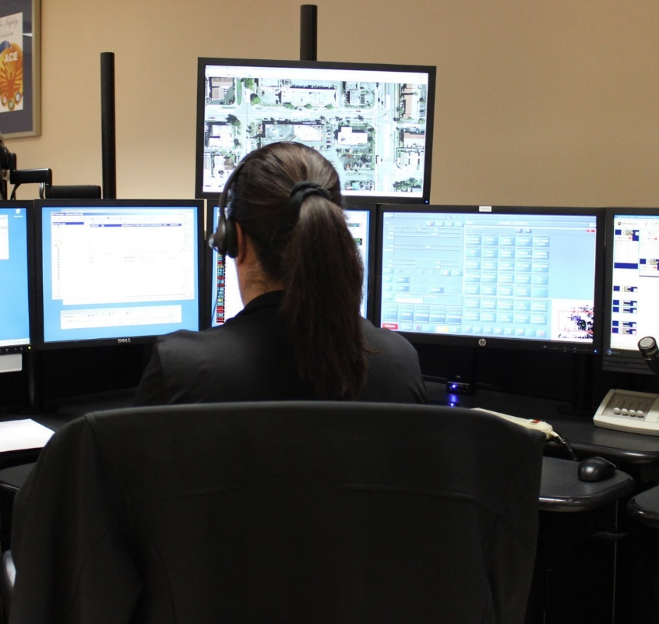
Overview
  WWD alerts will be provided to FHP at same time as FDOT for immediate FHP response.
  Application will support multiple WWD detection vendors.
  SAV Interface was included in SunGuide Release 8.2 HF2.
  Current State
    Tested by FTE
    Shared with FHP

Slide 22
The SunGuide Alert Viewer…
Is
An application that provides real-time notification of WWD detection system alerts.
A view-only application for informational purposes.
Is not
An interactive tool to manage WWD events.
A substitute for SunGuide Software.
A replacement for RTMC/FHP coordination.

Slide 23
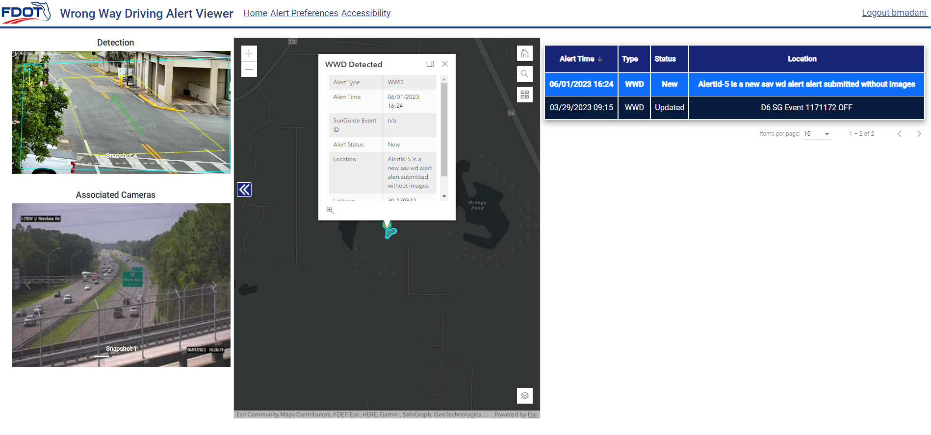
Questions?
Demonstration

Slide 24
Next Steps
Next Steps for the SAV
  OIT Final Compliance Reviews (Remediation, as needed)
  Shift to FDOT Production
  Provide Statewide Access and Training
  FHP Authorization/Authentication Discussion/Enhancements
Timeline
March 2023
April-May 2023
June 2023
July 2023
?
?
FHP Feedback
FTE Demo
FTE Testing
FHP Demo
Viewer Refinement
FHP Authentication Enhancement
Production Implementation and Monitoring

Slide 25
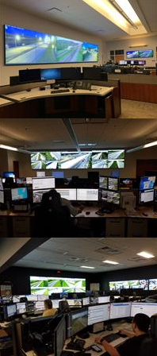

Video Wall Discussion
Current State:
  Authentication Token Expires after 12 hours
Option 1:
  When Token expires – present login screen and let a user relog in. (Minor add’l cost.)
Option 2:
  Rewrite authentication method to provide background updates to keep security token valid. (Significant add’l cost.)

Slide 26
QUESTIONS?
COMMENTS?

Slide 27
ANNOUNCEMENTS?
QUESTIONS?
COMMENTS?
ADJOURN.

