Slide 1


SunGuide Software
Users Group Meeting
September 22, 2022

Slide 2

WELCOME
ATTENDEE ROLL CALL

Slide 3
SG-6432 – Option to select different Driver for existing CCTV
Tucker Brown

Slide 4
Current Behavior and Enhancement
Current Behavior
  Devices are not able to switch drivers once the device is configured.
Enhancement
  Allow devices to change drivers so protocols can change.
    Priority for this is CCTV and TSS, as that is where the most frequent driver changes occur.

Slide 5
QUESTIONS?
COMMENTS?
SUPPORT?

Slide 6
SG-6430 – RWIS Communication Exchange Update
Tucker Brown

Slide 7
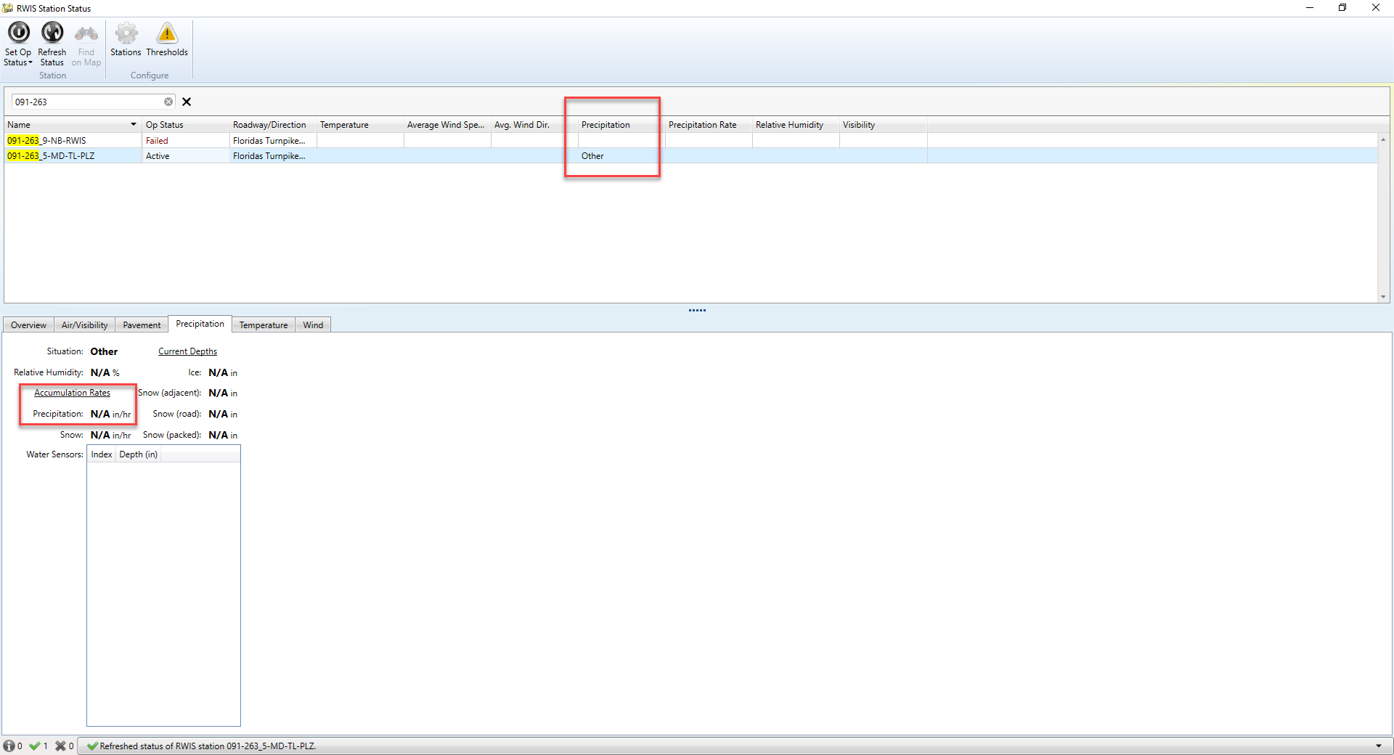
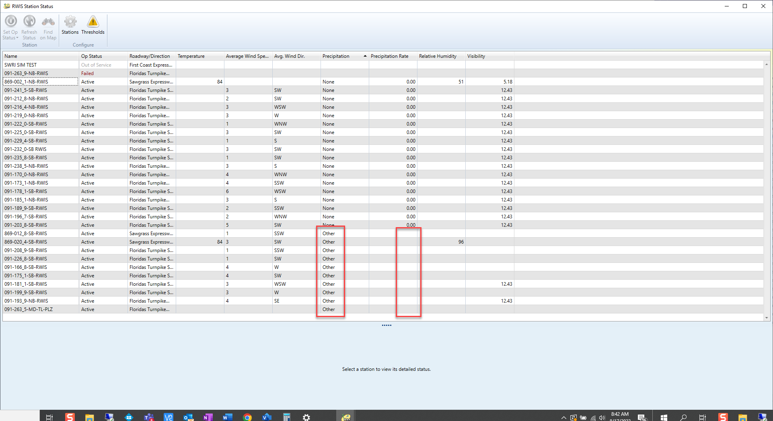
Current Behavior
  RWIS devices have a specific set of weather measurements that are polled from the device.
  SunGuide currently polls the following fields:

Slide 8
Enhancement
  Add the following measurements to logging and the User Interface:
  essPrecipitationSixHours
  essPrecipitationTwelveHours
  essPrecipitation24Hours

Slide 9
QUESTIONS?
COMMENTS?
SUPPORT?

Slide 10
SG-6422 – Add Field in SunGuide Vehicle alert window to activate predefined response plan
Tucker Brown

Slide 11
Current Behavior and Enhancement
  Current Behavior
    An event has to be created in order for a response plan to be generated.
  Enhancement
    Add an option to select a predefined response plan with no event creation as part of a Vehicle Alert.
    Allow operators to activate the predefined response plan before an event is created so DMS messages can be posted as quickly as possible.
    This would not be part of an event, and would send the items as an individual request to the DMS.

Slide 12
QUESTIONS?
COMMENTS?
SUPPORT?

Slide 13
SG-6463 – Status Log
Level Monitor
Tucker Brown

Slide 14
Current Behavior and Enhancement
Current Behavior
  When processes get set to Detail Logging, it can take up more space in the database and fill up hard drives.
Enhancement
  Add daily email that would alert a configured email list of processes that are in detail mode.
    Should an email be sent if nothing is set to Detail Logging?

Slide 15
QUESTIONS?
COMMENTS?
SUPPORT?

Slide 16
ANNOUNCEMENTS?
QUESTIONS?
COMMENTS?
ADJOURN.

