Slide 1


SunGuide Software
Users Group Meeting
IV&V Edition
October 20, 2022

Slide 2
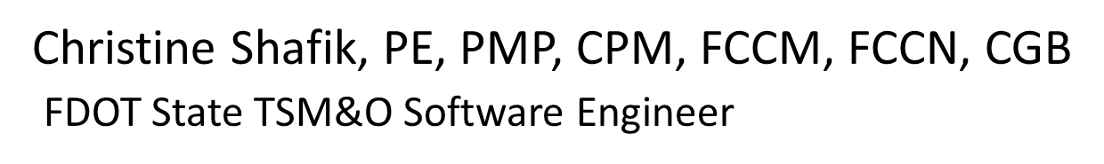
WELCOME
ATTENDEE ROLL CALL

Slide 3
SG-5143 – Chronology Report Able to Generated in Sections of Interest
Tucker Brown

Slide 4
Enhancement
  There is a new whitelist/blacklist filter for the Event Chronology types within the Event Chronology Report.
  The list of available types is pulled from the list of all known Event Chronology Types at the last restart of Event Management.
  This parameter filters out the list of Event Chronology Type entries displayed in the report.

Slide 5
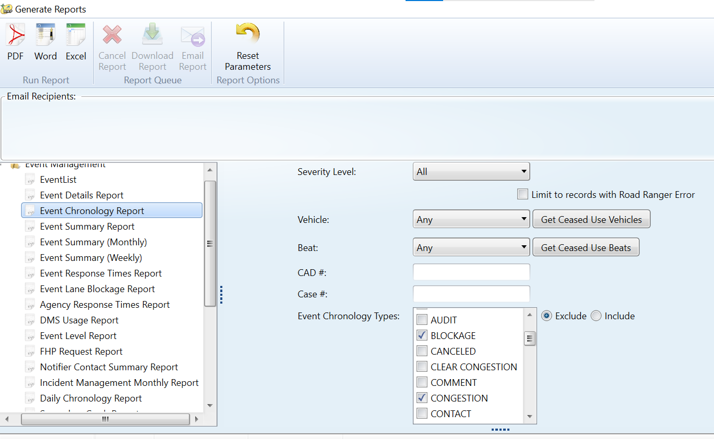
Enhancement

Slide 6
Questions
When the report is generated, the list of events included in the report is based on the event selection criteria selected for the reports,
AND THEN
The Event Chronology Types are removed based on the filter.
  Is there a need for an option to filter down to ONLY events that have (or don’t have) the Event Chronology Type selected?

Slide 7
QUESTIONS?
COMMENTS?
SUPPORT?

Slide 8
SG-5557 – Ability to Set WWD
Sites to Maintenance
Mode Via SG
Tucker Brown

Slide 9
Enhancement
  WWD devices can be set to maintenance mode, which will still poll the device but prevent any detections from triggering alarms in the system.
  The users can set either a duration or an end time for the maintenance mode on the device.
  The users get a popup, triggered a configured amount of time before the end of the maintenance mode period, asking what they would like to do with the device.

Slide 10
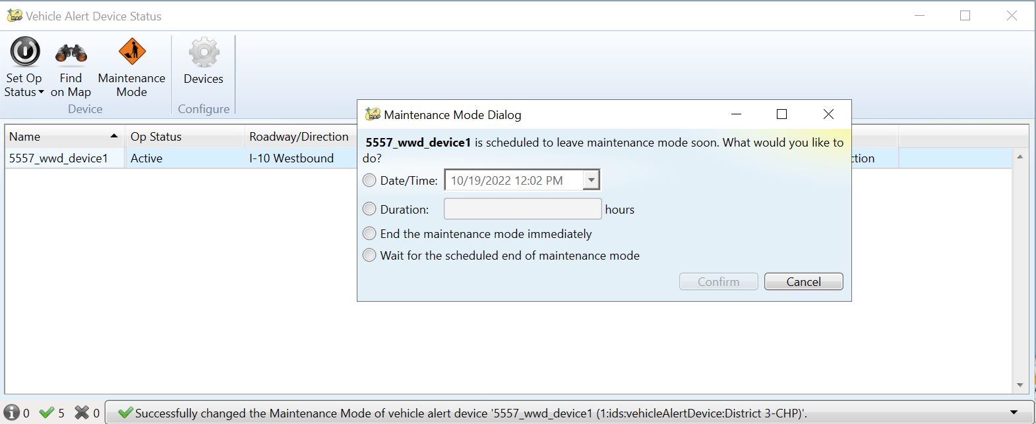
Enhancement

Slide 11
Questions
For the popup, is there a need to show when the maintenance mode will end?
  Should it be the time span (5 minutes) or the actual time (12:00:00)?
Is there a need to archive the username of the user who takes it out of maintenance mode earlier than scheduled?
  Status Logger or Database?

Slide 12
QUESTIONS?
COMMENTS?
SUPPORT?

Slide 13
SG-5706 – Add Timestamp
When Executive Notification
Emails are Sent
Tucker Brown

Slide 14
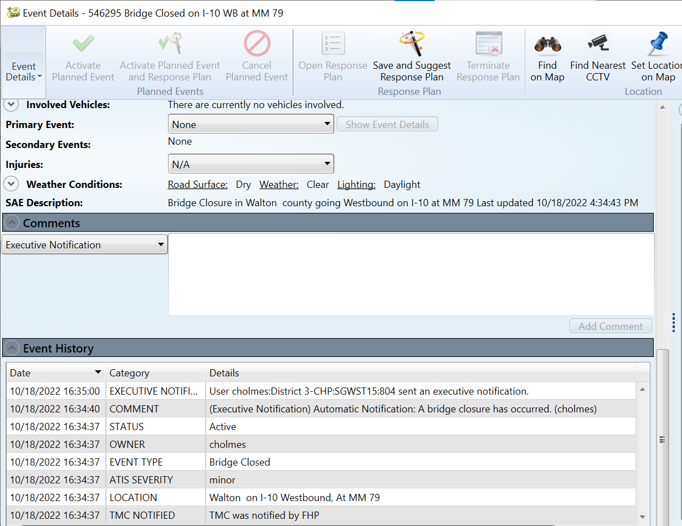
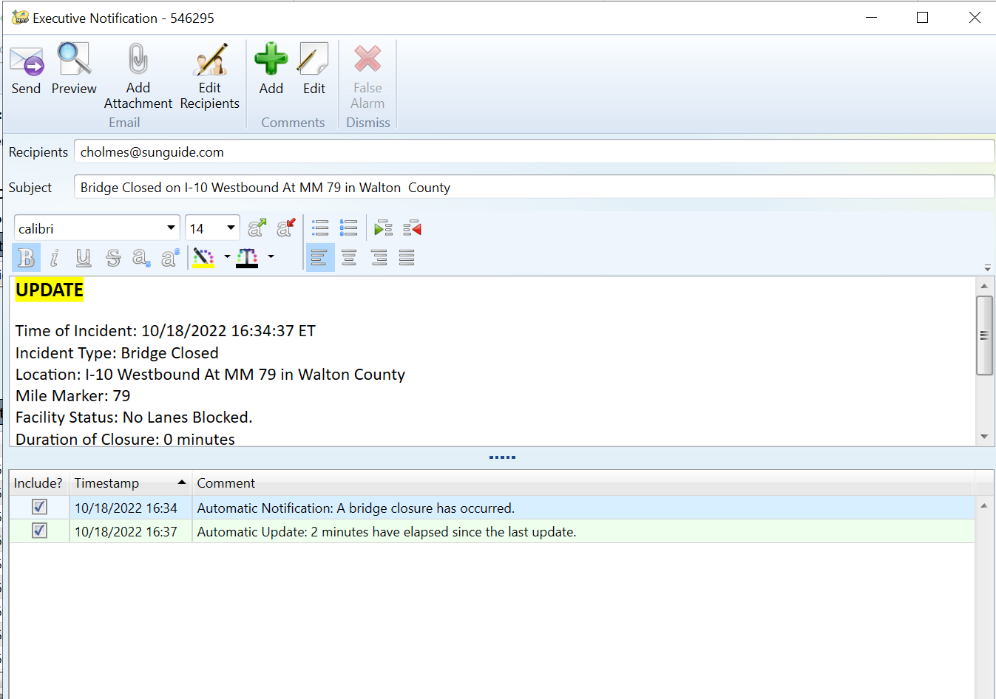
Enhancement
  The time an Executive Notification is sent is now logged in the Event Chronology, but not shown in the Executive Notification narrative dialog.

Slide 15
Questions
Is the sent time of previous Executive Notifications something that should be included in the Executive Notification narrative dialog?
  Should it be included in the default narrative or just something operators would click a checkbox to include?
Although it sounds trivial, this one is not and would require some extensive rework of how Executive Notifications work.
  Would this be used?

Slide 16
QUESTIONS?
COMMENTS?
SUPPORT?

Slide 17
SG-6015 – TPAS Prompt for Verifying Available Spaces for CO Reporting
Tucker Brown

Slide 18
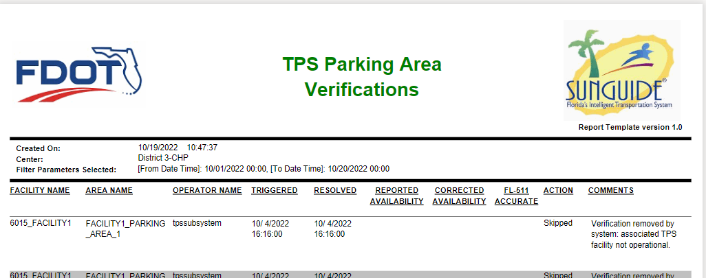
Enhancement
  The system will now prompt users to verify space counts in configured parking areas.
  Counts and user responses are archived, and a new template is available to report on the counts.

Slide 19
Questions
Currently, all facilities and parking areas configured to be reported are included in the report.
  Does the report need parameters to filter down to specific facilities and parking areas?
  Would any other filter parameters be useful?

Slide 20
QUESTIONS?
COMMENTS?
SUPPORT?

Slide 21
FYI:
SG-5456 – "TMC Notified" for all notified times regardless of whether notified box is checked
Tucker Brown

Slide 22
Enhancement
  The Event Responders’ check box combined with the time set in the Event Responders’ dialog will change the text of the Event Chronology entry to better clarify if the TMC notified the field, or the field notified the TMC.
FYI
  The Chronology text for the TMC NOTIFIED category was set to “TMC was notified by XX”.
  The Chronology text for the NOTIFIED BY TMC category was set to “XX was notified by TMC” instead of “TMC notified XX”.

Slide 23
QUESTIONS?
COMMENTS?
SUPPORT?

Slide 24
JIRA Changes
Tucker Brown

Slide 25
JIRA Security Changes
Remove users that have never logged in.
Deactivate all accounts which haven’t logged in for the last 6 months.
For future logins, if a user hasn’t logged for 5 months, they would receive an email indicating they need to log in or their account will be deactivated.
  If 6 months elapses, the account will be deactivated.
  If the user needs to re-activate the account, they will need to send an email to Central Office, and it can re-activated.

Slide 26
JIRA Updates
We were looking to have a box on the JIRA front page that would show Failure Issues needing updates from either SwRI or the District.
  Due to an issue with JIRA directly, permission is not allowing this to be shown to FDOT users.
  An issue has been logged with Jira to try to resolve the permissions issue. Awaiting response.
  We were also looking to include district/agency along with name (i.e., “John Doe, District X”) as previously requested, but Jira will not allow anything to be added to the name field.

Slide 27
QUESTIONS?
COMMENTS?

Slide 28
ANNOUNCEMENTS?
QUESTIONS?
COMMENTS?
ADJOURN.

