Slide 1


SunGuide Software
Users Group Meeting
November 16, 2023

Slide 2
WELCOME
ATTENDEE ROLL CALL
Christine Shafik, PE, PMP®, CPM, FCCM, FCCN, CGB
State CAV/STAMP/ML Engineer

Slide 3
SG-6857 – Desktop Video
Dialogs Aspect Ratio
Tucker Brown

Slide 4
Current Behavior and Enhancement
Current Behavior
  “Viewers” are 4:3 in Video on Desktop.
  16:9 videos can be seen in letterbox, or stretched to fit 4:3.
Enhancement
  Make the viewers 16:9 and allow the 4:3 video to be stretched to fit.
  Thought is that most video is natively 16:9 already.

Slide 5
QUESTIONS?
COMMENTS?
SUPPORT?

Slide 6
SG-6014 – Enhanced Tracking of Changes in SunGuide
Tucker Brown

Slide 7
Enhancement
Capture changes associated with modifications to SunGuide.
Offers assistance with the following:
  Identification of permissions attributed incorrectly to a user or user group.
  Identification of inadvertent/accidental changes. Who performed them and when.
  Useful details that can be included in troubleshooting.

Slide 8
Enhancement
Reviewed at the 10/25/2023 CMB, but the price tag for all subsystems was too high.
Decided to revisit at the SSUG and only do a subset of systems.
Estimated LOE for full implementation was $142k.
$5k for changes to the architecture.
~$7k per subsystem, but would need to estimate each as they can vary (EM vs. BMS).
What subsystems are priorities for the districts?

Slide 9
QUESTIONS?
COMMENTS?
SUPPORT?

Slide 10
SG-6870 – Track RR activities that support EVs
Tucker Brown

Slide 11
Current Behavior and Enhancement
Current Behavior
  No consistent manner to track when a RR assists electric vehicles.
  Enhancement
  Multiple Options:
    Add a RR Activity for something like “EV Assist”.
    Add an event type via a script that RRs could create as an event.
    Add an Event Attribute that says something like “EV Assist”.
  Each could be added with a script that would synchronize the whole state.
  Preference? Alternatives?

Slide 12
QUESTIONS?
COMMENTS?
SUPPORT?

Slide 13
SG-6744 - RR-Involved Incidents Reports
Tucker Brown

Slide 14
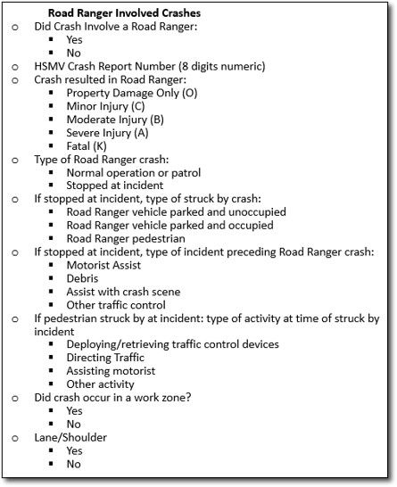
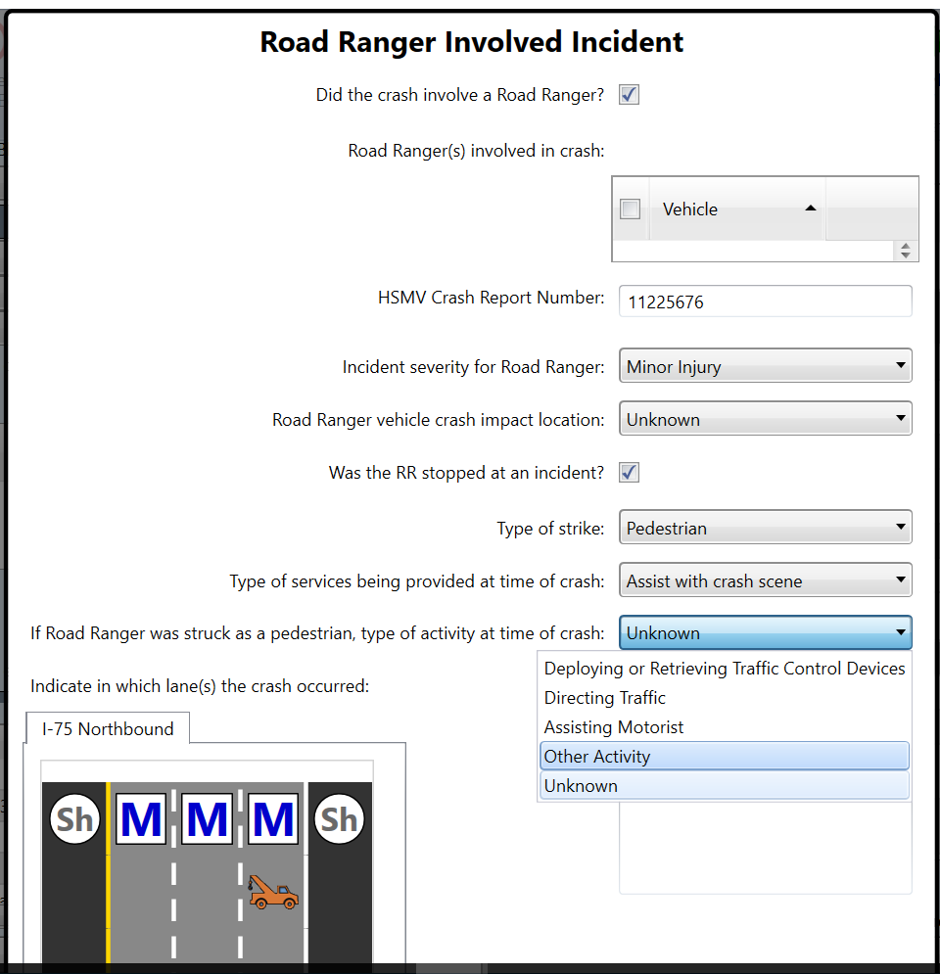
Current Behavior
SG-6087 - Collect additional data related to RR-involving incidents was released in SunGuide R8.2 HF2.

Slide 15
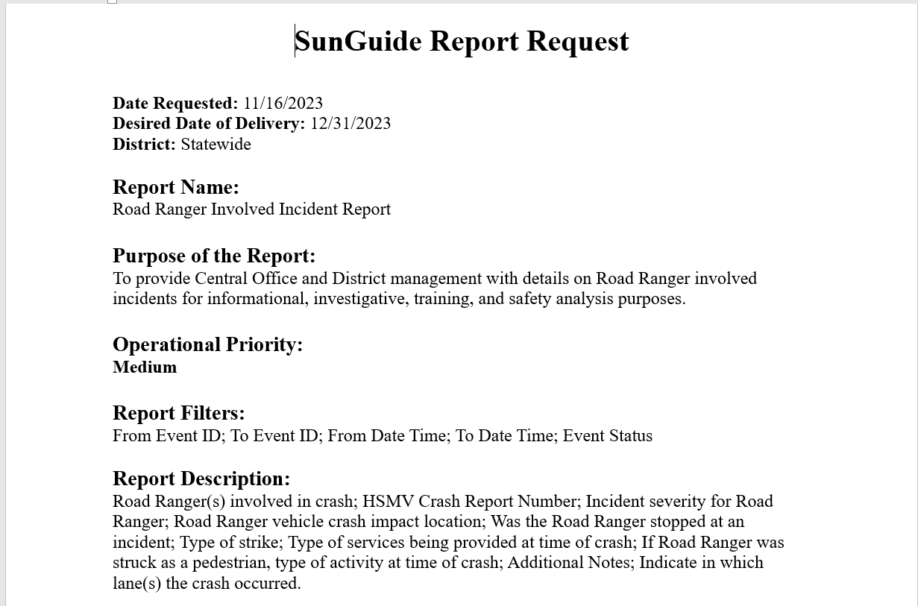
Enhancement
Create a report to capture information collected in the dialog.

Slide 16
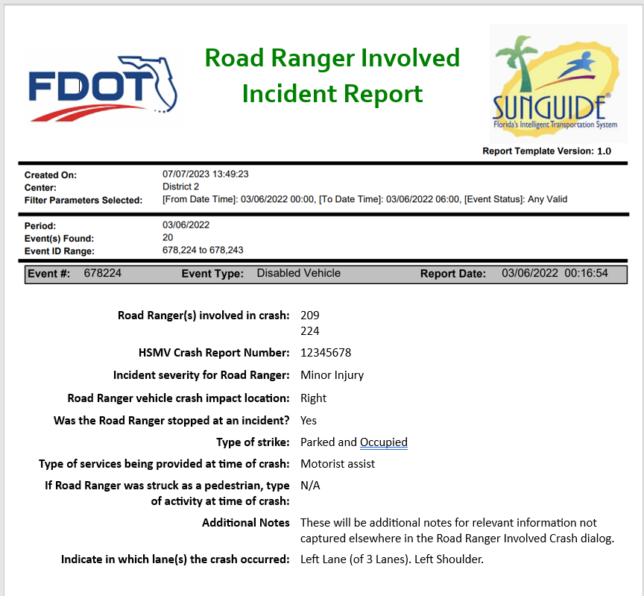
Enhancement
Other filter parameters needed?
Other information needed in the report?
Any other comments on report mock-up?

Slide 17
QUESTIONS?
COMMENTS?
SUPPORT?

Slide 18
ANNOUNCEMENTS?
QUESTIONS?
COMMENTS?
ADJOURN.

