Slide 1


SunGuide Software
Users Group Meeting
November 3, 2022

Slide 2
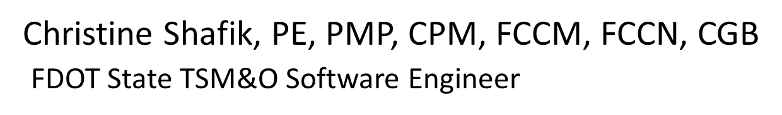
WELCOME
ATTENDEE ROLL CALL

Slide 3
SG-6464 – GIS Based SunGuide Map
Tucker Brown

Slide 4
Current Behavior
Locations in the system are based on configured Counties, Roadways, Directions, Reference Points, and Locations.
Roadways and Directions are also used in other subsystems to further specify locations.
Cumbersome to add new locations on the fly or add a full roadway’s worth of locations.

Slide 5
Enhancement
Change the system to use GIS mapping for locations.
  Events could be placed anywhere on the map.
  Should this extend to devices?
    TSS links would be mapped to specific mapping codes which would help 3rd parties interpret data.
    All devices have roadway and direction attributes.
  Add detour routes.
    Produce a GIS detour route.

Slide 6
Considerations
  GIS would define the way the roadway is defined.
  Not configurable from SunGuide.
  Naming inconsistency in GIS could result in different behavior in response plans (on-route/off route/name used in the response plan).
  Reporting changes based on locations.
  Would the GIS files contain a sort order for the roadway? Or define them as a line?

Slide 7
Considerations
  ALL event records would need to migrate to the new storage format.
  THIS IS A VERY LARGE CHANGE WITH A LOT OF SYSTEM IMPLICATIONS.
  All 3rd parties would be affected.
  DIVAS/FL511 would need large updates.

Slide 8
QUESTIONS?
COMMENTS?
SUPPORT?

Slide 9
SG-6479 – WWD Dismiss as False Alarm Closes Event
Tucker Brown

Slide 10
Current Behavior & Enhancement
Current Behavior
  When an event is created as part of a WWD detection, and the alarm is resolved as a false alarm, the event is set to CLOSED.
Enhancement
  If the user resolves the alert as a False Alarm, the event should be closed as a False Alarm so it does not count towards Performance Measures.

Slide 11
QUESTIONS?
COMMENTS?
SUPPORT?

Slide 12
SG-6271 – District 3 would like to propose a timeline feature in the event module of SG.
Tucker Brown

Slide 13
Enhancement
  This feature would work as a real-time QC check of an event, prompting the operator for required tasks and counting down the time allowed to perform said tasks.
  Additionally, add a Supervisor viewing window or subsystem allowing monitoring of timelines.

Slide 14
Enhancement
  Prompt the operator to perform the correct actions, in the correct order, and within allotted time frames.
  Allow operators to receive real-time positive feedback.
  Allow Supervisors to monitor, and more importantly possibly prevent, events from missing performance measures related to timestamps.
      Possible Web Interface?

Slide 15
Enhancement
  Allow immediate notification for missed PM’s, prompting a response.
  Reporting showing total events, timestamps, and the pass/fail percentages.
  Configurable for Routes, Districts, and Operators.
  Supervisor Portal allowing an overview of all events.
    Filter by area or operator.

Slide 16
Enhancement
  Time stamps may include, but are not limited to:
      Confirmation or Verification
      Response Plan
      DMS Posting
      Dispatch Times
      Notifications

Slide 17
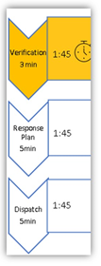
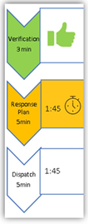
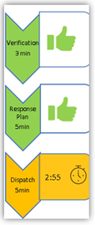
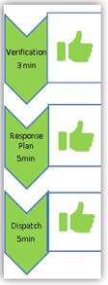
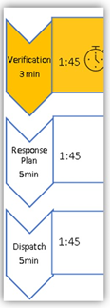
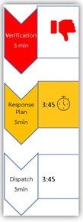
Samples
Standard
Flow
Missing
Step

Slide 18
QUESTIONS?
COMMENTS?
SUPPORT?

Slide 19
ANNOUNCEMENTS?
QUESTIONS?
COMMENTS?
ADJOURN.

