Slide 1


SunGuide Software
Users Group Meeting
December 14, 2023

Slide 2
WELCOME
ATTENDEE ROLL CALL
Christine Shafik, PE, PMP®, CPM, FCCM, FCCN, CGB
State CAV/STAMP/ML Engineer

Slide 3
Lane Control System (LCS) Enhancements
Tucker Brown

Slide 4
SG-6367 - LCS module for SunGuide
Integrating an LCS module from TDOT into SunGuide.
This new module is included in SunGuide R9.0.
Beta version of LCS module has been installed at CFX for observation and refinement of FDOT needs and use cases.
CFX and D2 have identified some enhancements they would like implemented in the SunGuide LCS Module.

Slide 5
Flex Lanes
SunGuide Integration

Slide 6
Flex Lanes Concepts
Per Lane Traffic Management System
Improves communication to traveling public for lane/road closure events
Closely integrated with travel time and traffic management DMS
Variable Speed Limit integration
Allows flexibility to manage the use of traveling on shoulder

Slide 7
Flex Lanes Components
Lane Control Signals (LCS)
Variable Speed Limit Signs (VSLS)
Incident Management Dynamic Message Signs (IDMS)
Travel Time Dynamic Message Signs (DMS)
Controlling Software – SunGuide Software
Also Supported by
CCTV Cameras
Traffic Detectors

Slide 8
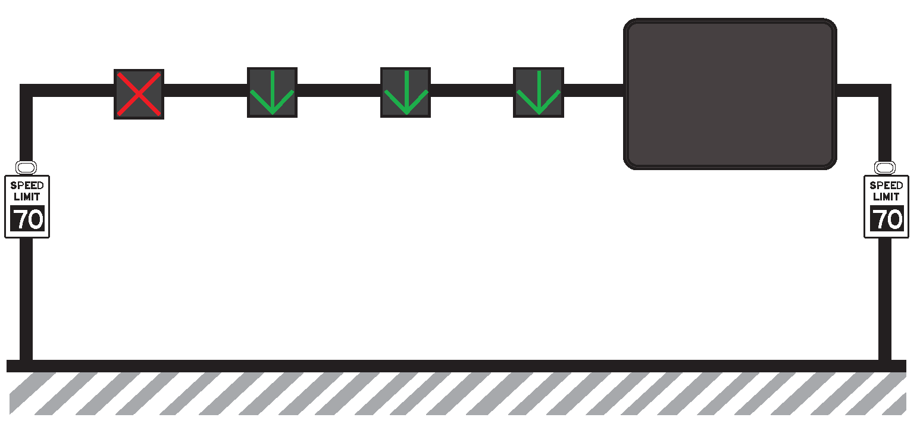
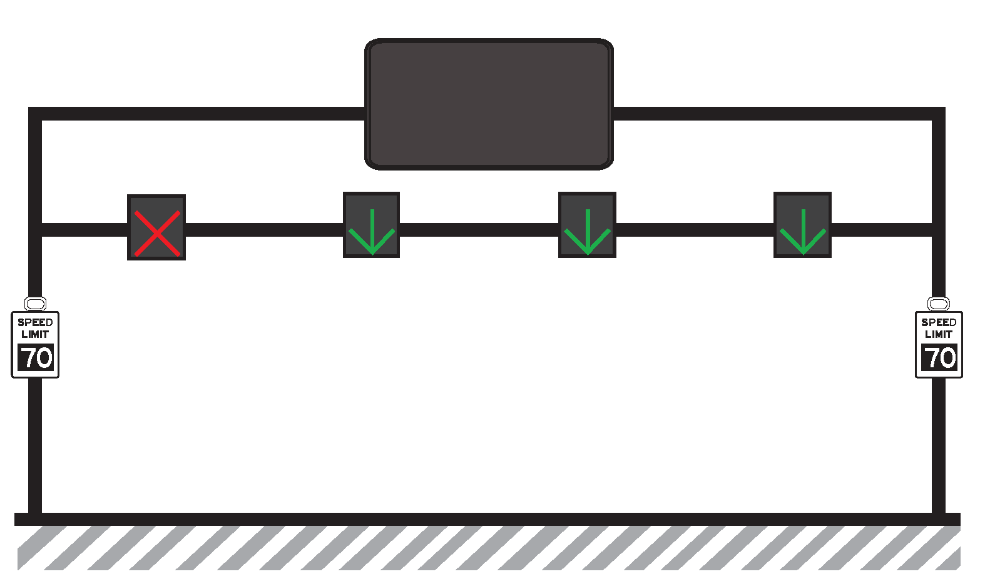
Flex Lanes – Device Configuration
Lane Control Signals
Incident Management DMS
GREEN ARROW: Road users are permitted to drive in the lane
YELLOW X: Road users should prepare to vacate the lane
RED X: Road users are not permitted to use the lane
Other messages used for special situations
Travel Time DMS
Variable Speed Limit Signs
Vary based event/lane blockage on location
5 MPG Increments from one set of VSLS to the next

Slide 9
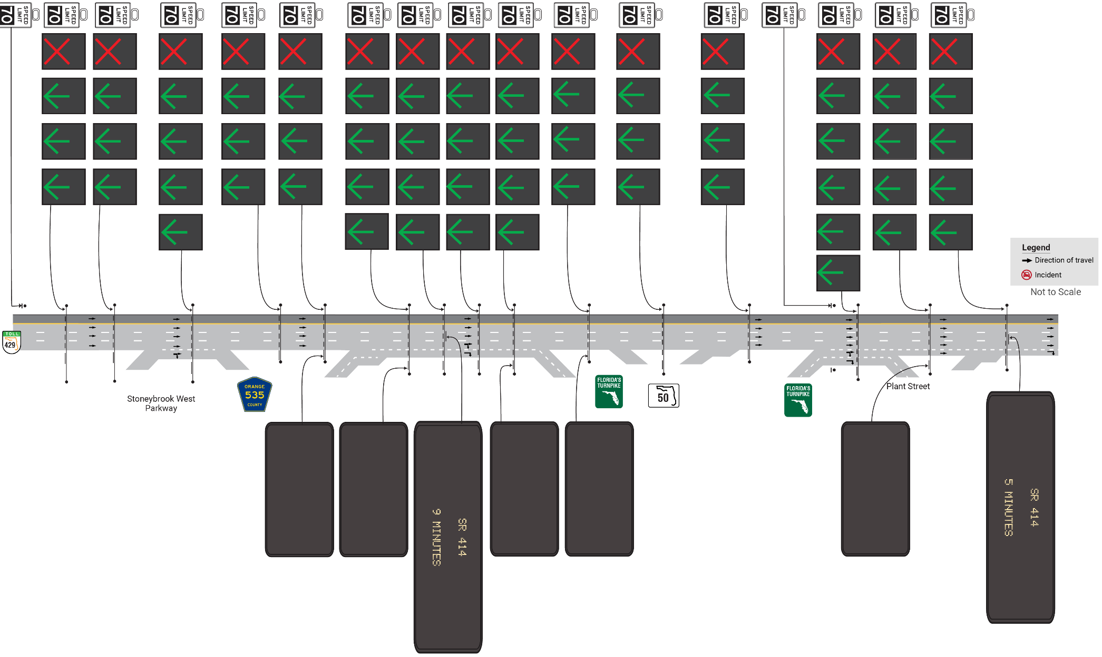
Flex Lanes
Scenario 1: Normal Conditions

Slide 10
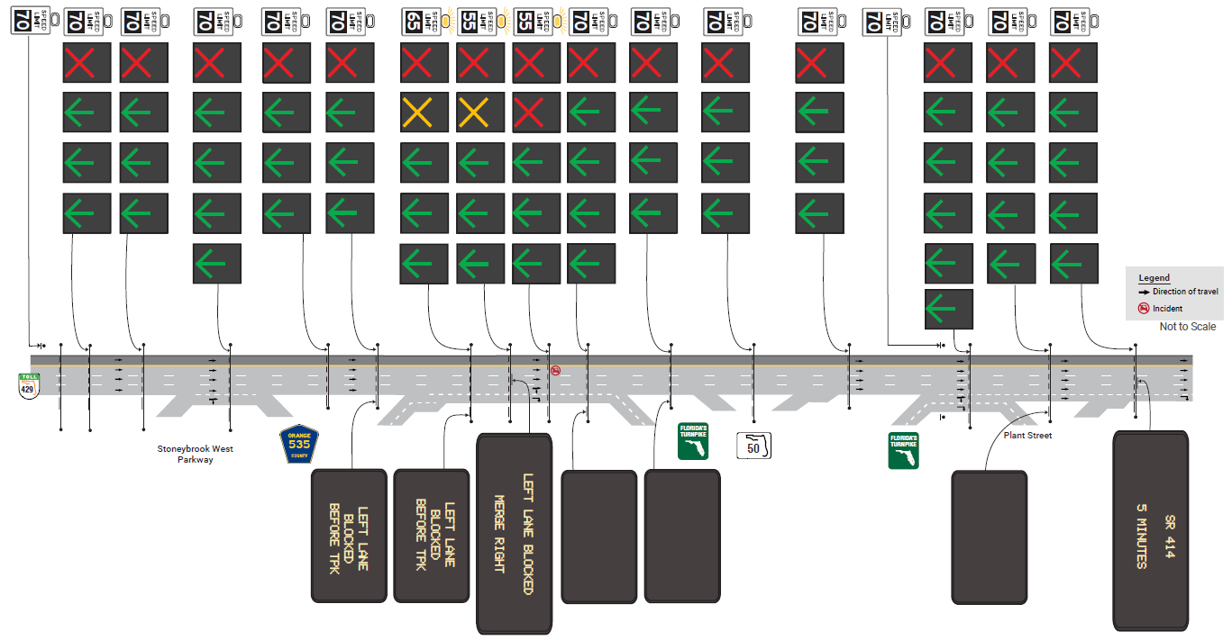
Flex Lanes
Scenario 2: Single Lane Blockage

Slide 11
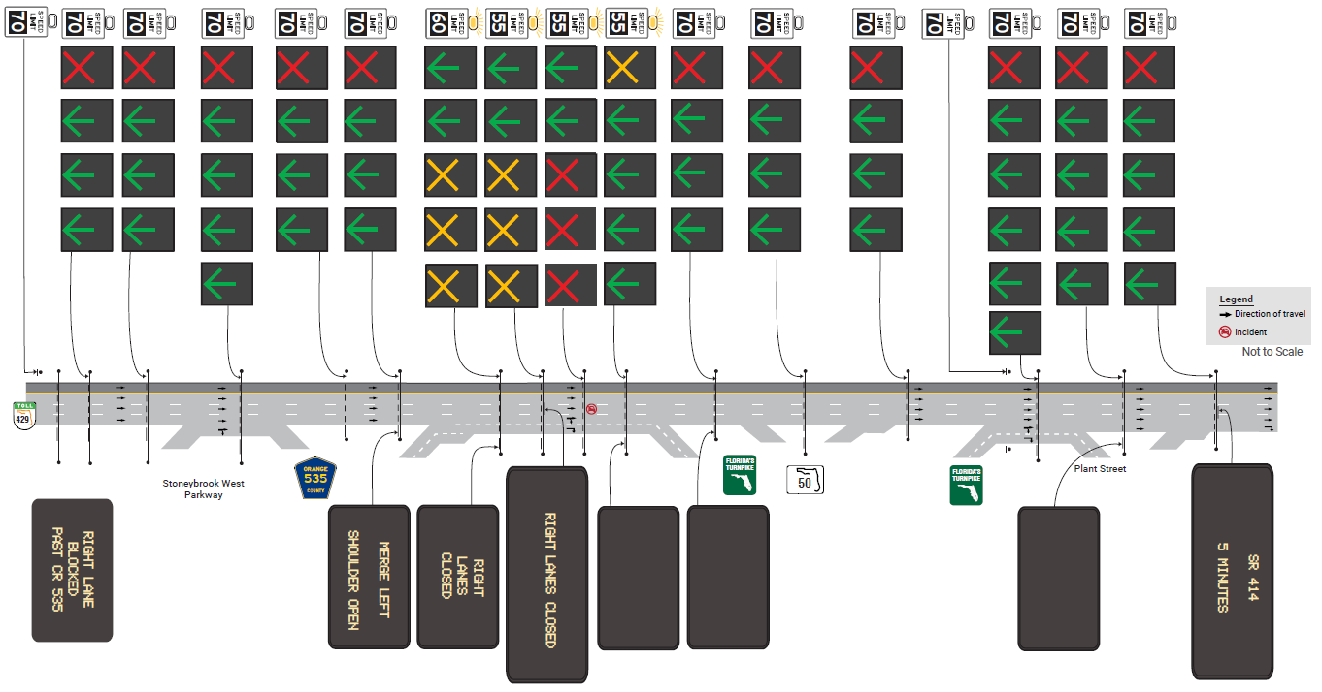
Flex Lanes
Scenario 3: Lanes Blocked, Open Shoulder

Slide 12
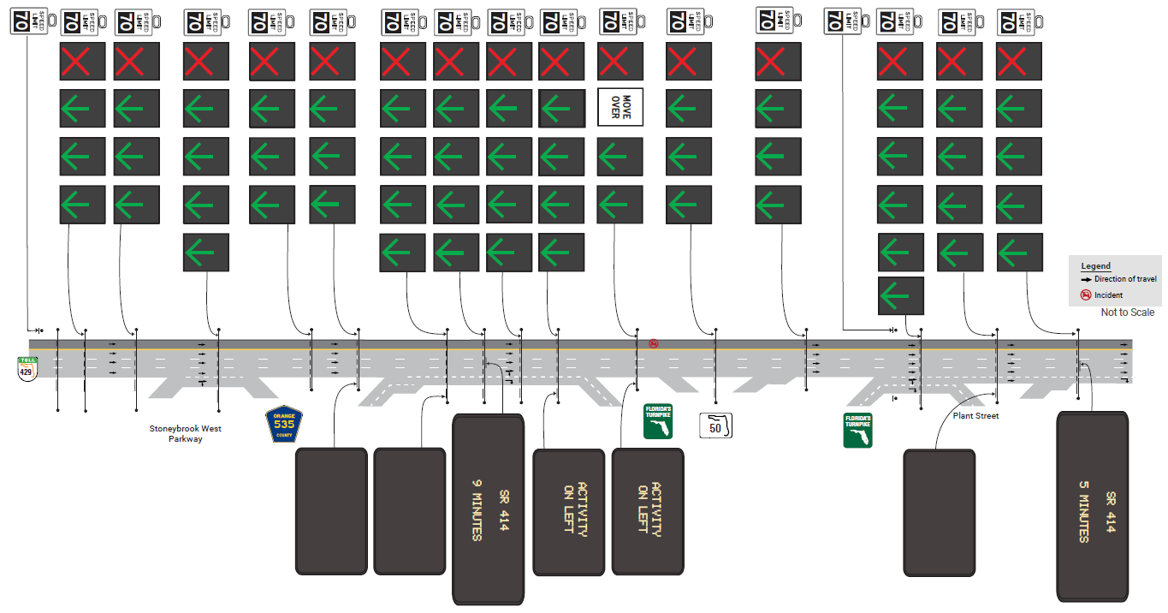
Flex Lanes
Scenario 4: Shoulder Blocked

Slide 13
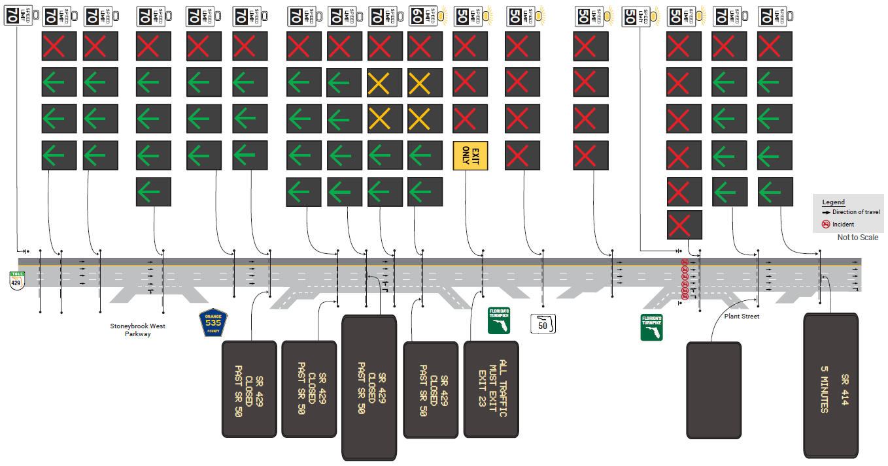
Flex Lanes
Scenario 5: Full Road Closure

Slide 14
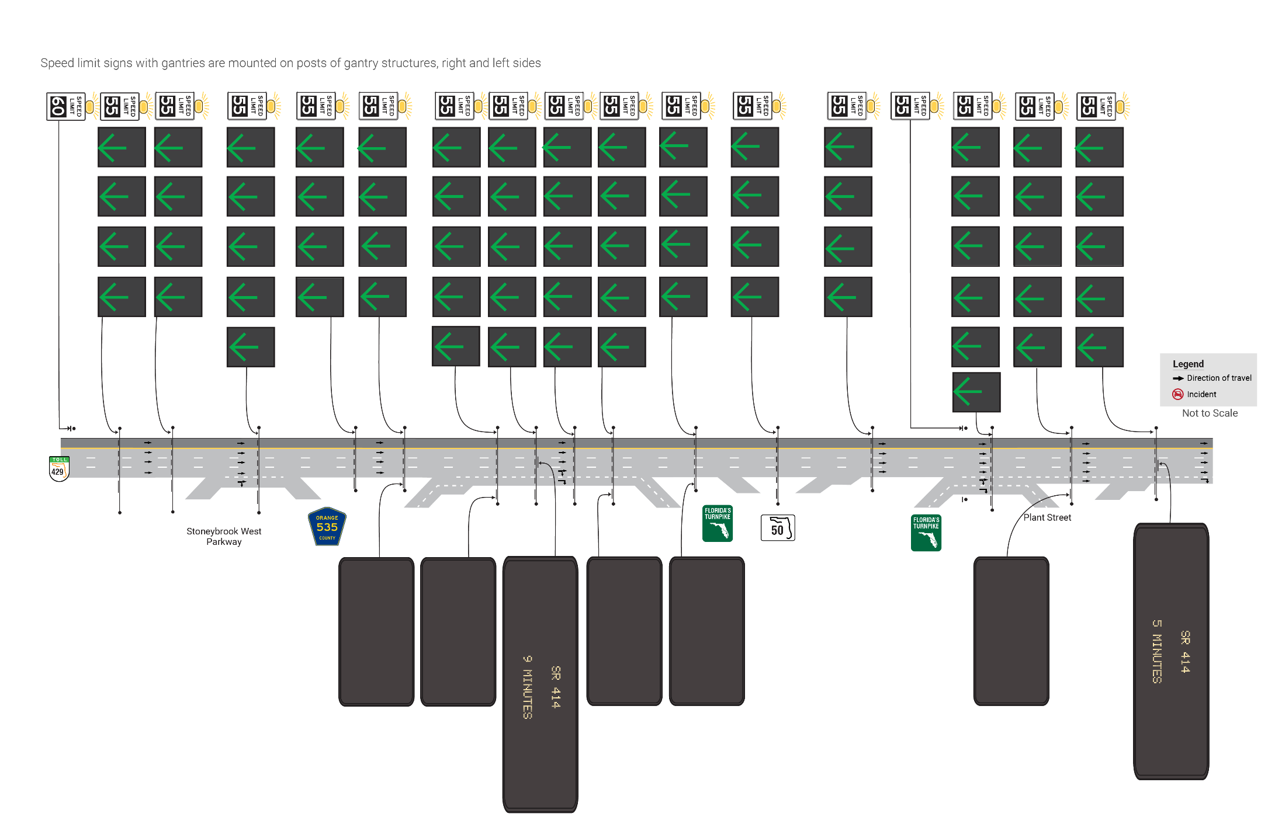
Flex Lanes
Scenario 6: Peak Period Congestion
FUTURE SCENARIO

Slide 15
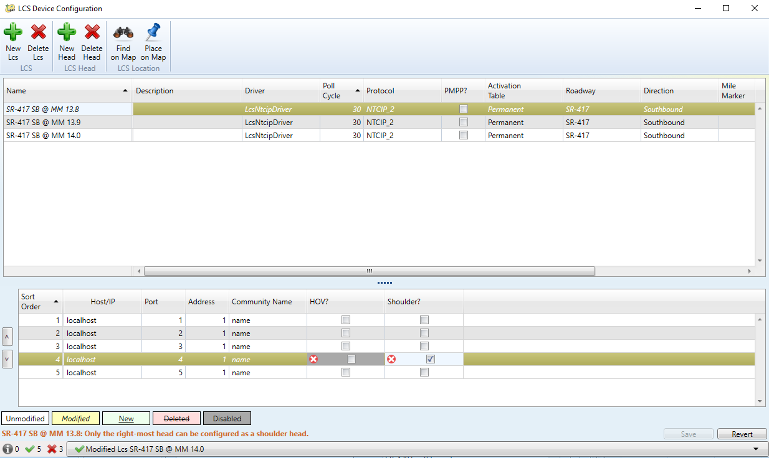
SunGuide Integration
SunGuide has Beta version of Lane Control Subsystem (LCS) in test at CFX
  Includes communication with LCS devices / control and status of signal heads
  Lacks functionality for full traffic operations

Slide 16
SunGuide Integration
CFX SunGuide Enhancements Requested
  SG-6860: Incorporate Corridor Status Window into SunGuide's Operator Map
  SG-6861: Incorporating LCS Business Rules for Response Plans
  SG-6862: Allow Configuration of Heads Outside of Shoulders
  SG-6863: Activate Beacons on Selected Heads
D2 Specific Requests
  SG-6877: Enhancements to the LCS System

Slide 17
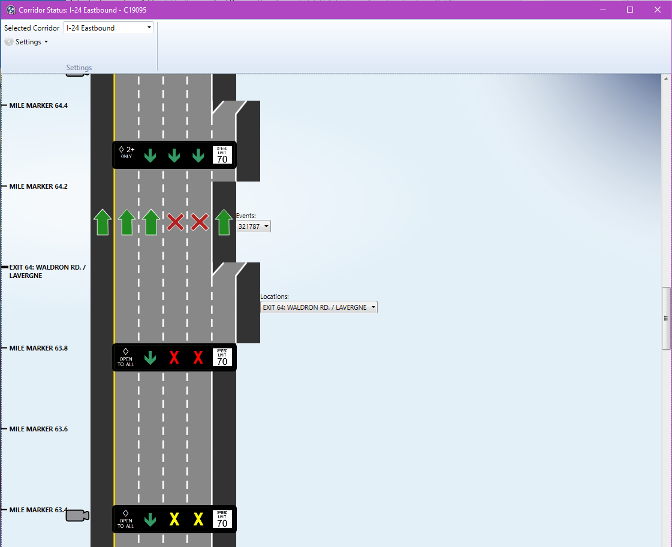
SunGuide Integration
SG-6860: Incorporate Corridor Status Window into SunGuide's Operator Map
Originally developed for Tennessee DOT
Efficient utility for displaying:
  Lane status
  LCS signage
  VSLS status
  Links to cameras
  Active events
  Re-sizable/filterable schematic
Enhancement leverages tool for use in SunGuide operator map

Slide 18
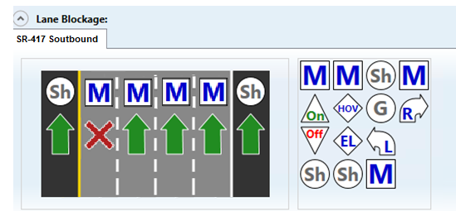
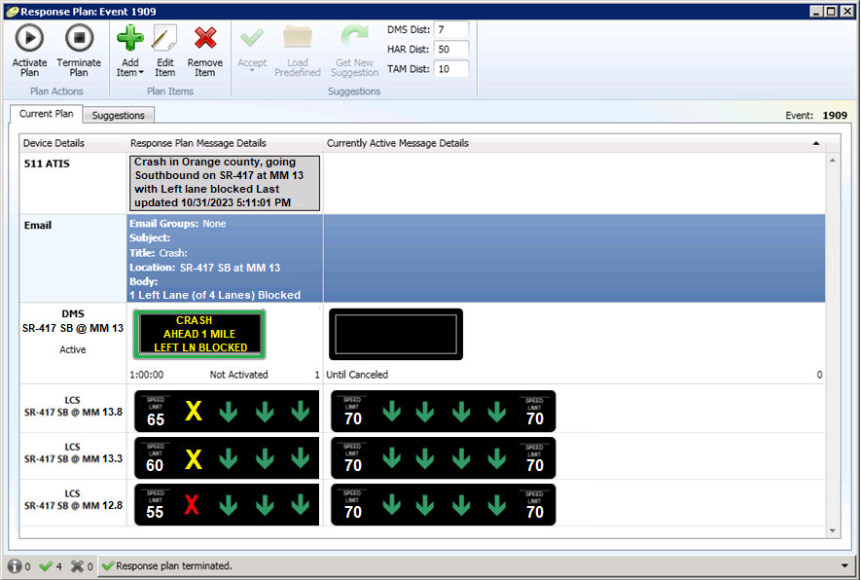
SunGuide Integration
SG-6861: Incorporating LCS Business Rules for Response Plans
Operator selects lane blockage
Provides ability to configure rules to display appropriate signage on per lane signals and variable speed limit signs
Provides suggested signage to operators via Response Plan Generation (RPG)
Simplifies signage changes/updates based on location and conditions
RPG Suggests plan with all necessary VSLS and LCS changes

Slide 19
SunGuide Integration
SG-6861: Incorporating LCS Business Rules for Response Plans (continued)
Key Rules:
  Always displays message, Green Arrow for normal conditions (X over shoulder)
  Warning (Yellow X) message displayed on two gantries prior to closed lane(s)
  Closed (Red X) message displayed at or just prior to closed lane(s)
  EXIT NOW message displayed at exits prior to full closures
  Reduced speed limits in 5 MPH or 10 MPH increments to lane closure location

Slide 20
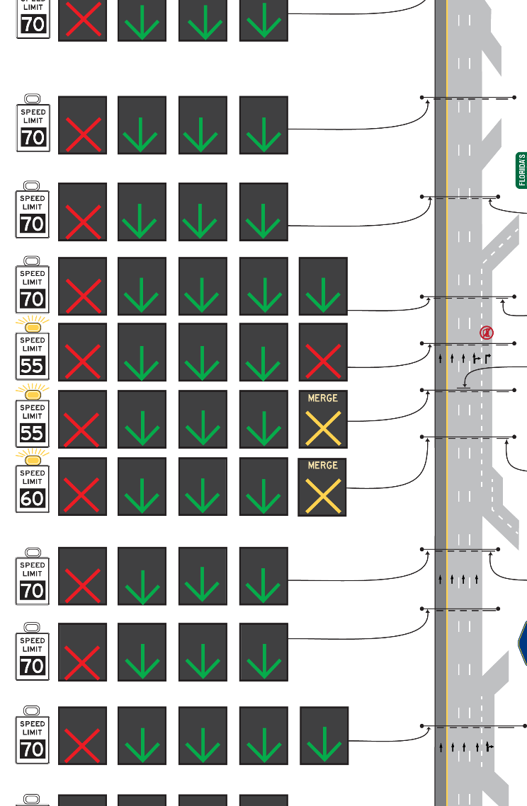
SunGuide Integration
SG-6862: Allow Configuration of Heads Outside of Shoulders
SG-6863: Activate Beacons on Selected Heads
Controls VSLS alongside LCS devices
Activates beacons upon VSLS updates

Slide 21
SunGuide Integration
SG-6877: Allow Configuration of Heads Outside of Shoulders
Ability to disable the variable speed limit signs.
Ability to have a green arrow on all signs at all times (always on instead of the current configuration of always blank).
  This is covered in the CFX requests as well.
Current configuration places red X's over blocked lanes on the first upstream structure and yellow X's on the next 2 upstream structures. Ability to configure the number of structures upstream where yellow X's are posted.

Slide 22
QUESTIONS?
COMMENTS?
SUPPORT?

Slide 23
FAT QUESTIONS:
SG-4385 – Apply on a per day basis filter to device report
Tucker Brown

Slide 24
Current Behavior & Enhancement
Current Behavior
  If running a report for a date range with a start and end time, the report will return results for the entire period starting at the start time all the way through to the end time.
  It is not currently possible to apply the time period per day.
  Enhancement
  Allow a checkbox that dictates that the time range should be used on each day, as opposed to the start and end date only.

Slide 25
FAT Questions
This enhancement was developed in SunGuide R9.0 and has been tested for several reports during Factory Acceptance Testing (FAT).
However, applying this filter to certain types of reports requires more that just a filter for the records being displayed.

Slide 26
FAT Questions
Device Reports
  How will this report filter be used on Device Reports?
  What are some examples of use cases for different device types?
  How do we handle devices that are Error/Failed in the Per Day period but recover outside the Per Day period?
  Is this needed?

Slide 27
FAT Questions
Billable Hours Reports for AVL Road Rangers
  Are these currently used by anyone?
  How do you count billable hours that cross over the per day threshold set?

Slide 28
ANNOUNCEMENTS?
QUESTIONS?
COMMENTS?
ADJOURN.

