Slide 1


SunGuide Software
Users Group Meeting
& R8.2 HF2
Design Review
December 15, 2022

Slide 2
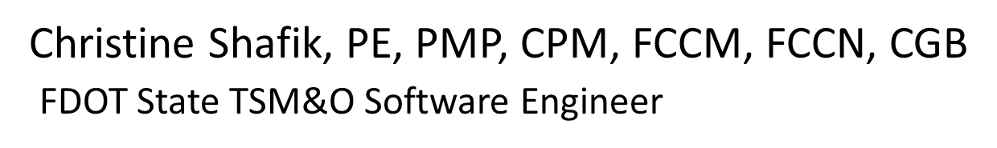
WELCOME
ATTENDEE ROLL CALL

Slide 3
R8.2 HF2
Design Review:
SG-6087 - Collect additional data related to RR-involving incidents
SG-6050 - FTE External Integrated Website – WWDS Alerts
SG-3769 - Allow sharing of created VOD tours and layouts

Slide 4
SG-6087 - Collect additional data related to RR-involving incidents
Tucker Brown

Slide 5
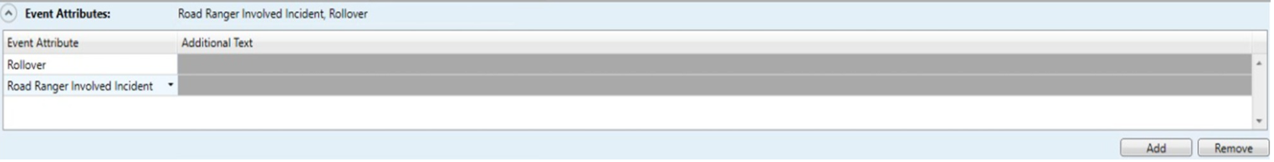
Enhancement
  Add additional information about Road Ranger-involved incidents.
  Add a system attribute to filter for these types of incidents.

Slide 6
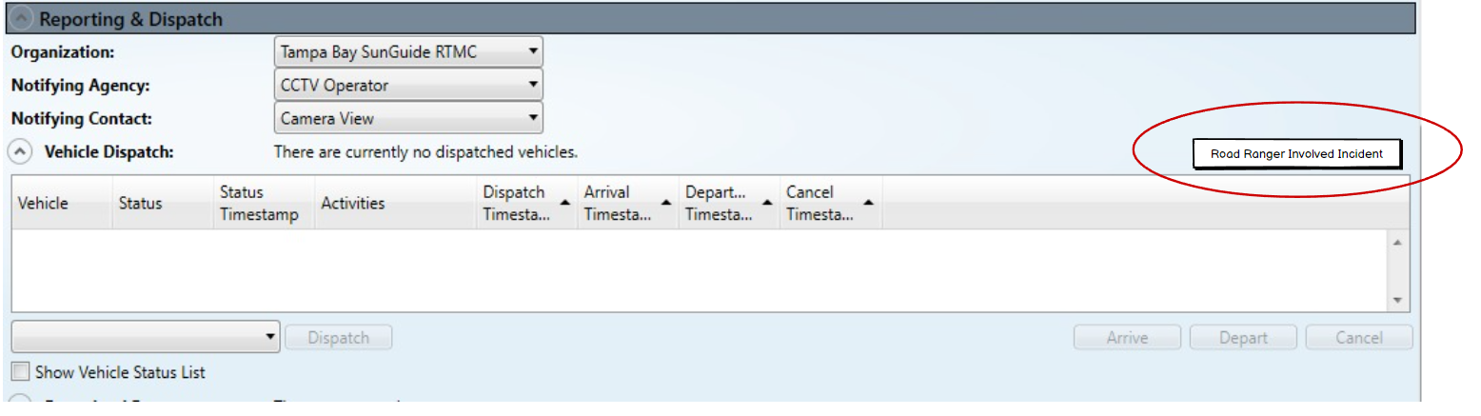
Enhancement
Add a button to the Vehicle Dispatch section that will always be visible.
Saving anything in the form will automatically add the attribute to the event if not already there.

Slide 7
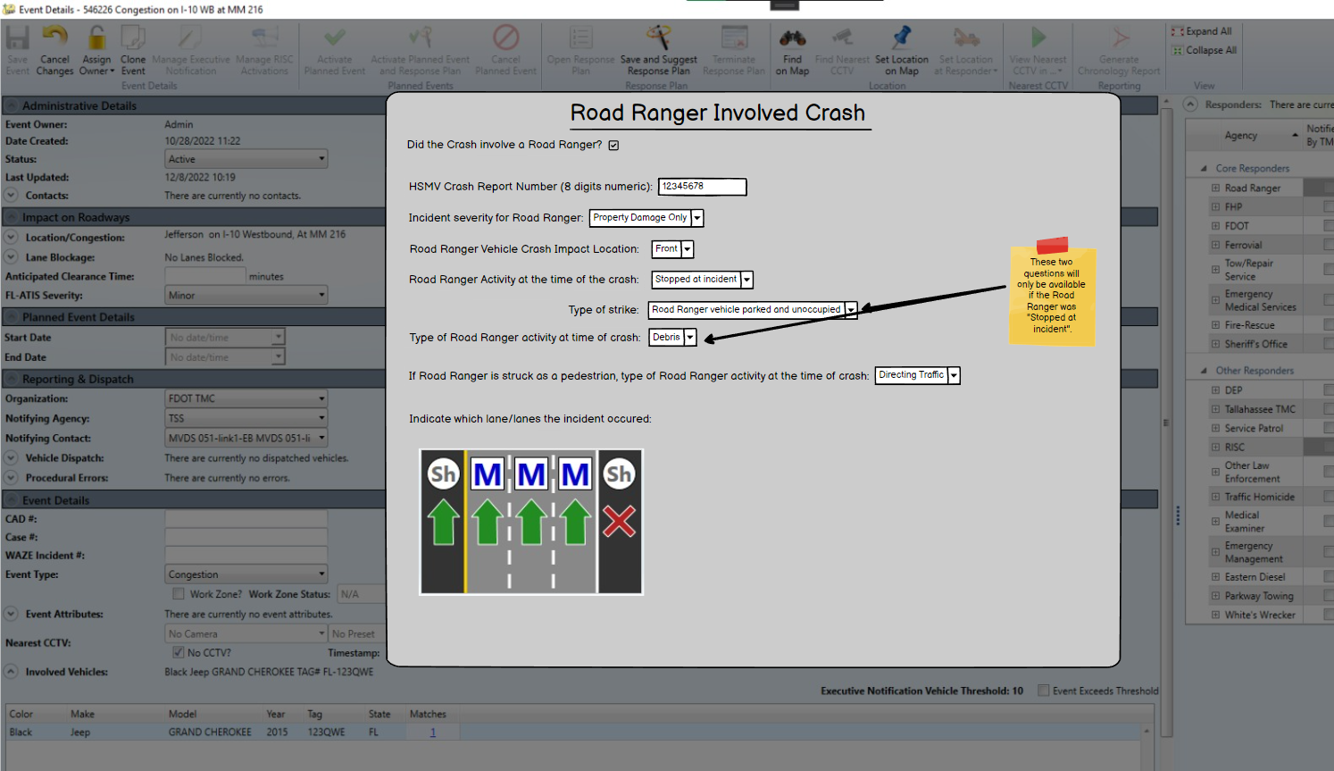
Enhancement
Form will overlay on the Event Details dialog.
All fields in the form will be available in the event audit.

Slide 8
QUESTIONS?
COMMENTS?

Slide 9
SG-6050 - FTE External
Integrated Website –
WWDS Alerts
Tucker Brown

Slide 10
Background
Initiated by FTE to improve how WWD alerts are shared with FHP.
Currently, FTE uses a WWD detection device vendor’s web interface for off-site locations to obtain WWD alerts.
The new SunGuide Alert Viewer application will display real-time alerts from all APL-approved WWD detection device vendors to FHP.
Will be starting with WWD alerts to FHP, but can be expanded to share other types of SunGuide alerts with other third parties.

Slide 11
Background
The SunGuide Alert Viewer application is comprised of three distinct components:
  A SunGuide Software interface to communicate to a central software piece and deliver WWD detection alerts to be posted to an external endpoint.
  Enhancements to FDOT’s Azure environment to receive WWD detection alerts from SunGuide.
  A Graphical User Interface using a GIS mapping service to present the alerts to FHP.

Slide 12
Enhancement
  Add an interface to SunGuide to allow the system to push WWD alerts, images, and resolutions to a 3rd party endpoint.
      TERL generated protocol
  This will be an individual process which can be run with the primary SunGuide install or on an individual server.
      Allows flexibility based on network access to District’s systems.

Slide 13
QUESTIONS?
COMMENTS?

Slide 14
SG-3769 - Allow sharing of created VOD tours and layouts
Tucker Brown

Slide 15
Current Behavior and Enhancement
Current Behavior
  VOD Tours and Layouts are specific to each user. These are not currently shareable.
Enhancement
  Add the capability to add global tours and layouts to VOD.
  Ability to save these will be tied to the ability to save System Settings.
  Ability to retrieve and use them will be tied to the ability to retrieve System Settings.

Slide 16
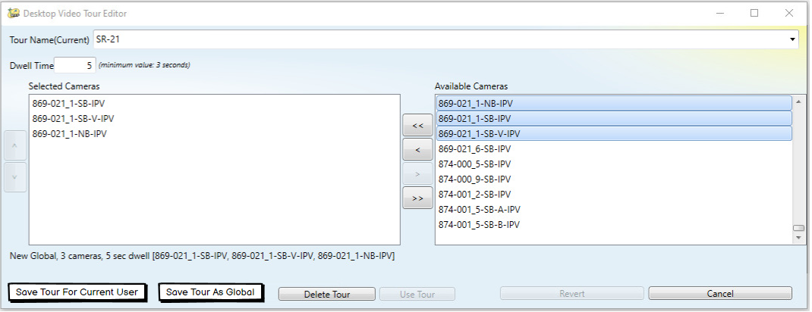
Enhancement
Global Tours

Slide 17
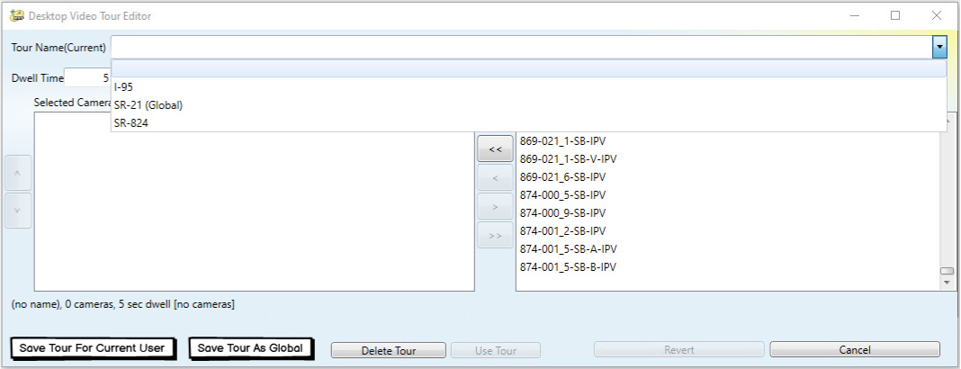
Enhancement
Global Tours selection

Slide 18
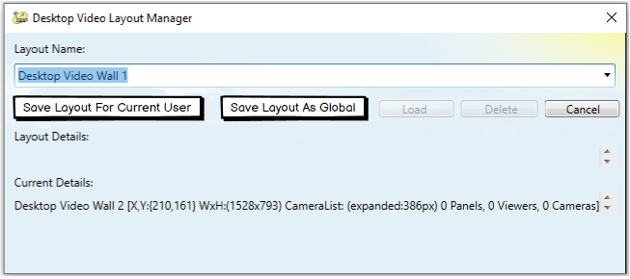
Enhancement
Global Layouts

Slide 19
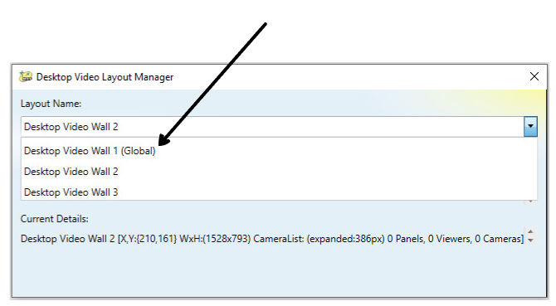
Enhancement
Global Layouts selection

Slide 20
QUESTIONS?
COMMENTS?

Slide 21
Regular SSUG Topic:
SG-6519 - Filter Event Attributes from Event Type and Auto-Fill Attributes
(Created as a result of discussion at 12/1/2022 SSUG about SG-6306 - Wrong Way Driver "Self Corrected" Checkbox.)

Slide 22
SG-6519 - Filter Event Attributes from Event Type and Auto-Fill Attributes
Tucker Brown

Slide 23
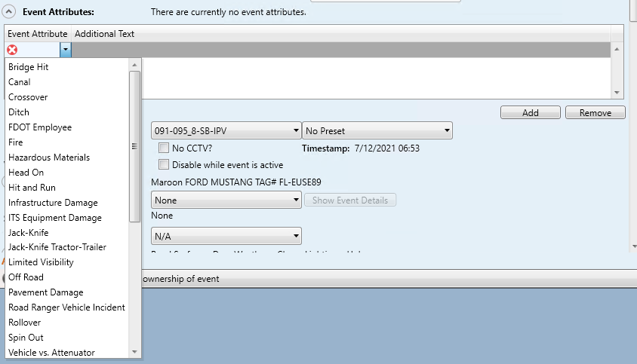
Current Behavior
Operators can add attributes from a full list of configured attributes.

Slide 24
Enhancement
Enhancement 1
  Allow administrators to configure specific attributes available for each event type.
  Filter the list of only those attributes when an event type is selected.
  If no configuration is specified for the event type, all attributes would be available
Enhancement 2
  Users can type into the drop down to quickly find attributes.

Slide 25
QUESTIONS?
COMMENTS?
SUPPORT?

Slide 26
ANNOUNCEMENTS?
QUESTIONS?
COMMENTS?
ADJOURN.

