Slide 1



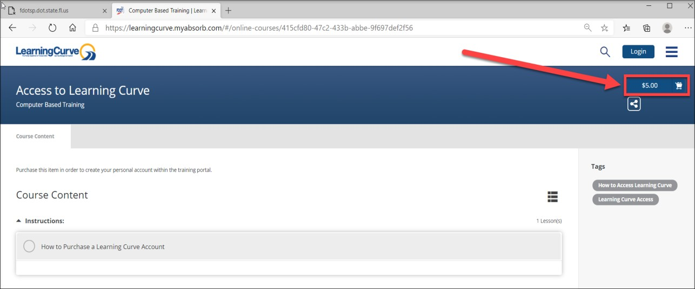
How to purchase a license/seat in Learning Curve?
Use the Learning Curve External Portal link below to purchase a license to access trainings. Hyperlinks need to be opened in an Internet browser (i.e. Internet Explorer or Google Chrome) or in an email. This is a one-time $5.00 fee for the Learner to gain system access to trainings.
Note: if you are a Consultant and do not have a FDOT email address you will need to access this link to access trainings.
➢
  https://learningcurve.myabsorb.com
Click on the “$5.00” blue button to proceed.

Slide 2
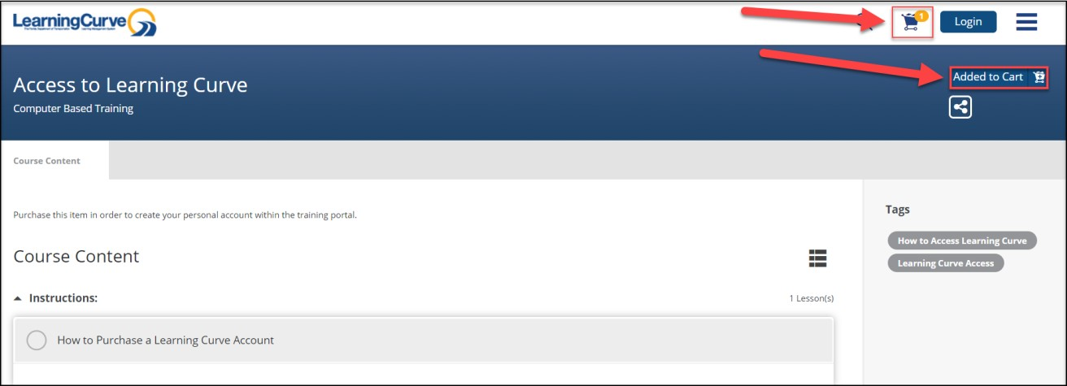
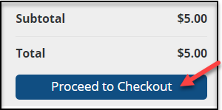
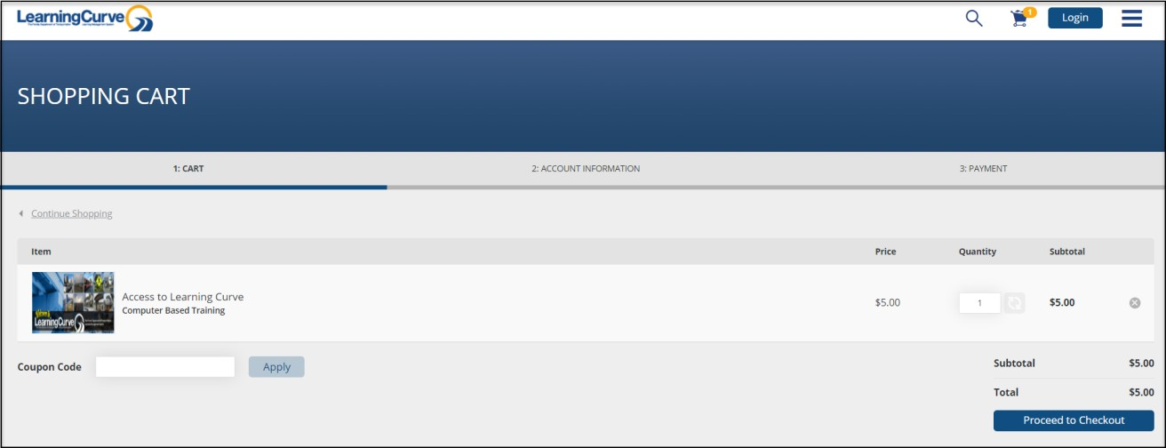
How to purchase a license/seat in Learning Curve?
3. Click on either the “Added to Cart” blue button or the blue shopping cart icon. Select the “View Shopping Cart” in the top right-side corner of the screen.
4. Click on the blue “Proceed to Checkout” button to continue the check-out process.

Slide 3
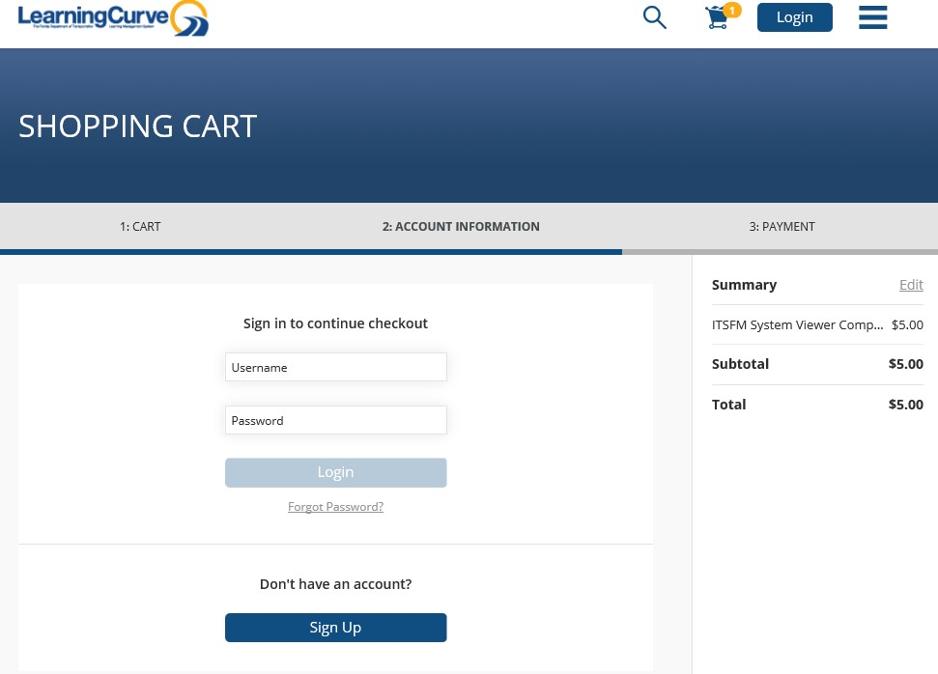
How to purchase a license/seat in Learning Curve?
5. Click on the blue “Sign Up” button to continue.

Slide 4
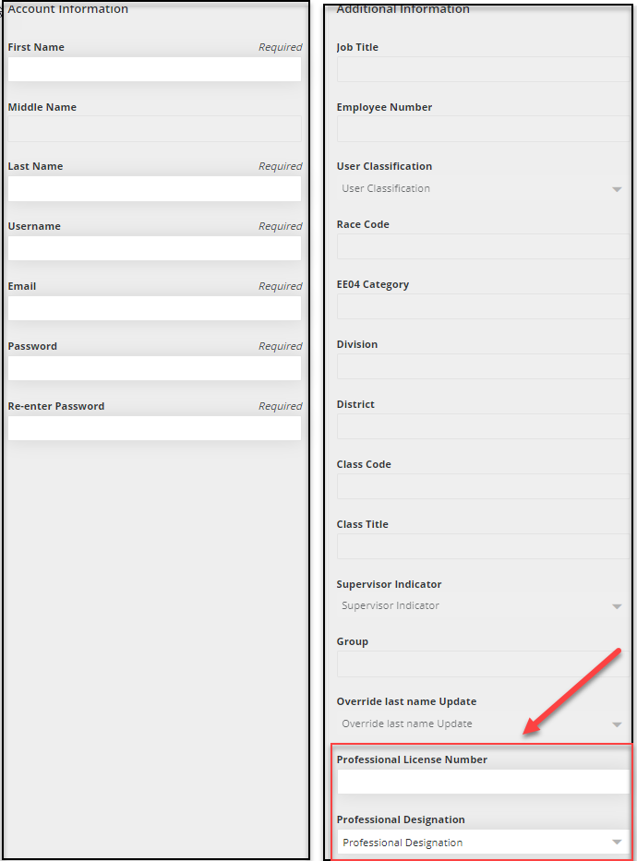
How to purchase a license/seat in Learning Curve?
6. Enter your details into the “Account Information” and if applies to you enter the Additional Information into the form.
Click on the blue “Proceed to Checkout” button to continue.
Account Information:
First Name
Middle Name
Last Name
Username
Email Address
Password
Re-enter
Password
Addition Information:
Profession License Number
Professional Designation

Slide 5
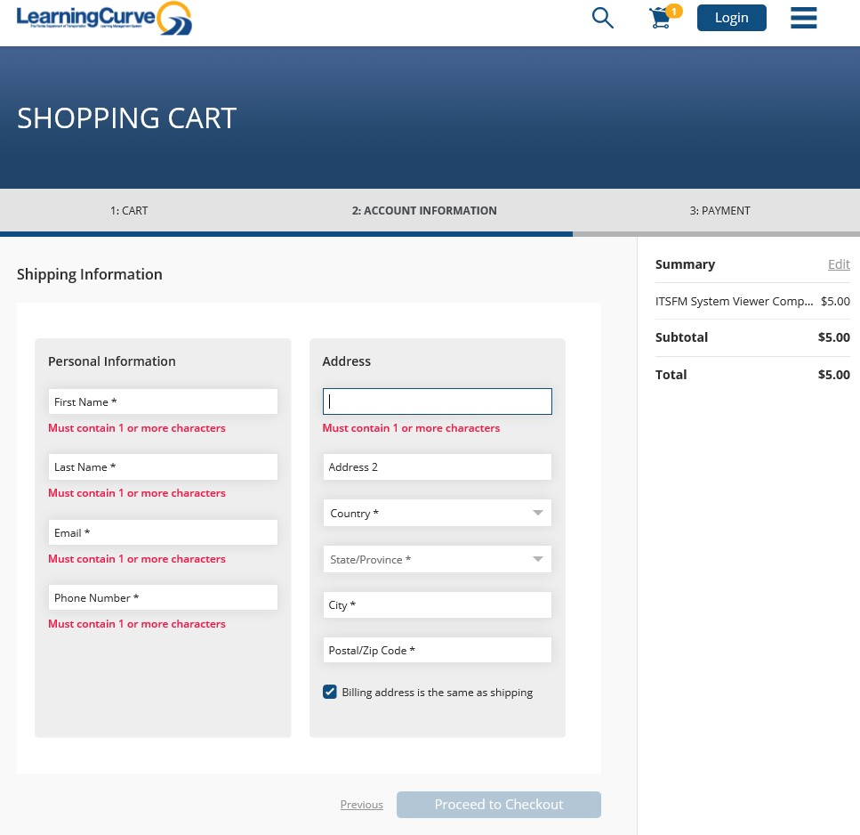
How to purchase a license/seat in Learning Curve?
7. Add your personal information, including your address, and select the blue “Proceed to Checkout” button
in the bottom right-side corner of the page.

Slide 6
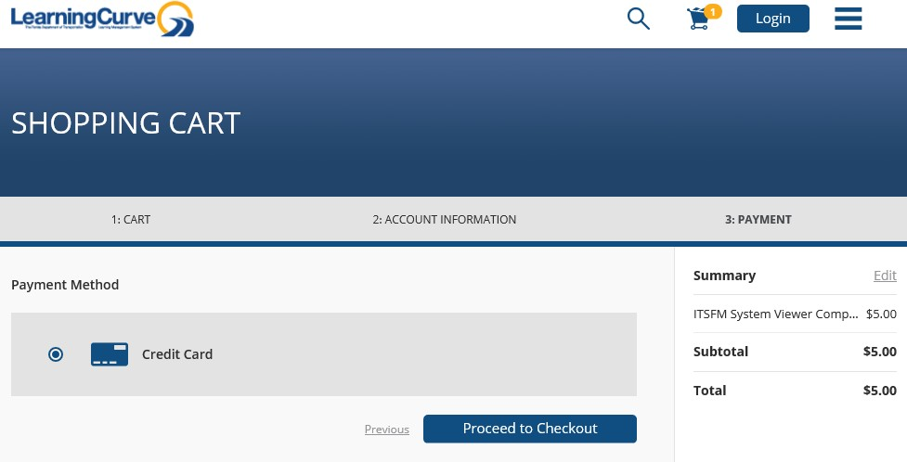
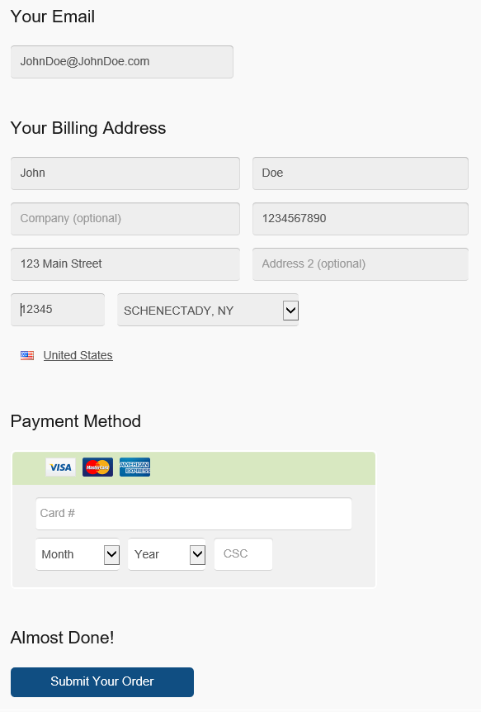
How to purchase a license/seat in Learning Curve?
8. Select the credit card payment method, then proceed to checkout by clicking on the blue “Proceed to Checkout” button.
Fill in your payment method information and click on the blue “Submit Your Order” button at the bottom of your screen.
Once your payment has been processed and your account has been approved, you will receive an email at the address you provided in your account.

